Slide 1
Law @ Uos

Slide 2
Legal careers
Dr reilly willis, course leader ug law

Slide 3
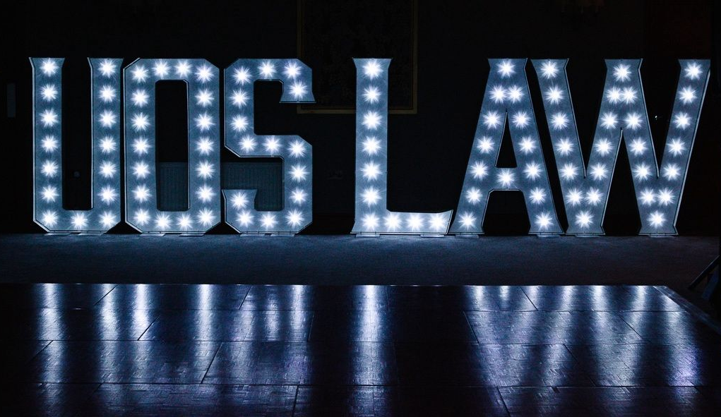
Ten reasons to study
Law @UoS:
10. Independent project
9. Personal academic coaching
8. Fresh and distinctive curriculum designed for traditional and non-traditional careers
7. Block and Blend
6. Innovative assessments
5. Links with legal community
4. Placements
3. Legal Advice Centre
2. Employability and graduate prospects
1. Support

Slide 4
'At the University of Suffolk we are taught, not lectured'
Matthew Cole, ‘22, now PhD candidate at UoS

Slide 5
r.willis5@uos.ac.uk

