Slide 1


Dr Andrea Smith
Lecturer in English & Creative Writing
University of Suffolk
andrea.smith@uos.ac.uk

Slide 2
University of the year
Lecturers & teaching quality
Student support
RANKED
1
ST
IN the uk
Whatuni Student Choice Awards 2025

Slide 3

English BA (Hons)
Incorporates Literature, Language (Linguistics) and Creative Writing
Dedicated employability module including work placement
Currently working on options for 27/28 enabling students to combine subjects

Slide 4

Don’t currently offer journalism
Lots of courses that would be good for media career
Strong careers team (also available to alumni) to support you when looking for a job

Slide 5
History BA (Hons)
Digital Film Production BA (Hons)
Crime, Justice & Society BA (Hons)

Slide 6


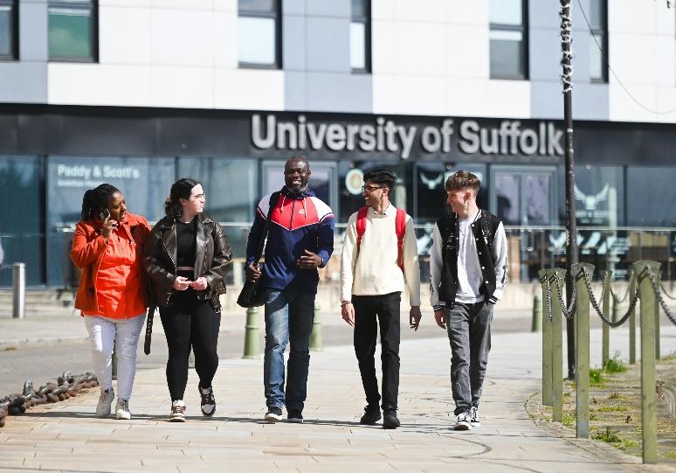
Other possible courses
Business Management BA (Hons)
Games Development BSc (Hons)
Graphic Design BA (Hons)
Law LLB (Hons)
Photography BA (Hons)
Screenwriting BA (Hons)
Sociology BSc (Hons)
Wildlife, Ecology and Conservation Science BSc (Hons)

Slide 7
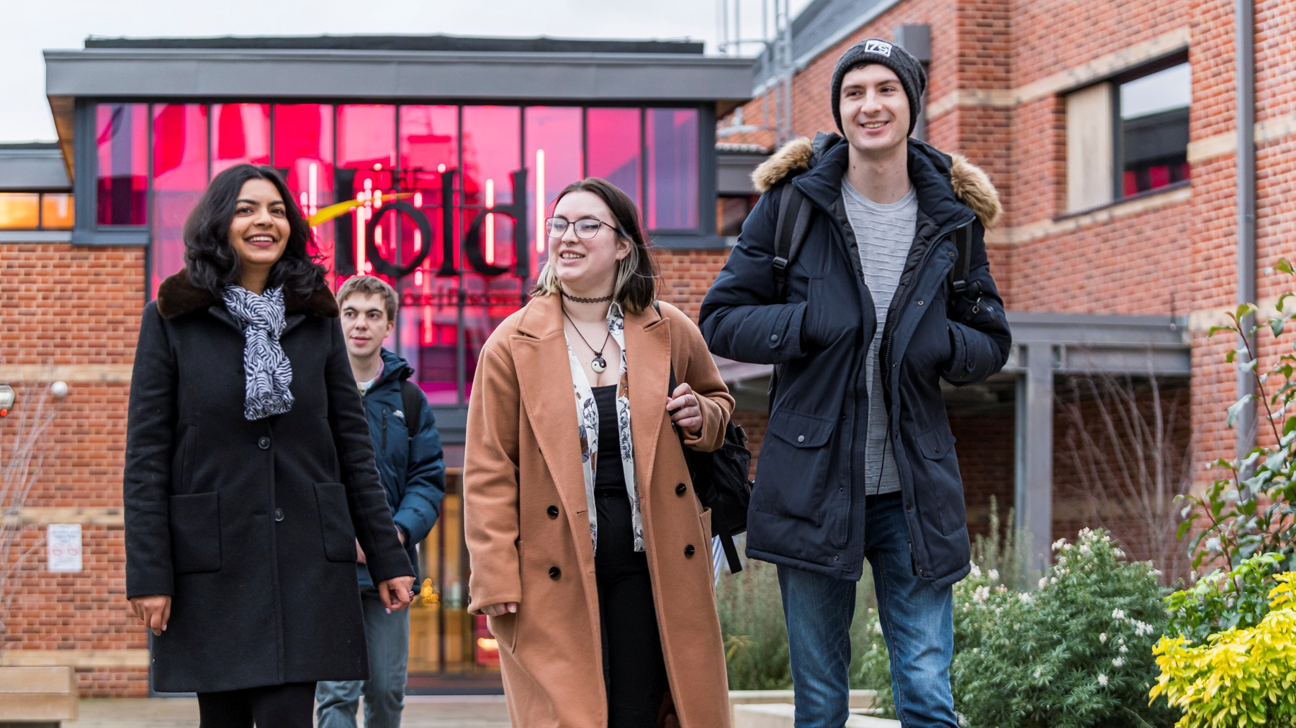
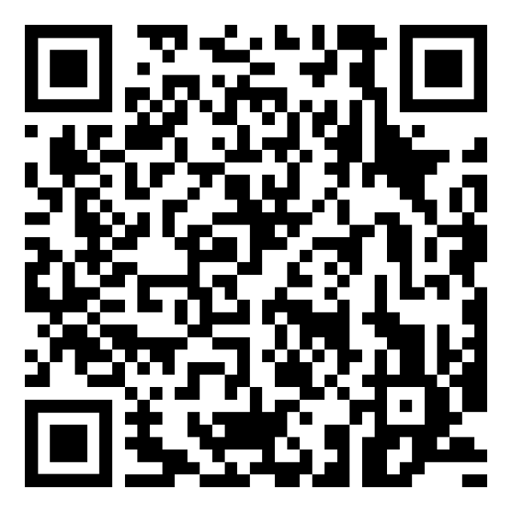
For more info
Scan the QR code opposite, go to our website: https://www.uos.ac.uk/ or contact me direct.

