Slide 1
BSC (Hons)
Computer Science

Slide 2






Welcome
Welcome to Computing at the University of Suffolk
We are located within the School of Technology, Business and Arts
Our specialist areas include cyber security, web and mobile development, software engineering, data science and networking

Slide 3
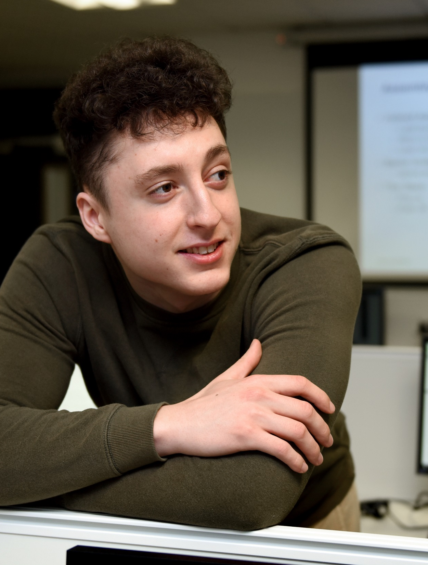

COMPUTING SUFFOLK
A focus on practical, hands-on experience in line with industry expectations and supported by our research
A flexible structure of specialist pathways in cyber security, web and mobile, and artificial intelligence
Opportunities to work on real-world projects, briefs and datasets

Slide 4
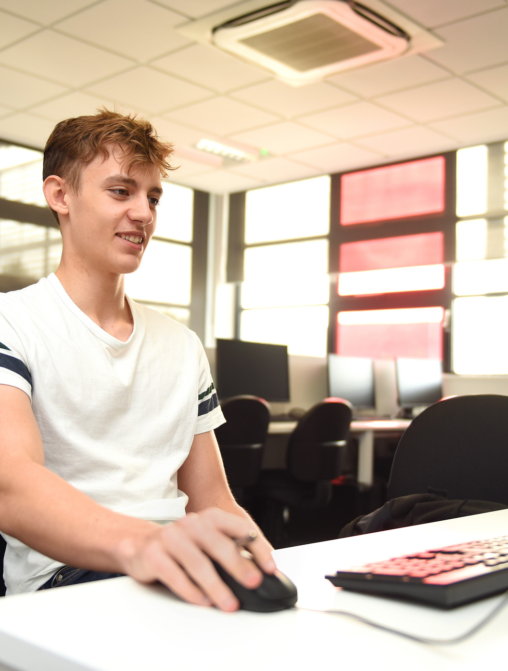
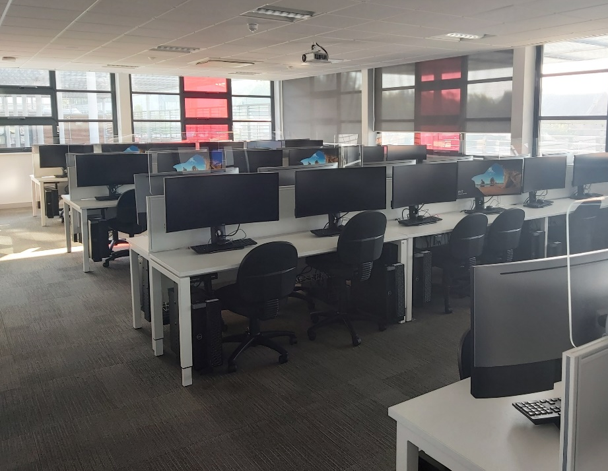
BSc (Hons) Computer Science
A “create your own degree” option. Choose from a range of computing modules in cyber security, web and mobile, software, data science and networking
All students receive access to £300 worth of sponsored web hosting for website development
Access for all students to our state-of-the-art DigiTech Centre
Distinct specialist awards available according to options chosen
Placement year option available
COMPUTING
Notes:
And finally

Slide 5

One degree, four pathways
BSc (Hons) Computer Science
Or, follow a specialist pathway:
BSc (Hons) Computer Science (Web and Mobile)
Computer Science
BSc (Hons) Computer Science (Cyber Security)
BSc (Hons) Computer Science (Artificial Intelligence)

Slide 6


BSc (Hons) Computer Science (Web and Mobile Development)
Year 1: Introduction to Web Design
Year 2: Advanced Web Development
Year 3: Mobile Application Development, Cloud Computing
Pathways
BSc (Hons) Computer Science (Cyber Security)
Year 1: Networking and Cyber Security
Year 2: Security Testing
Year 3: Cyber-Physical Security, Cyber Forensics and Intrusion Management
BSc (Hons) Computer Science (Artificial Intelligence)
Year 1: Introduction to Artificial Intelligence and Data Science
Year 2: Machine Learning
Year 3: Advanced Artificial Intelligence, AI and Data Science Applications

Slide 7

IPSWICH AWARD
The Ipswich Award is a £1000 automatic cash award for students starting on our BSc (Hons) Computer Science degree in September 2024 and 2025.
You must:
Live in the UK and have access to Student Finance England
Exceed 112 UCAS points (BBC / DMM / Merit) and study full-time *
* In some cases, meeting the UCAS tariff points may be sufficient - for full details and terms and conditions visit uos.ac.uk/ipswichaward

Slide 8

The University of Suffolk is an accredited Amazon Web Services (AWS) Academy.
Over 33% of the worlds cloud infrastructure is managed by AWS and students on all our computing degrees have the opportunity to interact with this infrastructure. It’s the same infrastructure that is used to power Netflix, Disney+, Twitch and Facebook.
We are currently 1 of only 18 universities in the UK accredited as active AWS Academy Members.
Notes:
Our students have the opportunity to train on AWS training modules and run actual AWS tools in their lab environment. We can offer free certification practice exam vouchers and heavily discounted certification exam vouchers

Slide 9
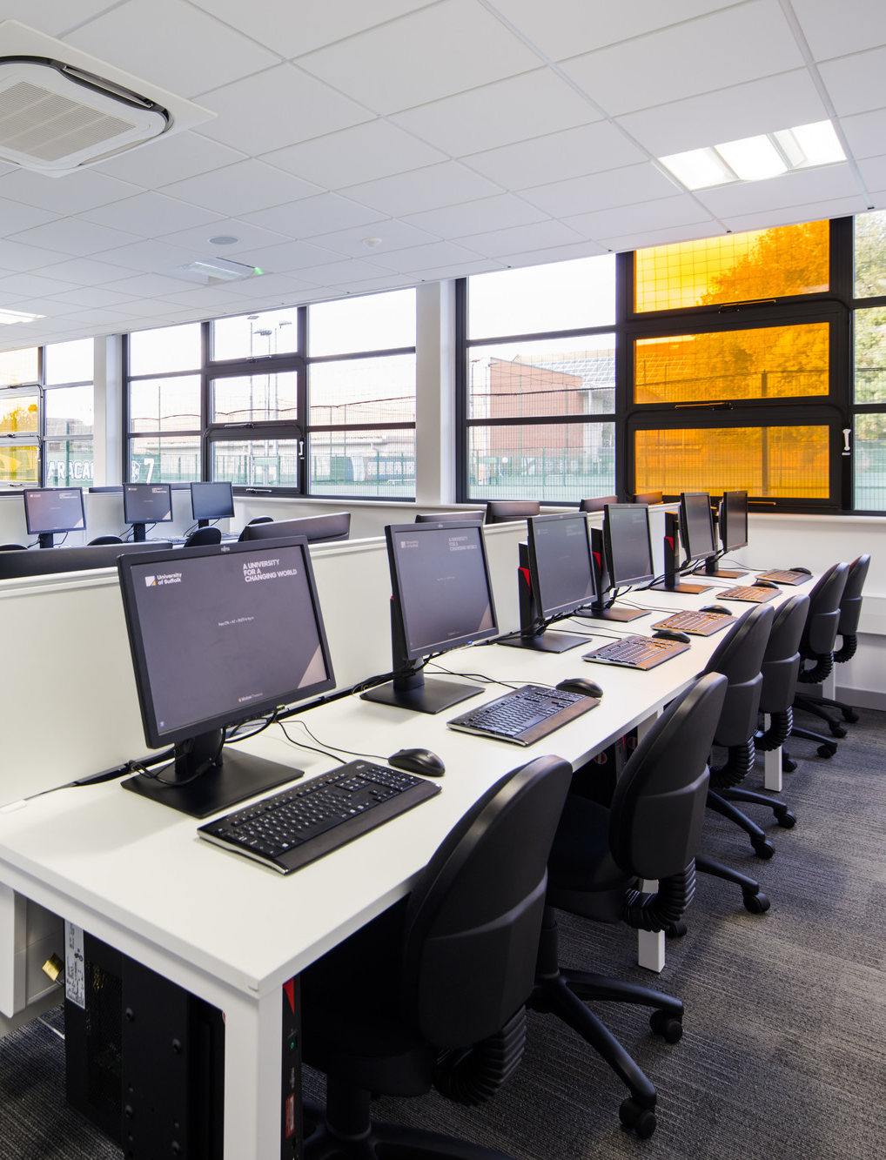
Facilities
Computing labs
Our dedicated computer labs contain all the software and hardware you need to develop industry-ready systems.
Technology-focused communal areas
Our student communal areas are great for collaborating on projects or if you just want to play a video game, board game or socialise with other students!
Library
Access books to support your learning, book a study pod or access study skills support with our on-campus library.
Open Access
Outside of scheduled lessons, you can make use of the facilities on campus to support your learning with open access to labs and group working spaces.

Slide 10

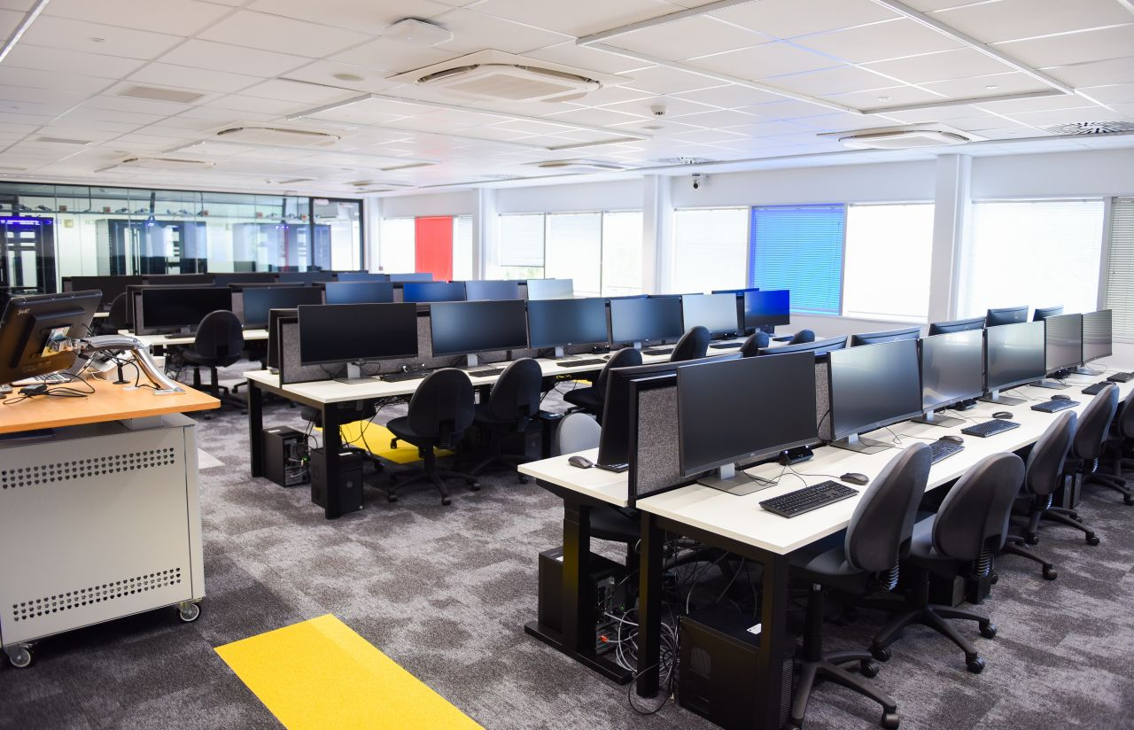
DIGITECH CENTRE
BRAND NEW £9.6M FACILITY
Specialist modules in data science, artificial intelligence and cyber security can take place in the new DigiTech Centre at Adastral Park.
A Technology Hub
Adastral Park is an exciting cluster of over 150 High-tech telecommunication and technology companies. An excellent and valuable environment to begin your career in the ICT sector.
Transport
A free bus route exists between our Ipswich Campus and Adastral Park for students.

Slide 11
Any questions?

