Slide 1



THIS IS
BA Education
BA Education, Learning and Teaching
BA Education, Childhood and Culture
BA Education, Special Educational Needs and Inclusion
Insta @uea_education
SCHOOL OF EDUCATION AND LIFELONG LEARNING

Slide 2
OUR COURSES
BA(Hons) Education
BA(Hons) Education, Learning, and Teaching
BA(Hons) Education, Childhood, and Culture
BA(Hons) Education, Special Educational Needs, and Inclusion
All courses are available with a Study Abroad Year (4 years)

Slide 3
Learning and teaching
How will I learn?
Workshops and Tutorials
Lectures
Seminars
Guest Speakers
Placement
Educational visits
You will learn from experts who are actively involved with the School of Education’s research groups
Tutorial support and seminar size means all students are treated as individuals who have valuable contributions to make

Slide 4


PLACEMENT – a chance to merge RESEARCH and practice
Our students choose their placements from a wide range of education settings and gain 20 credits for this career building activity:
    Primary and Secondary Schools
    Museums and Theatres
    NNUH Training and Development Department
    FE Colleges
    Outdoor Education Facilities
    Digital Education Design
    Prison and Probation Services
    NCC Children’s Services
    Norwich City Football Club
    UEA Students’ Union
    Corporate Education Programmes
PLACEMENT options

Slide 5
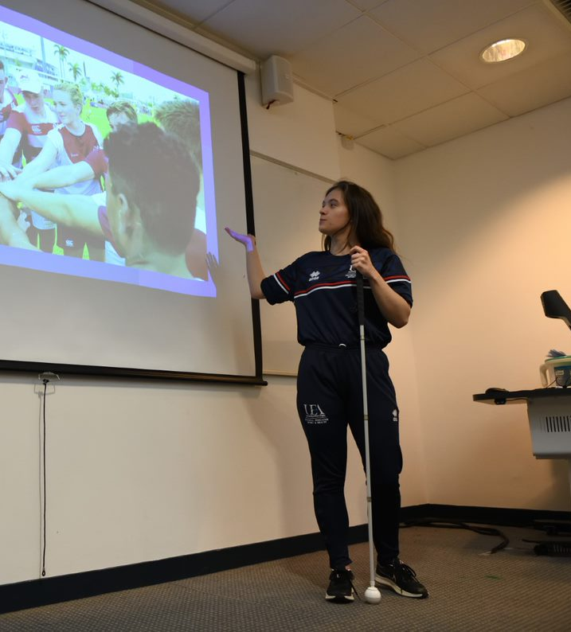
VARIED Assessments
Essays
Individual & Group Presentations
Individual Research Projects
Conference Posters
Group Research Projects
Article Reviews
Reflective Journals
Experience Reports
Art-based Assessments
Resource/Toy Development
Dissertation

Slide 6
YOUR FUTURE
BA Education, Learning and Teaching
Primary school teacher
Educational management
Educational Researcher
Further Education Lecturer
Education Consultant
Educational advocacy and outreach
Curriculum development
Editing and/or journalism
PG Study: PGCE, MA Education
BA Education, Childhood and Culture
Early years practitioner
Education Officer Arts and Museums
County Council
Charity Youth work
Community Education and Outreach Officer
Education and Welfare Consultant
PG Study: PGCE, MA in Education, MA in Social Work, MRes in Social Sciences
BA Education, Special Educational Needs & Inclusion
SEN teacher
Government work & public advocacy
Cultural exchange/language learning
Public Policy Development
Charity Commission
Disability & Inclusion Advisor
PG Study: PGCE, MA in Education or Social Work, MRes in Social Sciences, or MSc in Occupational Therapy.
BA Education
All possible career destinations listed!
Business Sector Graduate Schemes
Youth Work and community engagement
PhD and lecturing
Arts and creative programmes
Charity and youth advocacy
PG Study: MA in Education, MRes in Social Sciences, PGCE

Slide 7
Teacher training at UEA
Primary PGCE courses:
Primary (3-7)
Primary (3-7 with Mathematics)
Primary (3-7 with SEND)
Primary (5-11)
Primary (5-11 with Mathematics)
Primary (5-11 with Modern Languages)
Primary (5-11 with SEND)
Secondary PGCE courses:
English
Geography
History
Mathematics
Mathematics with Computing
Modern Languages (French, German, Spanish)
Physical Education
Science (specialising in Biology)
Science (specialising in Chemistry)
Science (specialising in Physics)
Science (specialising in Physics with Mathematics)
Science (Engineers Teach Physics)

Slide 8
Any questions?
Please do ask us any questions you have!
If you want to contact the course directors about the BA Education courses, please email them:
Harry.T.Dyer@uea.ac.uk
E.Scholefield@uea.ac.uk

Slide 9





Information about your subject
Application advice
Open Day news
Student life in Norwich
www.uea.ac.uk/enquire
@uniofeastanglia
Discover life at UEA

