Slide 1
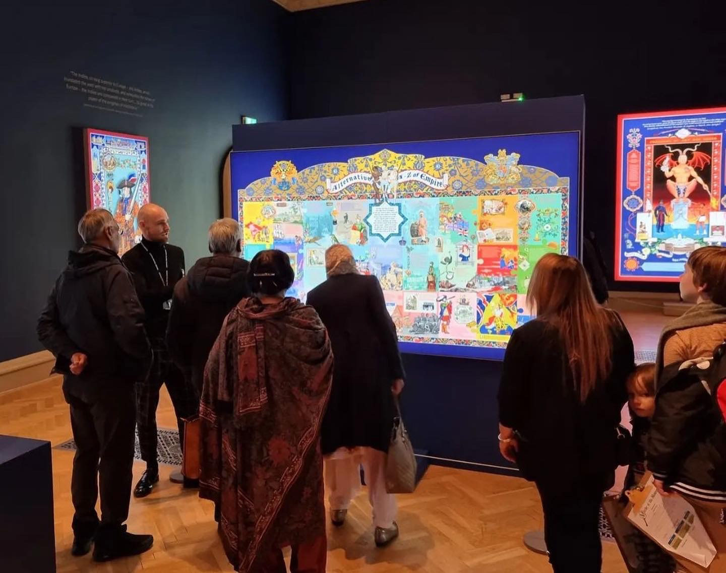
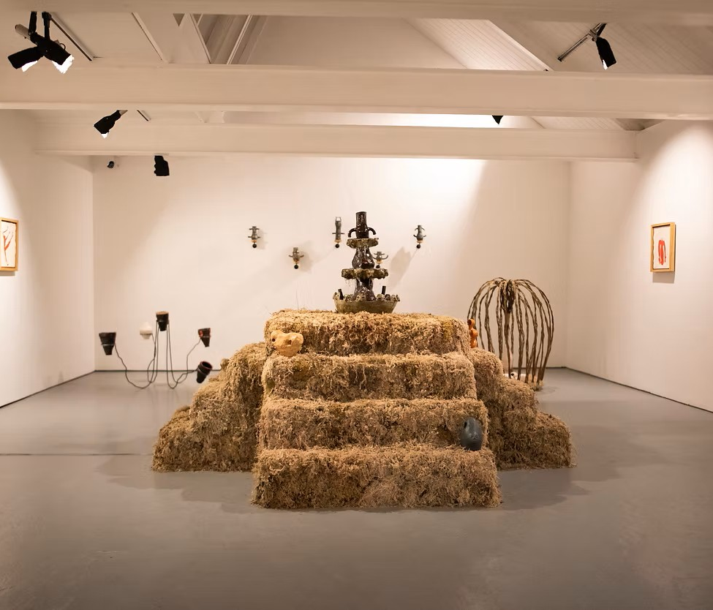
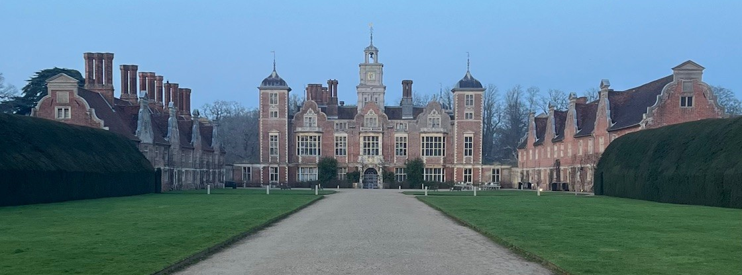
Aloys Feeney
Museum Operations Manager, Freelance Curator & Gallery Trustee

Slide 2
Timeline
Summer 2016
Graduated NUA Illustration BA
Sep 2017
Moved to Bristol started volunteering as a Gallery invigilator at Spike Island
May 2018
First Paid arts roles: Weekend Supervisor, Spike Island
Gallery Invigilator, The Edge
Jun 2018
Summer Programme Coordinator
Sep 2018
Visitor Services Manager
Jan 2020
Started Masters in Curating
Apr 2022
Moved back to Norwich
Jul 2022
FoH Manager at Norwich Museums
Jan 2023
Operational Support Manager, Norfolk Museums Service
Jan. 2025
Property Operations Manager at Blickling Estate, National Trust
Jul 2023
Trustee at Norwich OUTPOST:
(OUTPOST Gallery & OUTPOST Studios)

Slide 3
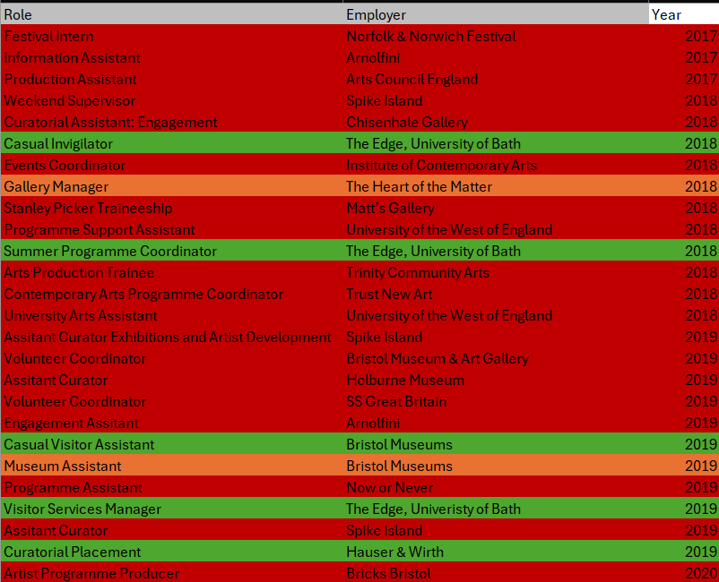
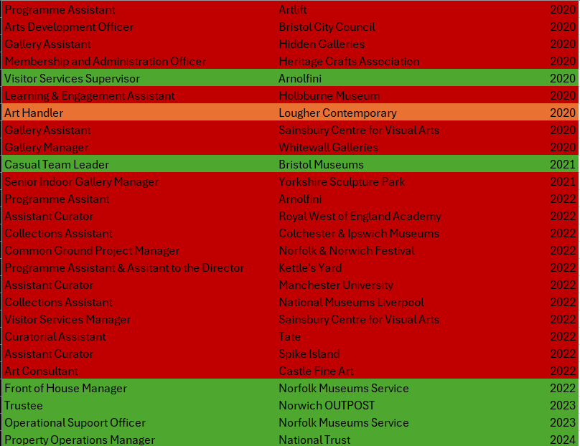

Slide 4
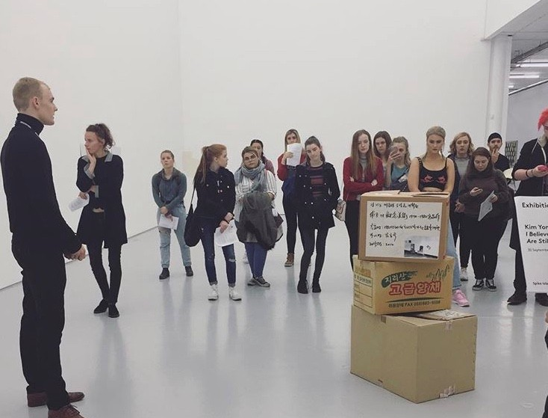
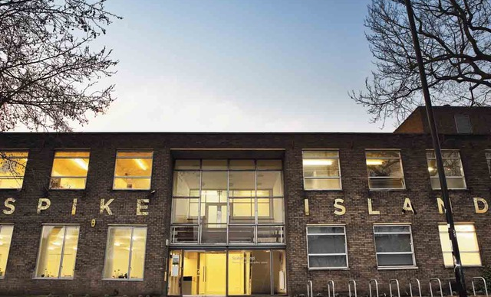
Volunteering
Volunteer Gallery Invigilator and tour guide at Spike Island 2017.
Wiring and delivering tours, protecting artworks, opening and closing the gallery.

Slide 5
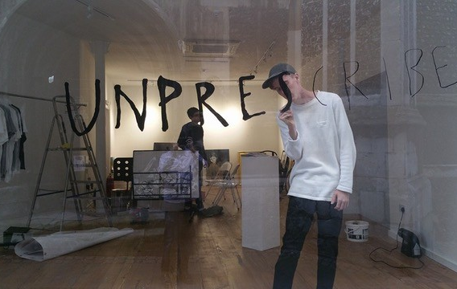

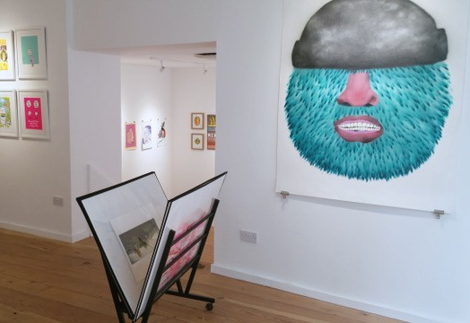
Independent Exhibitions

Slide 6
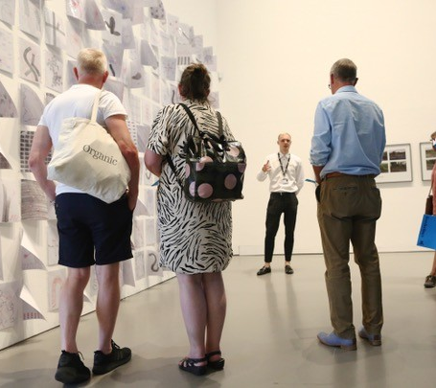
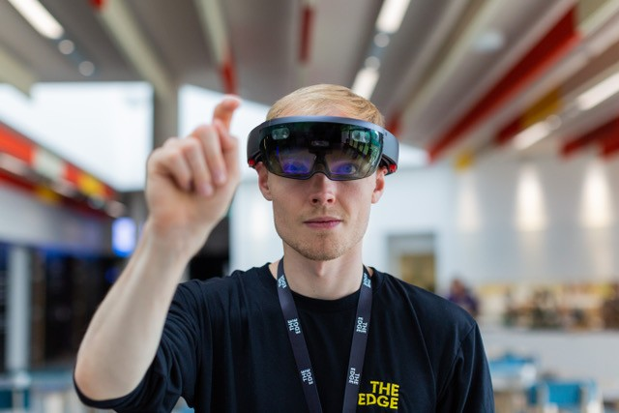

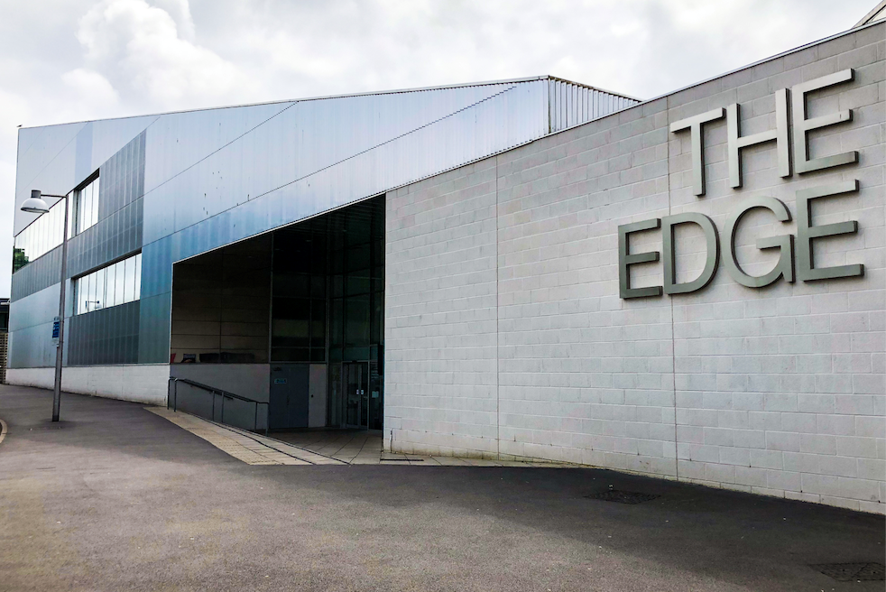
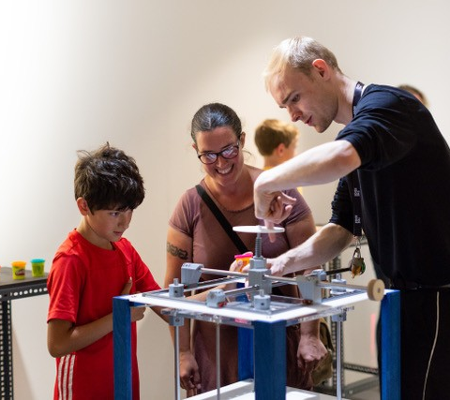
Summer Programme Coordinator
The Edge, University of Bath
Installing Exhibitions
Artist liaison
Writing tours
Writing interpretation and gallery texts
Giving invigilator briefings
Writing evaluation reports

Slide 7
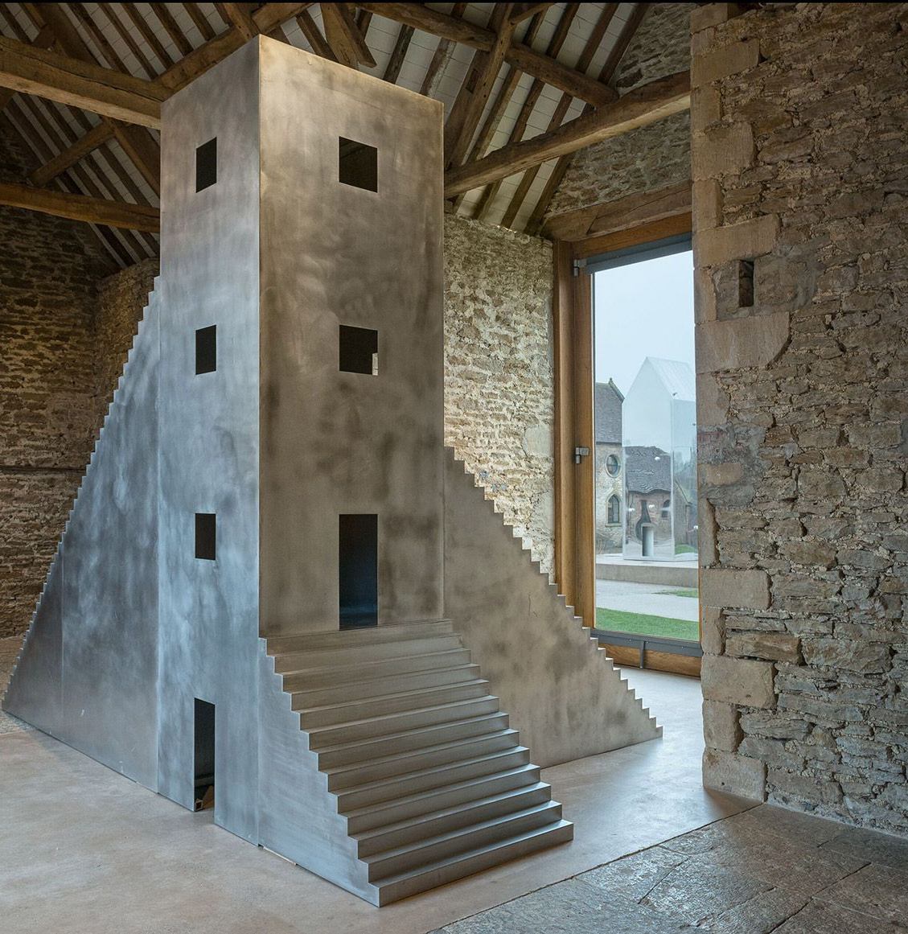
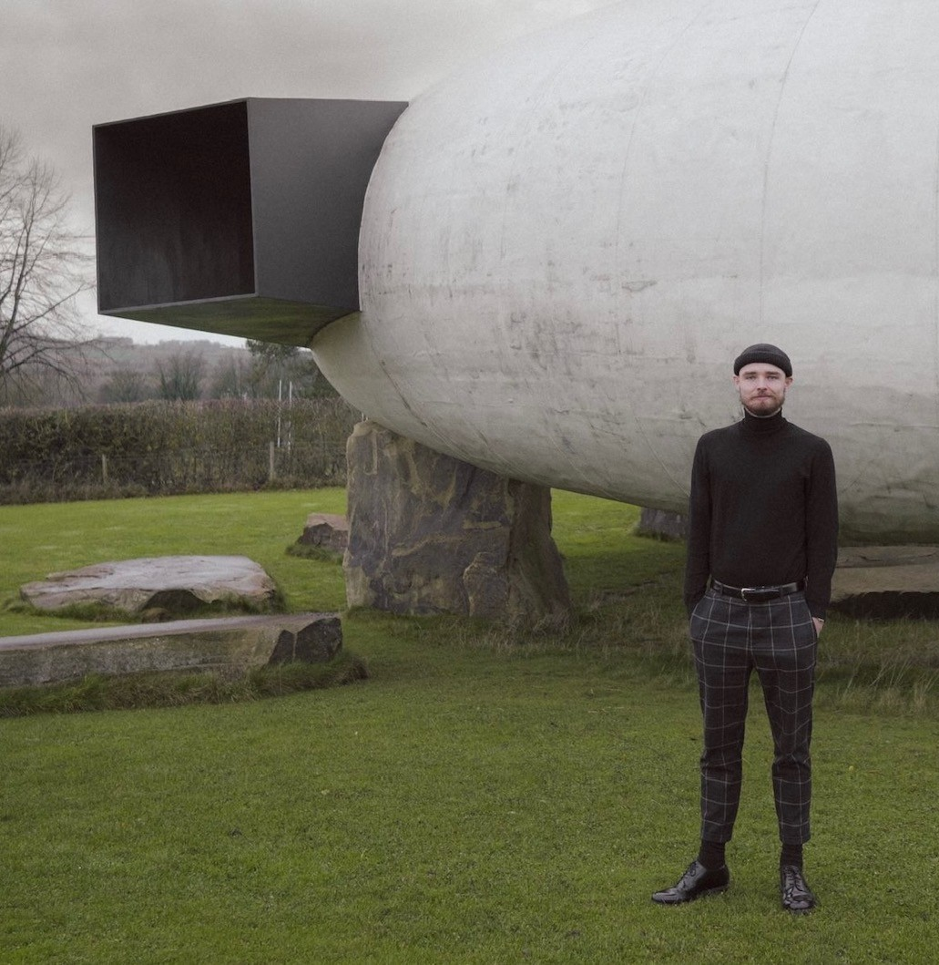

Hauser & Wirth – Curatorial Placement

Slide 8
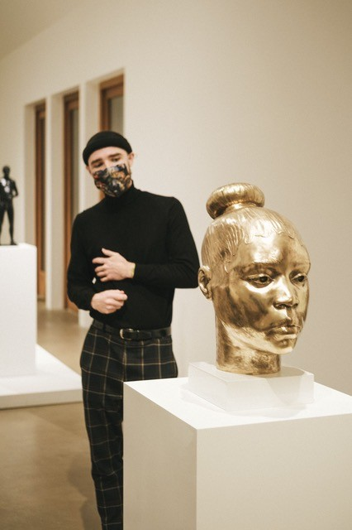
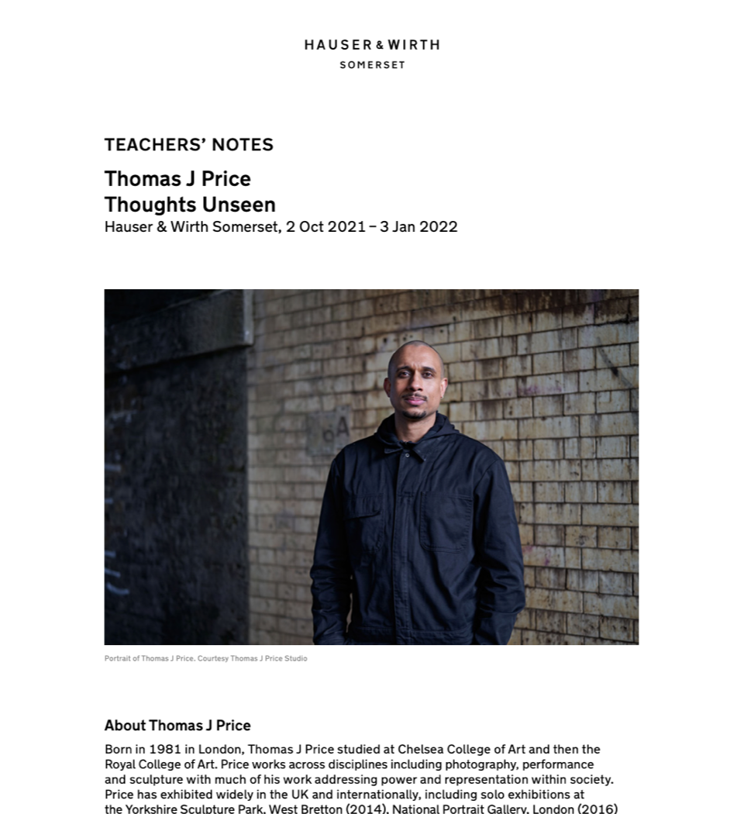

Slide 9
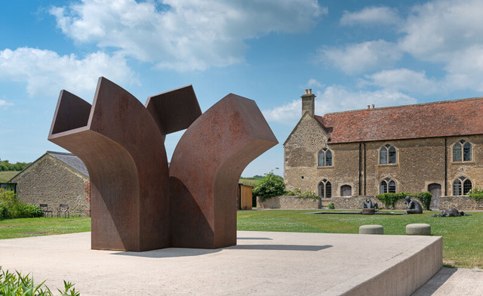
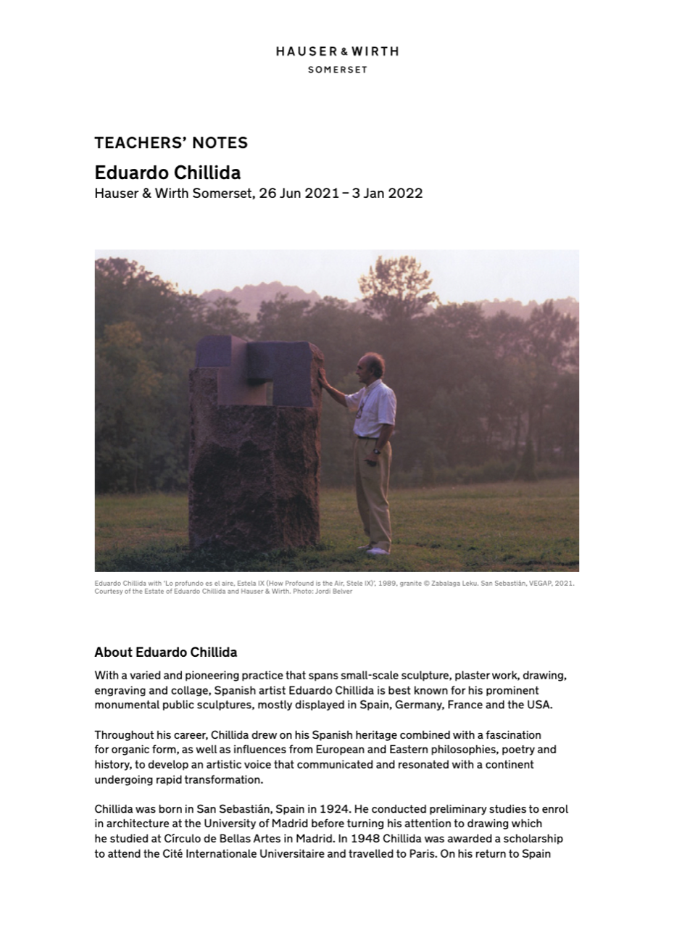
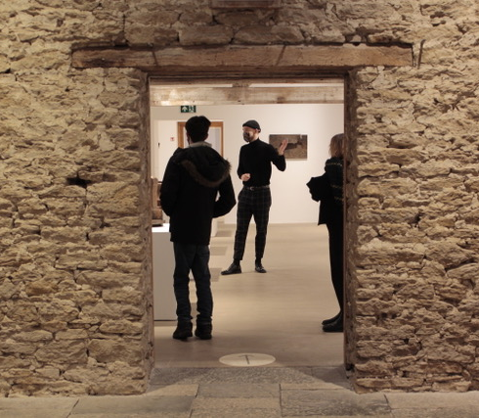
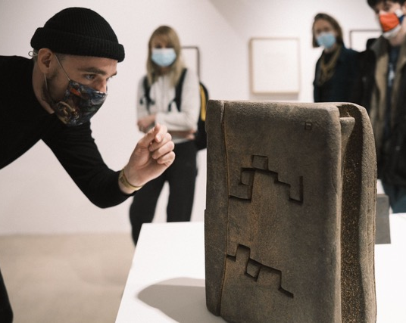

Slide 10
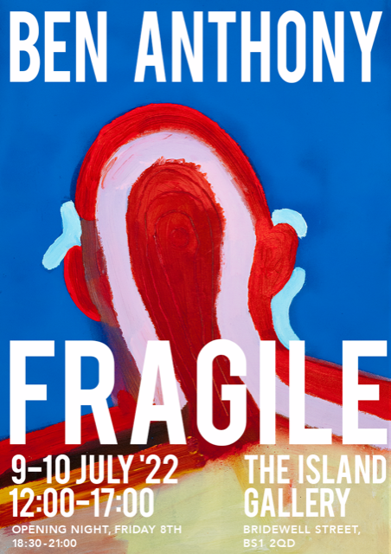
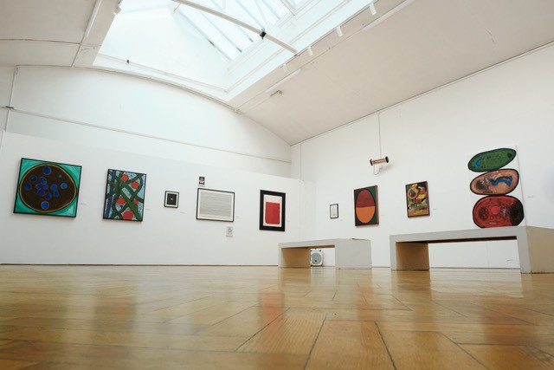
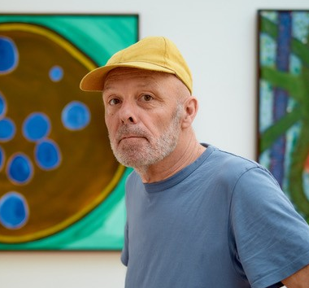
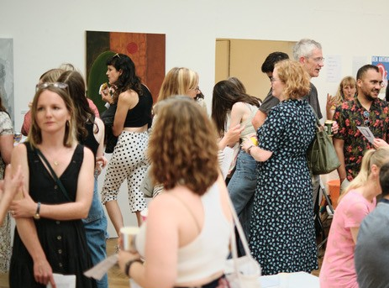
Freelance Work
FRAGILE
“There’s all this new fragility in the world, in myself, in everything”
Ben Anthony
Fragile presents selected new and existing works by Bristol-based Artist, and Art Psychotherapist, Ben Anthony. Containing a mixture of abstract paintings and political pieces the exhibition explores diverse themes such as climate change, othering, conflict and personal suffering; informed by the artist’s more than 30 years’ experience working in Art Psychotherapy. The artist states of his practice “As an Art Psychotherapist I have been affected by the people I have worked with over the years, nearly all of whom have endured one or more forms of severe trauma”.

Slide 11
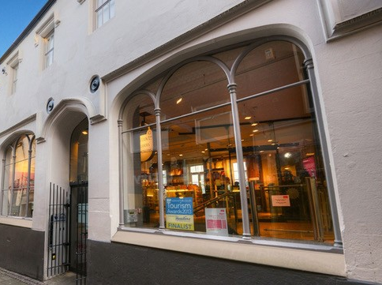
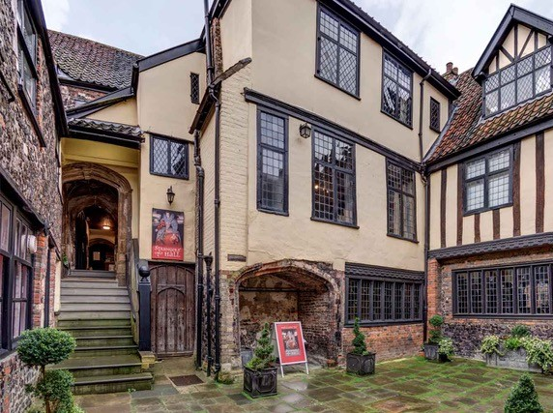
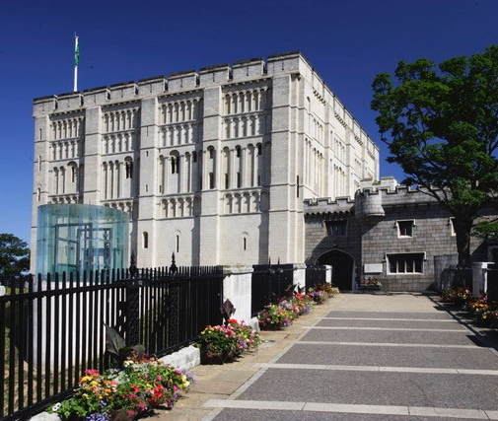
Norfolk Museums
Front of House Manager
Leading Front-of-House Teams.
Giving tours.
Management, staffing, rotas, recruitment.
Procurement, finance, budgeting.

Slide 12

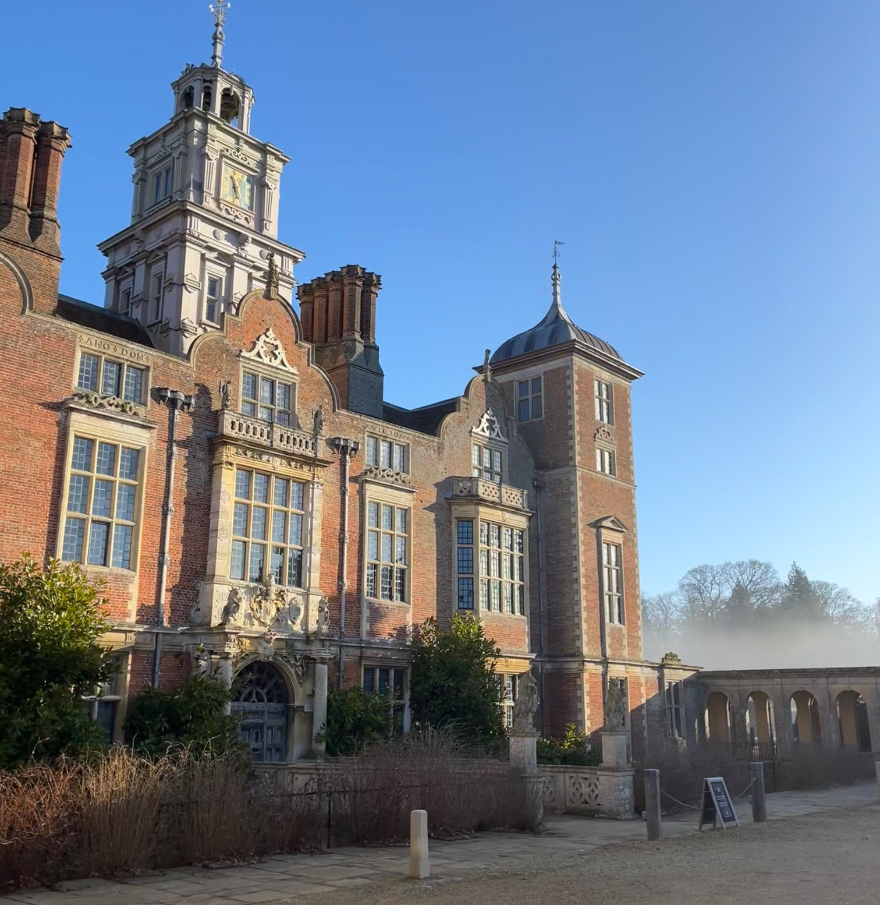

Property Operations Manager
Blickling Estate
Visitor Experience design
Event Programming
Compliance and H&S
Recruitment
Budget Management
Conservation and building projects

