Slide 1
MSF
S.Sudan
PIBOR
2009

Slide 2
SETTING THE SCENE

Slide 3
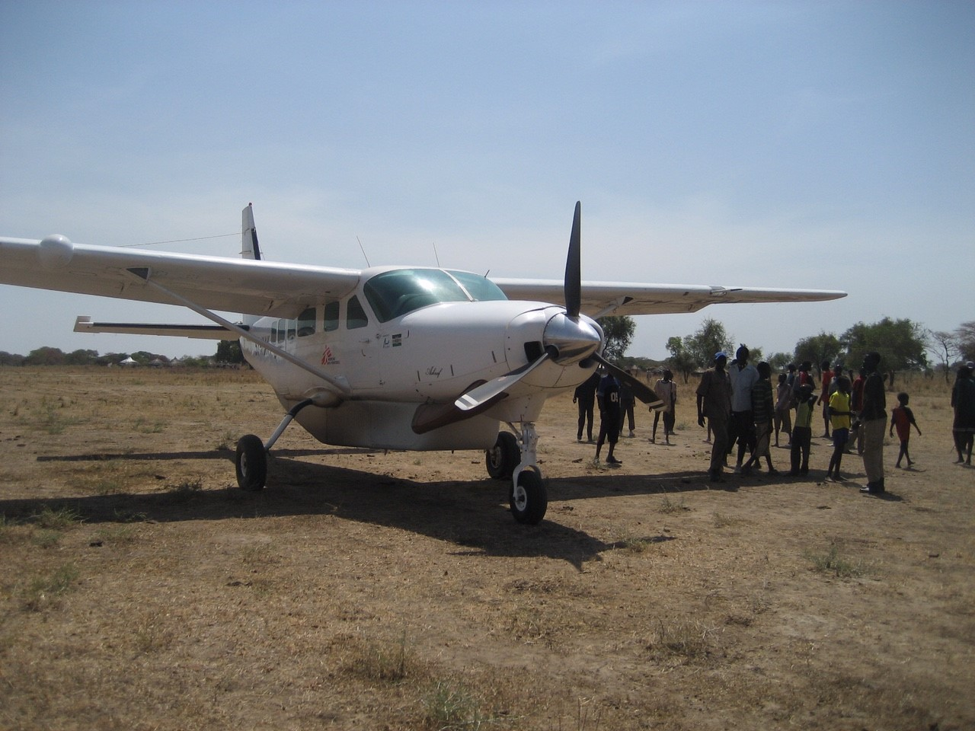
ARRIVAL

Slide 4
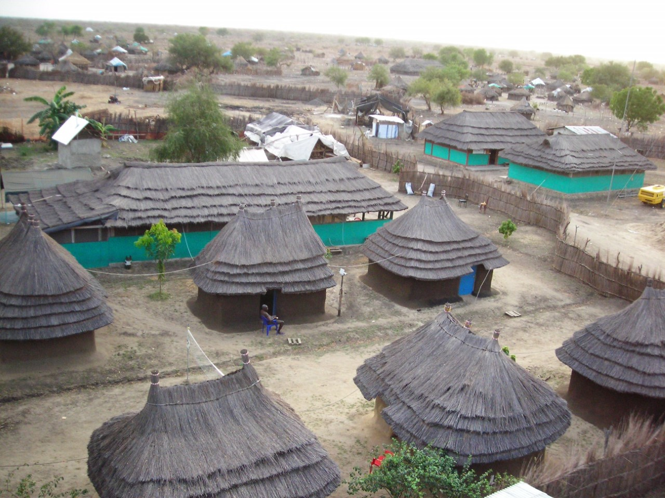
The Project Compound

Slide 5
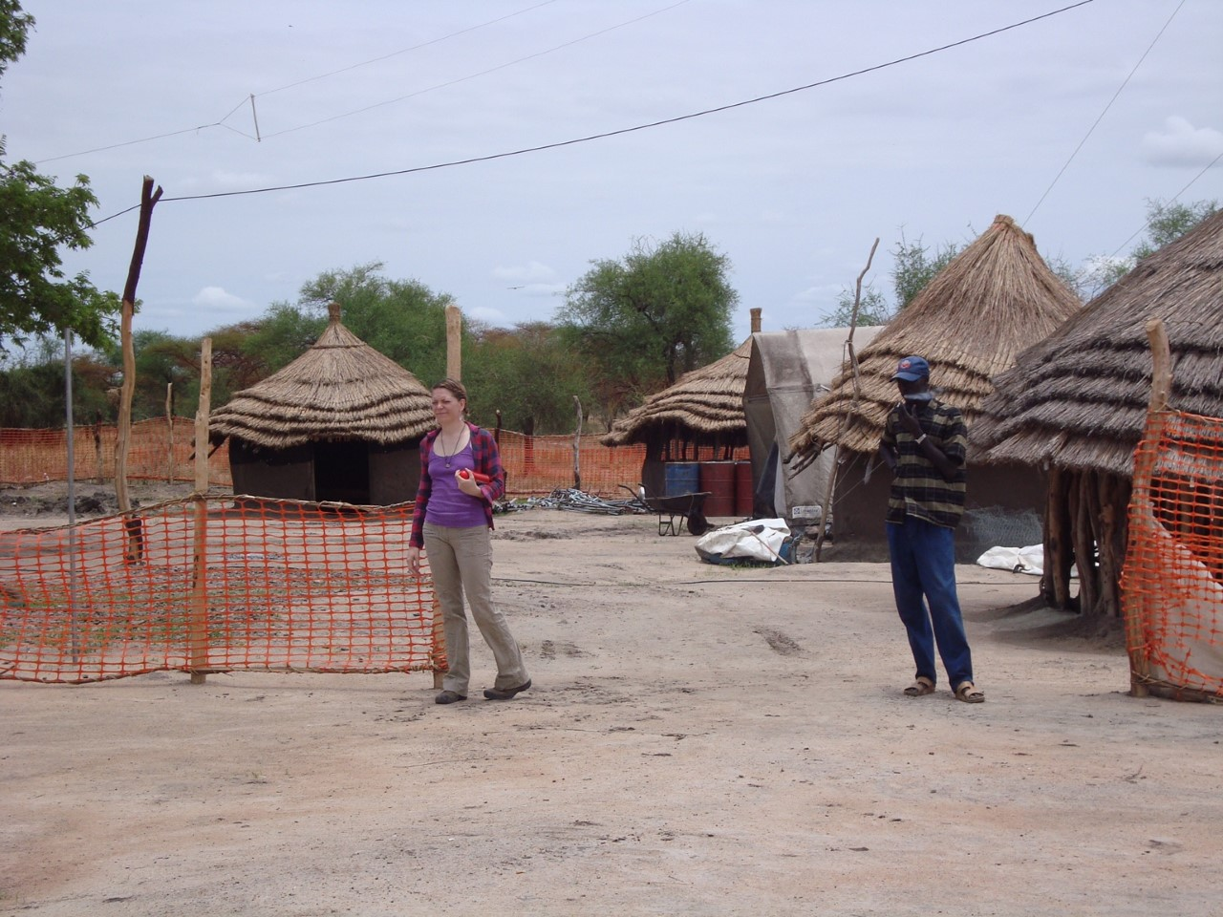

Slide 6
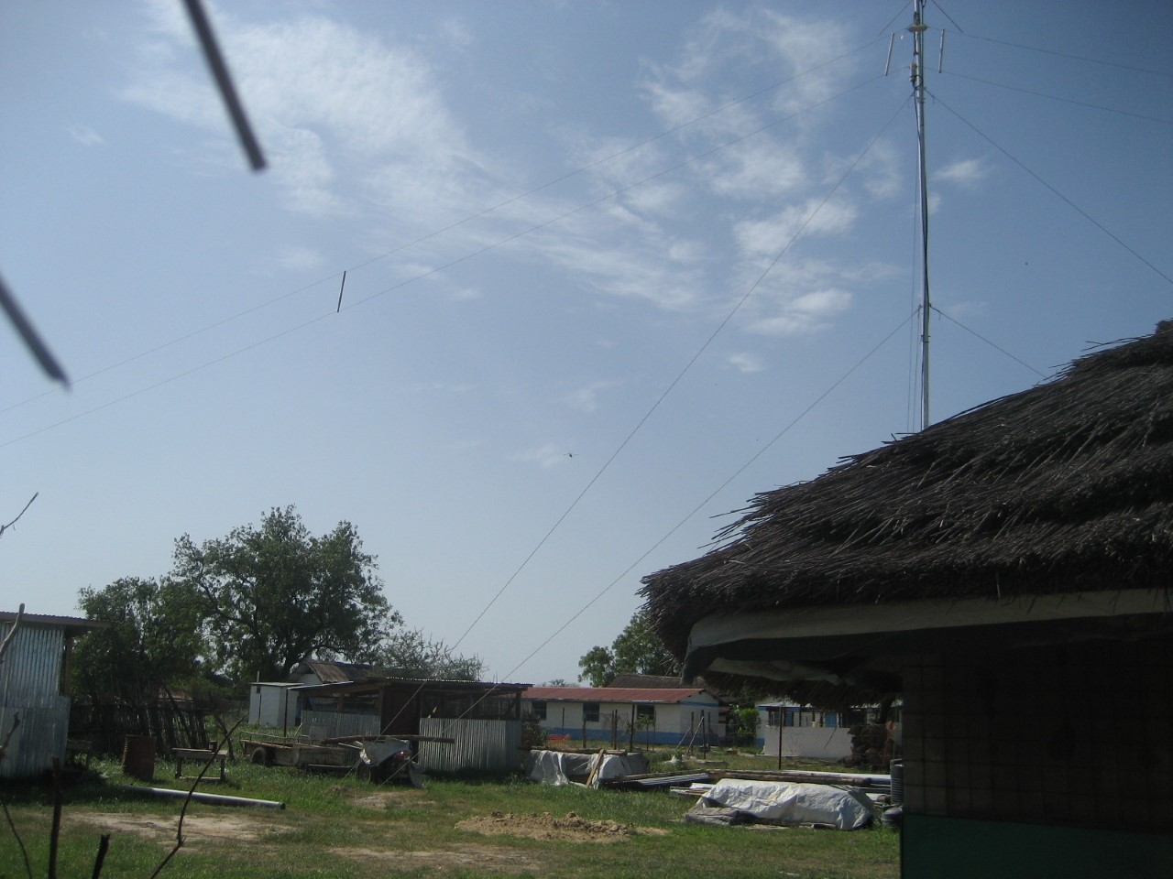

Slide 7
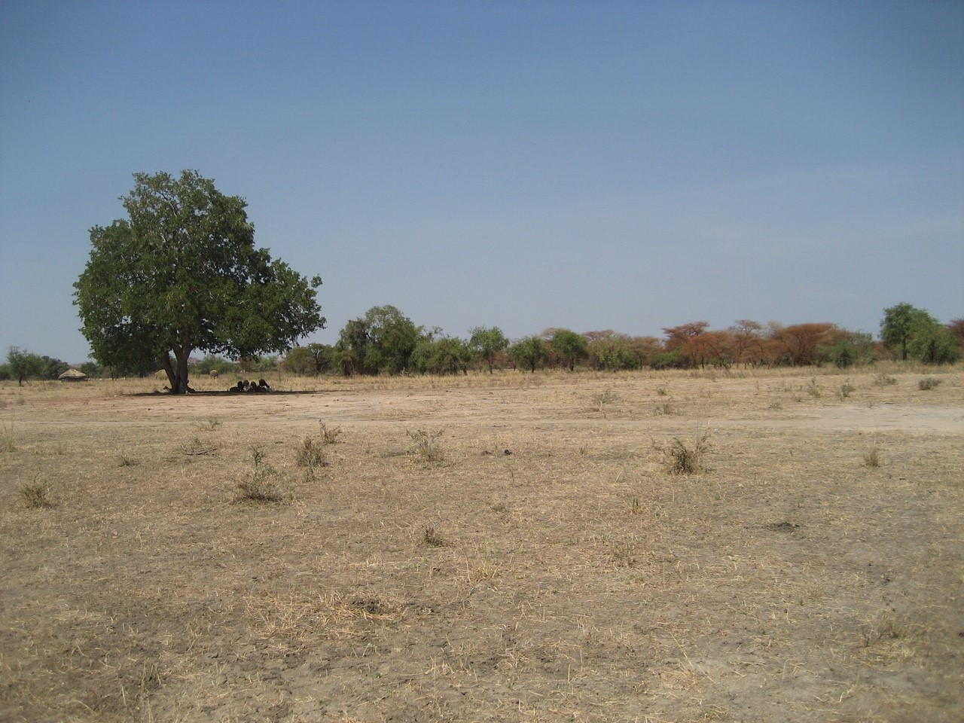
Savanna

Slide 8
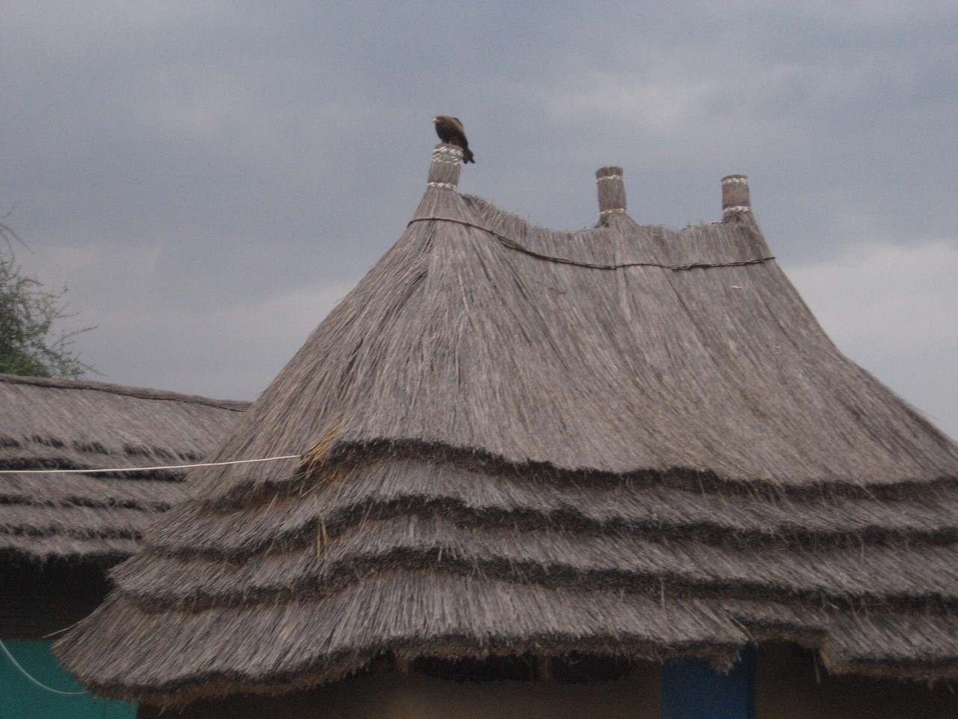
Alternative home

Slide 9
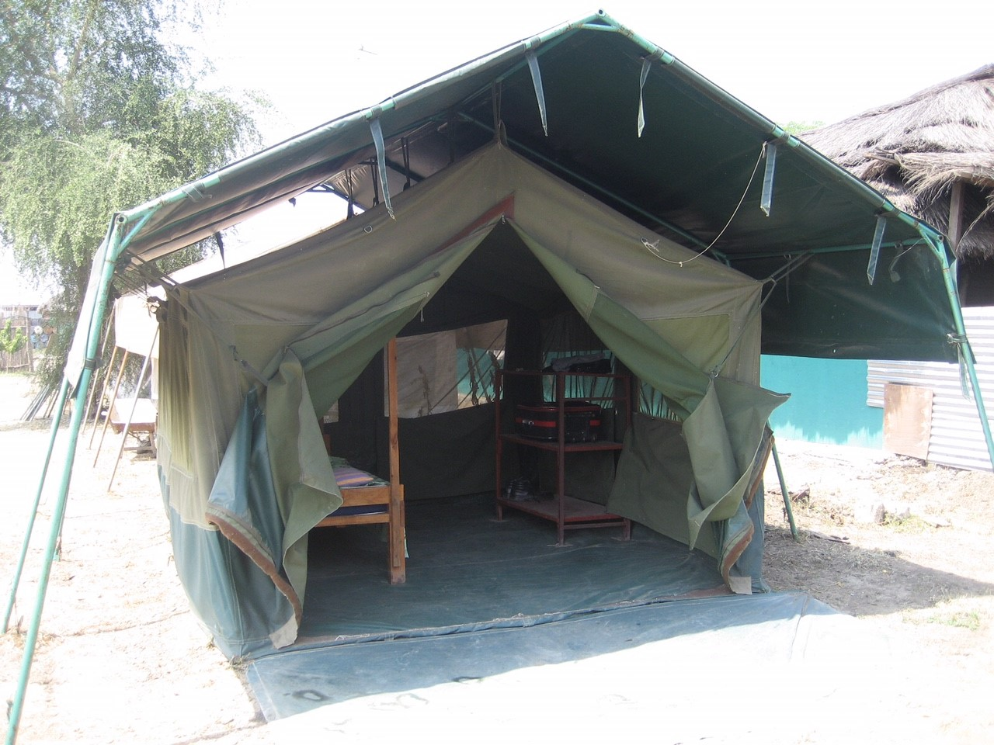
Home

Slide 10
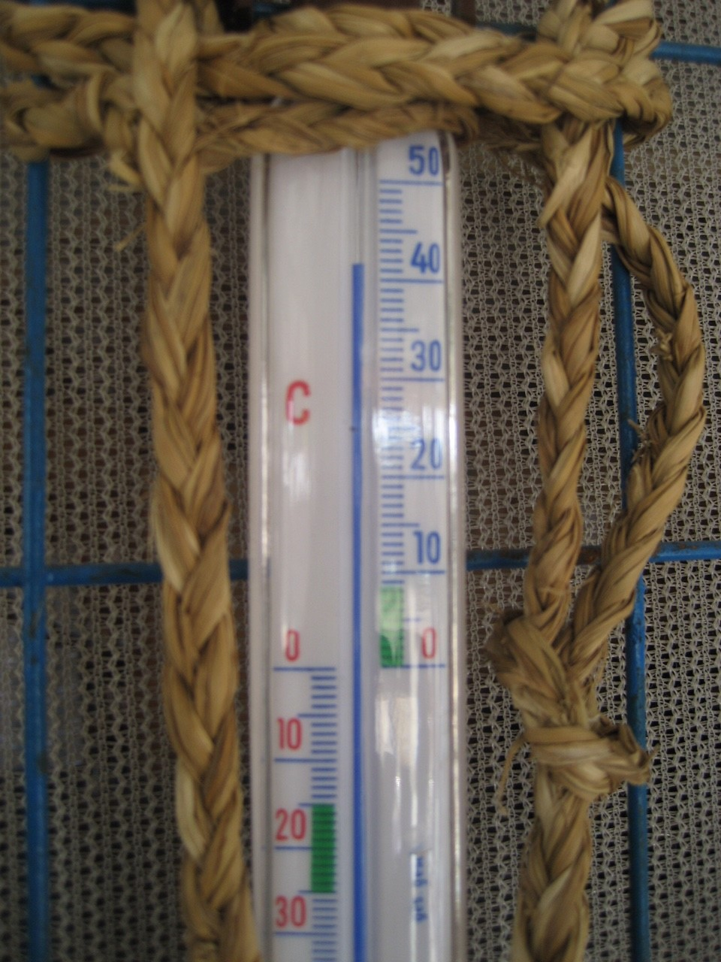
7.30 AM

Slide 11
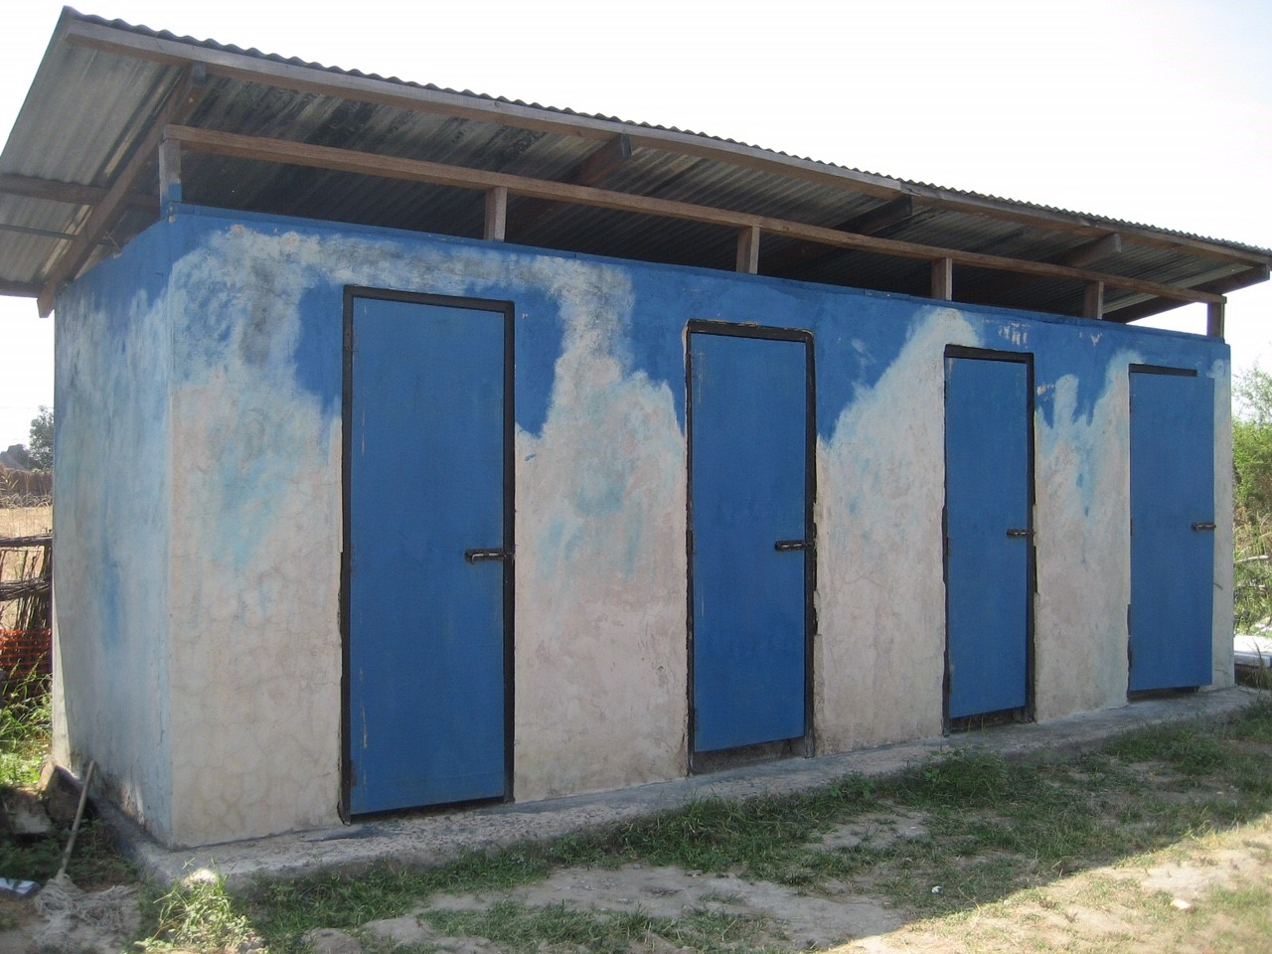
Toilet Block

Slide 12
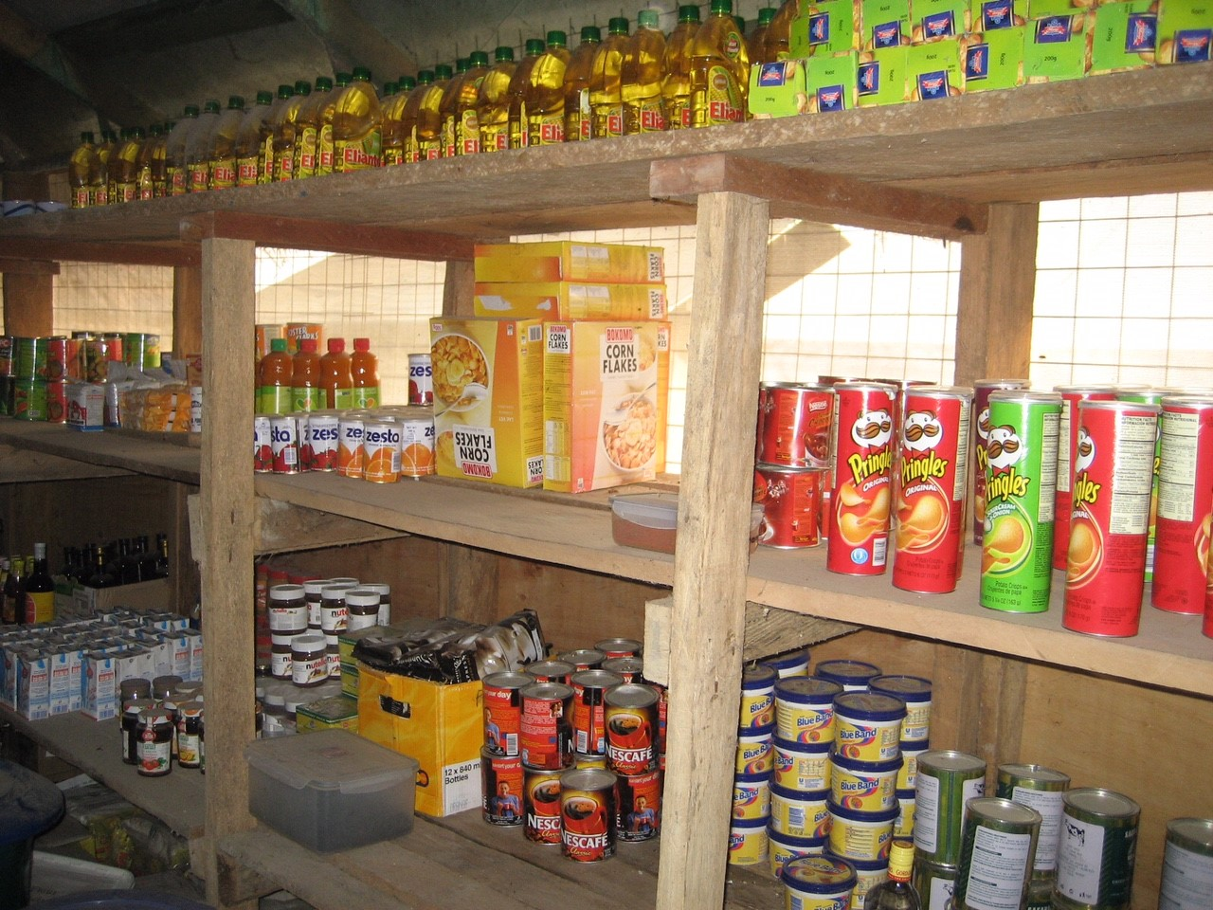
All our food

Slide 13
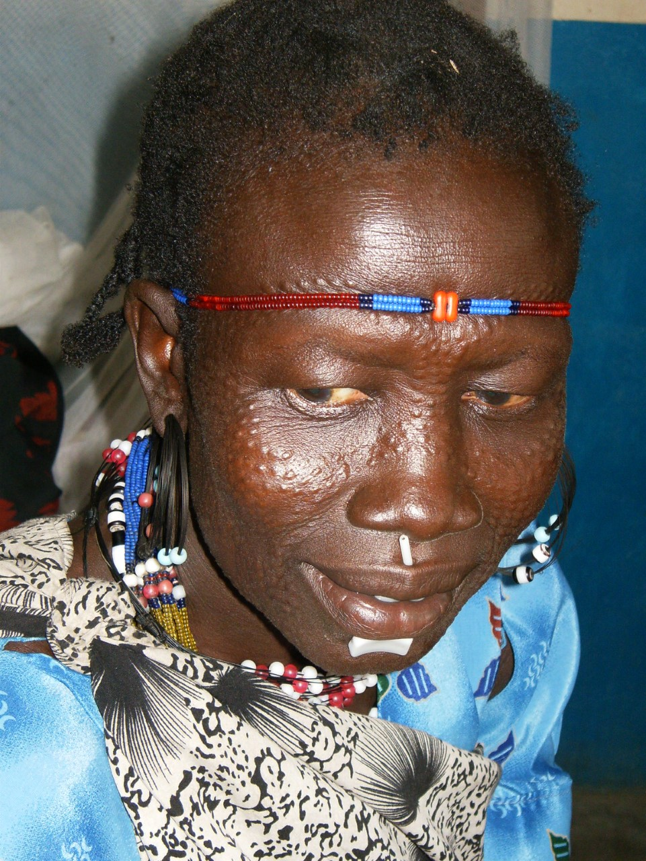
The murle

Slide 14
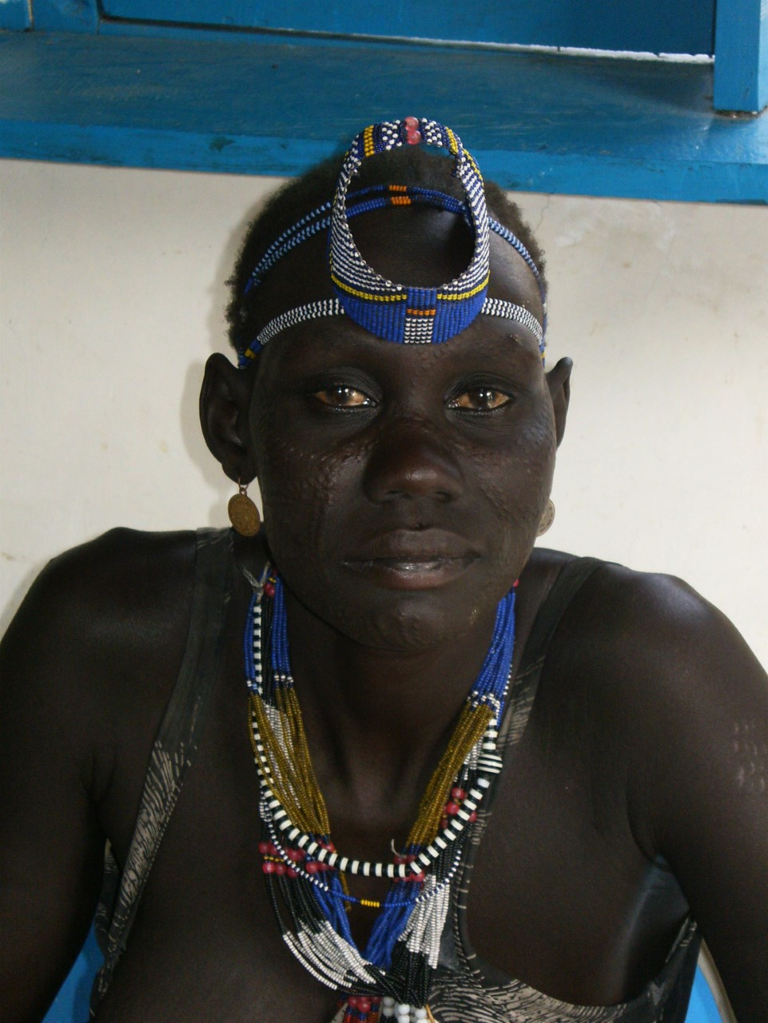

Slide 15
THINGS IMPORTANT TO THE MURLE

Slide 16
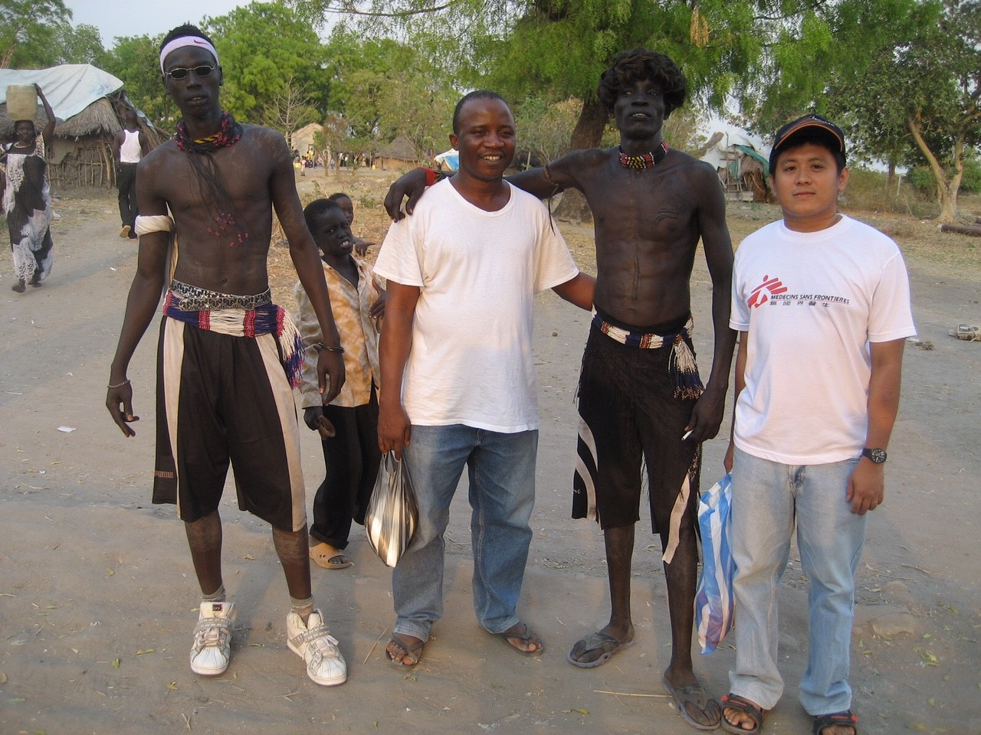
DANCING

Slide 17
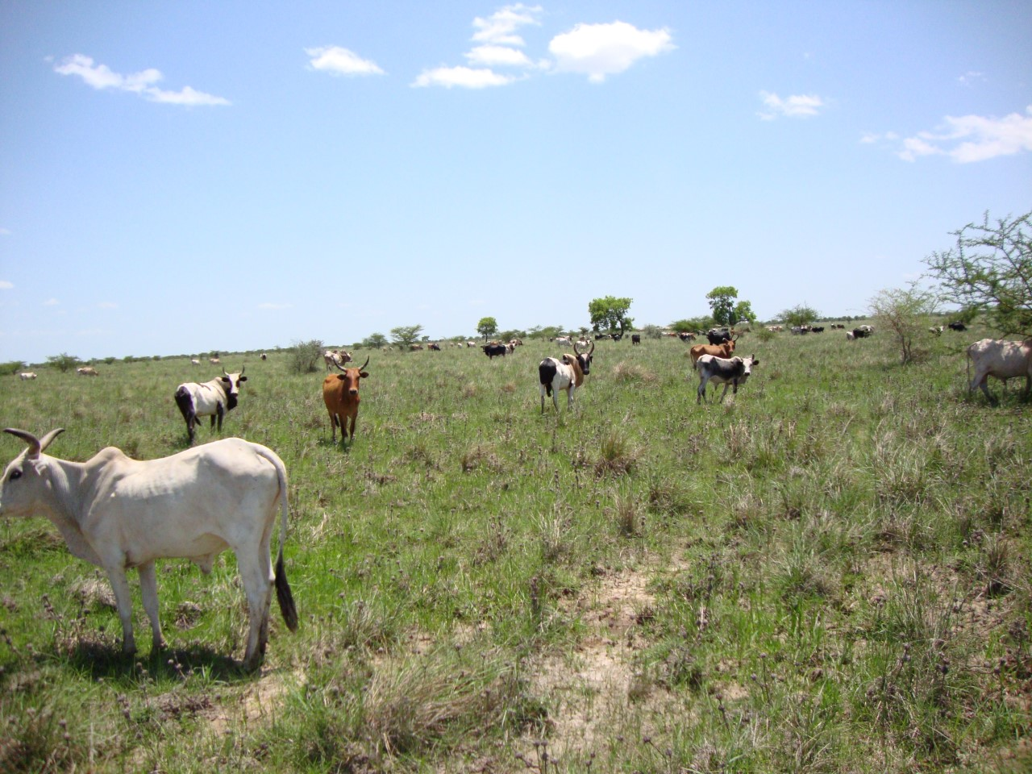
Cows

Slide 18
INTERNATIONAL STAFF

Slide 19
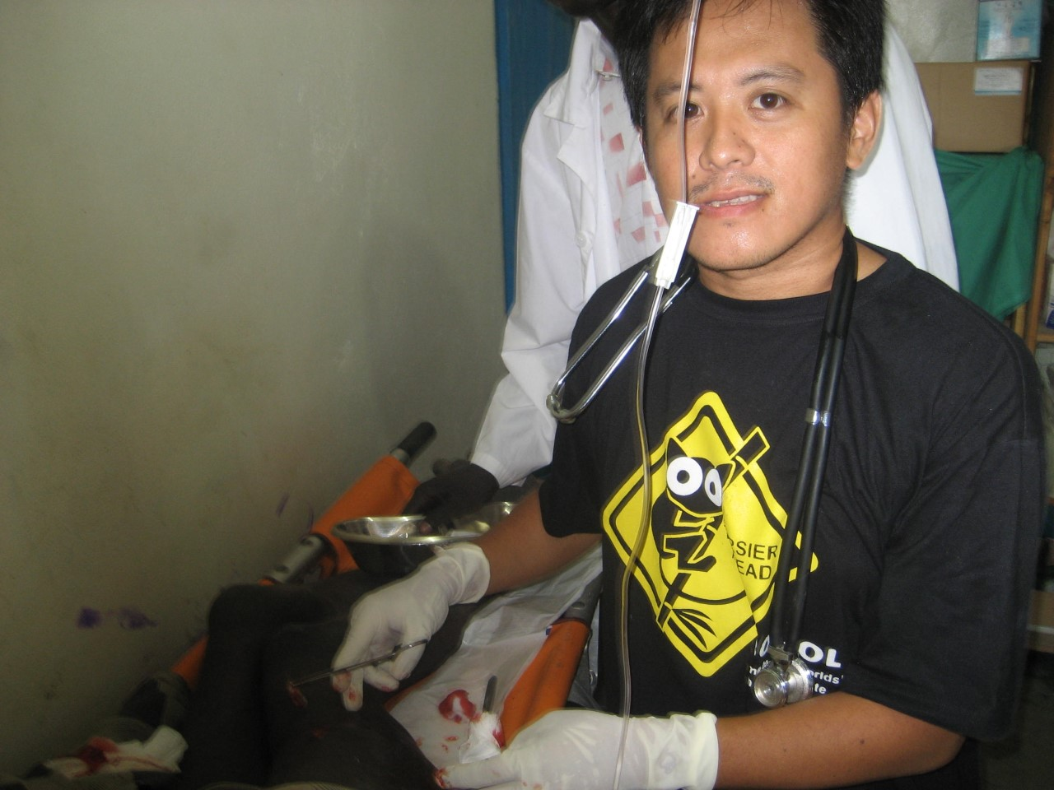
My friend Ricky

Slide 20
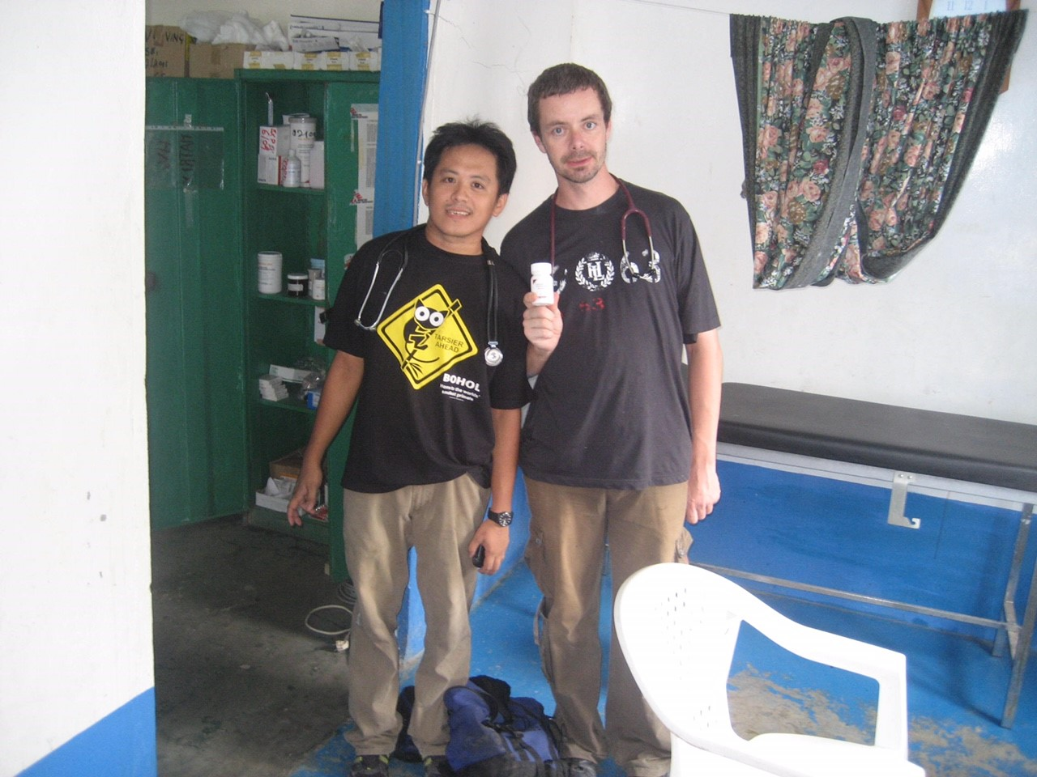
We found the Cure!

Slide 21
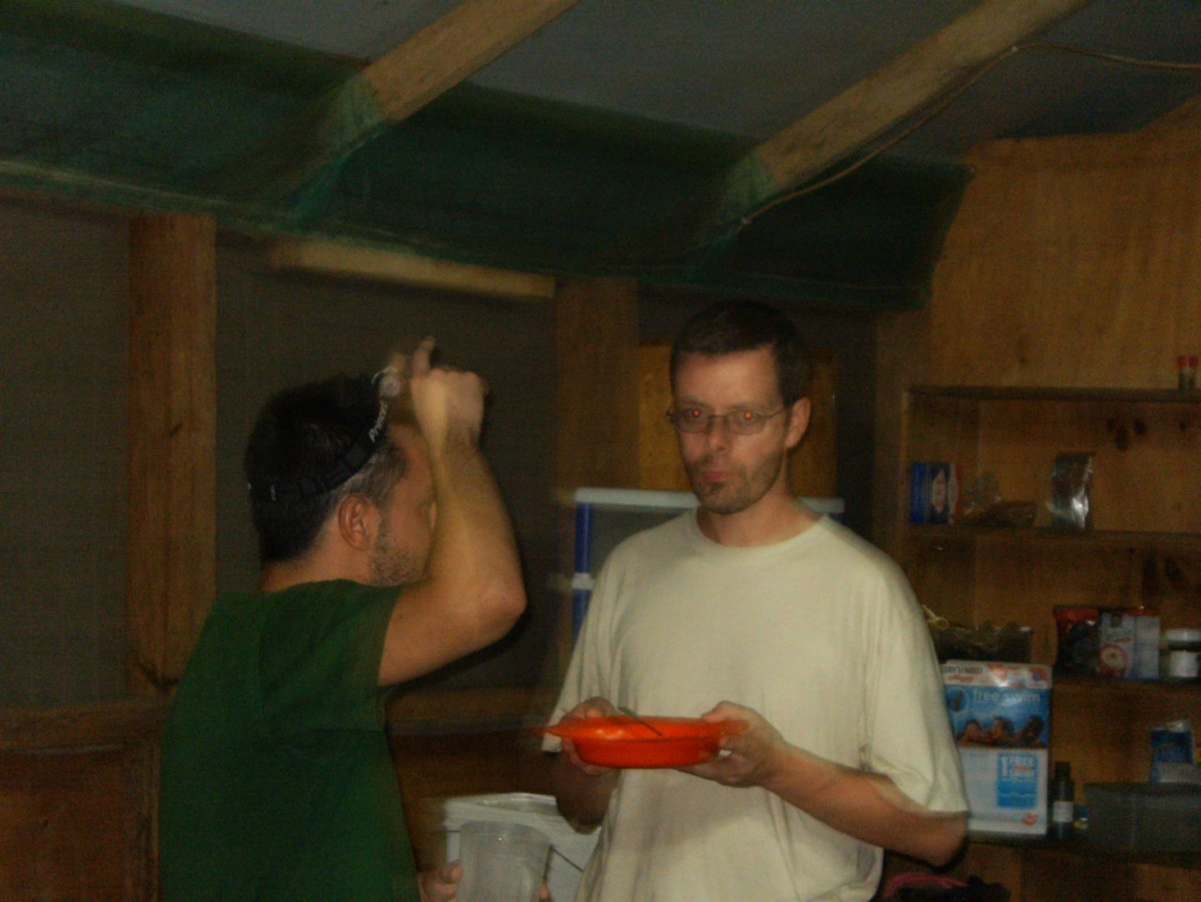
Claudio PC

Slide 22
Departments

Slide 23
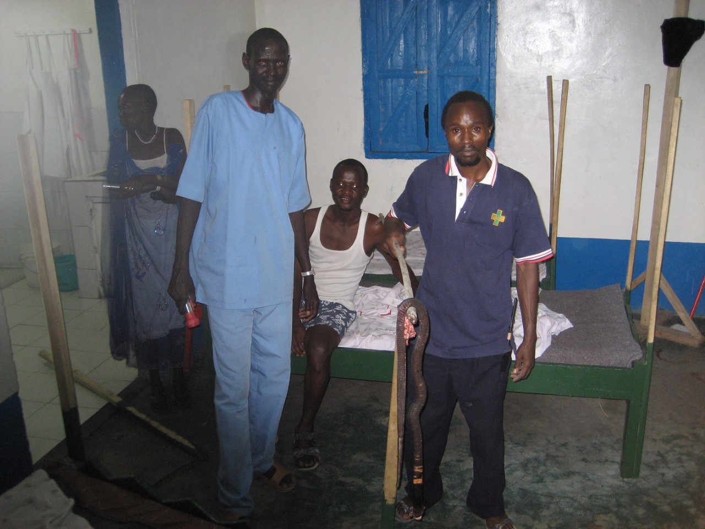
In patient STAFF

Slide 24
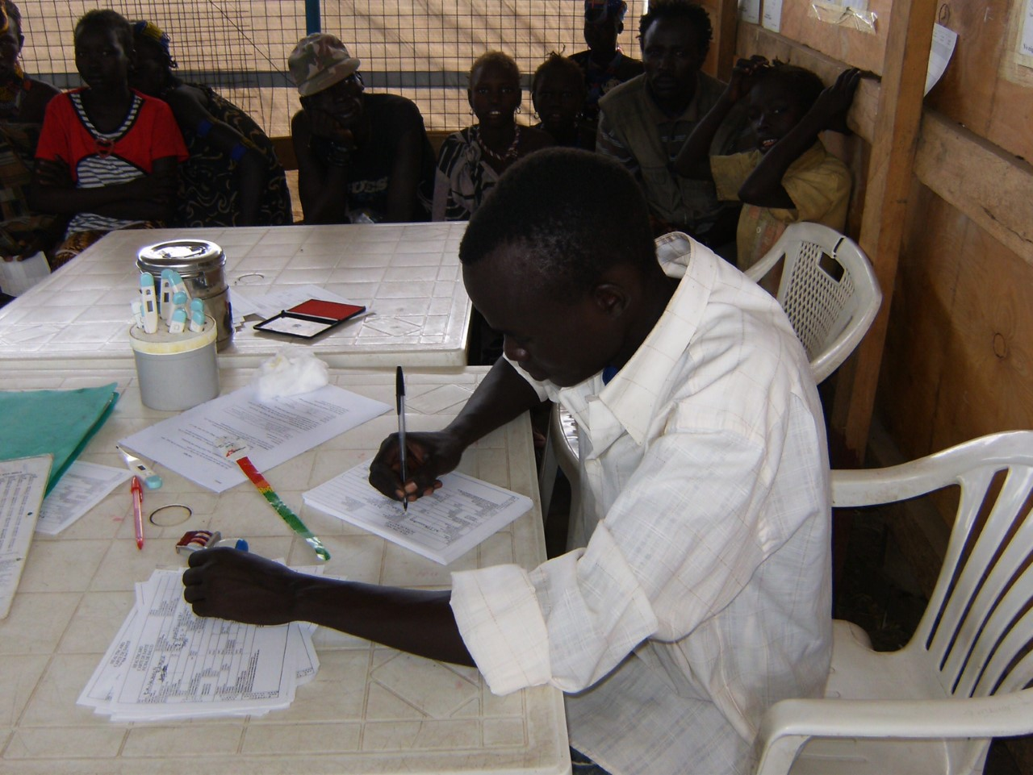
Therapeutic Feeding Program

Slide 25
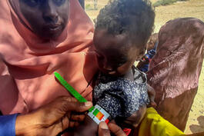

Slide 26
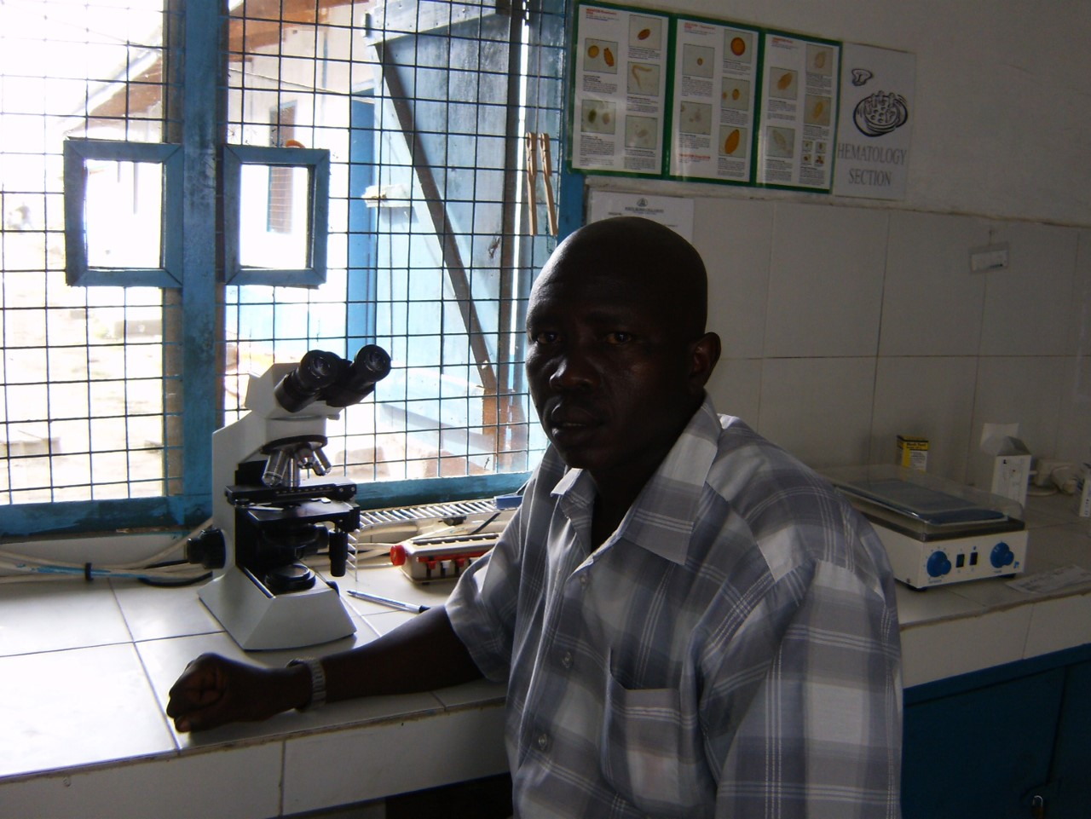
The LAB

Slide 27
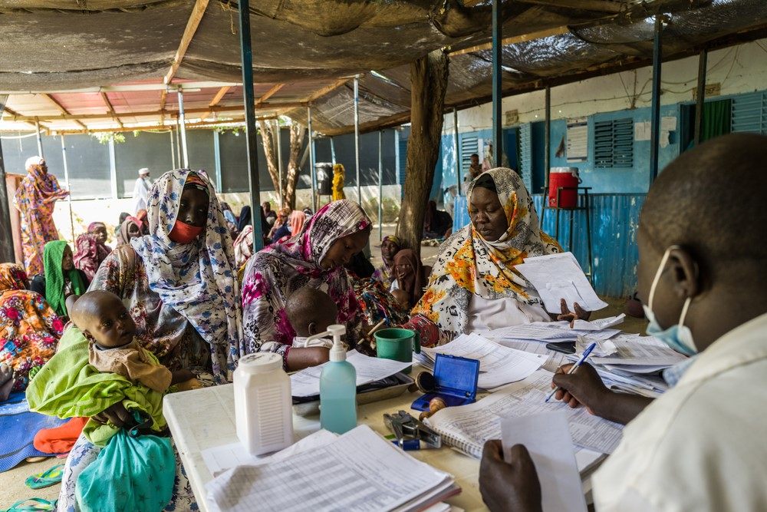
Vaccination program

Slide 28
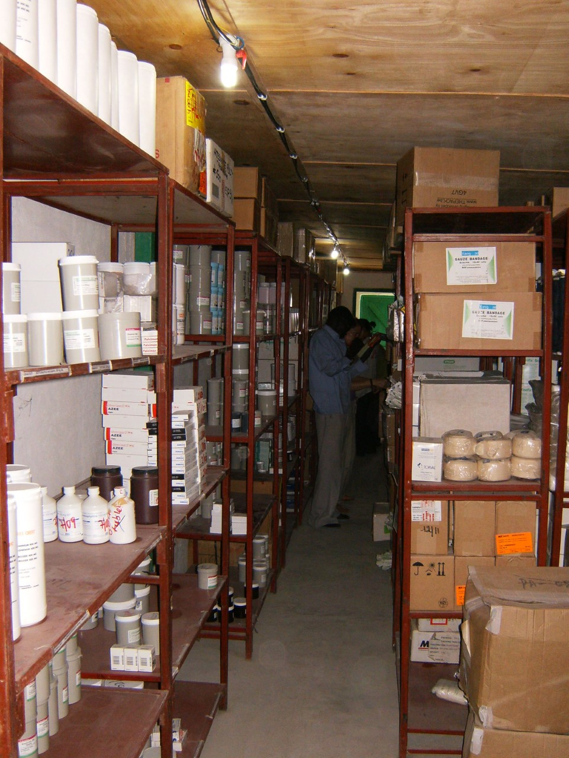
Pharmacy

Slide 29
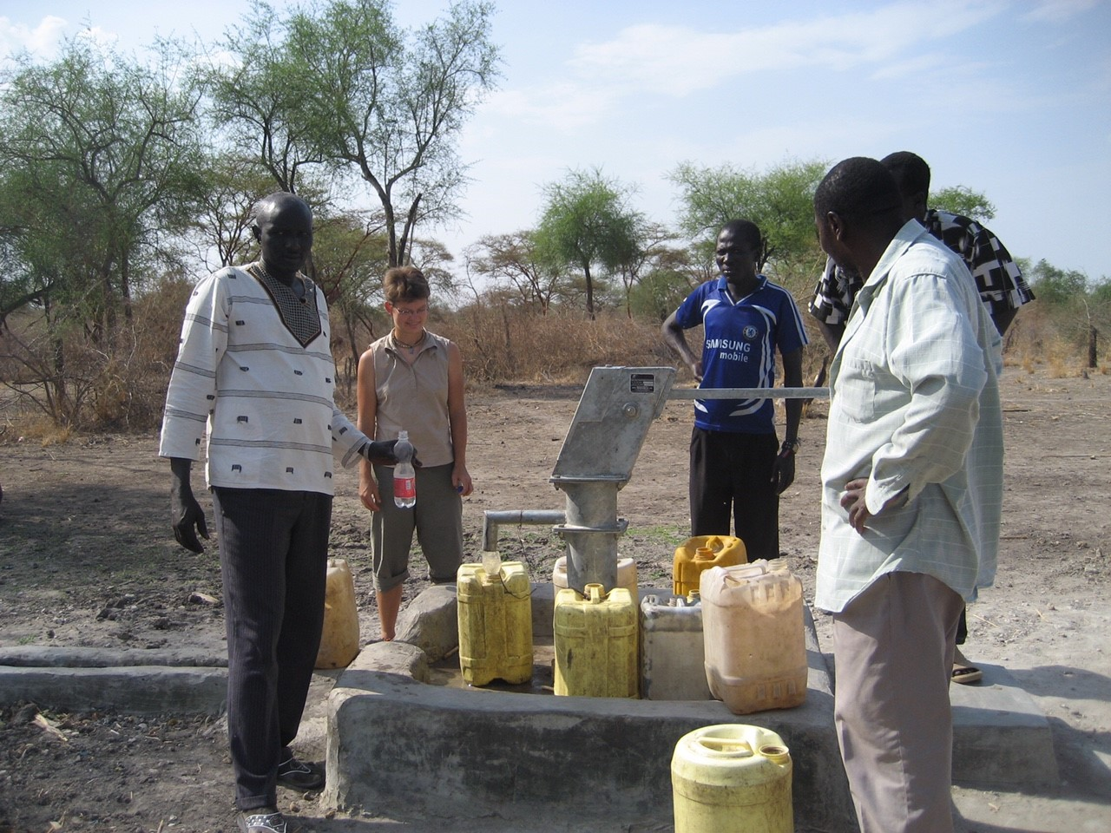
WatSan

Slide 30
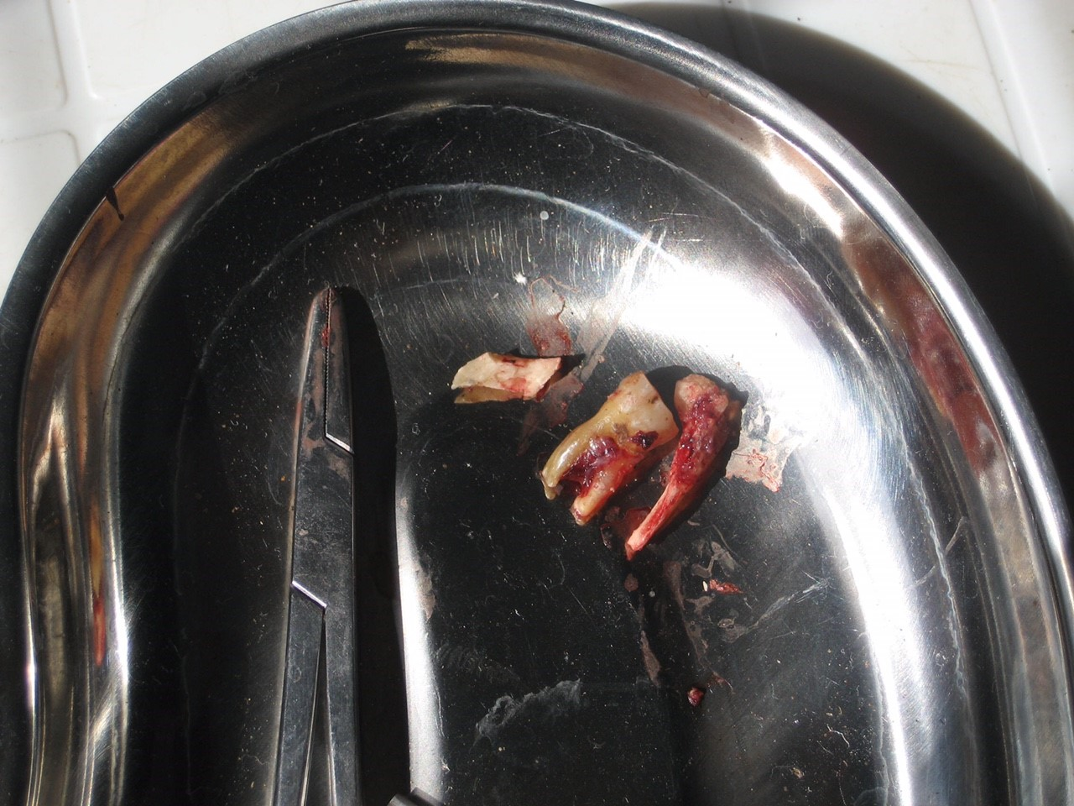
Max Fax

Slide 31
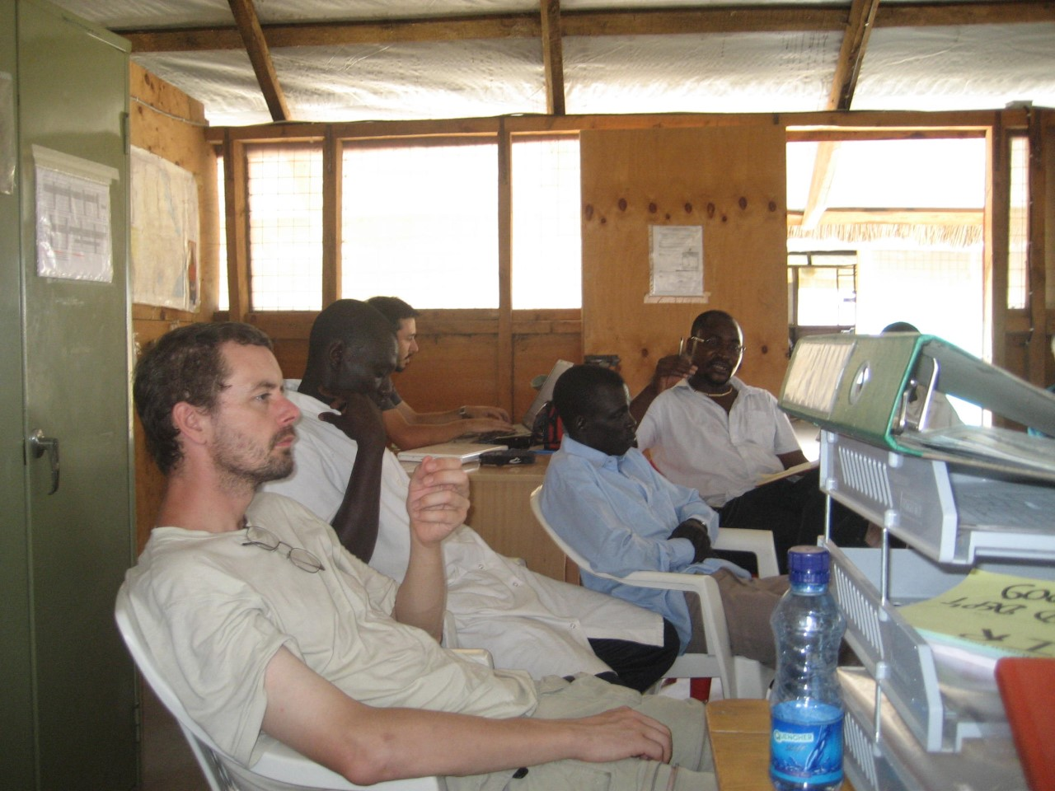
Team Meetings

Slide 32
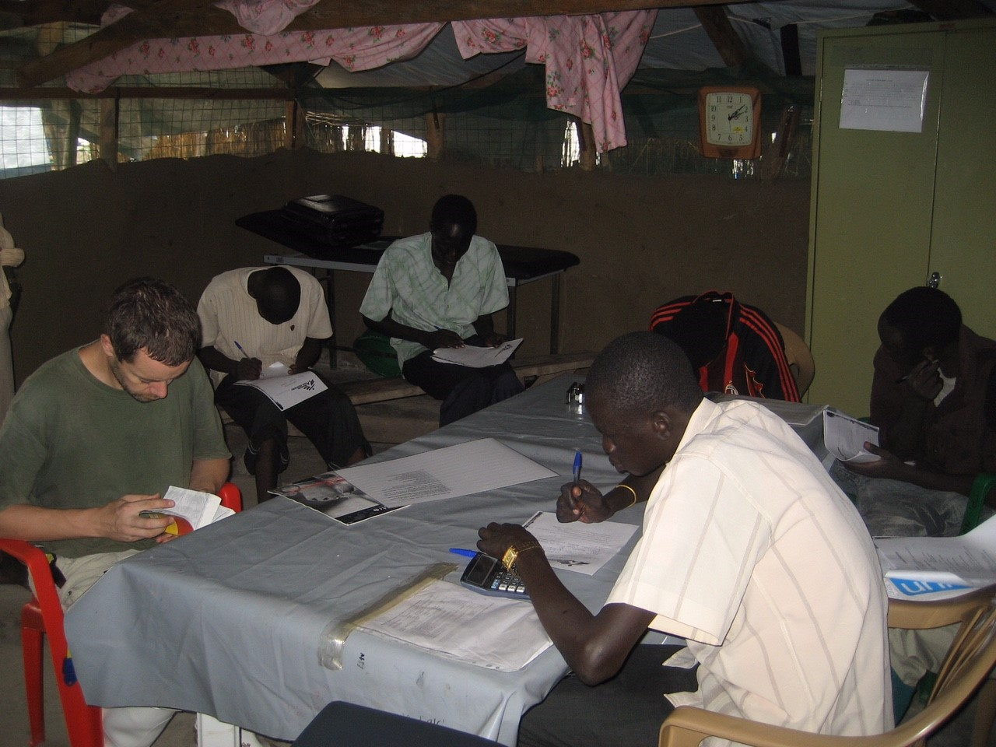
Library

Slide 33
Stuff we Treated

Slide 34
Gunshot

Slide 35
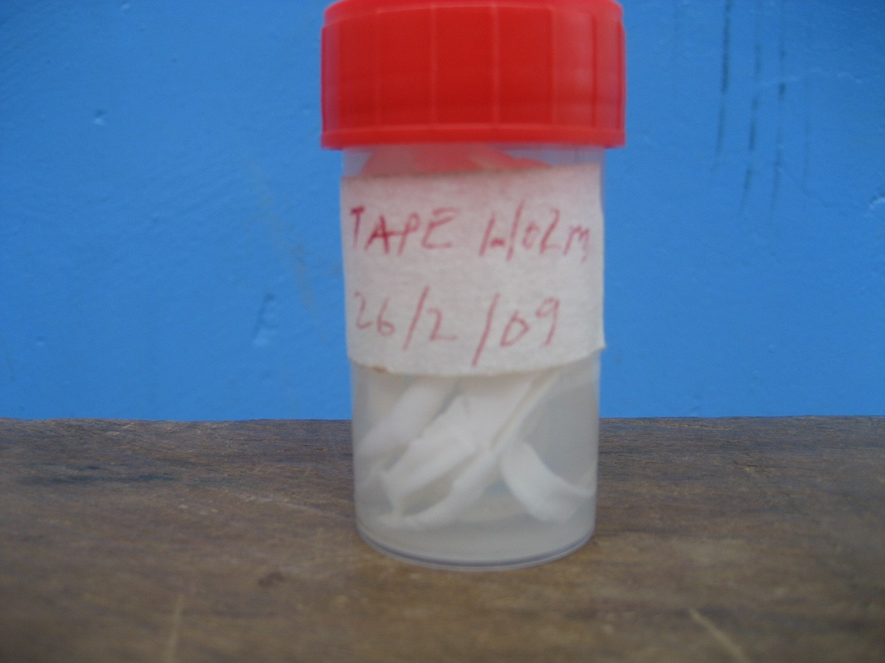
Tape worms

Slide 36
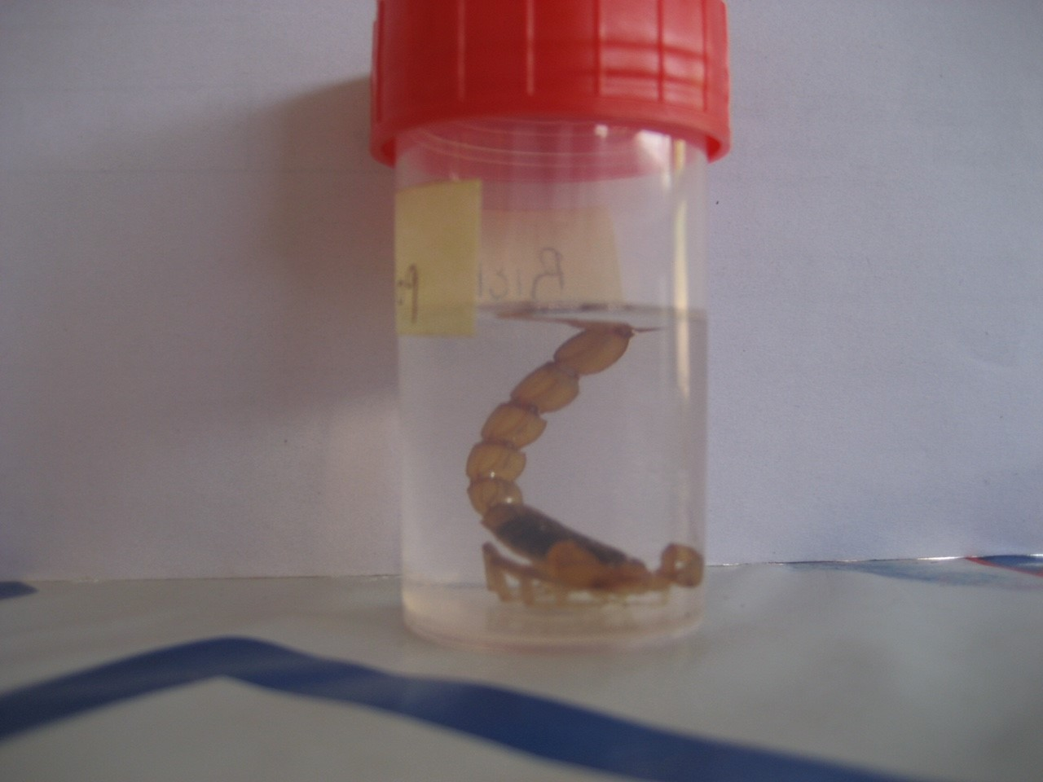

Slide 37
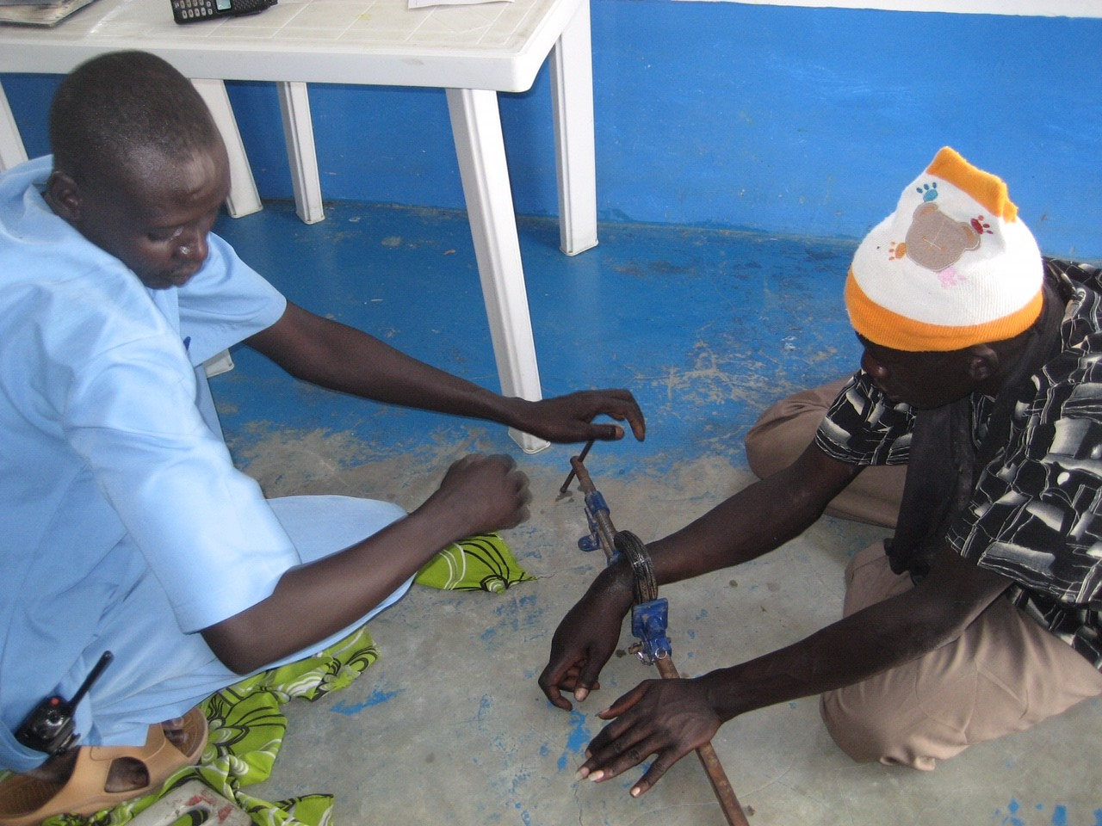
Fighting Bracelet

Slide 38
THE EMERGENCY

Slide 39
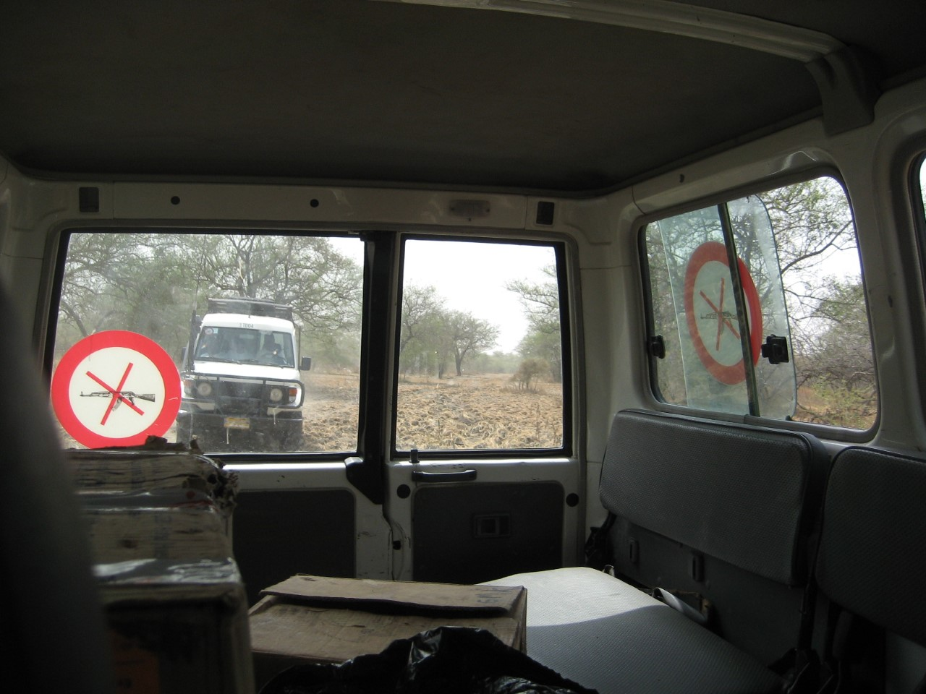
Travel

Slide 40
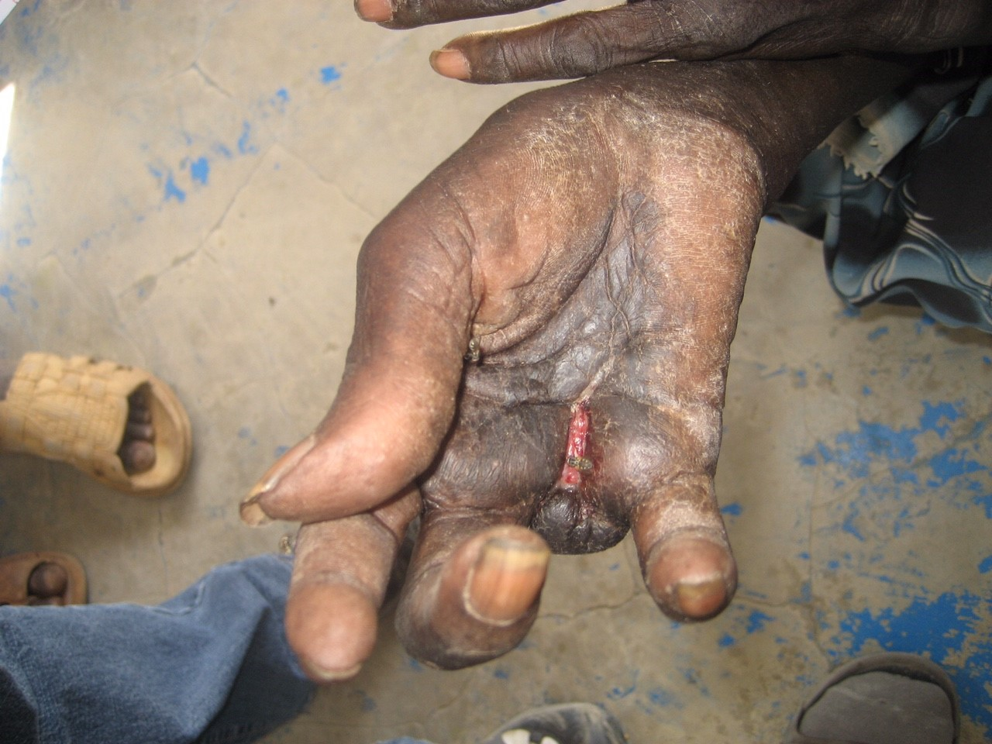
Post amputation

Slide 41
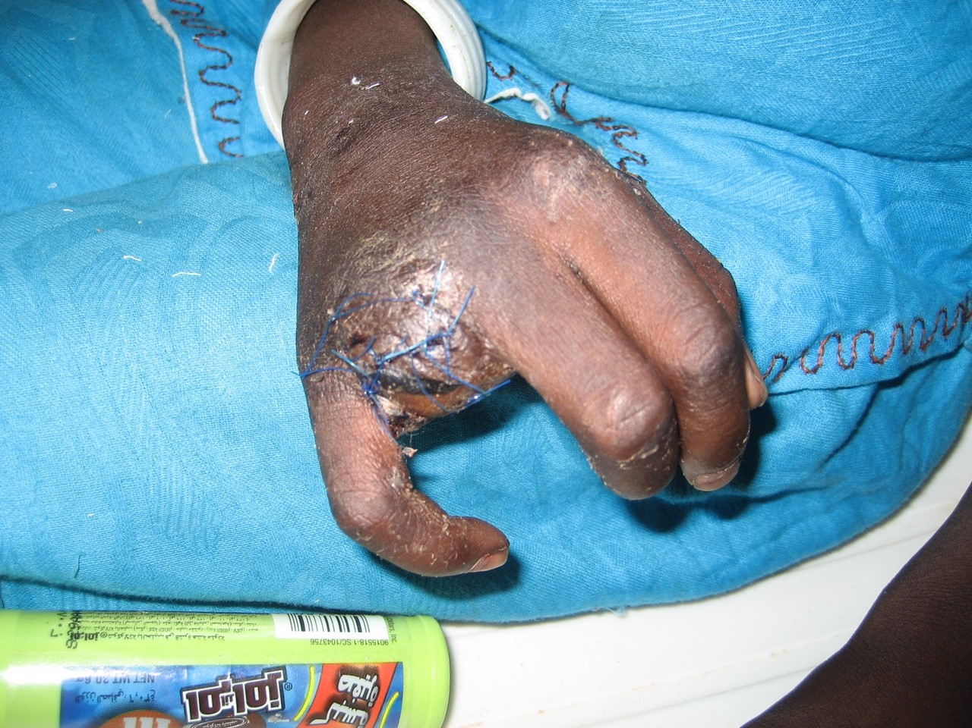

Slide 42
Cholera

Slide 43
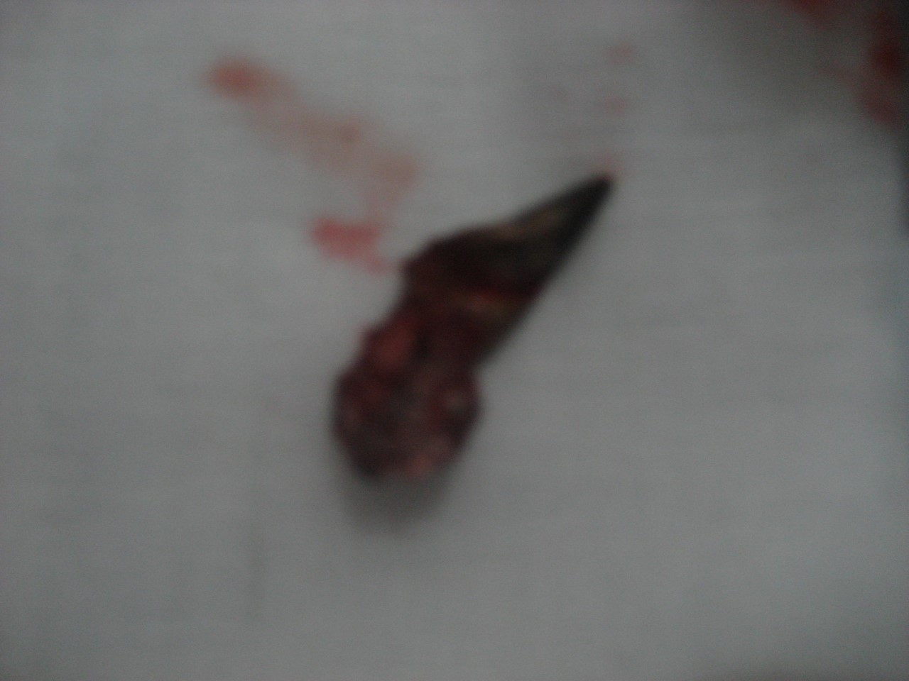
Bullet REMOVED

Slide 44
Chest Drain

Slide 45
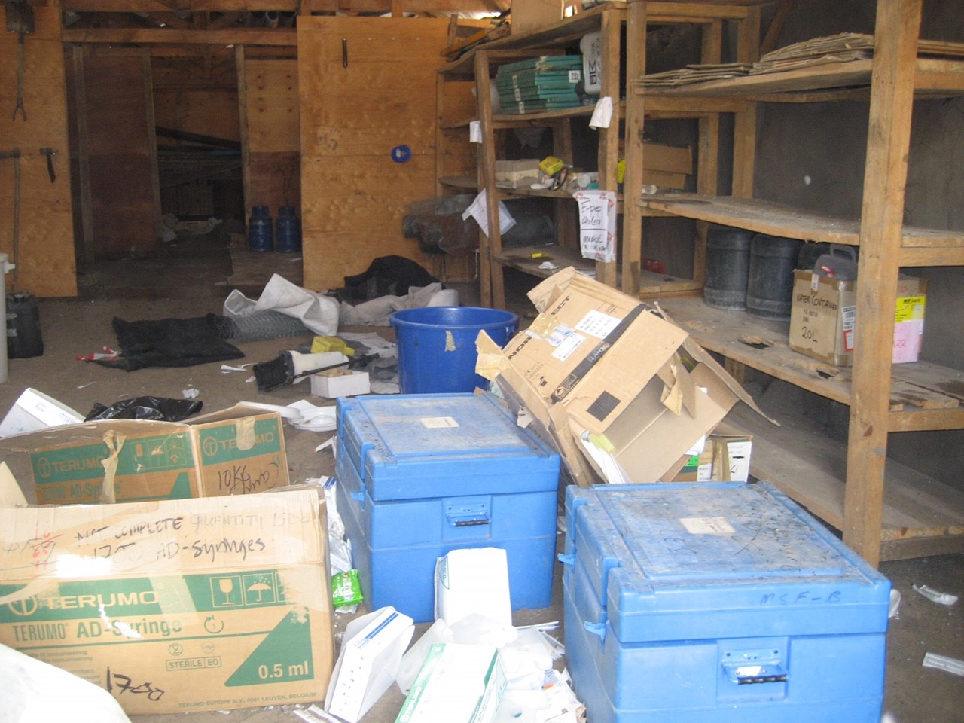
Looting

Slide 46
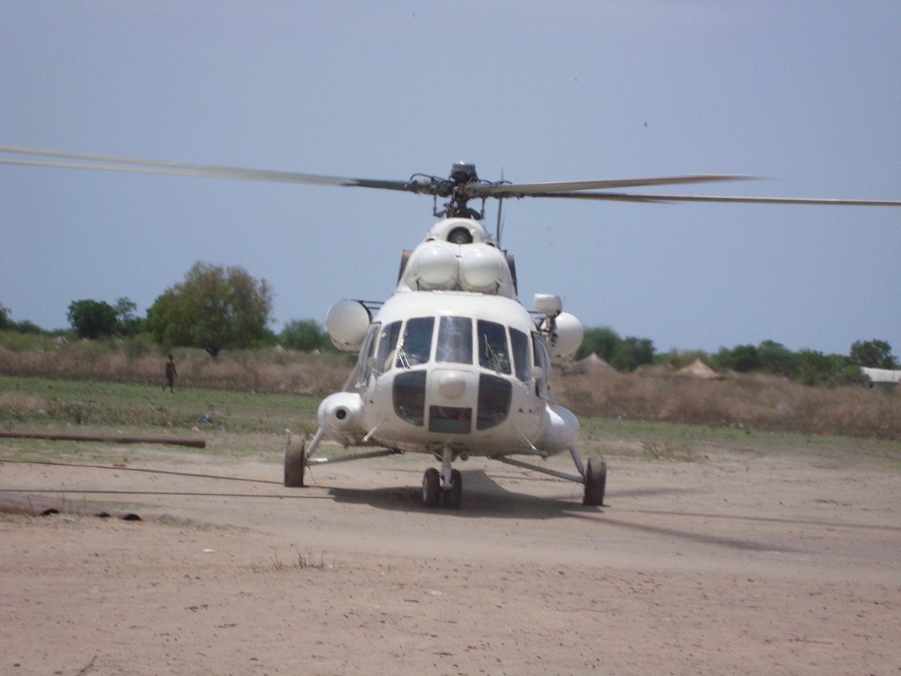
UN came

Slide 47
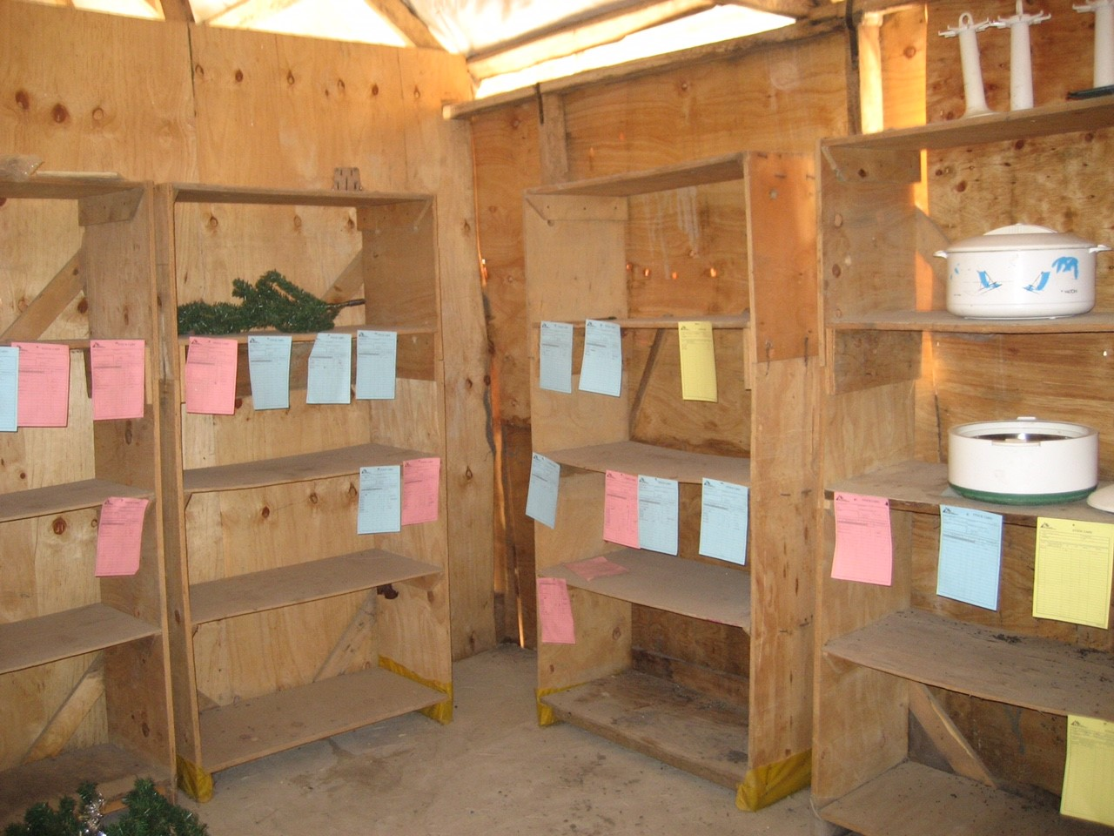
After… our food

Slide 48
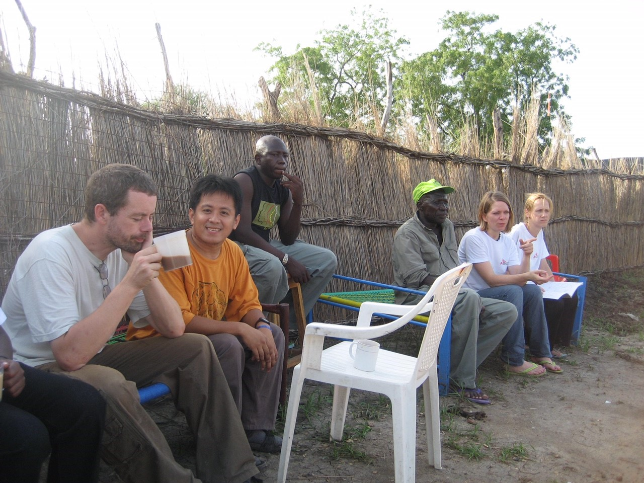
Tired

Slide 49
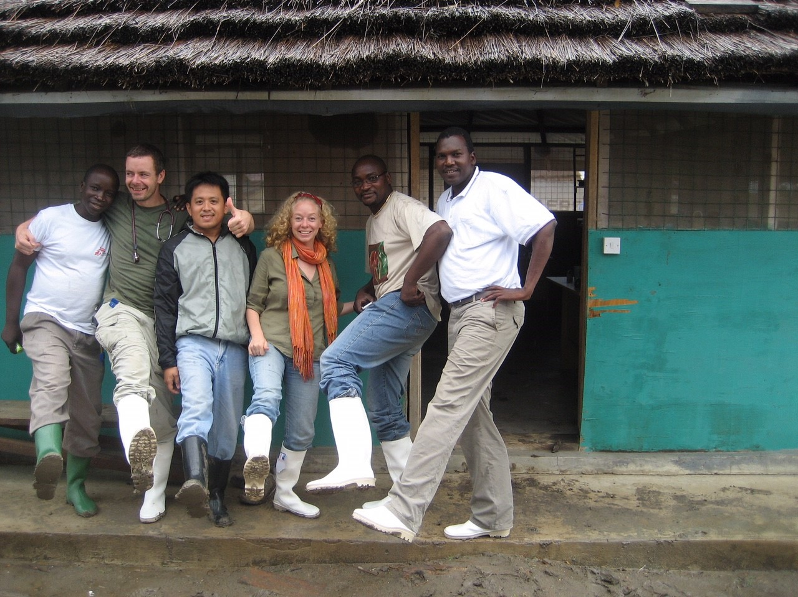
But they gave us Gum boots!

