Slide 1
CAREER IN NURSING

Slide 2
What is MSF?
international humanitarian aid organisation;
providing emergency medical relief to those who need it most;
regardless of ethnic origin, religion or political affiliation;
wherever they are in the world.
Notes:
MSF is an international, voluntary movement for emergency medical aid. We provide independent medical relief to victims of war, disasters and epidemics in more than 80 countries around the world. We strive to get that assistance to those who need it most, regardless of ethnic origin, religion or political affiliation.

Slide 3
The MSF Charter
Neutral
Impartial
Independent
Notes:
THE CHARTER OF MSF
1. MSF offers assistance to populations in distress, to victims of natural or man-made disasters and to victims of armed conflict, without discrimination and irrespective of race, religion, creed or political affiliation.
2. MSF observes strict neutrality and impartiality in the name of universal medical ethics and the right to humanitarian assistance and demands full and unhindered freedom in the exercise of its functions.
3. MSF volunteers undertake to respect their professional code of ethics and to maintain complete independence from all political, economic and religious powers.
WHAT THIS MEANS
To get to and care for the most vulnerable, MSF must remain scrupulously independent of governments, as well as religious and economic powers. We rely on private individuals for most funding. In the field, we conduct our own assessments, manage projects directly and monitor the impact of our aid. MSF insists on exercising its responsibility to speak out when it sees that those we are trying to help are being abused. We campaign locally and internationally for greater respect for humanitarian law and the right of civilians to impartial humanitarian assistance. We also campaign for fairer access to medicines and health care for the world’s poorest people.

Slide 4
Notes:
A LOT OF NON MEDICAL – LOGISTICIANS ETC…
LOT OF NON MEDICAL – LOGISTICIANS TEC

Slide 5
MSF Action
Medical Interventions
Bearing Witness/Temoignage
To help victims of – war
– famine
        – disease
        – natural disasters
        – displacement
Notes:
TEMOOGNAGE – BEING THERE AND INVOLVED SO THAT YOU CAN COMMENT

Slide 6
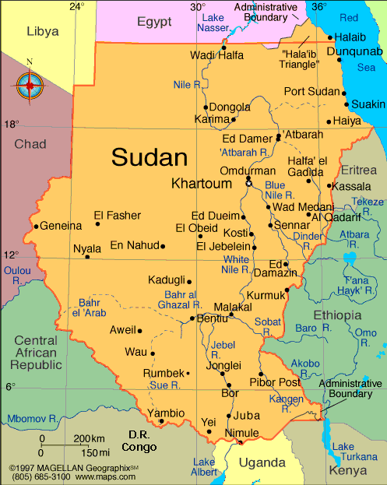

Slide 7
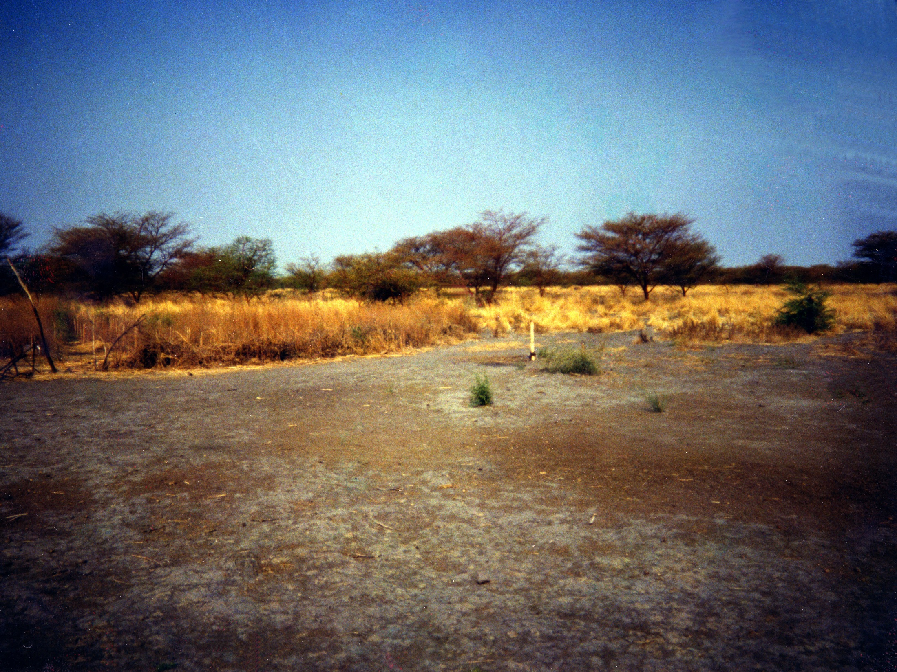
Notes:
NOTHING BUT ME FOR 200 KM
General landscape of southern sudan: savanna / brush land.
Sude means swamp – wet season access issue. Either way clean water becomes an issue….

Slide 8
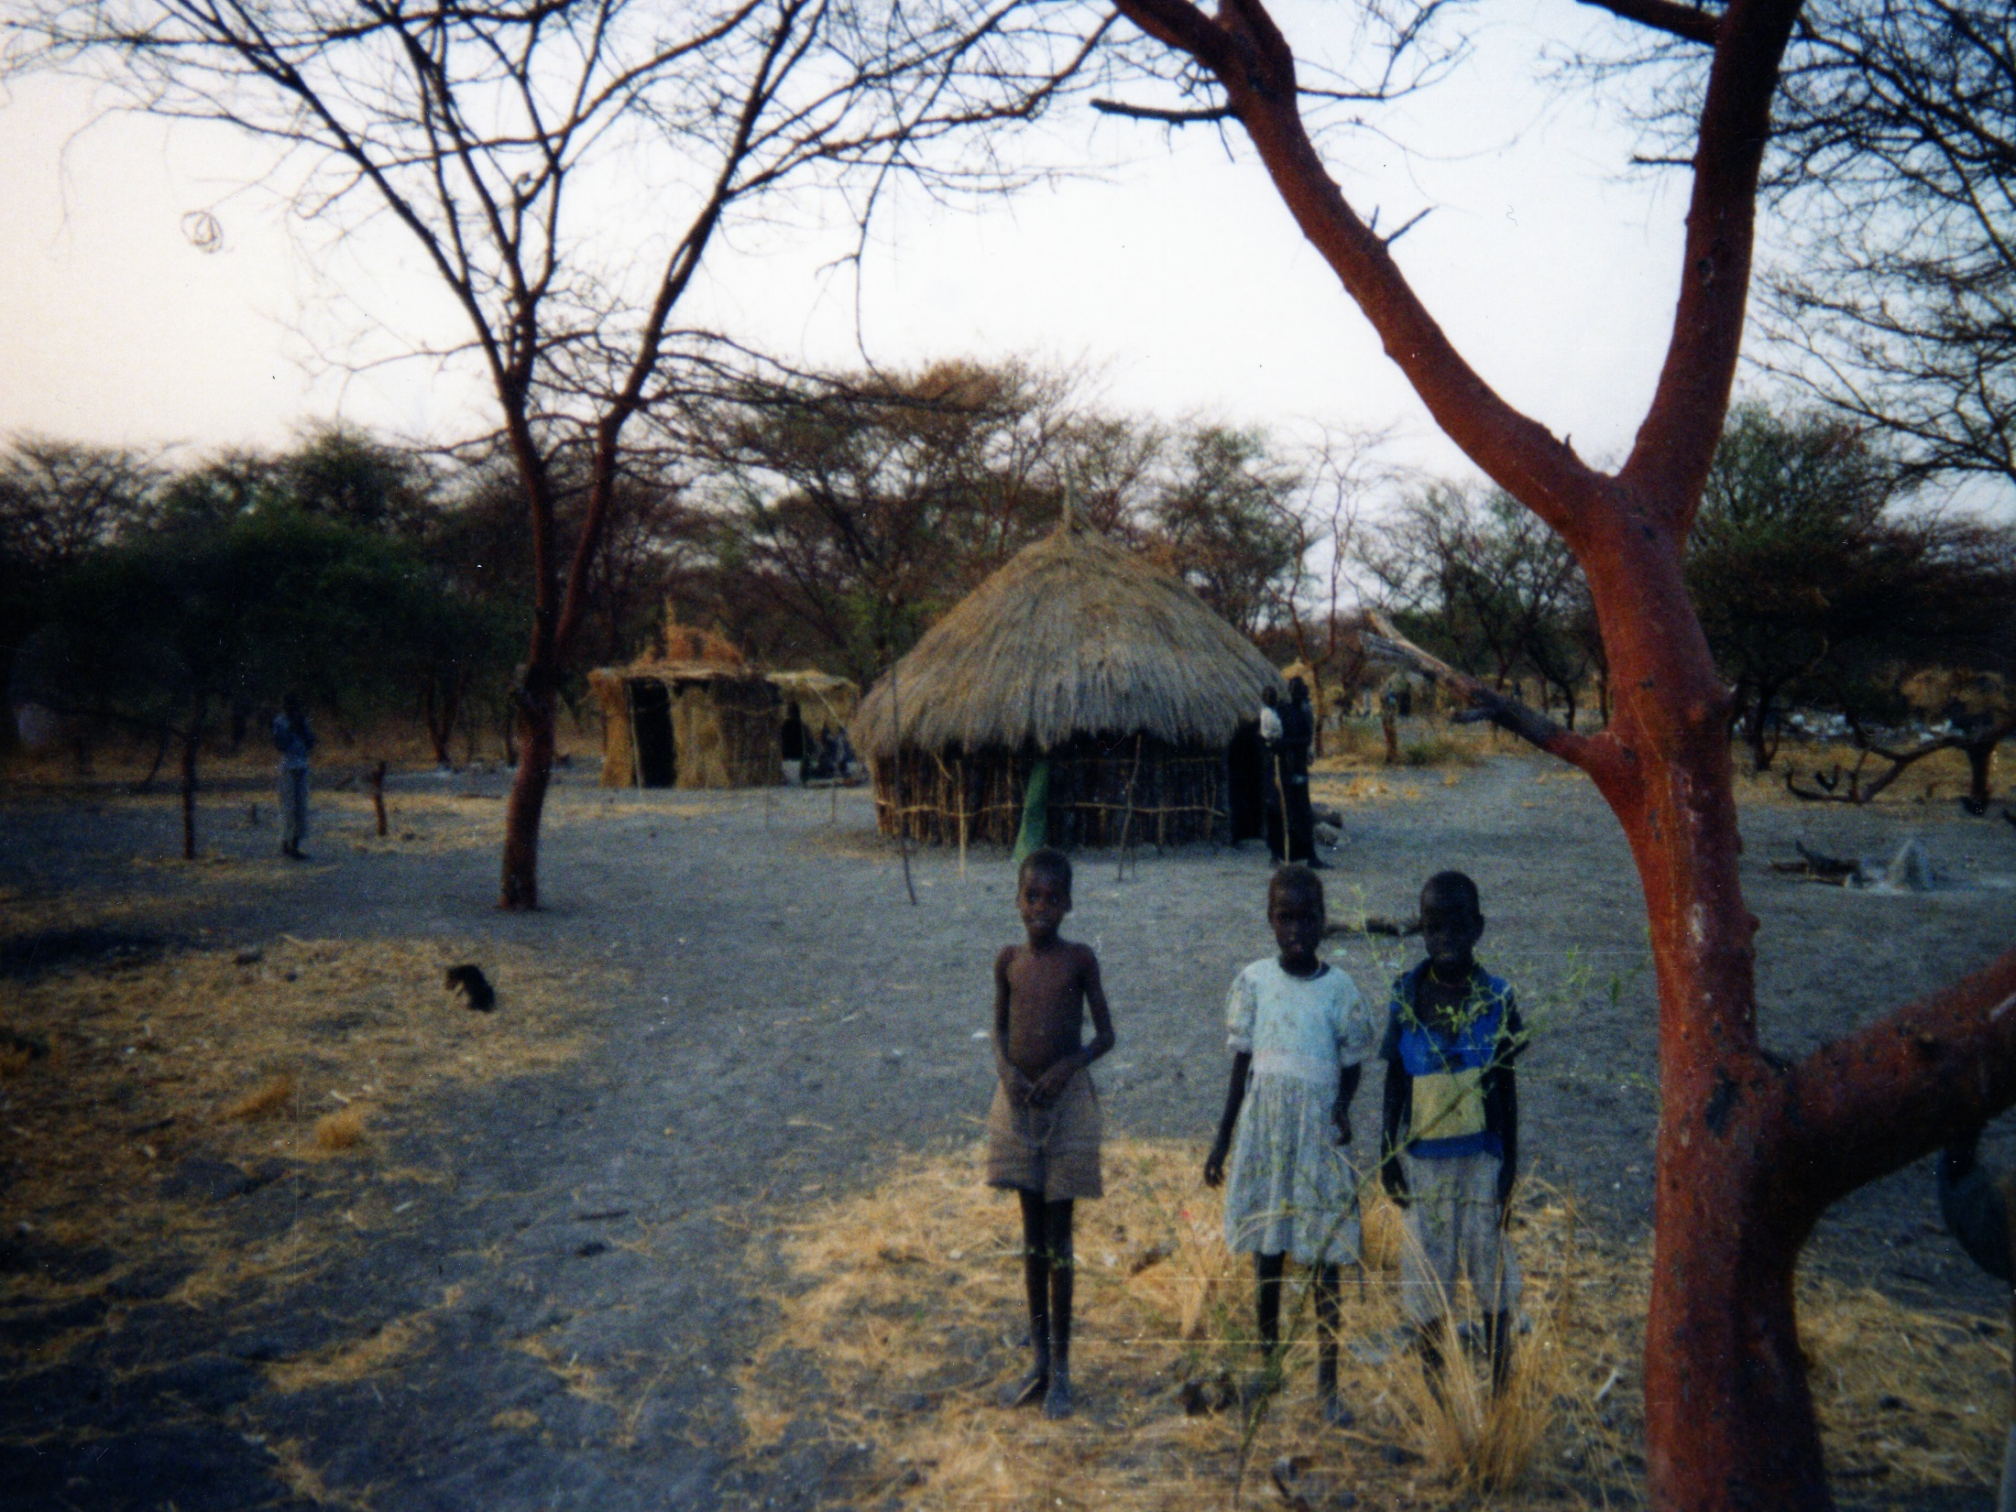
Notes:
THIS IS WHERE I ENDED UP [BACK TO MAP
Local huts: tukels people are dinka trees are acacia [sandflies are around]

Slide 9
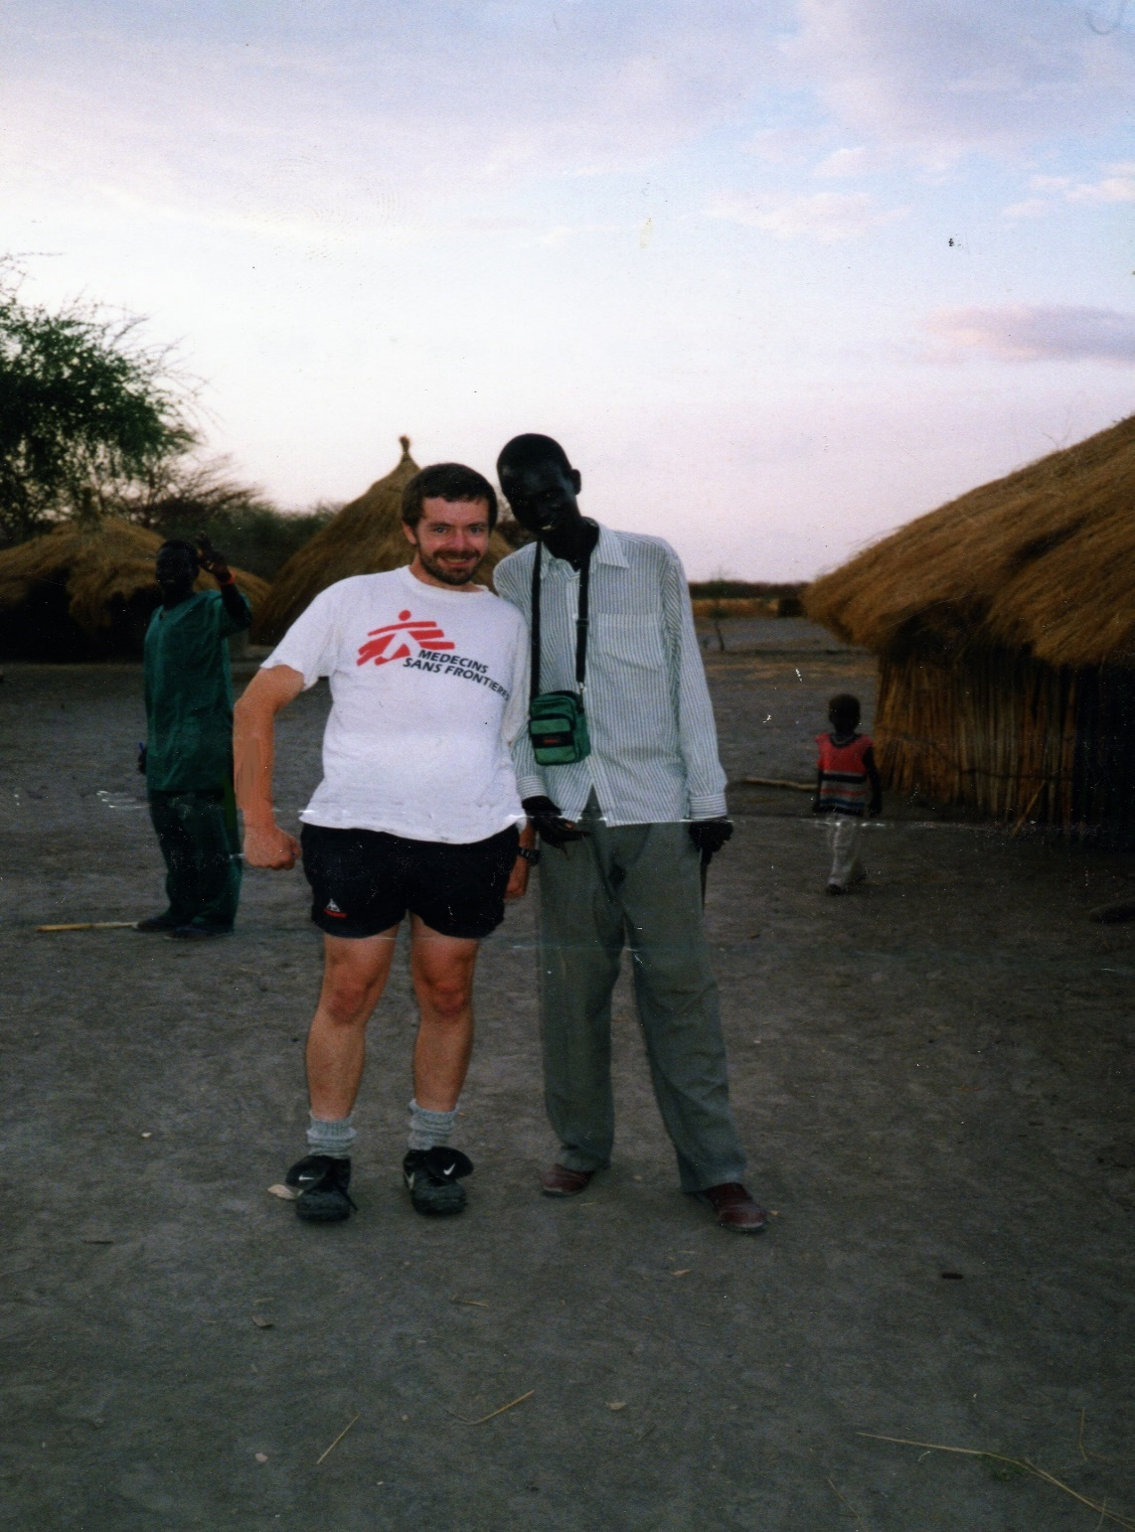
Notes:
These are the people I ended up with:Dinka people – nylotic tribesman – james 210
COMPLETELY DIFFERENT COMPOSITION TOWARDS BMI – WE USED WT/ HT [A MEASURE DEVISED USING BLACK AFRO AMERICAN POPULATION – THIS DIDN’T REALLY FIT

Slide 10
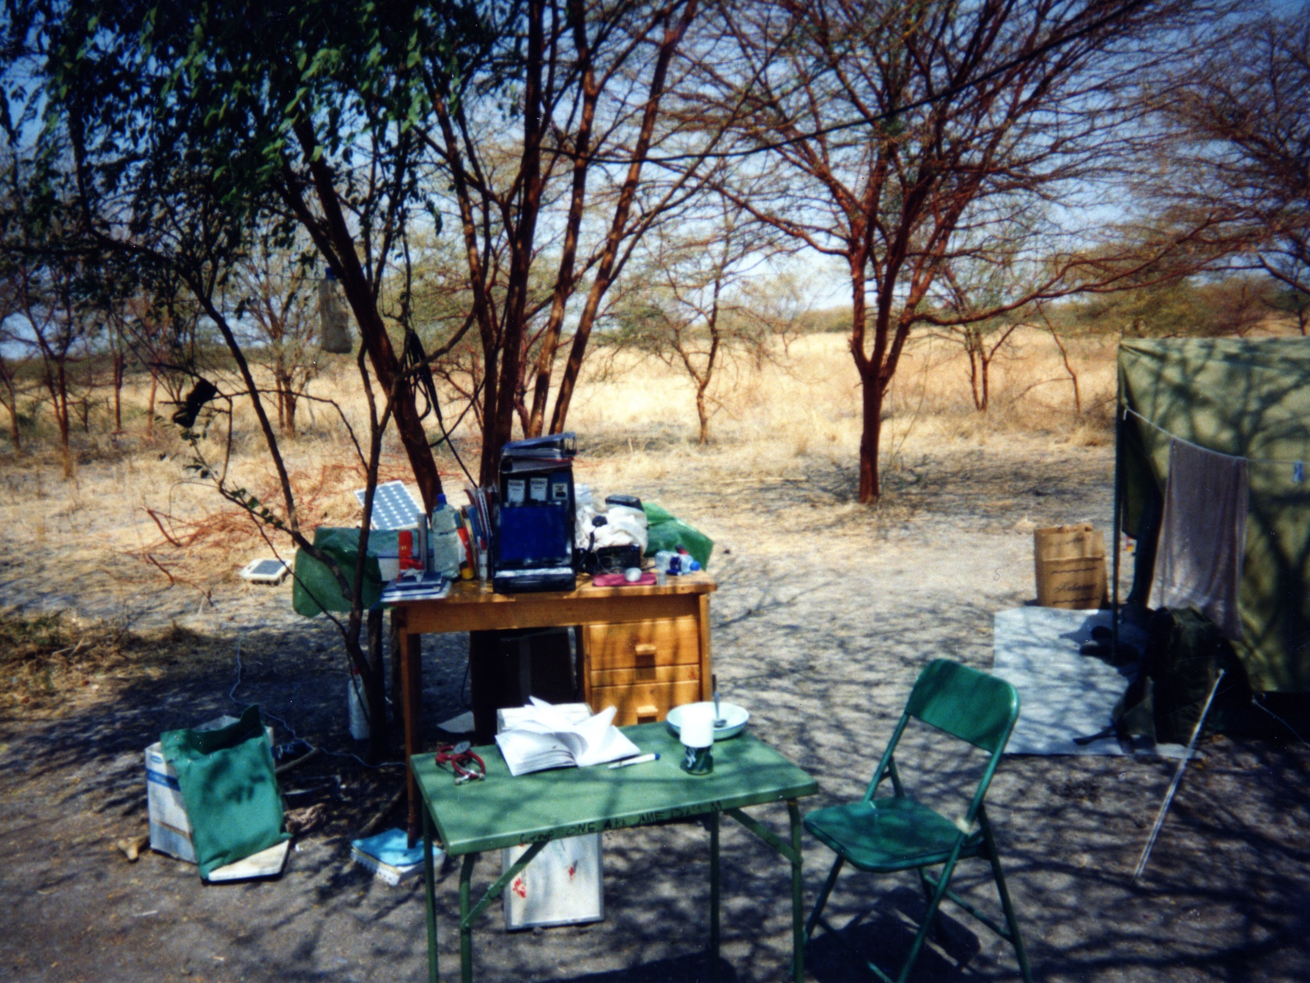
Notes:
If youre having a day at the office well this is the Office – acacia tree- HF radio

Slide 11
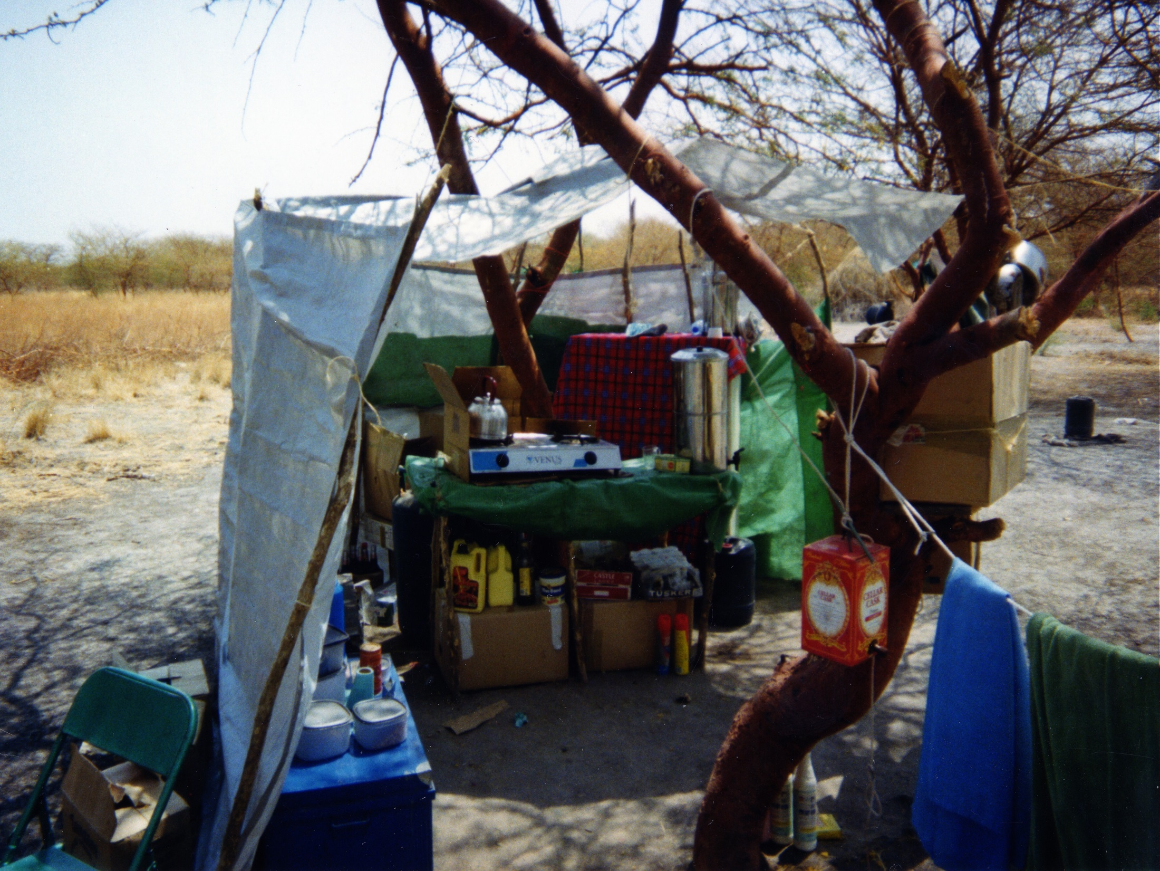
Notes:
Ex pat facilities: the KITCHEN
GIARIASIS FOR 7 MONTHS

Slide 12
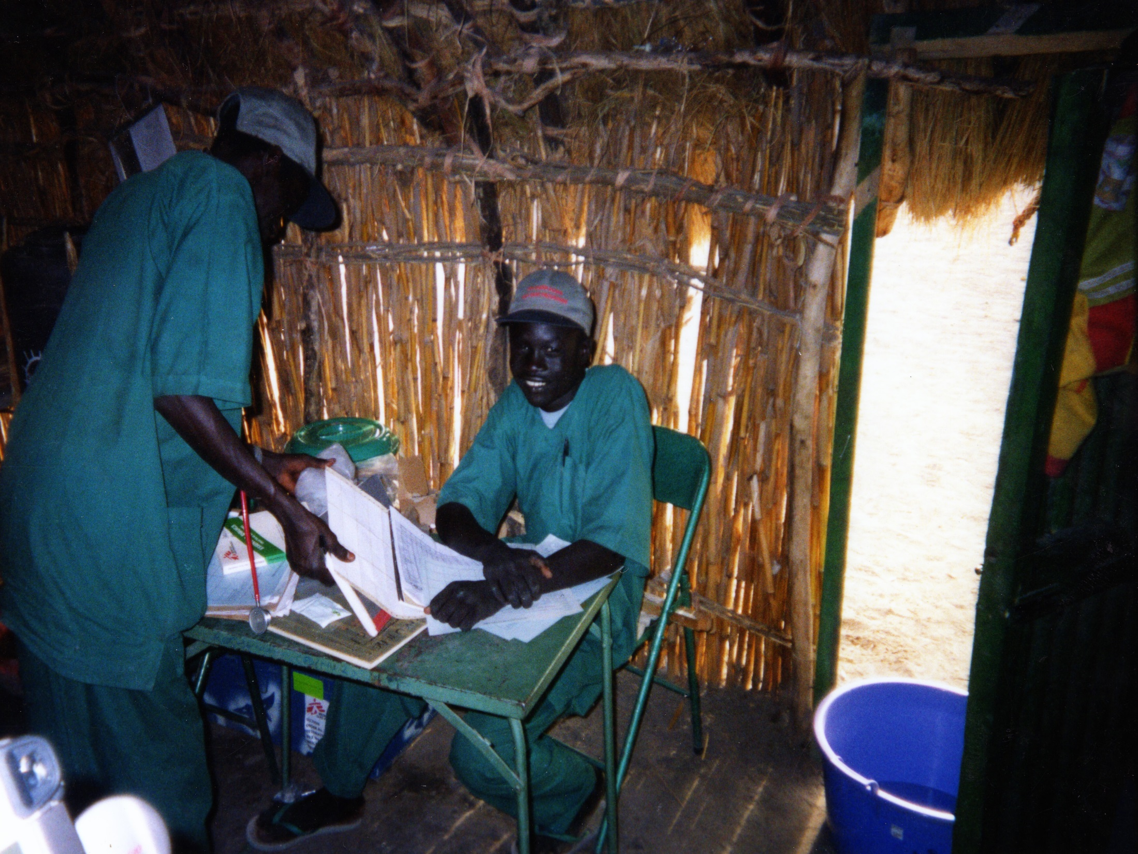
Notes:
PHCU – local staff
TASK ORIENTATED + VERY MINIMALISTIC
WHEN STARTED THEY COULDN’T USE A THERMOMEMETRE, READ ANY LANGUAGE,TELL THE TIME PLAN + ORGANISE TEACHING +++

Slide 13
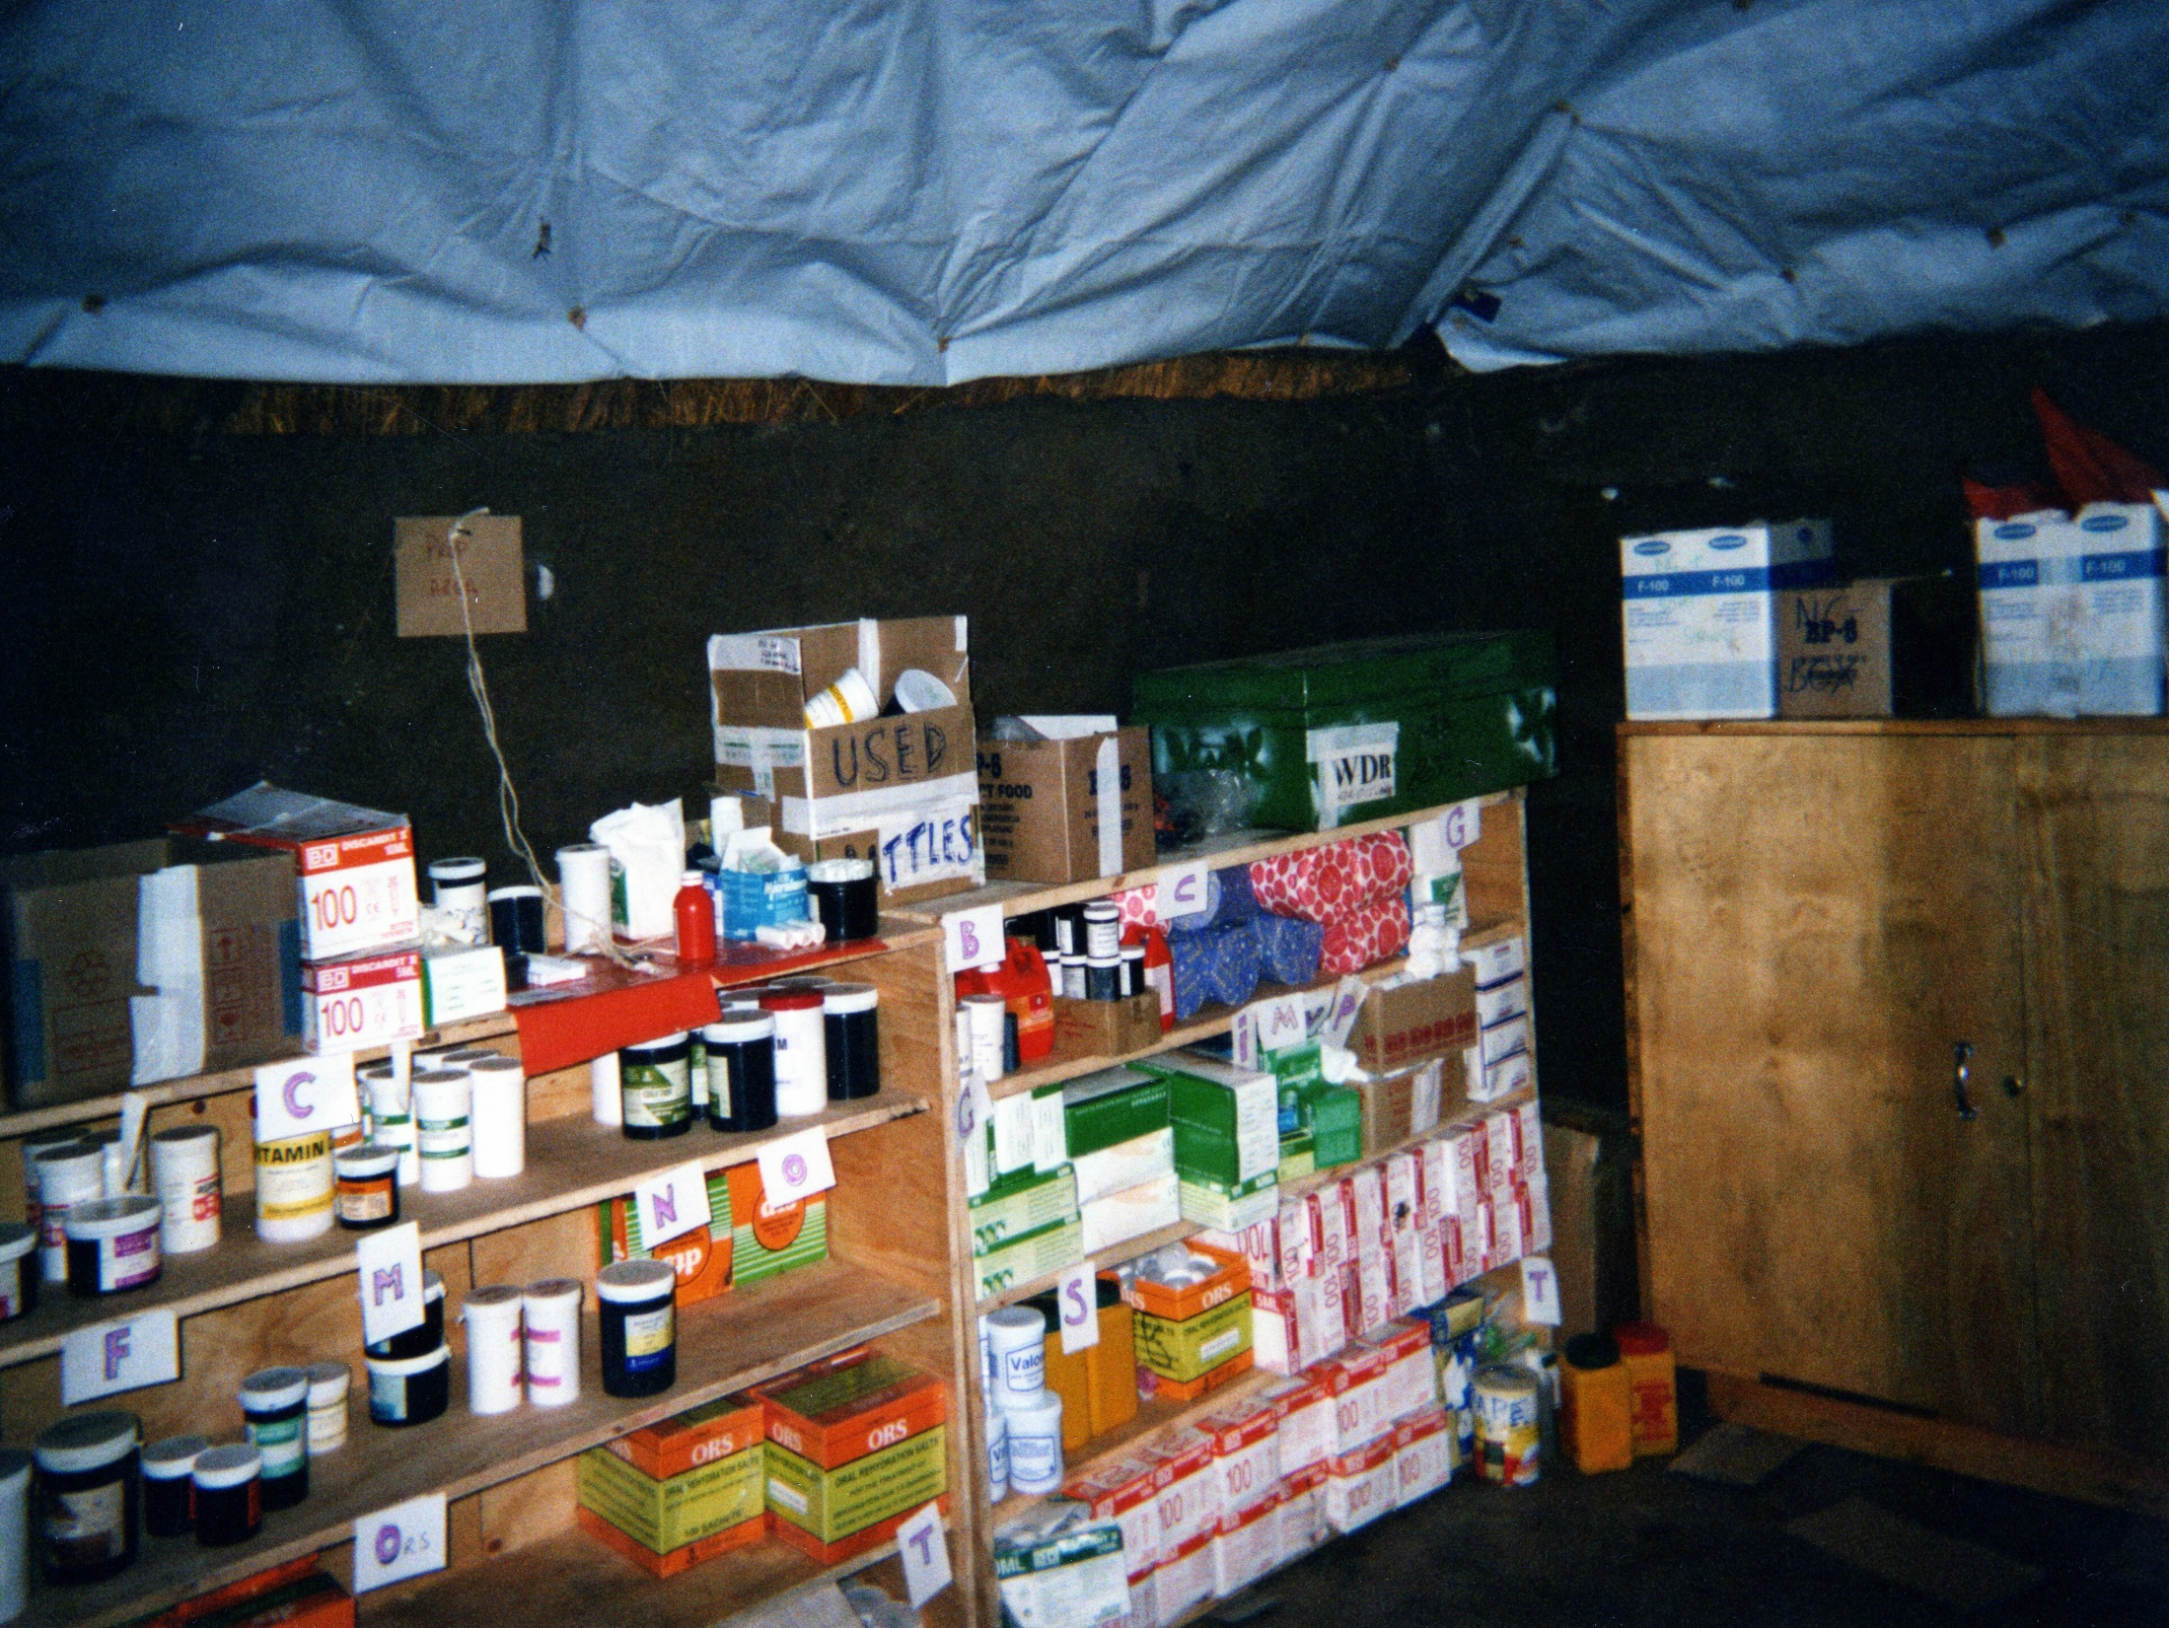
Notes:
PHARMACY
PHARMACY
ABC…. NOT DRUG GROUPS
IVS LOCKED SEPARATELY

Slide 14
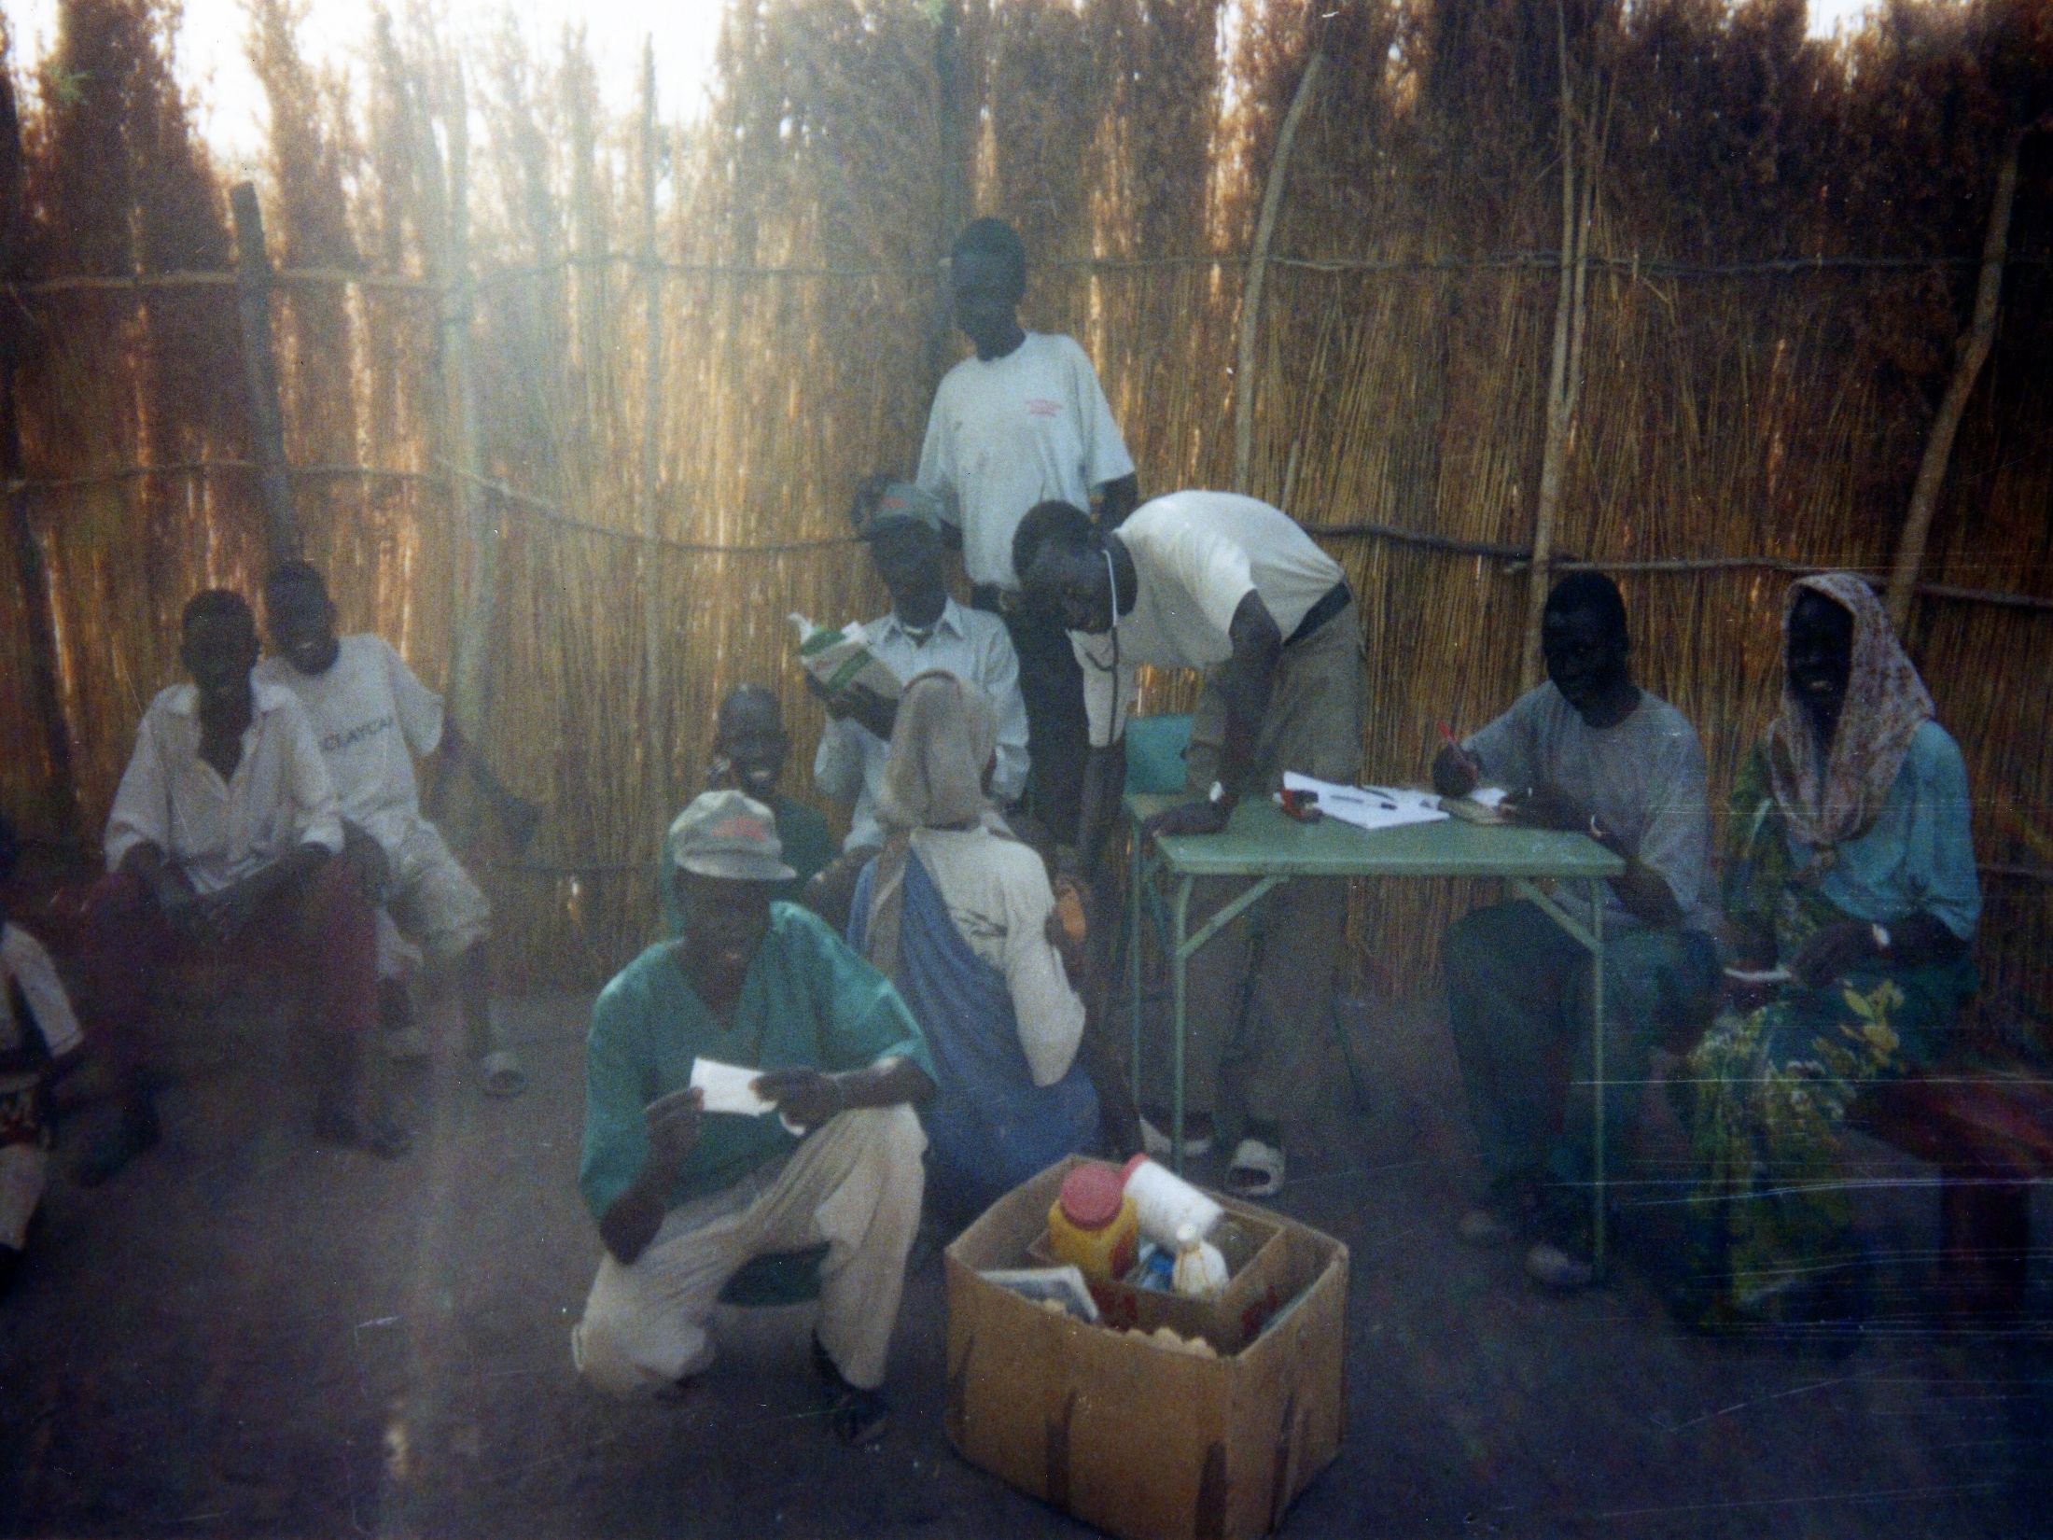
Notes:
Kala azar clinic – open air
DAT TESTING – WHETFIELDS PAPER – TREAT CLINICALLY [EXPAT ONLY]

Slide 15
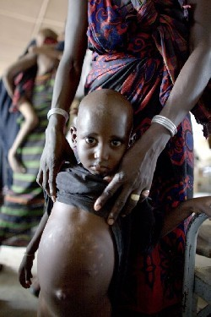
HEPATOSPENOMEGALI
Notes:
HACKERT SCALE – DIFFICULT TO DIFFERENTIATE FROM TROPICAL SPLENOMEGALI

Slide 16
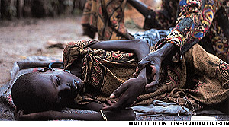
GROSS CACHEXIA
Notes:
PANCYTOPENIA

Slide 17
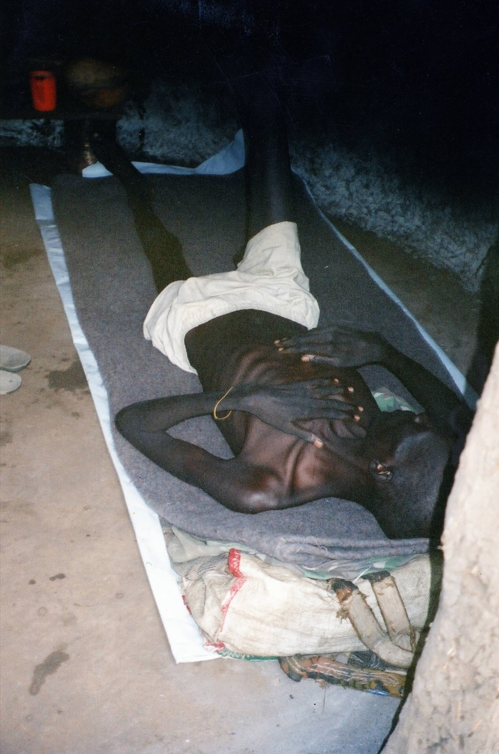
Notes:
This however is one of my pts. Spla soldier – ka [did v well] treatment was ssg + high calorie food – anti malarial treatment [routine], iron tablets [post malarial treatment – fansidar, chloroquine], treat all concurrent infections

Slide 18
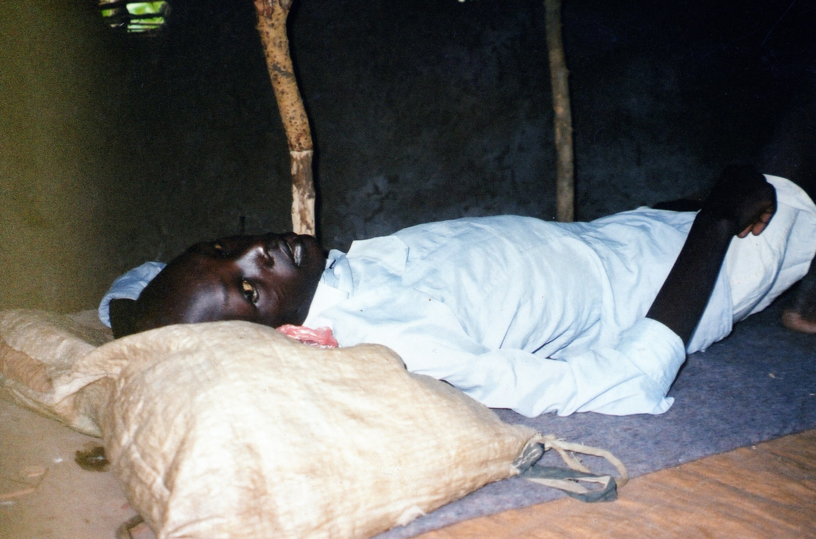
Notes:
This pt didn’t – chw gave ors because of diarrhoea – gross heart failure and died

Slide 19
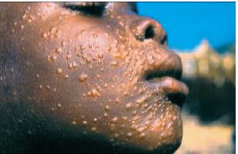
POST KALA AZAR DERMAL LIESHMANIA
Notes:
POST TREATMENT – PARACITE SEQUESTERING TOWARDS SURFACE – SURVIVAL MECHANISM
REMEMBER PKMDL……. Both ka and phcu provided patients for the 3 component of the programme….

Slide 20
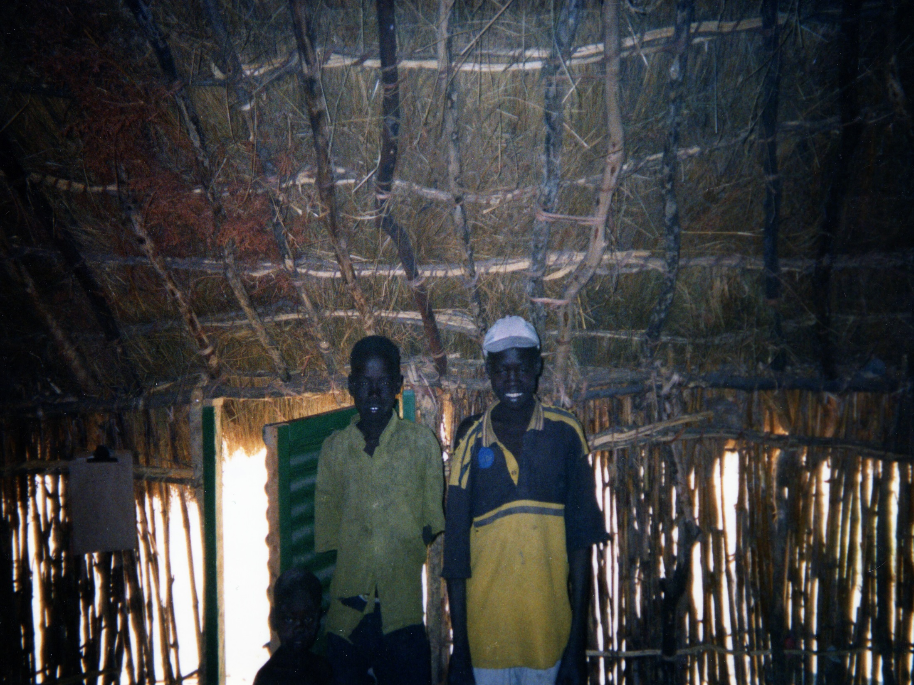
Notes:
In patient facility –

Slide 21
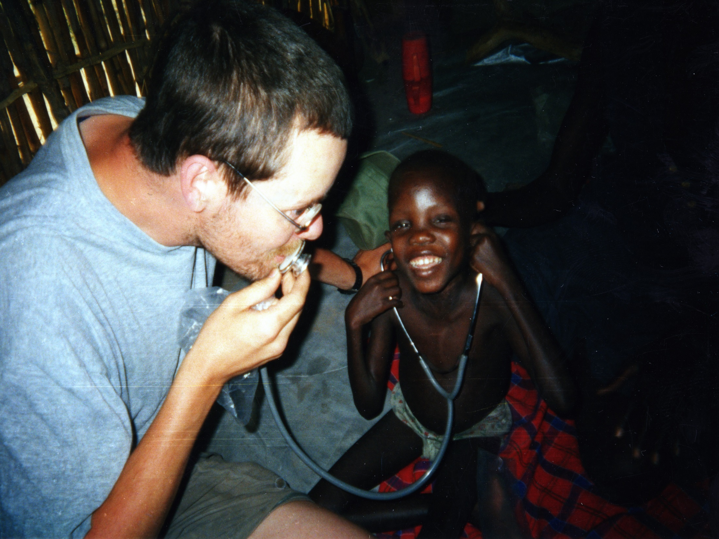
Notes:
INPATIENTS – GOT REFUGE BLANKET – PLASTIC SHEETING – WATER BOTTLE – CUP. F100 +FAMILY RATION
Nanjo mabil – 58% wt/ ht 2ndary to kala azar
PROBABLE TB
SENT TO LANKIEN

Slide 22
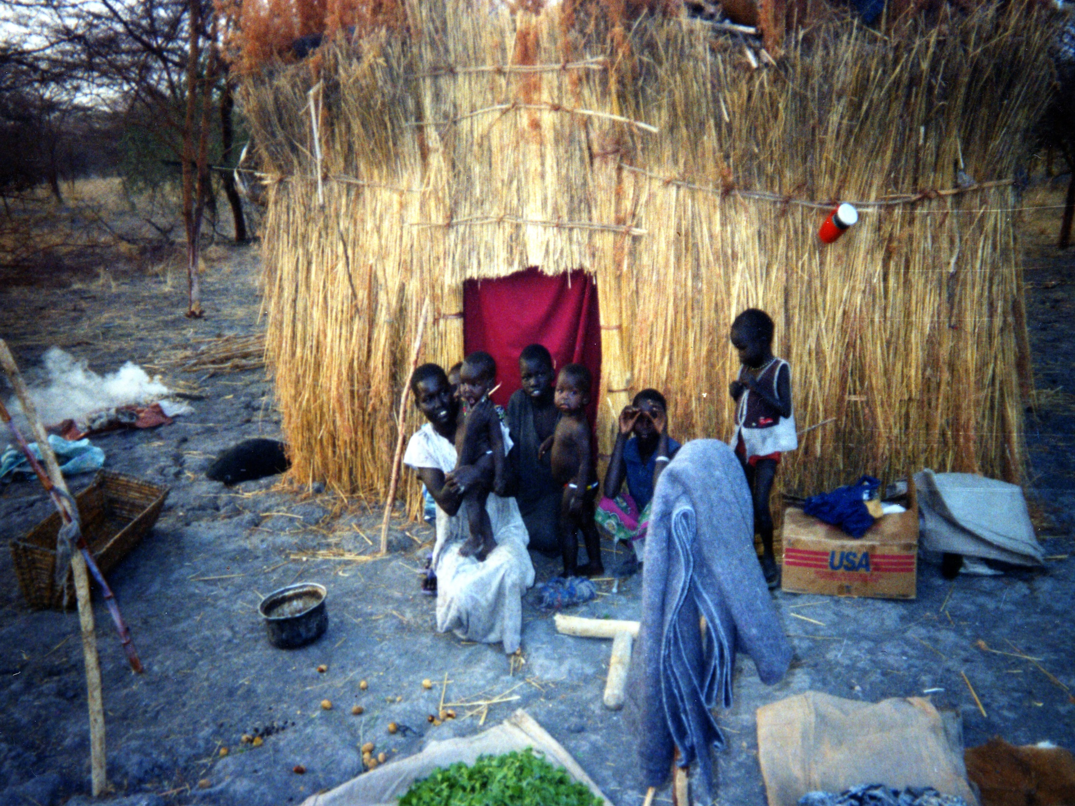
Notes:
Relevance of this picture is the leaves –hunger gap – eat leaves little nutrition – sign of desperation

Slide 23
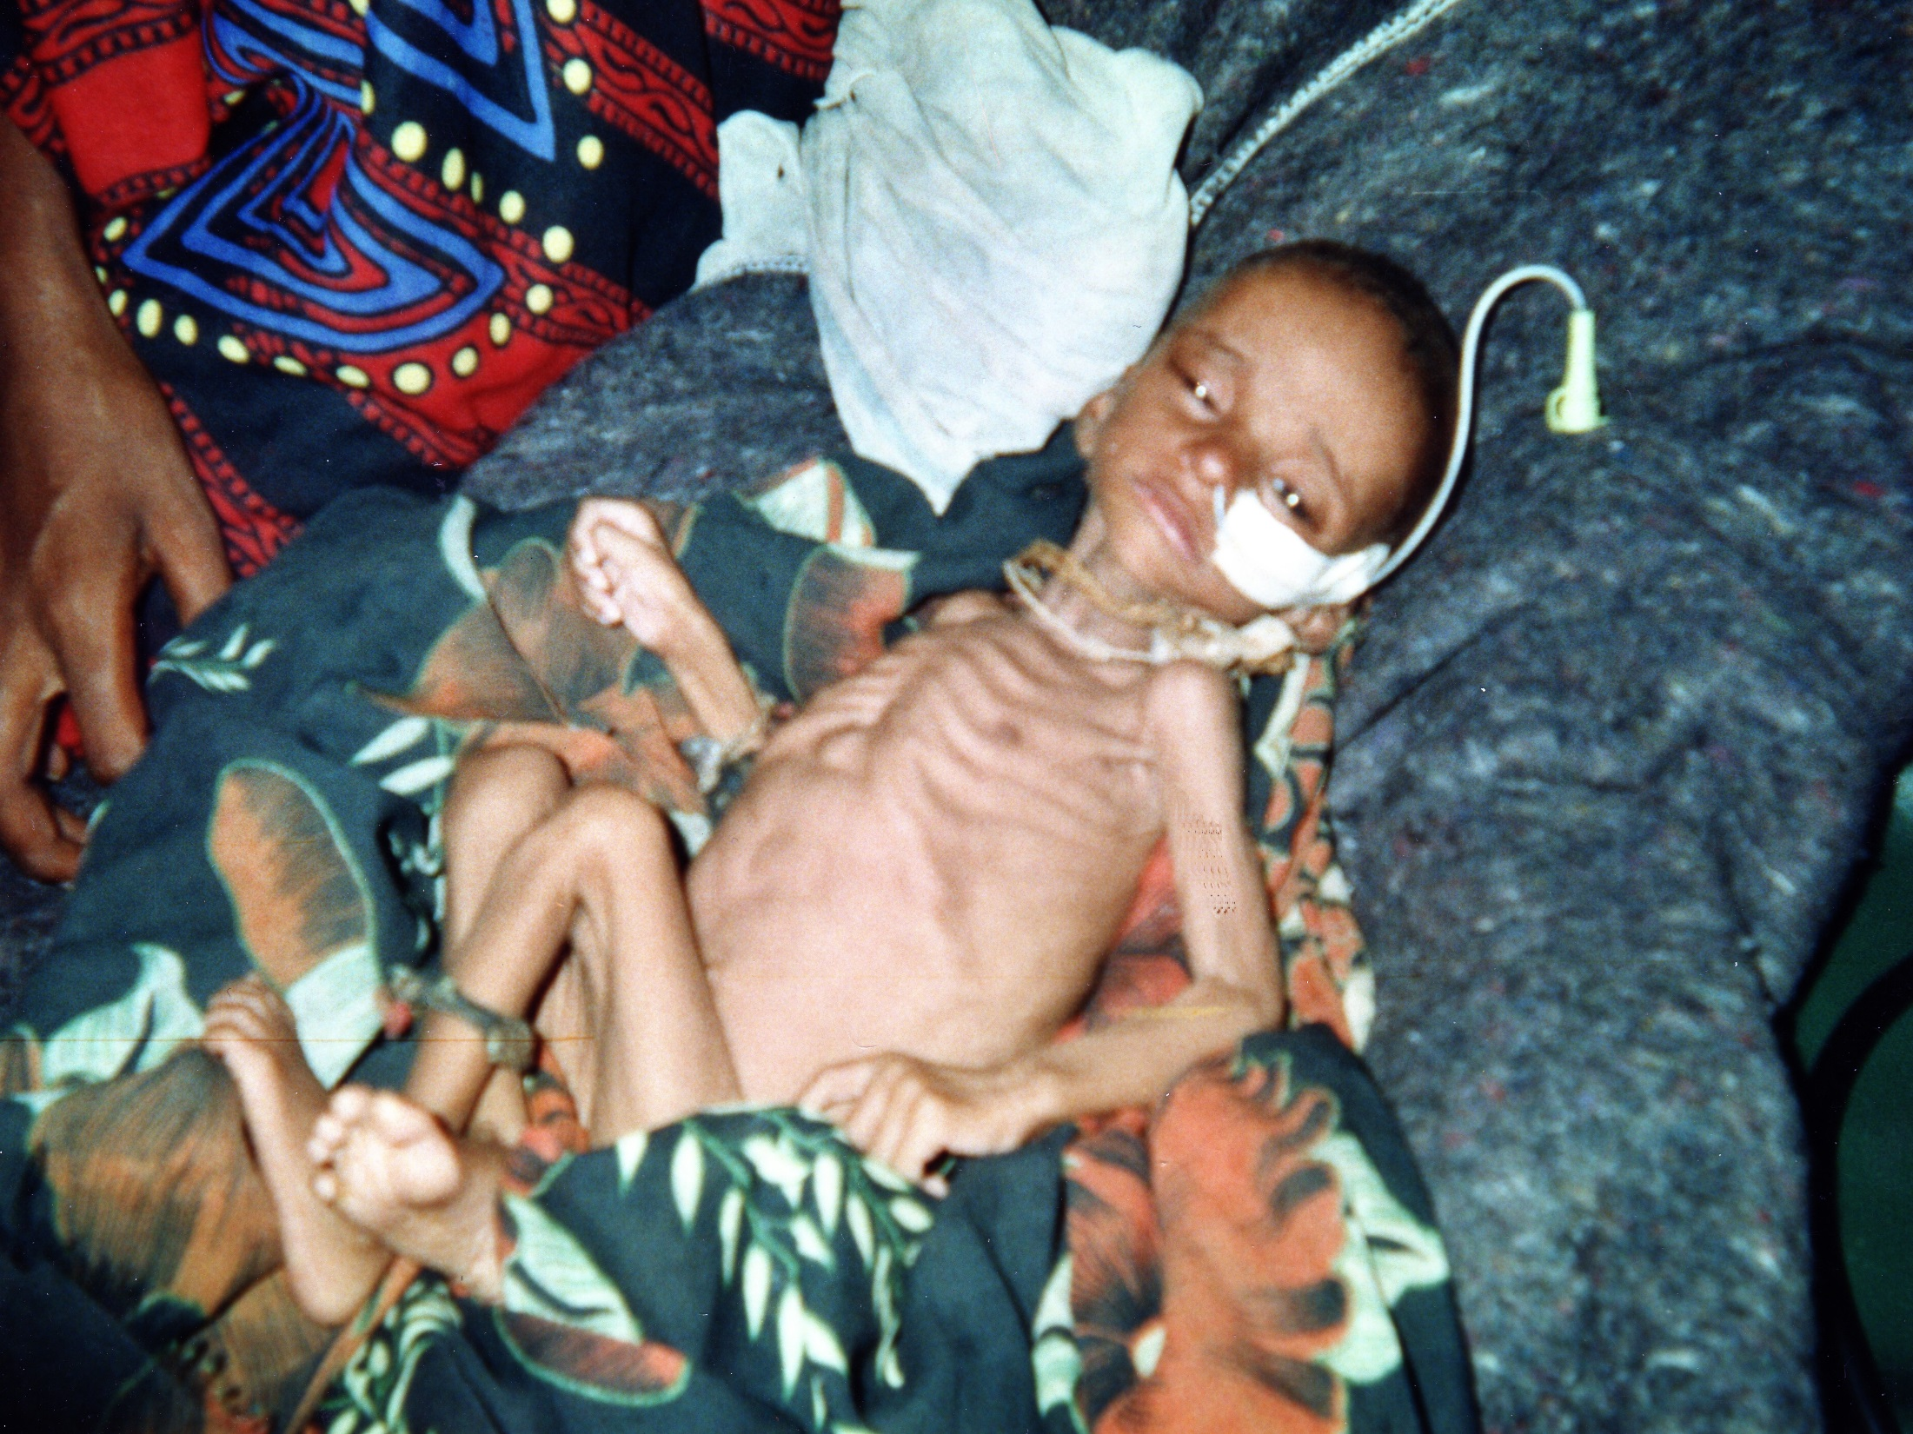
Notes:
MARASMUS – MENTALLY NORMAL – GROSS MUSCLE WASTAGE – HEART ATROPHY
NOTE THE LITTLE BAG ON LEG – WITCH DOCTOR

Slide 24
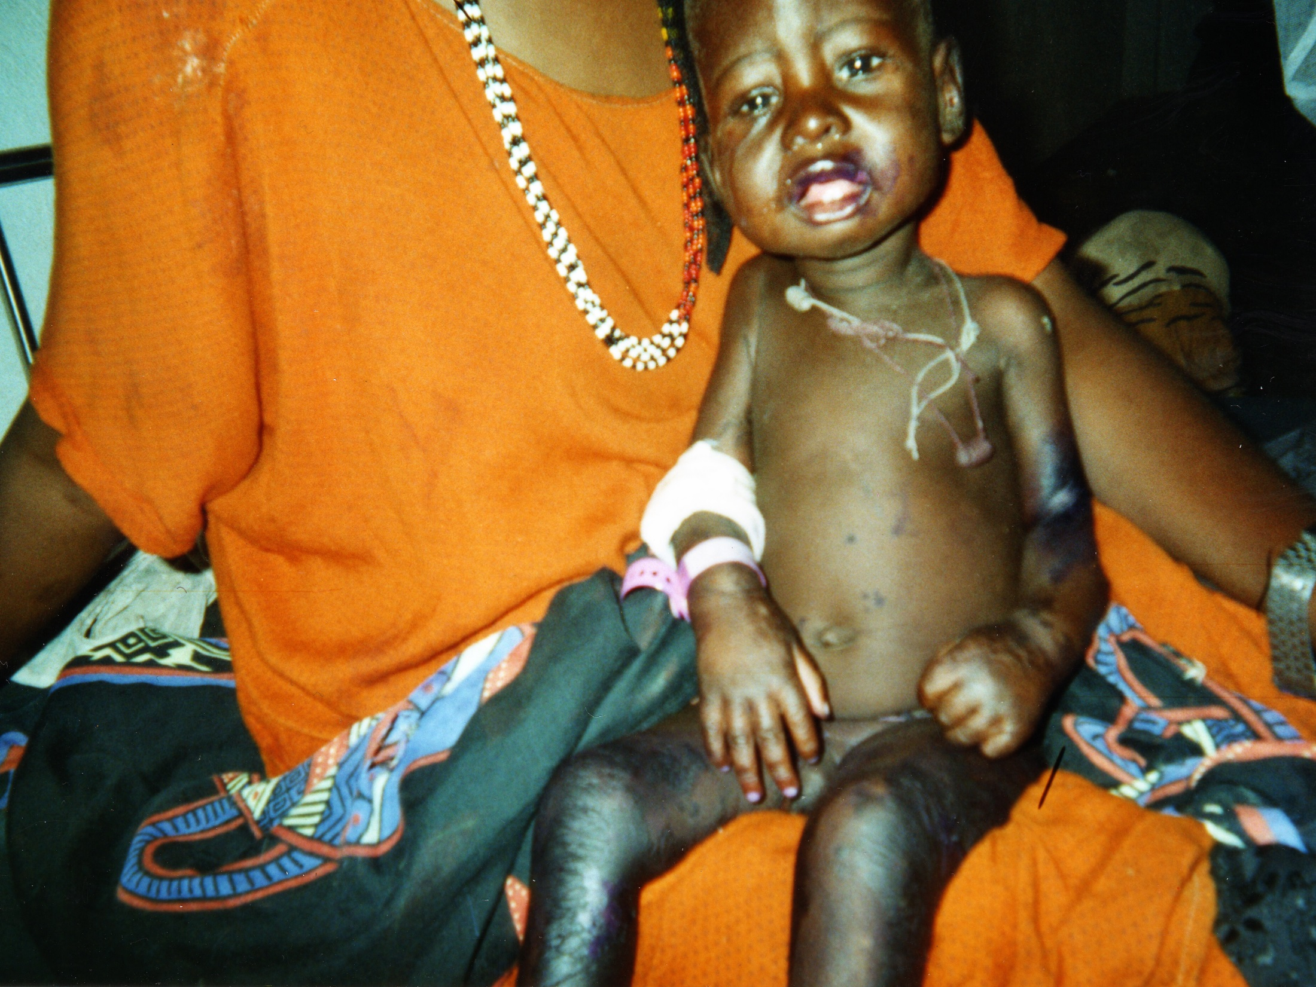
Notes:
QUAHIKOR [PROTEIN ENERGY MALNUTRITION
MENTALLY BLUNTED
ASCITES + SOLW TO TREAT

Slide 25
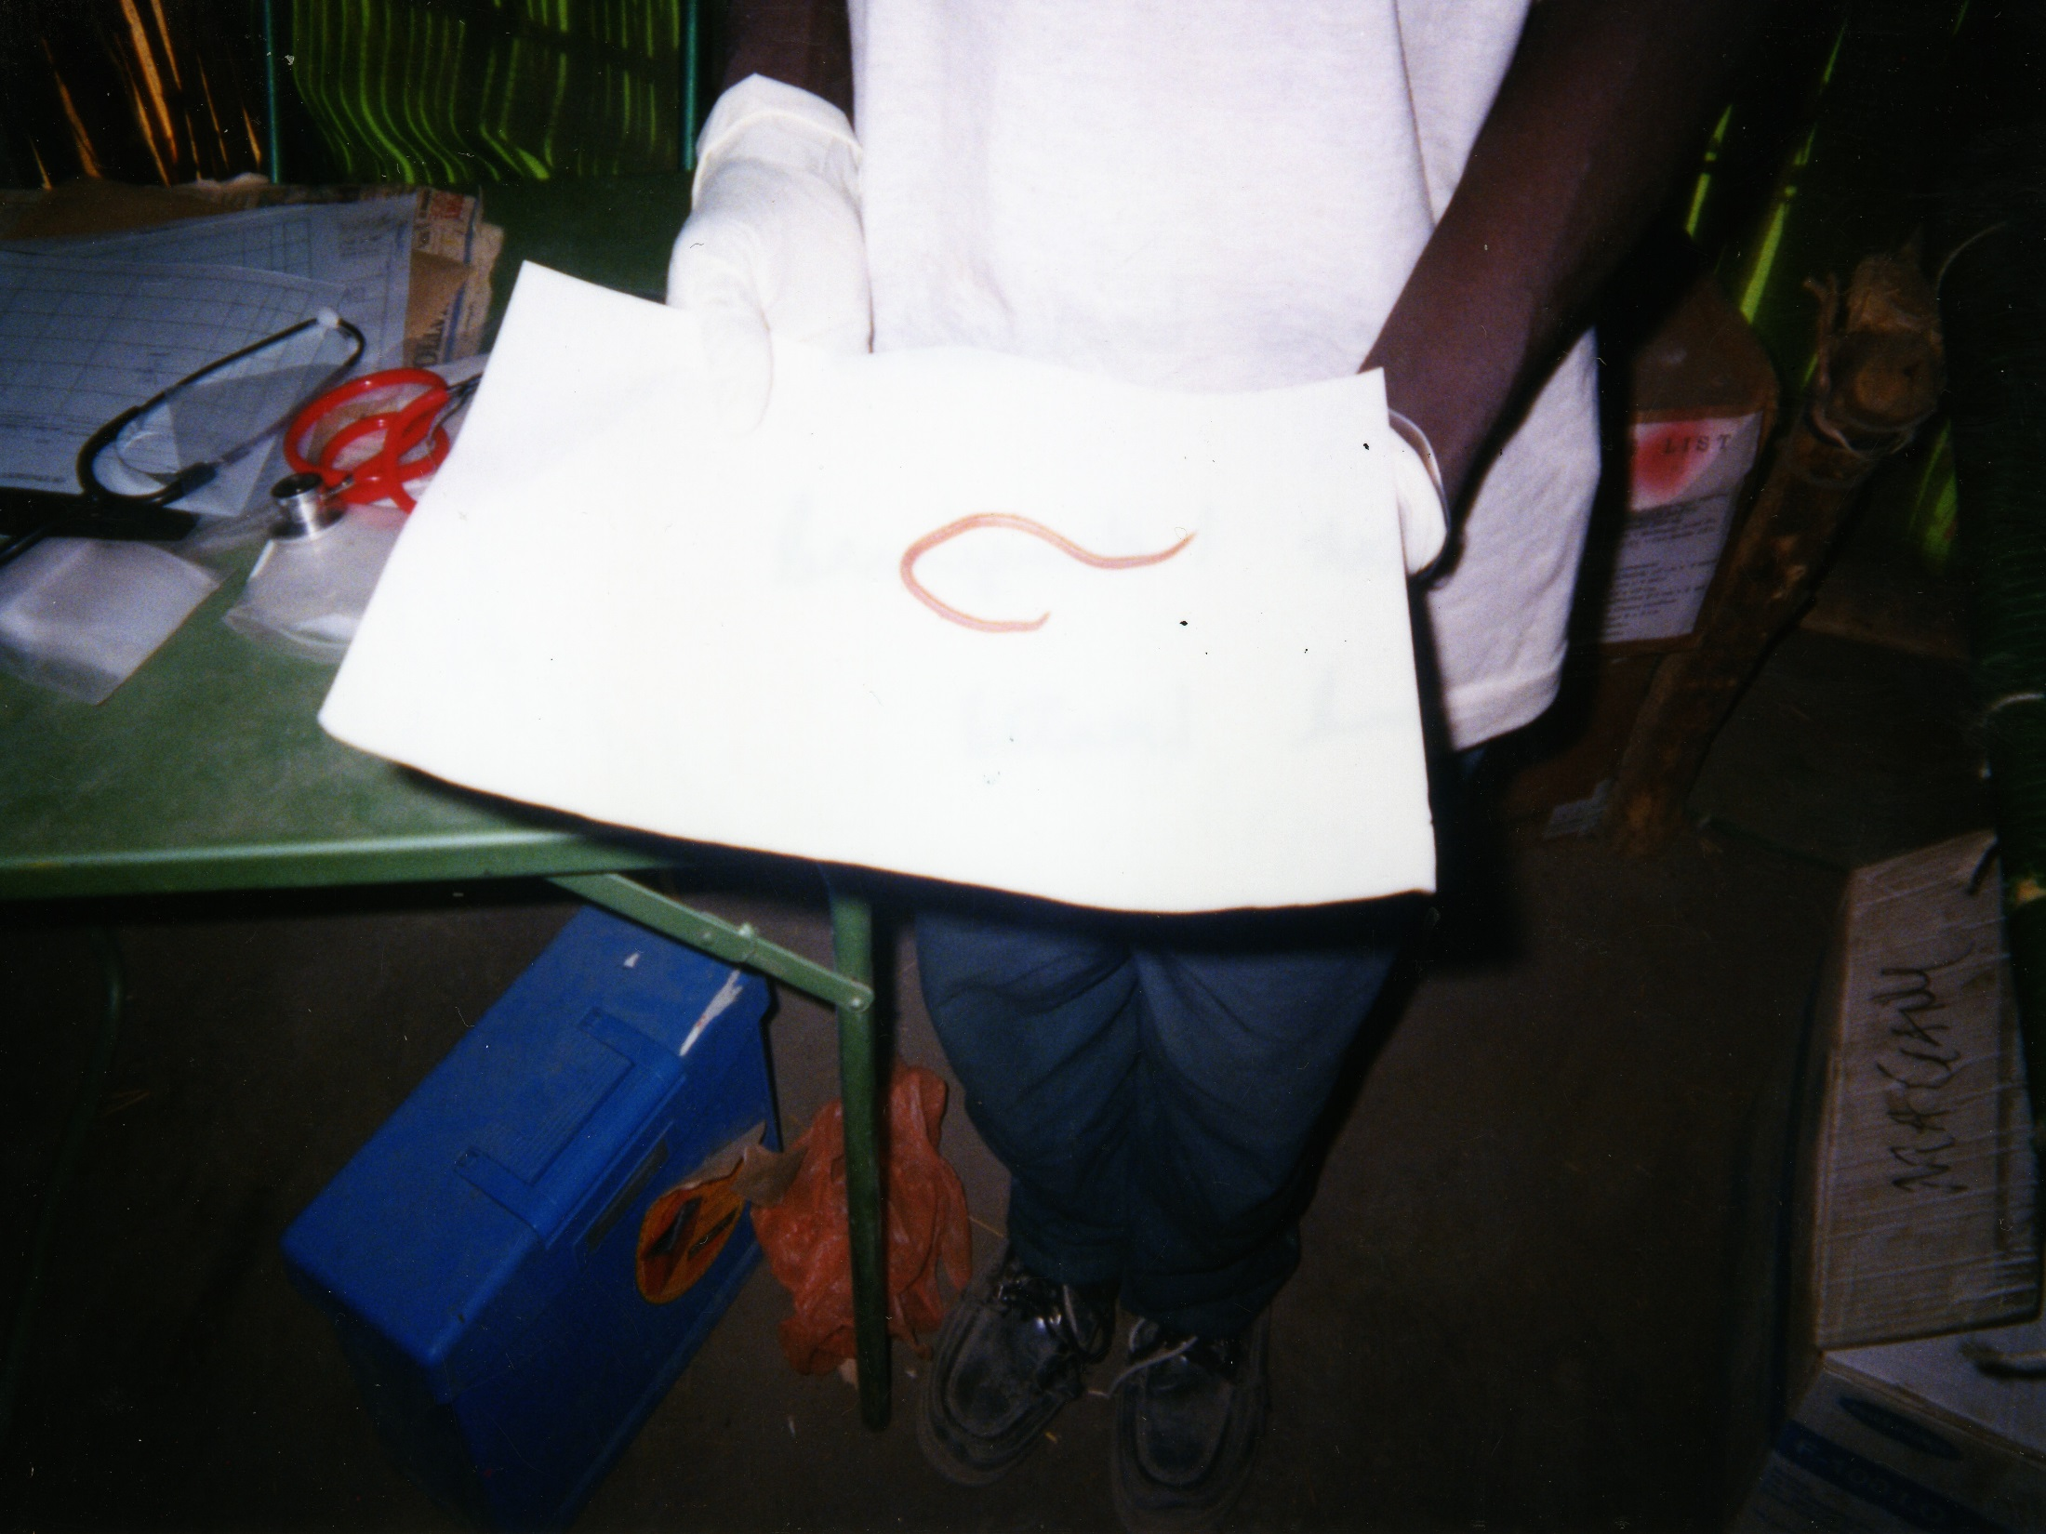
Notes:
Ascaris lumbricoides

Slide 26
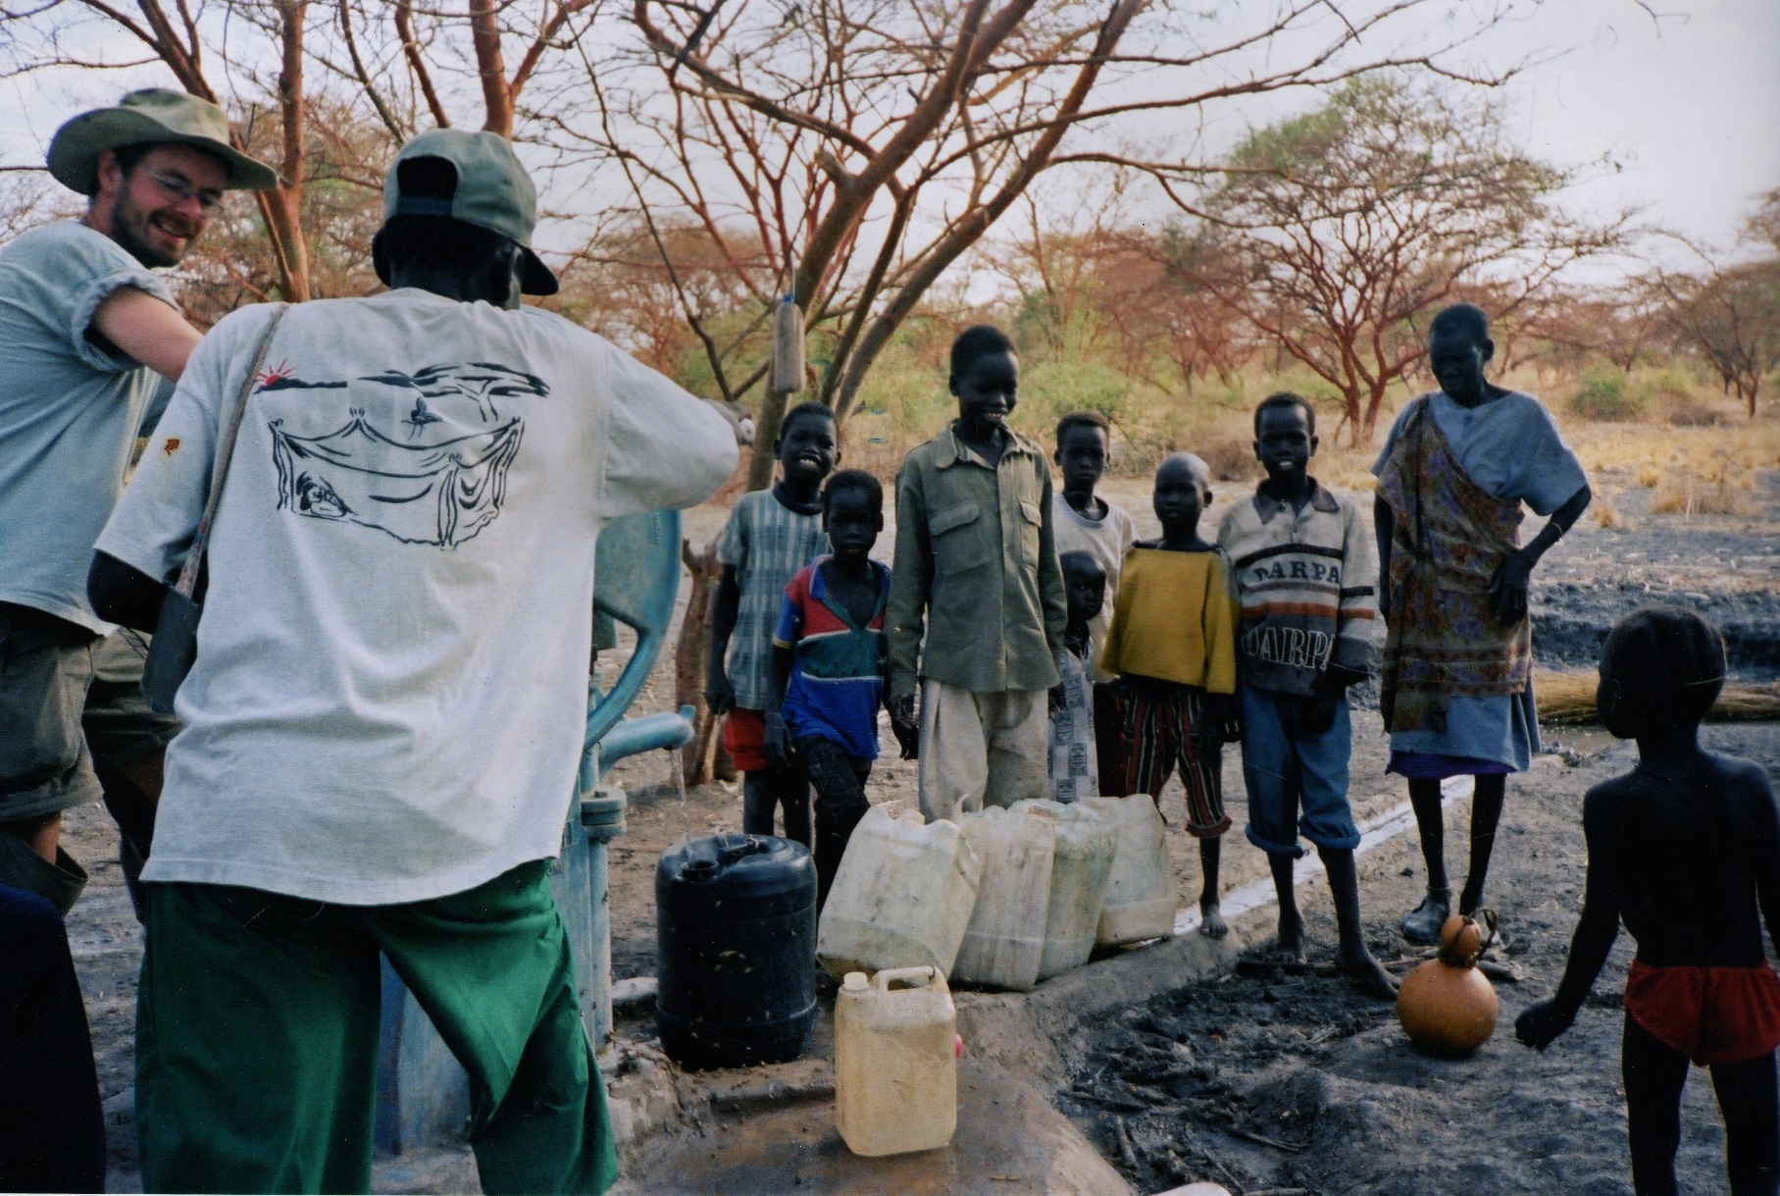
Notes:
So bore hole
Was in magang for 5 months. Then…..+

