Slide 1
LAW AT ARU

Slide 2
Active Collaborative Learning
At ARU we recognize that people learn in lots of different ways, but the way that they are least likely to learn is just listening to someone talk,
So, from the outset, students learn by doing law.
Students will learn the facts of law
But fundamental to this course is that students learn the skills to be able to apply the law

Slide 3
Law degree/LLB
3 Year course
A qualifying law degree for the Bar
Covers the key areas of functioning legal knowledge
Plus a large range of optional topics

Slide 4
Law degree/LLB
Year 1
4 Compulsory modules: English Legal Systems and Skills, Constitutional and Administrative Law, Contract Law, Criminal Law
Year 2
Compulsory Modules: Business Law, Tort Law, Equity Trusts and Succession, Ruskin Module
Optional Modules (including The Law of Family Relationships, Commercial Law, Medical Law)
Year 3
Compulsory Modules: Property Law, EU Law, Undergraduate Major Project
Optional Modules (including Civil Litigation, Criminal Litigation, Employment Law, Diversity, Equality and the Law, Legal and Social Obligations of Business)

Slide 5
Do you aspire to become a Solicitor?
We offer a comprehensive legal education for those interested in becoming a Solicitor.
After studying your Law degree with us, join our Master’s programme preparing you for the Solicitors Qualification Examination (SQE).
Just a few reasons why you should study the LLM SQE with ARU:
Benefit from an Alumni discount if you have studied their Law degree with us
Gain an internationally recognised LLM/Masters qualification
Stand out by tailoring your studies through elective subjects and a Major Project

Slide 6
LLM International Business and Commercial Law
For those students not wanting to qualify as Solicitors but wanting to expand their horizons through further study, we offer a Masters in International Business and Commercial Law.
The programme focuses on the theoretical and practical aspects of international law within the context of regulating transnational commercial, political, and social interactions.
This course is taught over one year with intakes in September and January.
Core modules include: International trade law, International commercial arbitration, Law Major Research Project.
Optional modules include: Digital law and cybersecurity, International intellectual property, Competition law in an international context.
Notes:
Enhances Learning
When students are actively engaged, they are more likely to pay attention, participate in class discussions, and retain information1. This active involvement helps deepen their understanding of the material.
2. Boosts Academic Performance
Engaged students are more likely to take responsibility for their education, leading to better grades and higher academic achievement1. They tend to complete assignments on time and are more motivated to succeed.
3. Fosters Critical Thinking
Engagement encourages students to think critically and ask questions. This not only helps them understand the subject matter more deeply but also develops their problem-solving skills1.
4. Encourages Creativity
When students are engaged, they are more likely to explore new ideas and think creatively. This can lead to innovative solutions and a more dynamic learning environment1.
5. Promotes a Positive Classroom Environment
Engaged students contribute to a positive and collaborative classroom atmosphere. This sense of community can enhance social-emotional well-being and make learning more enjoyable for everyone1.
6. Builds a Sense of Belonging
Emotional engagement, where students feel connected to their school, teachers, and peers, fosters a sense of belonging. This can reduce feelings of isolation and increase overall satisfaction with the school experience2.
7. Supports Long-Term Success
Students who are engaged in their learning are more likely to develop skills and habits that will benefit them throughout their lives, such as self-regulation, persistence, and a love for learning2.

Slide 7
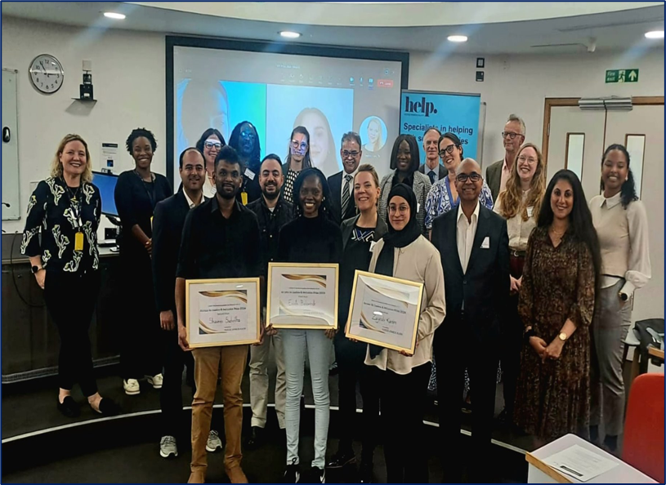
Our Law Community
Academic team comprised of researchers and practitioners
The Centre for Access to Justice and Inclusion (CAJI): Opportunities, events and prizes on legal research projects led by our Law Scholars
“Engages in real world research, dialogue and policy initiatives targeted at influencing public debate, achieving policy change and law reform.”
Legal Advisory Board: Board of legal professionals (judiciary, local authorities, legal firms, local/multinational companies) that partner with the ARU Law in delivering programmes, opportunities, module content insight, course development, etc.
“…which is unlocking opportunities for law students and alumni and identify potential collaborations which will benefit the region in the future.”

Slide 8
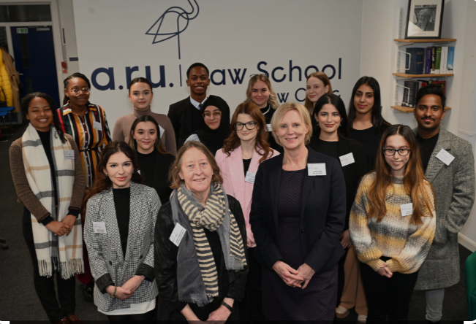
Award-winning Law Clinic
One of the busiest university law clinics in England serving approximately 800 clients per year.
Collaborate with around 100 lawyers from nearly 50 firms to provide pro bono legal advice to the local community.
Provide virtual and in-person one-on-one advice, form assistance, and court support in areas like immigration, family, employment, and personal injury, etc.
Shortlisted as a finalist in the following category for the LexisNexis Legal Awards 2025: University Commercial Impact Award
Sarah Calder (Law Clinic Director), Patron Judge Lindsay Davies, and our excellent Student Advisors
Volunteer, network, learn lawyering skills and help those in need!
Notes:
Image: ARU Law Clinic students with Lady Hale at the Law Works Awards 2019
Busiest University Law Clinic, serving 3625 clients with £453,125 monetary value for legal advice
- Work with experienced lawyers to give advice and provide assistance and support during the client interview process
- Build on your strengths and confidence within the legal profession
- Develop a range of transferable professional skills and enhance your employability prospects
- Strengthen your network of contacts and develop strong relationships with the local legal professionals and advice agencies
- Gain useful insight into the successes and challenges of working in a legal practice
Help make a difference in people’s lives by offering them vital access to legal advice

Slide 9

How we’ll support you
Faculty and School administrative support
PDT tutor
Student representatives
Course director
Module leaders and tutors

