Slide 1
Everything post-GCSE
Make it about law
Zoom in
Engage with, scrutinise and reflect on things you’ve read / done
Grammar
Word Count
General points
“At A-Level I study English, History and Politics. English has improved my ability to critique complex texts and evaluate contrasting interpretations. History has helped me learn how to analyse different sources and form judgements of them. My study of politics means I can engage with current affairs and understand how society is constantly shifting. All these skills make me ideal to study law.”

Slide 2
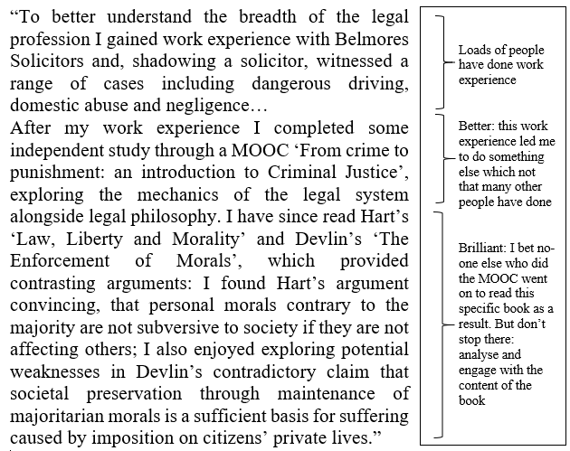
Everything post-GCSE
Make it about law
Zoom in
Engage with, scrutinise and reflect on things you’ve read / done
Grammar
Word Count
General points

