Slide 1




Inspiration Trust Teacher Training
What is distinctive about Inspiration Trust Teacher Training?
What are the different routes into teaching?
What are the courses on offer?

Slide 2

What is distinctive about Inspiration Trust Initial Teacher Training?
The core of placements take place within the Inspiration Trust family of schools (18 across Norfolk and Waveney)
All schools are OFSTED 'good' or better, with 4 graded Outstanding
Wide regional coverage with a diverse mix of schools – urban, rural and coastal
Strong track record of school improvement in challenging contexts – Great Yarmouth, Lowestoft and Thetford
Partnership with a national provider, the National Institute of Teaching (NIOT) - evidence led and research informed course developed with some of the most successful MATs nationally
Delivered locally by phase and subject specialists, who are both curriculum and teacher development experts and serving practitioners
Our ITT programme is part of a 'golden thread' of training, which means you can continue to study with us as an Early Career Teacher and take National Professional Qualifications too.

Slide 3

Core Teacher Training Options – An overview
Name | Typical entry requirements | Suitable for…
Undergraduate Initial Teacher Training | Appropriate A-Level or equivalent | Those who want to gain QTS whilst on an undergraduate degree course.
Postgraduate Teacher Training: fee-paying | Relevant degree (Usually 2:2 or above) | Graduates with degree in relevant subject / area of study and want to complete teacher training in 1 year.
Postgraduate Teacher Training: Salaried | Relevant degree (Usually 2:2 or above) | People who already work in schools and are very competent – still require good levels of training and require a salary.
Postgraduate Teaching Apprenticeship | Relevant degree (Usually 2:2 or above) | People working (or not…) in schools who require a salary and where the school can be helped with apprenticeship levy and employer grants.
Assessment Only Route | Relevant degree (usually 2:2 or above) + experience of teaching in2 or more schools. | Experienced non-qualified teachers and instructors who want to keep working whilst gaining QTS.

Slide 4
“I don’t have a degree and want to be a teacher.”
Who are these most suitable for?
Colleagues without a degree who want to be a teacher
College leavers
Programme design
3-year degree which includes teacher training OR
3-year degree in subject then 1-year ITT programme
Cost and financial support
Degree tuition fee costs (varied)
1-year ITT programme – typical costs £9,250
Bursaries of varying amounts available for secondary (changes annually)
Can apply for student finance if eligible
Click here for more info on this route
Undergraduate Initial Teacher Training
OR
Degree in relevant subject then Teacher Training

Slide 5

“I am a graduate and want to be a teacher.”
Who is this most suitable for?
Graduates with a degree in a relevant subject
Career changers with a degree in relevant subject
Programme design
1 year training towards QTS + PGCE (most courses)
Either school-based or university-based approach
Require at least two placement schools.
Cost and financial support
1-year ITT programme (2 years part-time) – typical costs £9,250
Bursaries of varying amounts available for secondary (changes annually)
Can apply for student finance if eligible
Some schools may offer a salaried route rather than trainees paying fees
Postgraduate
Teacher Training
Click here for more info on Postgrad Teacher Training

Slide 6
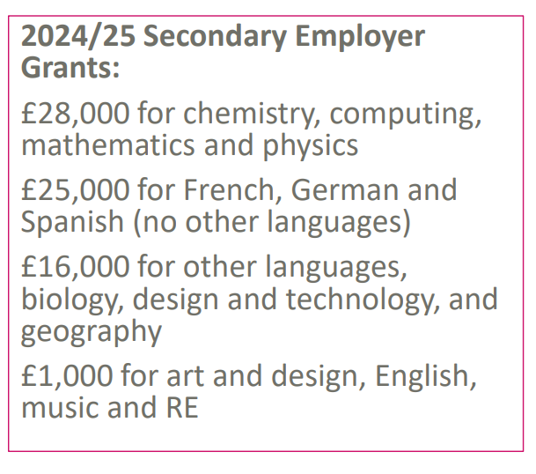
“I have a degree and worked in schools…now I want to qualify.”
Who is this most suitable for?
Graduates with a degree in a relevant subject
Colleagues already working in a school who need a salary to complete teacher training.
Majority of apprenticeships are in secondary
Programme design
1 year training towards QTS
School-based with weekly training day
Require at least two placement schools – with a 6-week contrasting placement
Cost and financial support
Salaried employment with varied employer grants for each vacancy
Schools employ apprentices on an unqualified teacher pay scale
Funded training via Apprenticeship levy
Postgraduate Teaching Apprenticeship
Click here for more info on teaching apprenticeships

Slide 7

Next steps…
Subjects on offer
Primary 3-7 | English
Primary 5-11 | Geography
Primary 5-11 with Maths | History
Art and Design | Maths
Biology | Modern Foreign Languages
Chemistry | PE
Computer Science | Physics
Design and Technology | RE
As part of all of our teacher training courses you will obtain a PGCE. This is taught alongside your school placement through study sessions at our Teaching School Hub in Norwich. This qualification is gained in addition to Qualified Teacher Status (QTS)

Slide 8
Next steps…
Subjects on offer
Primary 3-7 | English
Primary 5-11 | Geography
Primary 5-11 with Maths | History
Art and Design | Maths
Biology | Modern Foreign Languages
Chemistry | PE
Computer Science | Physics
Design and Technology | RE
As part of all of our teacher training courses you will obtain a PGCE. This is taught alongside your school placement through study sessions at our Teaching School Hub in Norwich. This qualification is gained in addition to Qualified Teacher Status (QTS)

Slide 9
Next steps…
Subjects on offer
Primary 3-7 | English
Primary 5-11 | Geography
Primary 5-11 with Maths | History
Art and Design | Maths
Biology | Modern Foreign Languages
Chemistry | PE
Computer Science | Physics
Design and Technology | RE
As part of all of our teacher training courses you will obtain a PGCE. This is taught alongside your school placement through study sessions at our Teaching School Hub in Norwich. This qualification is gained in addition to Qualified Teacher Status (QTS)

Slide 10
Next steps…
Subjects on offer
Primary 3-7 | English
Primary 5-11 | Geography
Primary 5-11 with Maths | History
Art and Design | Maths
Biology | Modern Foreign Languages
Chemistry | PE
Computer Science | Physics
Design and Technology | RE
As part of all of our teacher training courses you will obtain a PGCE. This is taught alongside your school placement through study sessions at our Teaching School Hub in Norwich. This qualification is gained in addition to Qualified Teacher Status (QTS)

Slide 11
Useful links for guidance
National Links for Teacher Training
AGCAS routes into teaching
Get into Teaching - Undergrad or Postgrad training
Info on Teaching Apprenticeships
Info on Assessment Only route
Apply for Teacher Training
Links for NIOT@Inspiration teacher training
Inspiration Teacher Training
NIOT Teacher Training

