Slide 1


Oxbridge Admissions
Pravahi Osman
Balliol College
outreach@balliol.ox.ac.uk

Slide 2


Asian and Middle Eastern Studies
Archaeology and Anthropology
Biochemistry
Biology
Biomedical Sciences Chemistry
Classics
Computer Science Earth Sciences
Medicine
Modern Languages
Music
Philosophy, Politics &
Economics
Physics
Psychology
Religion
Theology & Religion
Economics and Management Engineering Science
English Language and Literature Fine Art
Geography
History
History of Art Human Sciences Law
Materials Science Mathematics
www.ox.ac.uk/courses

Slide 3


A First-Year Law Timetable
 | Monday | Tuesday | Wednesday | Thursday | Friday
9am
10am |  |  | Criminal Law | Constitutional Law
11am | Criminal Law | Civil Law | Constitutional Law
12pm | Tort Law | Tort Law | Civil Law
1pm
2pm
3pm |  |  |  |  | Civil Law Tutorial
4pm | Tort Law Tutorial
Lectures + tutorials + independent Study = around 40 per week

Slide 4

...... Exceptional Teaching
The tutorial
system is
incredible and
unmatched by
any other form
of education
delivery.
Having to come up with a convincing
argument each week is challenging, but it’s
taught me how to question what I come
across and how to ‘look beyond’ – it’s a skill
that will last a lifetime.
Aditi
Rebecca

Slide 5


Financial Support
Crankstart
Scholarships for low-
income students
If your household income is assessed as being £32,500 or less, you
will be eligible for an annual Crankstart Bursary of up to £6270 per
year towards living costs
If you are a UK student with a household income up to £50,000 you
will be eligible for an Oxford bursary worth between £1080 -£4,320
There is no separate application process for the Oxford bursary or
Cransktart Scholarship
Oxford Bursaries are
non-repayable support
No separate
application process at
Oxford
Individual colleges also provide financial support | Individual colleges have funds to support students once they are on course- e.g. for buying books, support for field trips
 |  | mssnu /fe n- ox.ac.uk/funding

Slide 6
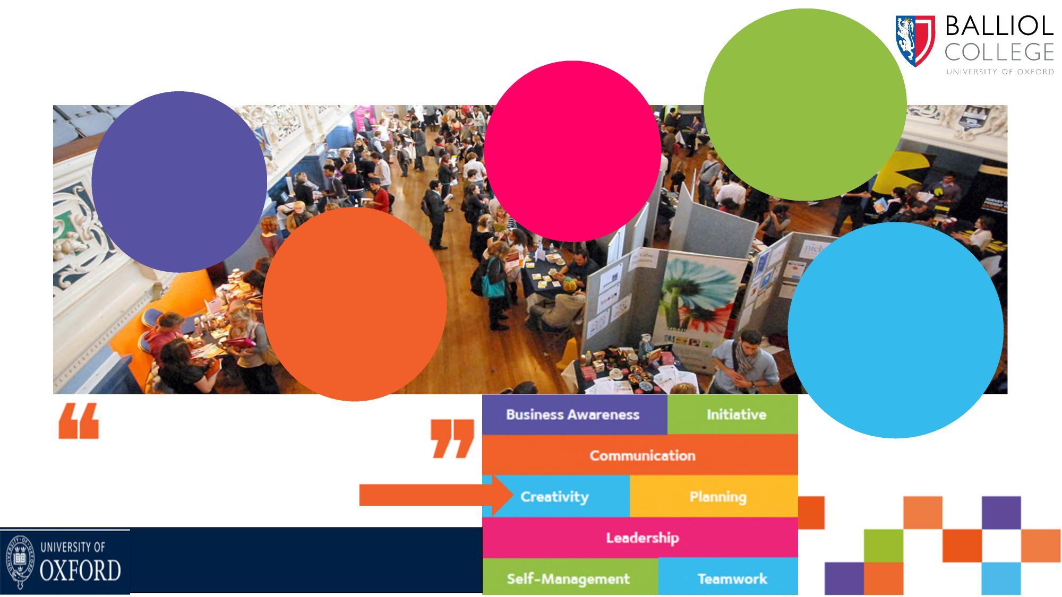
....Opportunity for Life £41,600
average annual
9,400
opportunities
on website
over past year
salary of our
graduates after
15 Months (data
from GOS)
Lifelong
expert
career
advice 100’s of
exclusive local
and global
internships
Studying at Oxford
gives you an
impressive and
highly sought
after skill set
Develop your employability
skills with
‘Octane
’
ox.ac.uk/careers

Slide 7

.Not all about Work!
There are far
more
opportunities
to get involved
in all sorts of
things than I
had expected!
Alistair

Slide 8



How We Choose... | Academic Achievement
Personal
Statement
Interviews
Contextual
Data
Teacher’s
Reference
Admissions
Tests
Written
Work
ox.ac.uk/apply

Slide 9

Follow the Application Timeline......
June July August September October November December January
Deadline
15th October
UCAS
ox.ac.uk/apply
Application
Tests
Choose your course
Decide - college
preference or open
application
Write Personal
Statement
Organise Academic
Reference
Submit from early September
Deadline is 6.00p.m.
15th October
Confirm which tests
you need to take
Find your test centre
(usually your school)
Register for tests-
check dates on
website
Take test on given date
some are earlier than
others!
Check dates at
ox.ac.uk/tests
Written work
Check if written
work required for
your subject
Use advice from
faculty and your
teachers to choose
Submit to your
college by 10
November
Interviews
If you are
shortlisted,
1 – 20
December
Decisions
If deferring, check this is possible for your course
Early Jan
2027

Slide 10

What Else Can I do to Prepare?
Grades
Super-curricular resources -
https://www.balliol.ox.ac.uk/admissions/schools-and-outreach/useful-links-for-schools
Course choices resources -
https://www.ox.ac.uk/admissions/undergraduate/courses/course-listing
Sustained contact programmes
Talks University Open Days
Taster Days Summer 2026

