Slide 2
Dr Lenka Krupová
Senior Lecturer in Financial accounting
ARU Chelmsford campus

Slide 3
ARU campuses in the UK
Cambridge
Chelmsford
Peterborough
London – two sites (Farringdon and East India)
Writtle

Slide 4
On UG level, ARU offers:
Accounting and Finance – Cambridge, Chelmsford, Peterborough, London
Banking, Finance and Fintech – Chelmsford
Business Management with Finance – Chelmsford

Slide 5
Structure of the study
The first year of study is the same for all courses, and specialisation begins in the second year.
If a student wants to change their specialisation after the first year, it is not a problem.

Slide 6
The length of the study
All BSc degrees are expected to complete within 3 years
  BSc (Hons) Accounting and Finance
  BSc (Hons) Banking, Finance and Fintech
  BSc (Hons) Business Management with Finance
Duration of the course may increase up to 4 years if you choose to include an element of European study, International study, or Industrial experience in your course – a placement year

Slide 7
Foundation year option
Is designed for students who don’t quite meet the standard entry requirements, are changing subject area, or want more confidence before starting the full degree
Leads directly into Year 1 of the honors degree once you pass, so your course becomes 4 years with foundation instead of 3 years.

Slide 8
Accounting and Finance and Banking, Finance and Fintech: IFRS & ACCA
IFRS (International Financial Reporting Standards)
We follow IFRS which is a single set of high-quality, understandable, enforceable and globally accepted accounting standards.
Recognition from the ACCA
You’ll be exempted from the nine foundation papers of the ACCA qualification.

Slide 9
Life Brief
A Live Brief provides students with the opportunity to tackle a real-world task, allowing them to develop innovative and creative solutions or ideas.
Practical application of module learning
An opportunity to network with industry professionals
Excellent experience to speak about during job interviews
Competitive advantage when completing job applications
Awareness of skills and career options

Slide 10
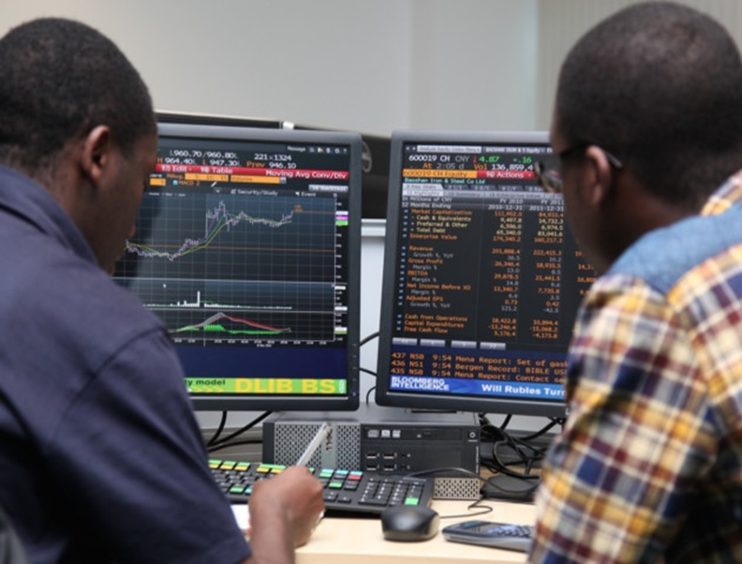
Bloomberg financial labs
Bloomberg Terminal
Brings together real-time data on every market, breaking news, in-depth research, powerful analytics, communications tools and world-class execution capabilities — in one fully integrated solution.

