Slide 1
Part 2
Practice Material

Slide 2
No calculator
No formulae sheet
Erasable whiteboard and pen for doing any working on

Slide 3
Mathematics 1

Slide 4
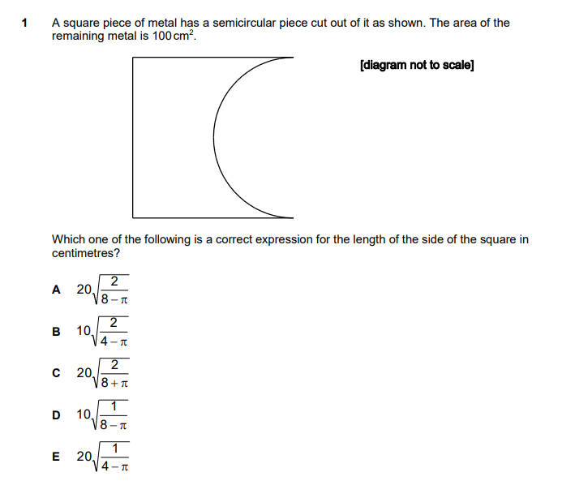
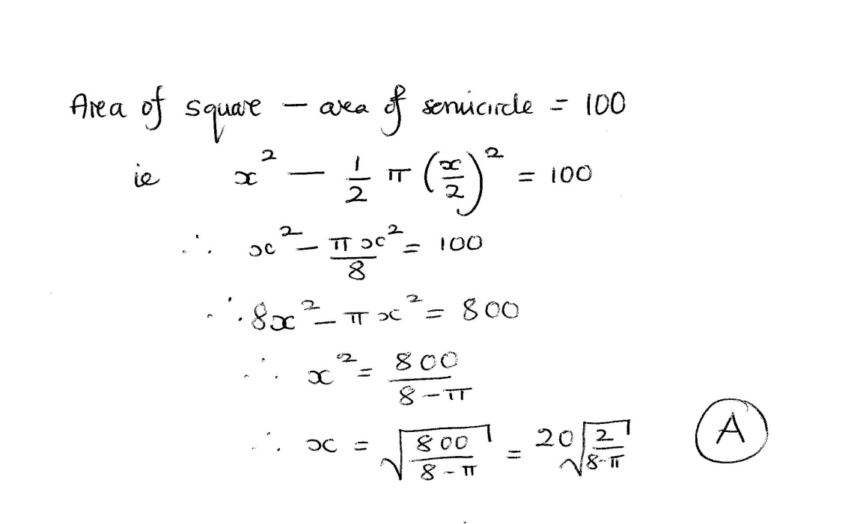
x/2
x
x

Slide 5
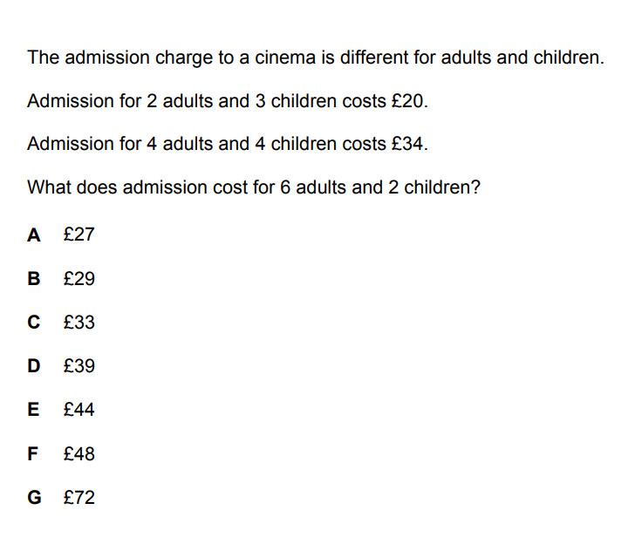
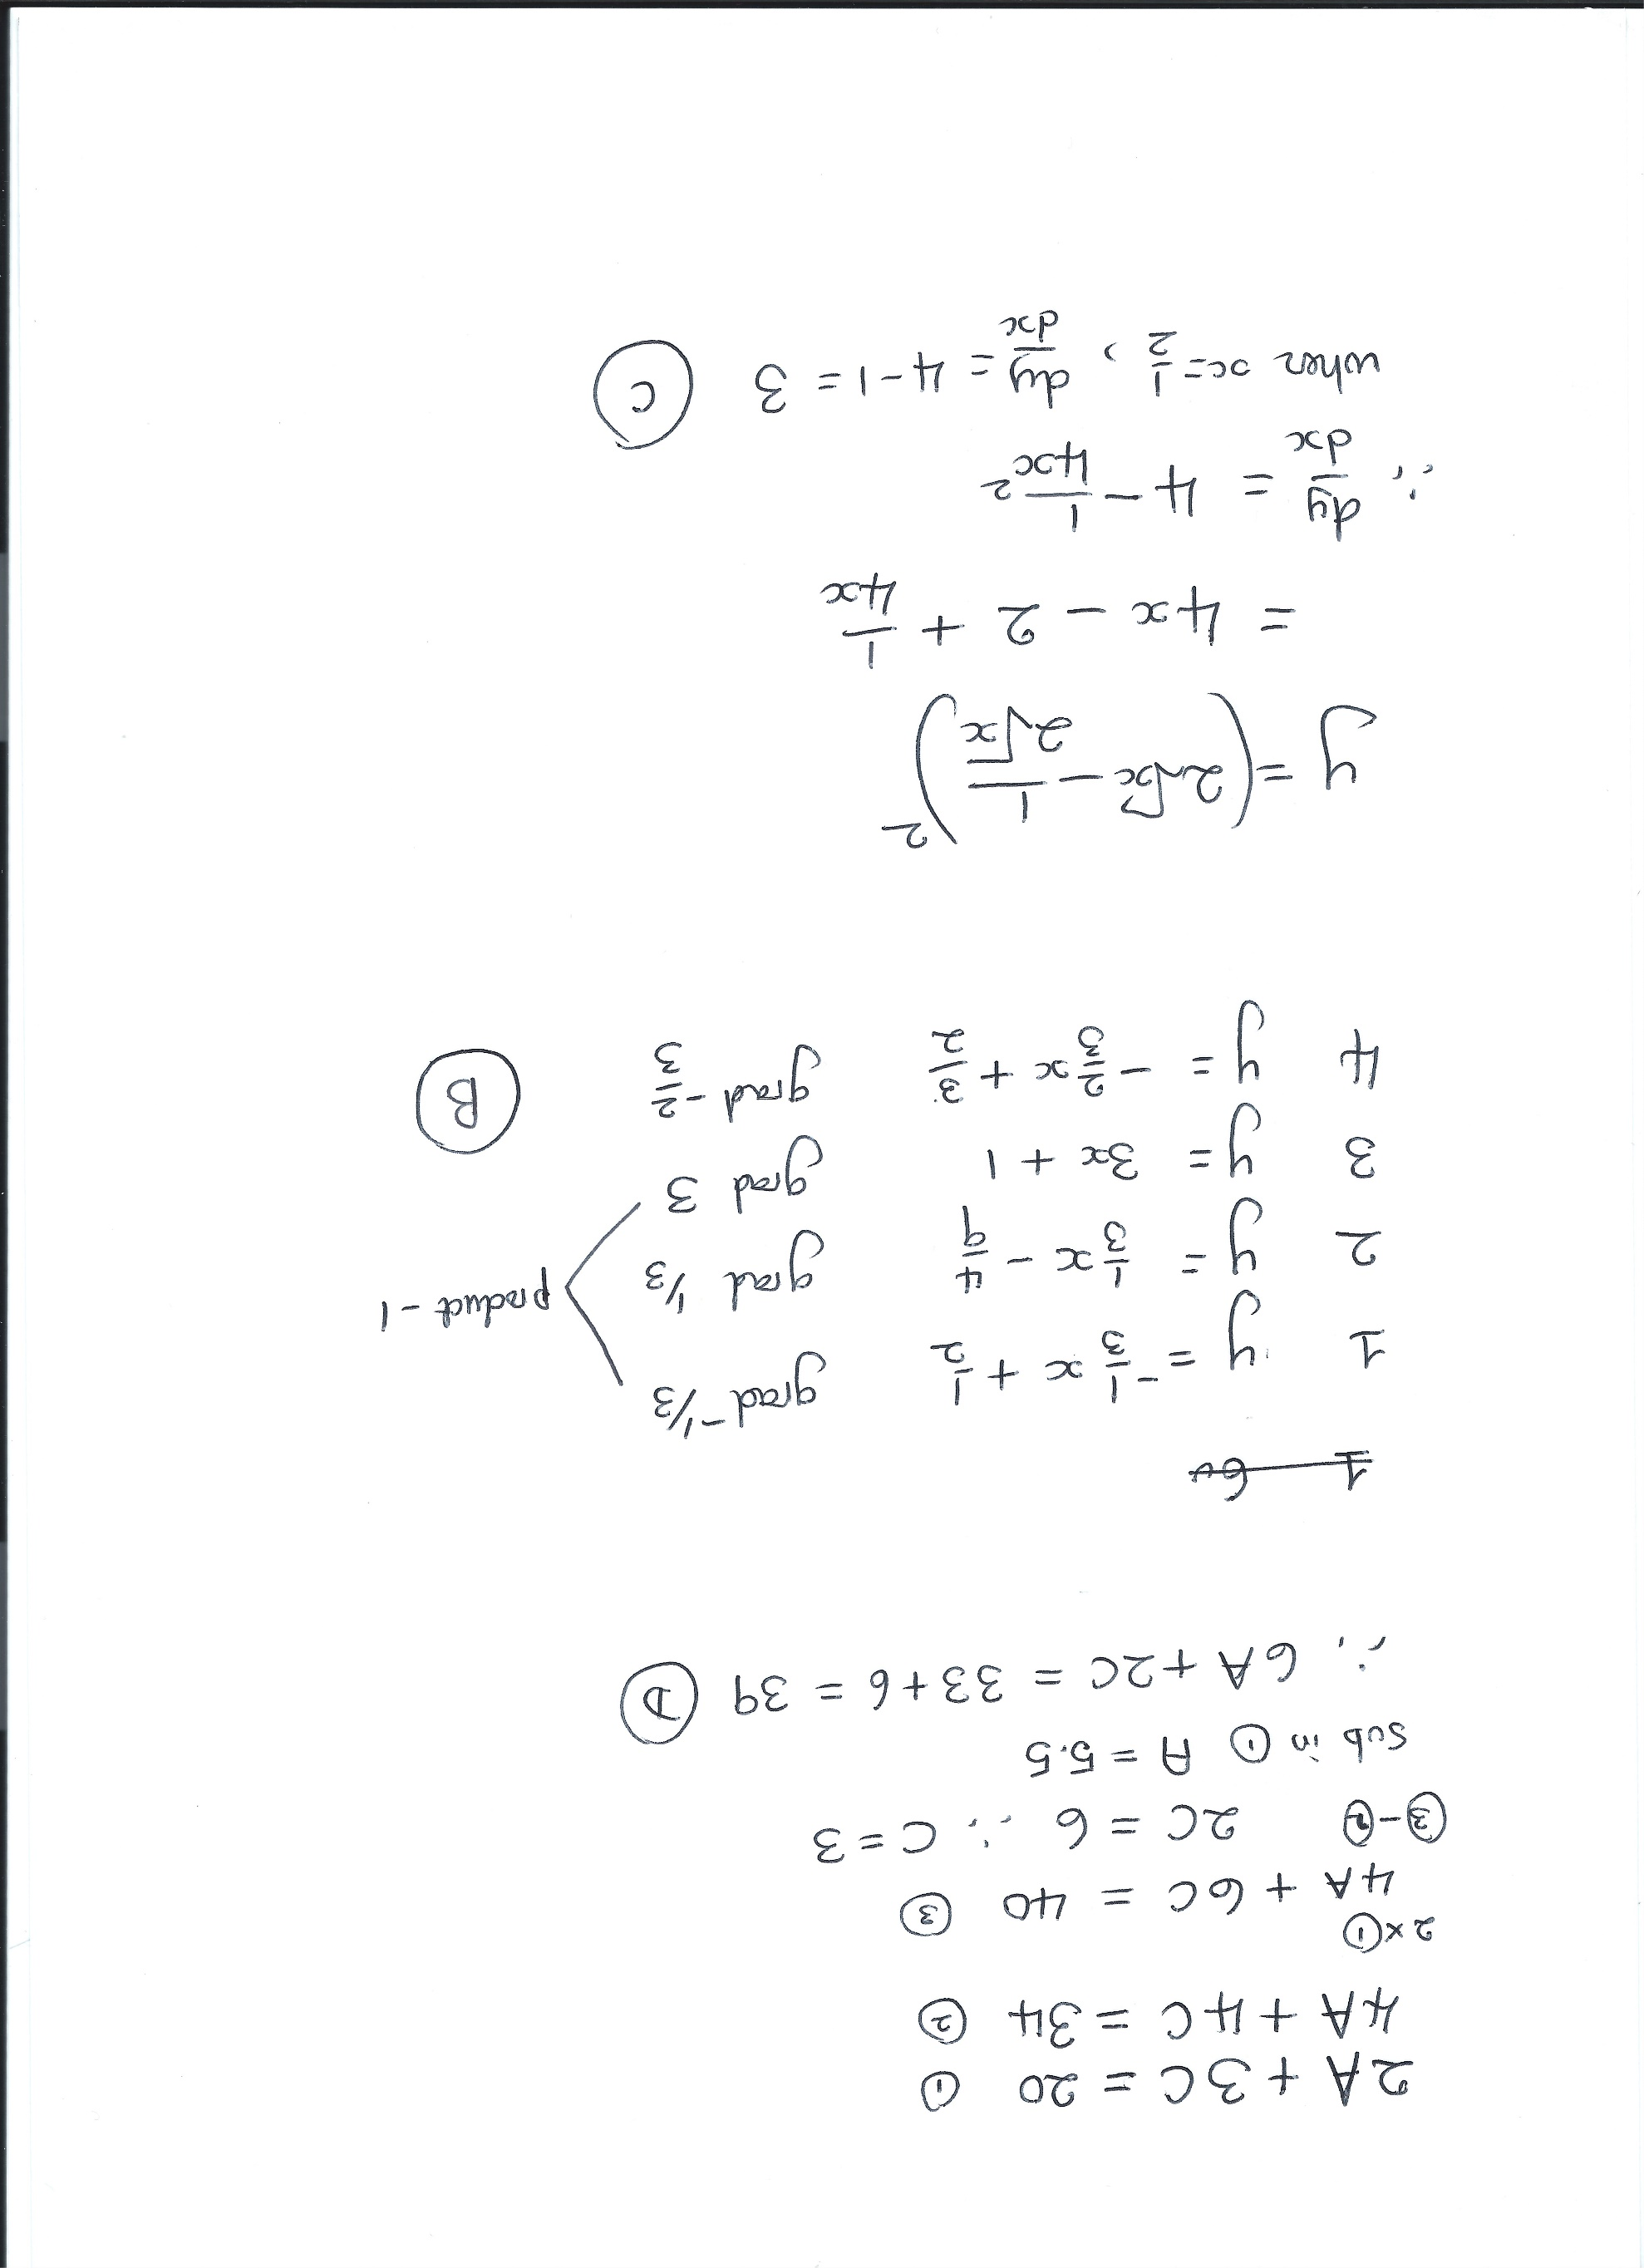

Slide 6
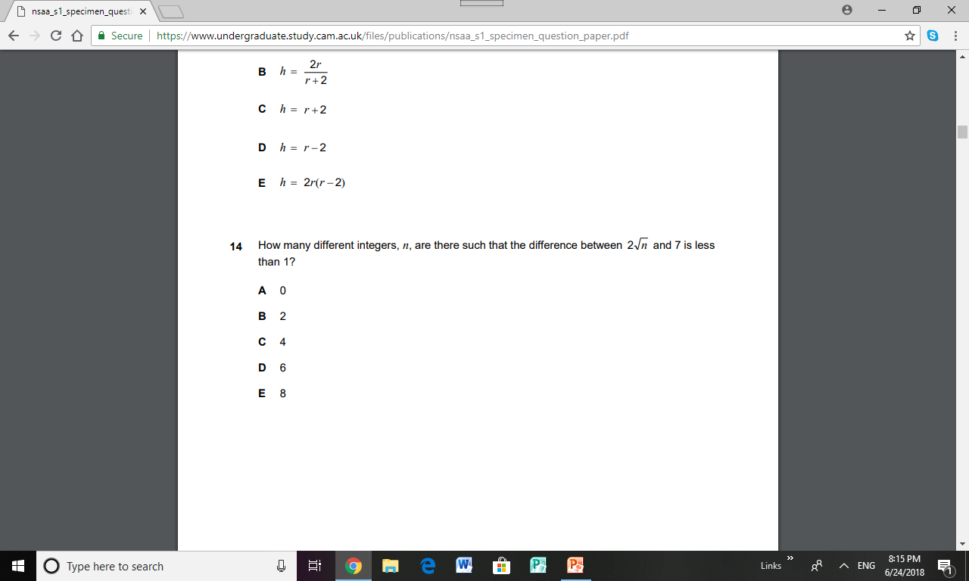
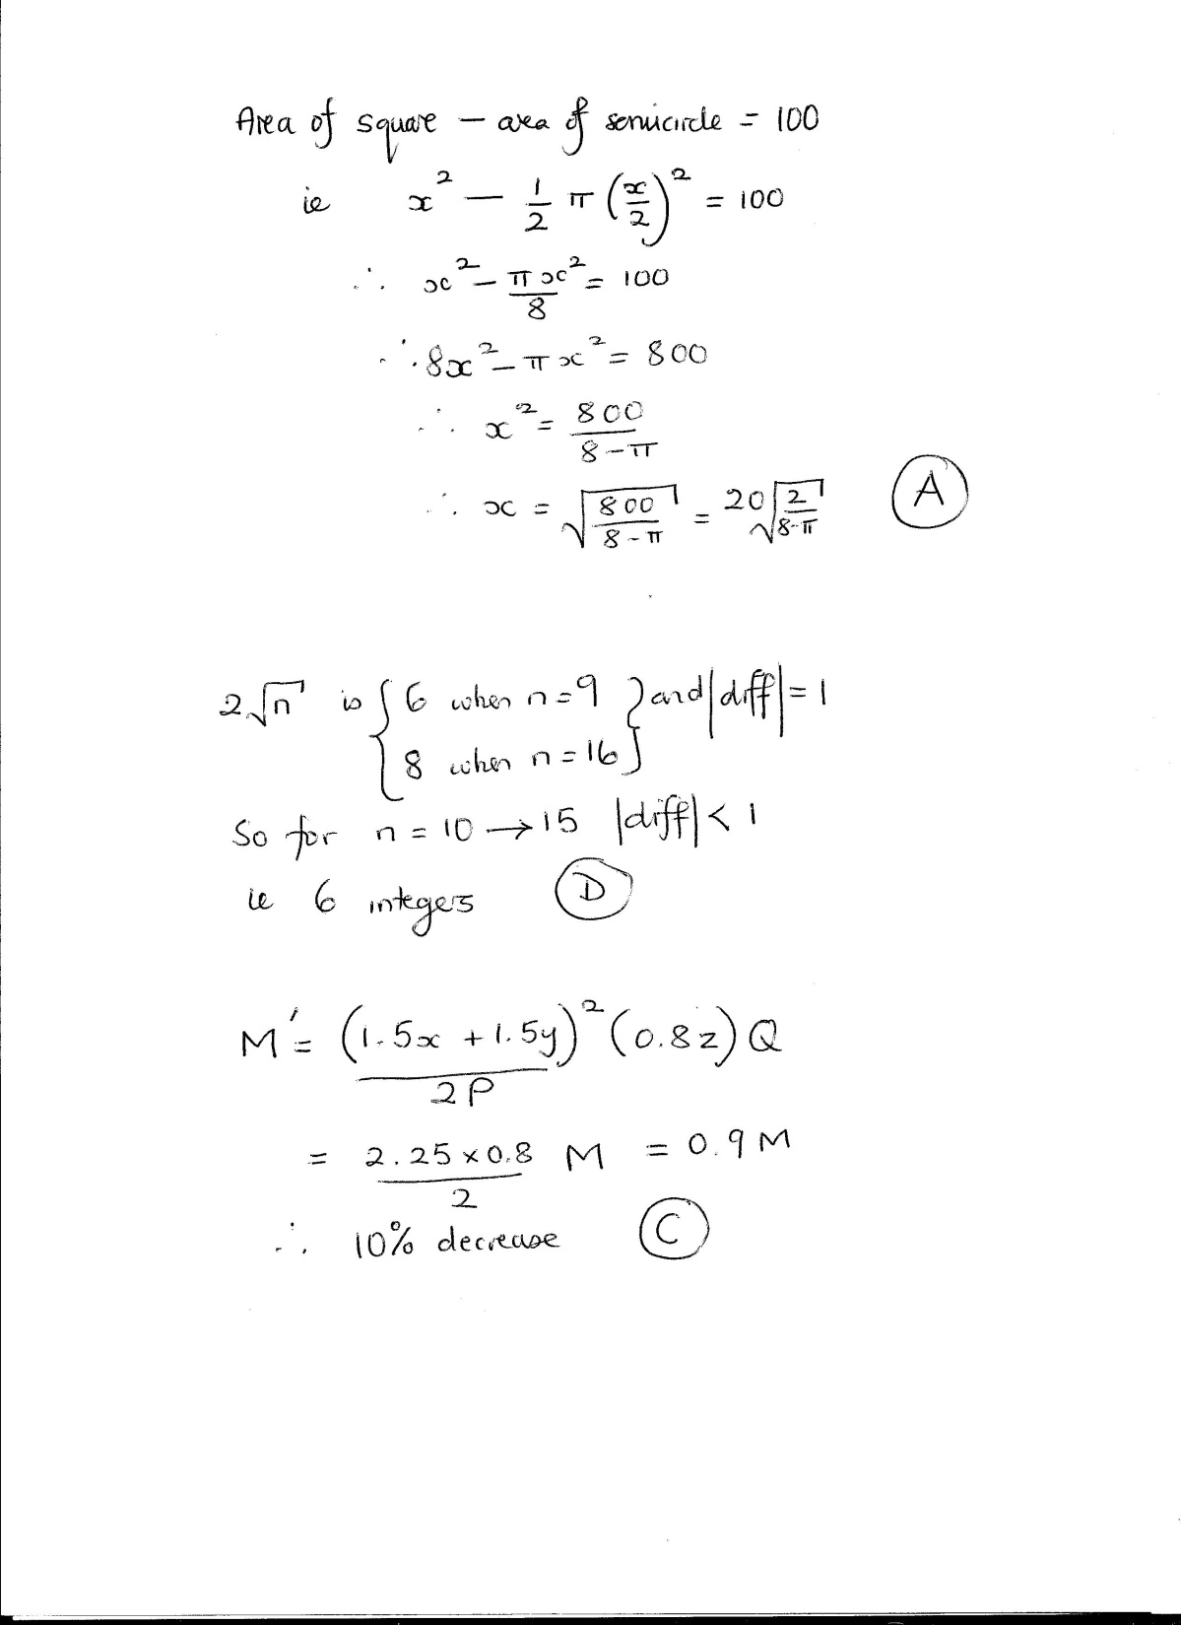

Slide 7
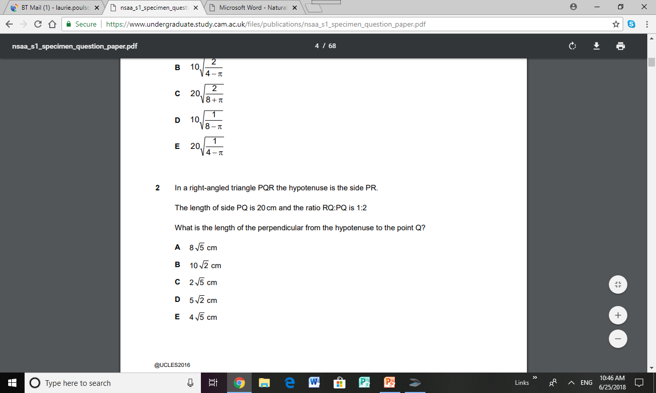
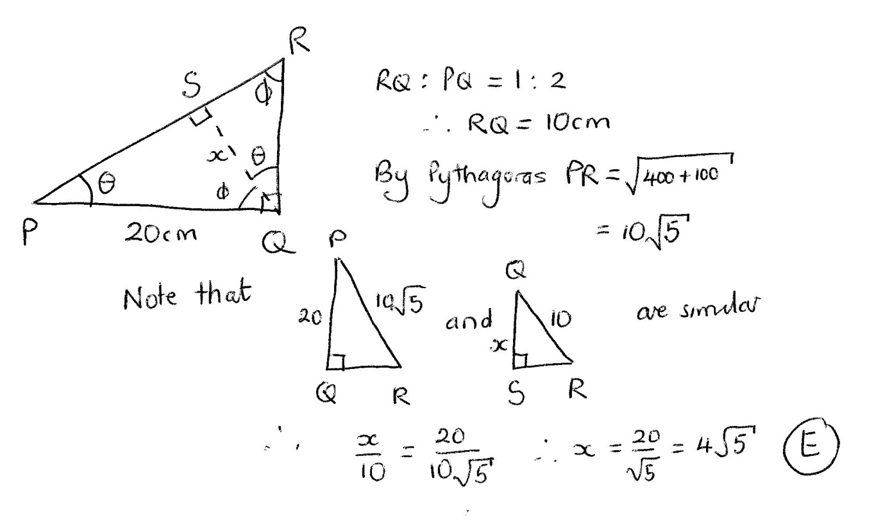

This method takes a lot longer! If you are unlucky to choose the wrong method in a question, don’t just keep going. It’s better to guess and mark the question for review if there is time at the end.
This method can be done in 1½ minutes but . . . . . .

Slide 8
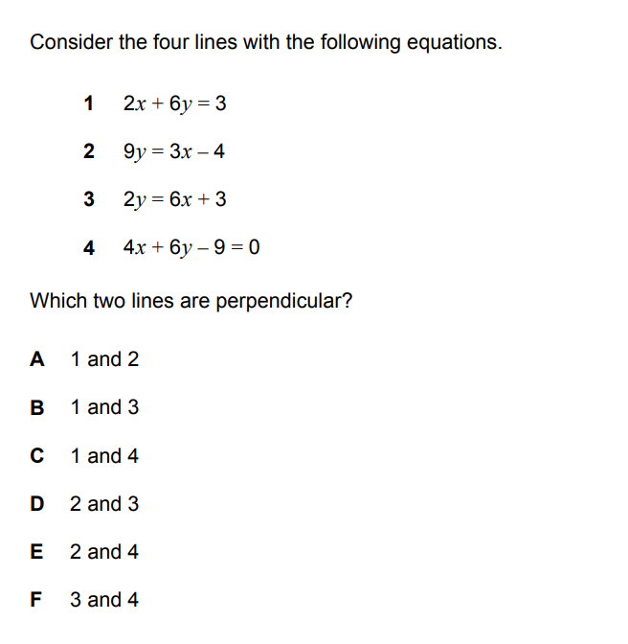
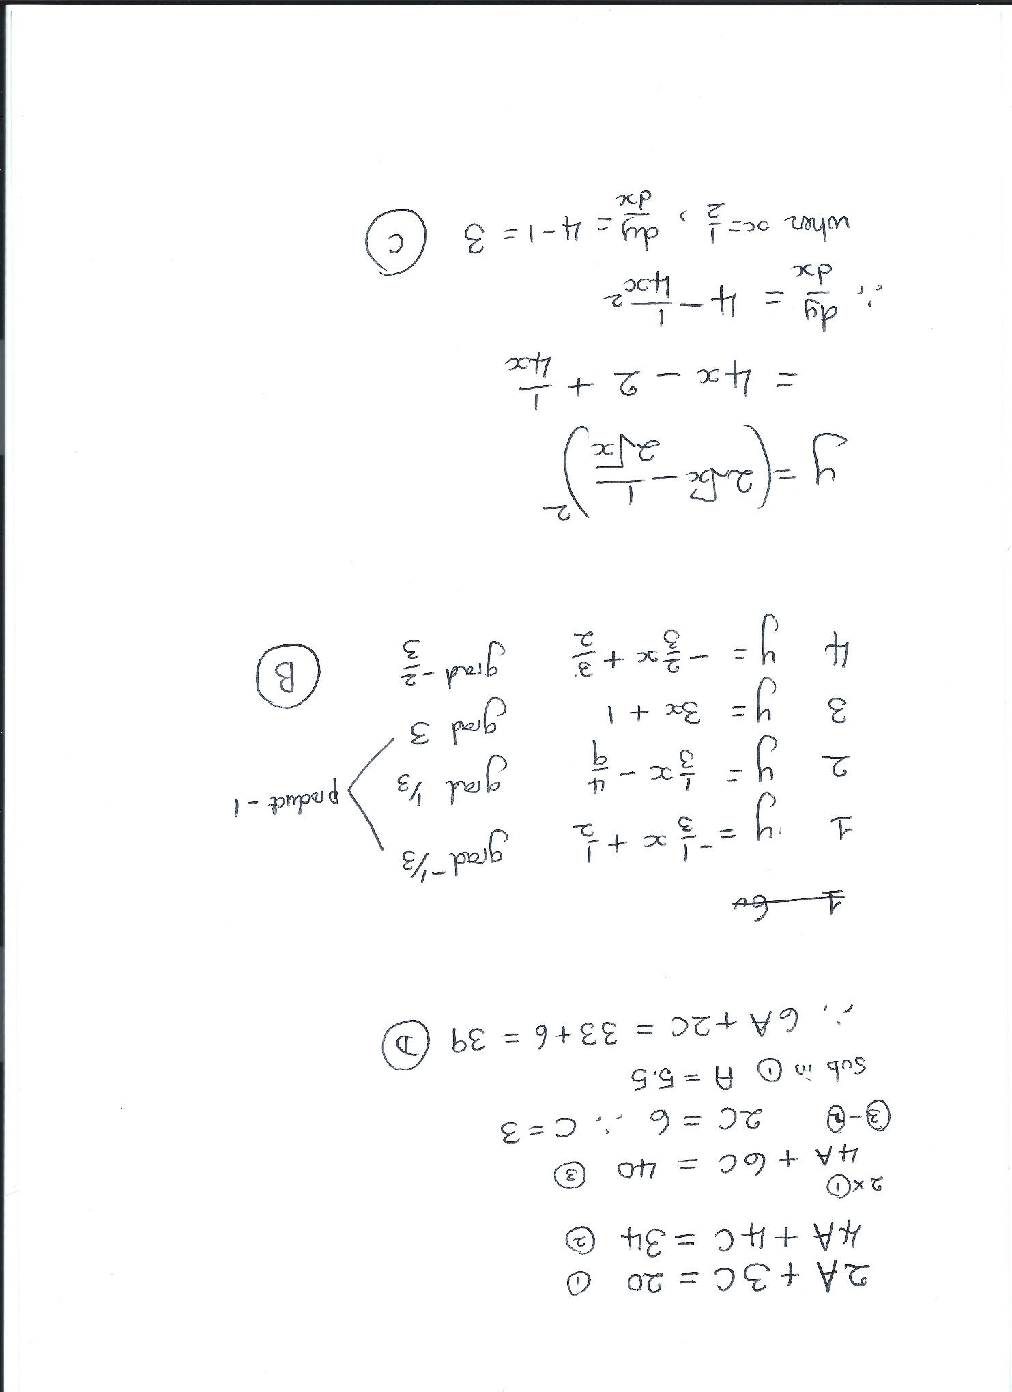

Slide 9
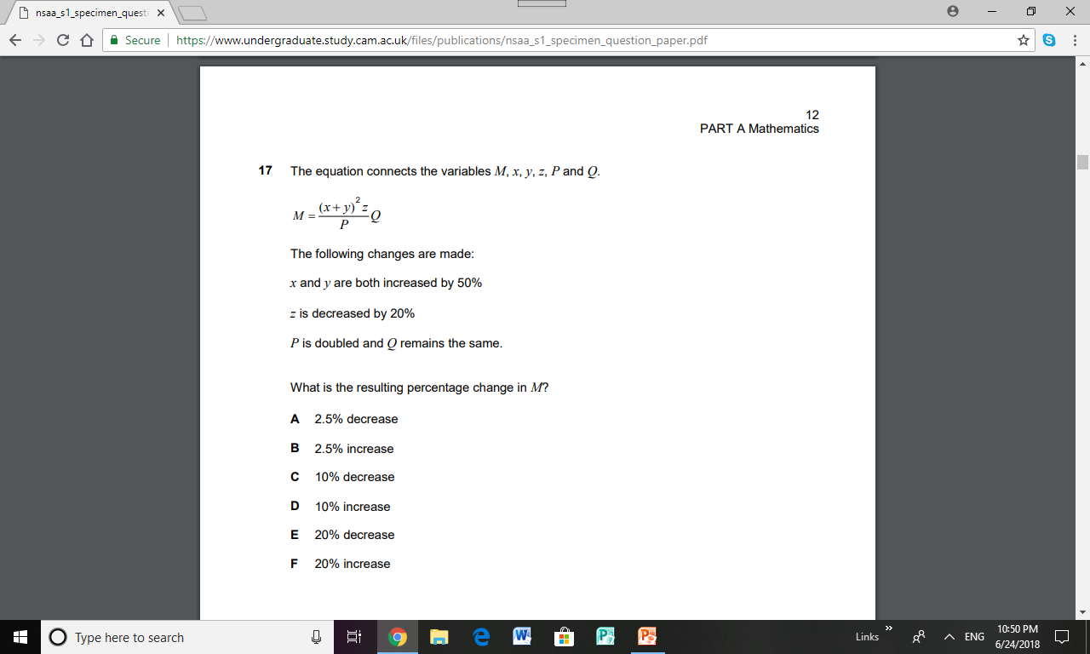

Slide 10
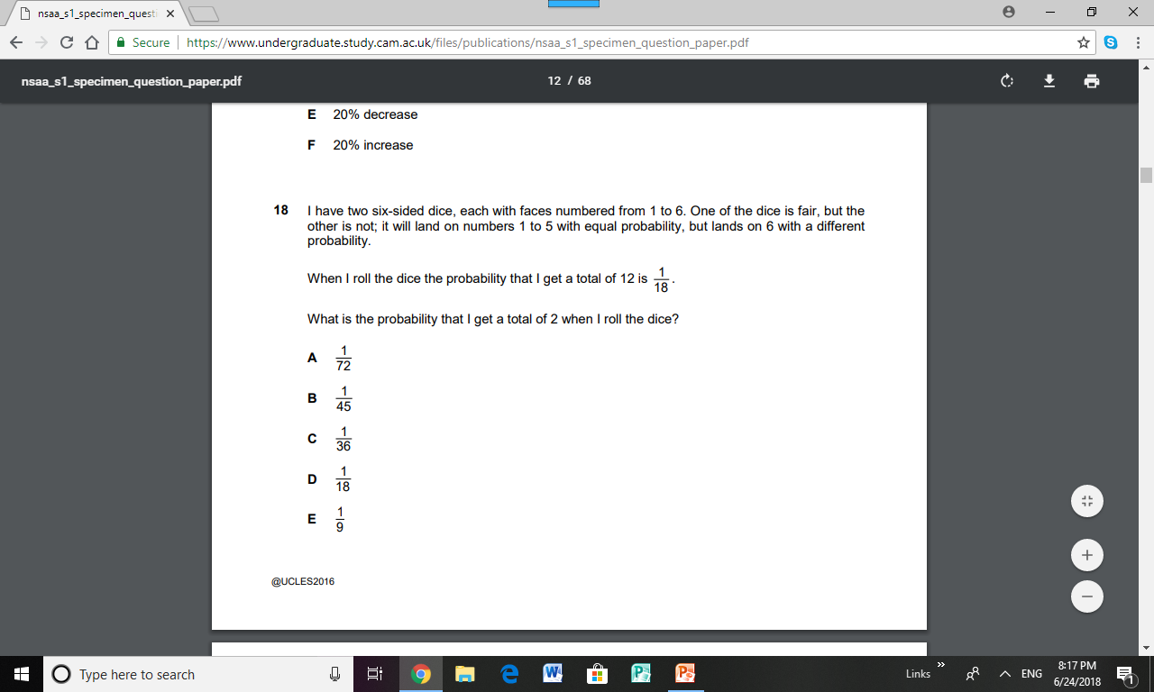
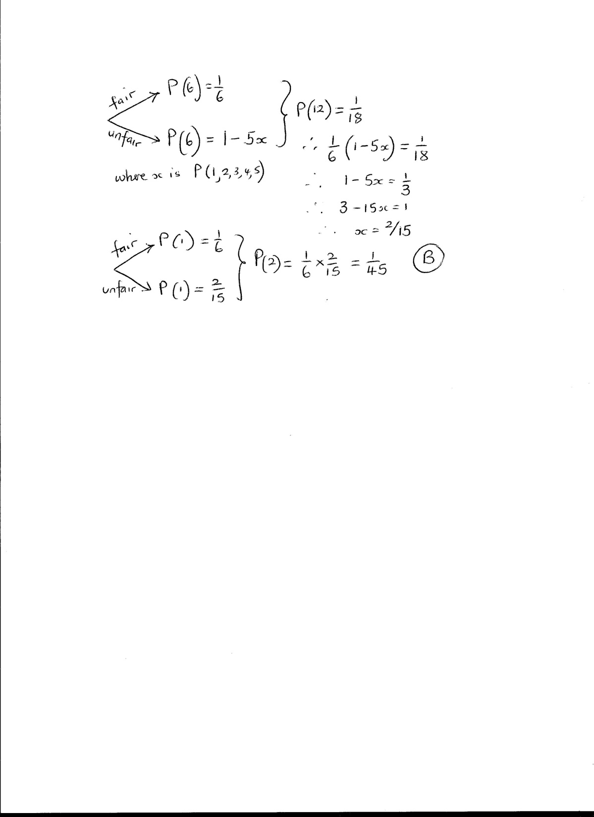

Slide 11
Biology

Slide 12
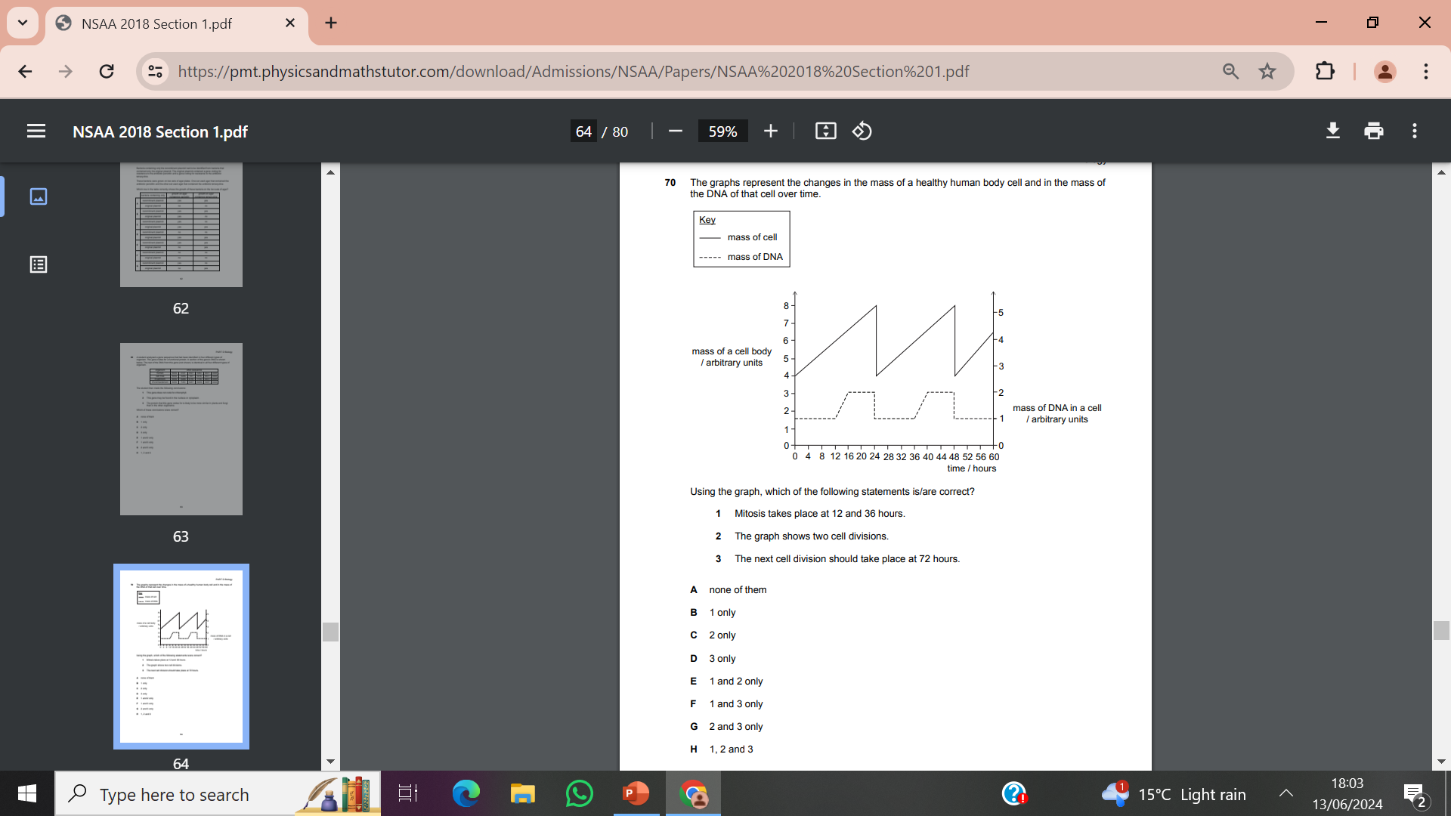

Slide 13
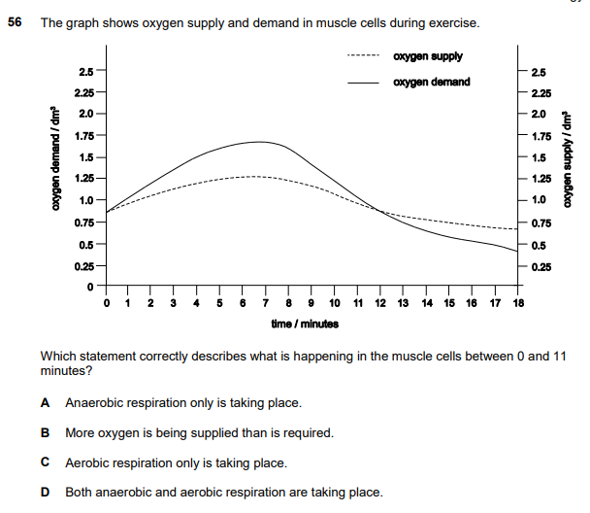
No
No
No
YES

Slide 14
Pavlov's dogs are famous for salivating when they heard a bell ring. What is the best explanation for this?
The bell made the dogs hungry.
The dogs learnt that food appears when the bell rings.
The bell sounds like the dogs' food bowls.
The bell hurts the dogs' ears.
The dogs salivate after any loud noise.

Slide 15
Which of the following elements is NOT present in haemoglobin?
Iron
Oxygen
Nitrogen
Phosphorus
Hydrogen

Slide 16
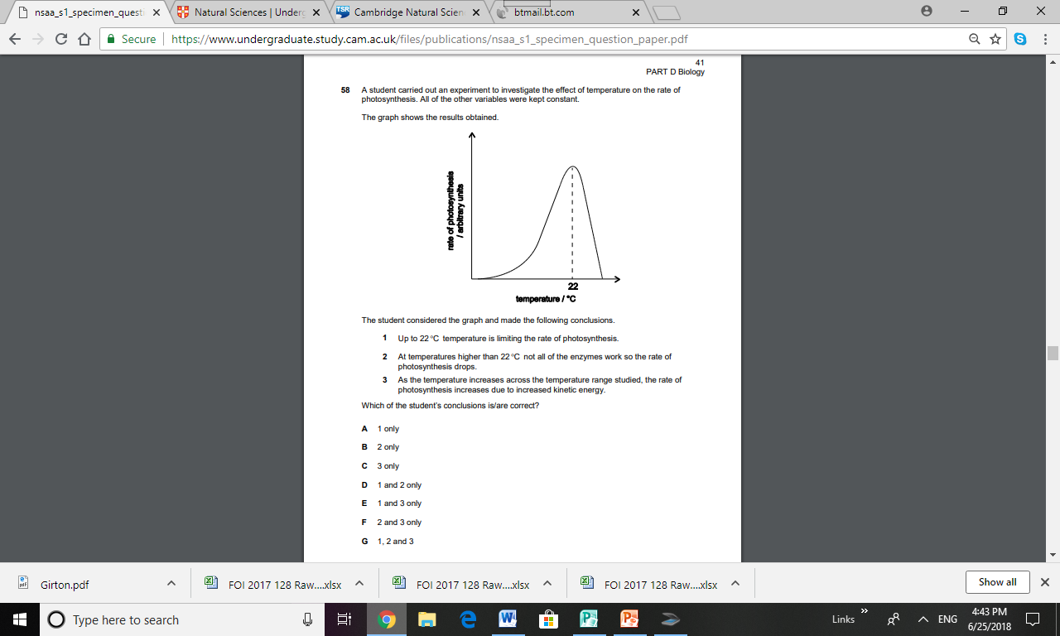
YES
YES
No

Slide 17
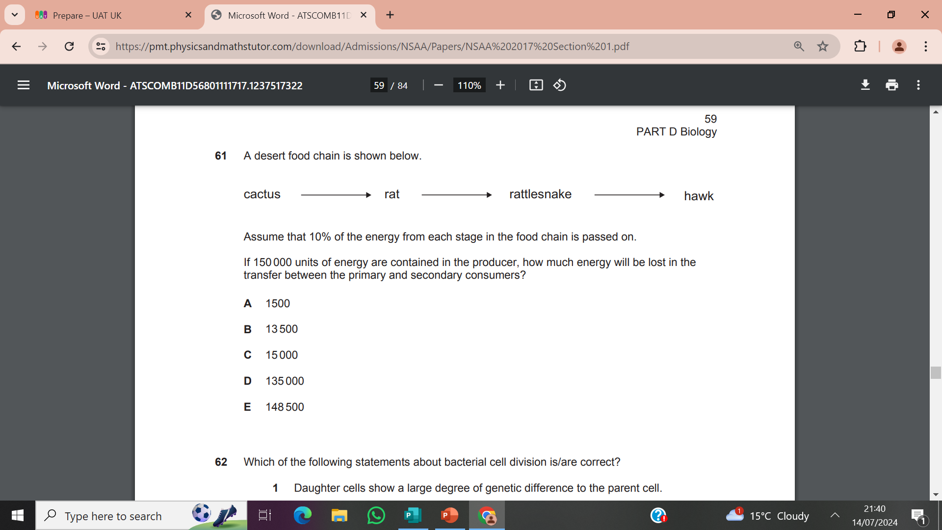
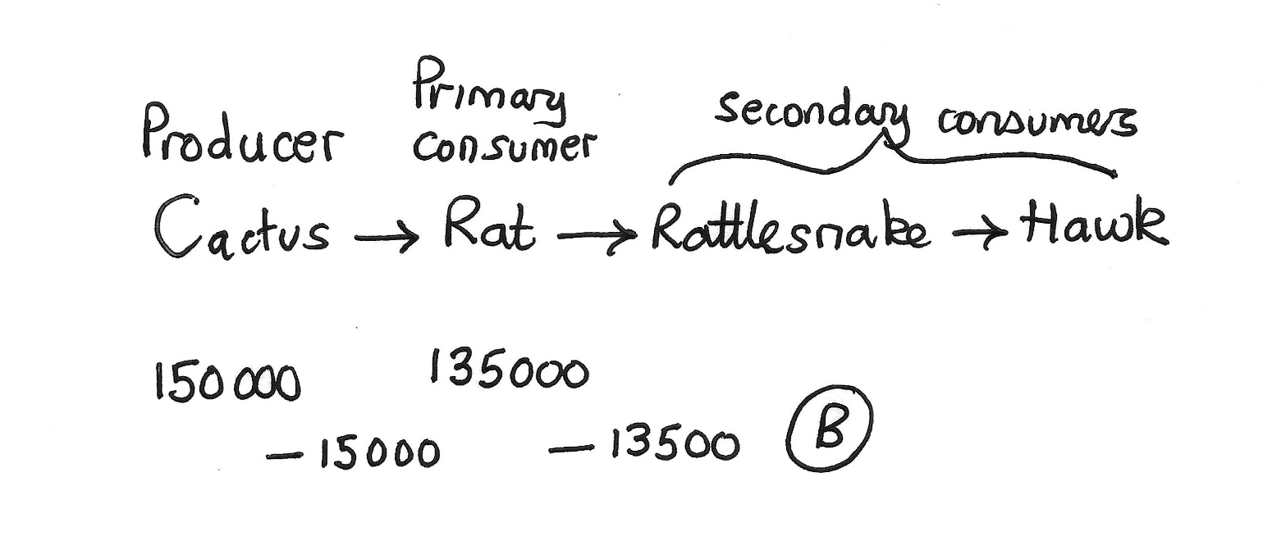

Slide 18
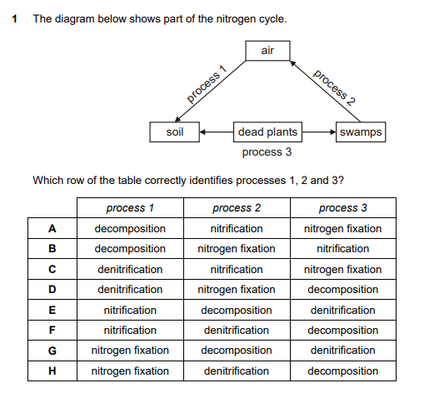

Slide 19
Chemistry

Slide 20
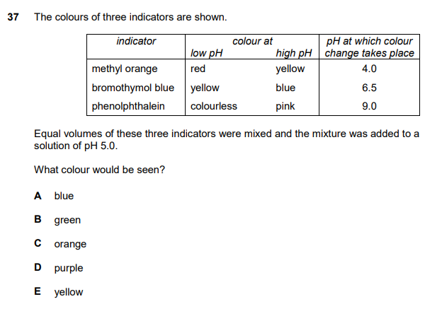
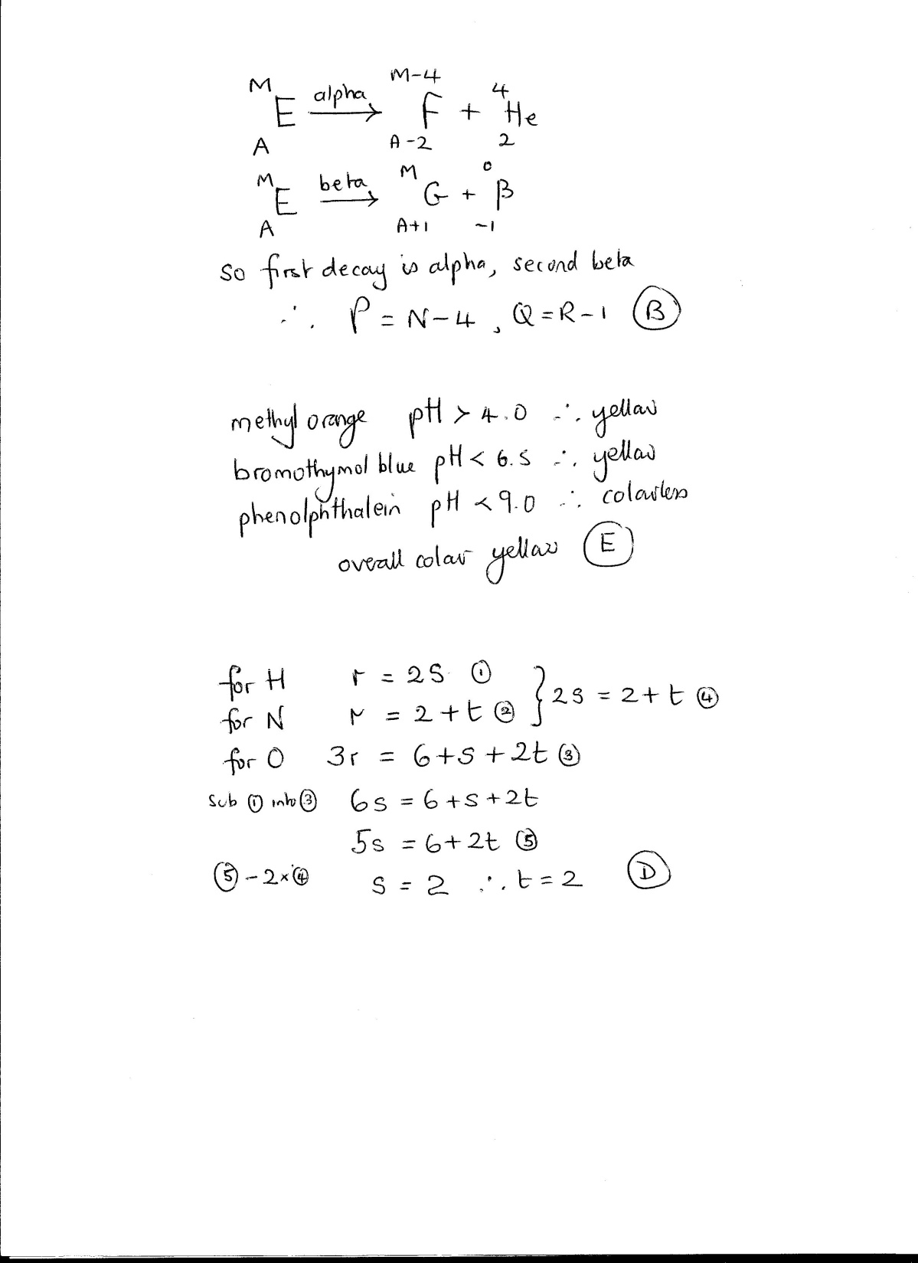

Slide 21
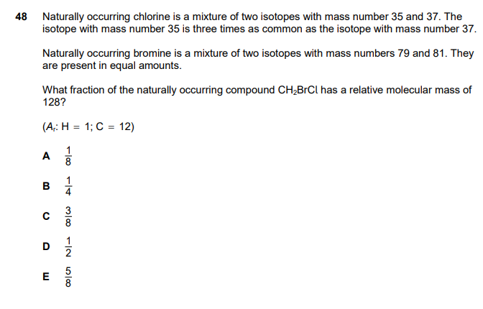
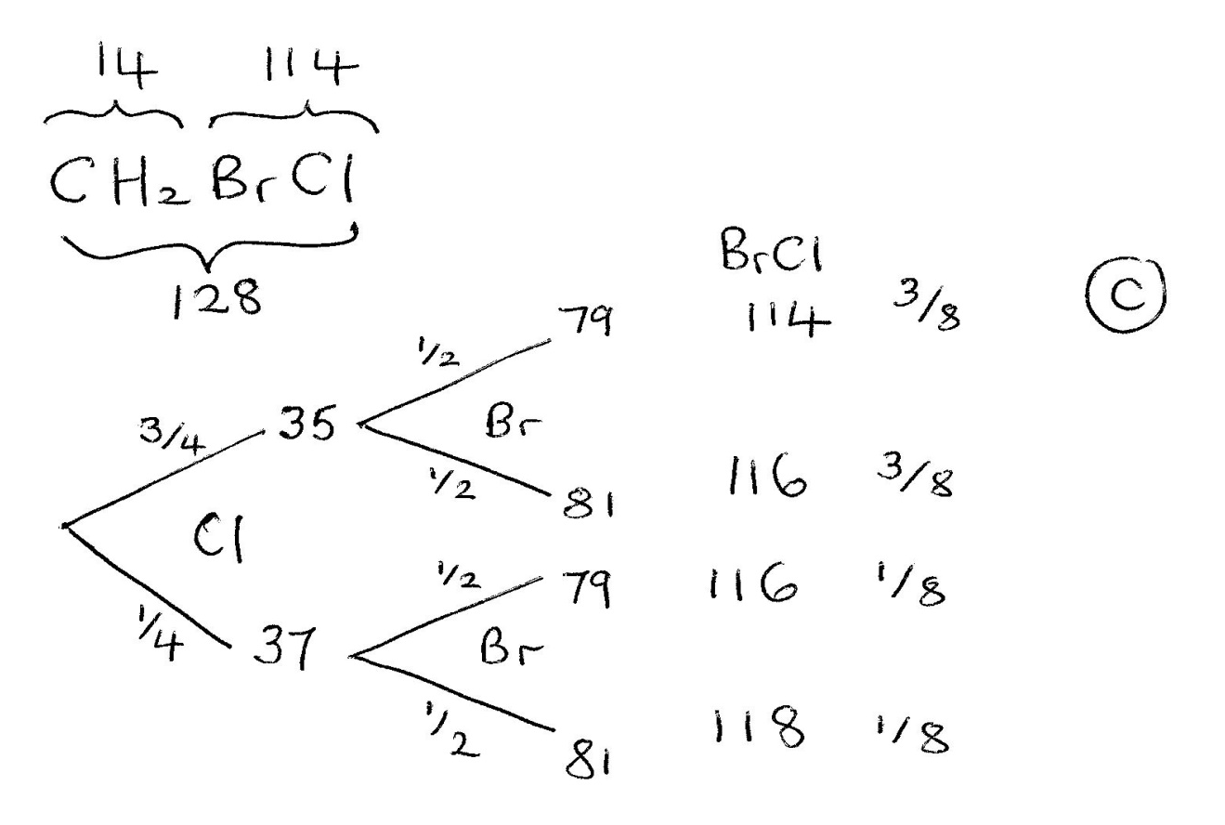

Slide 22
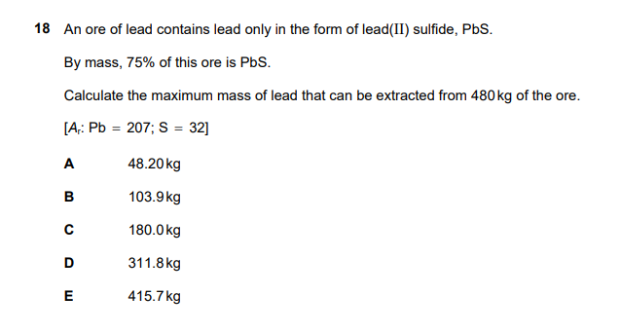
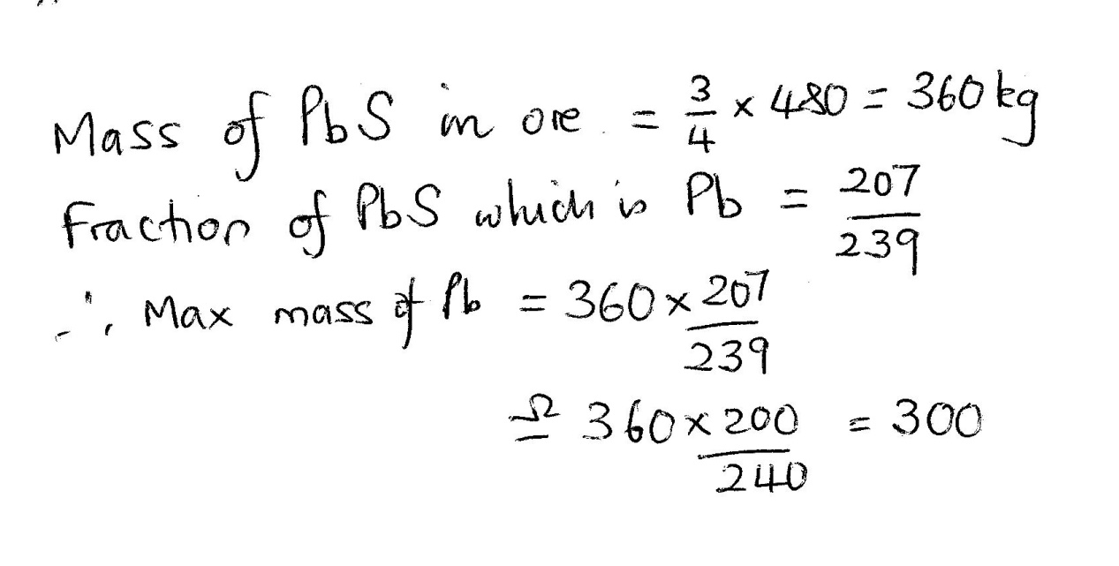

Slide 23
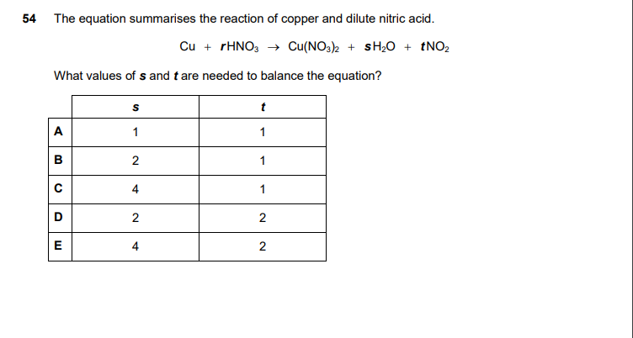


Slide 24
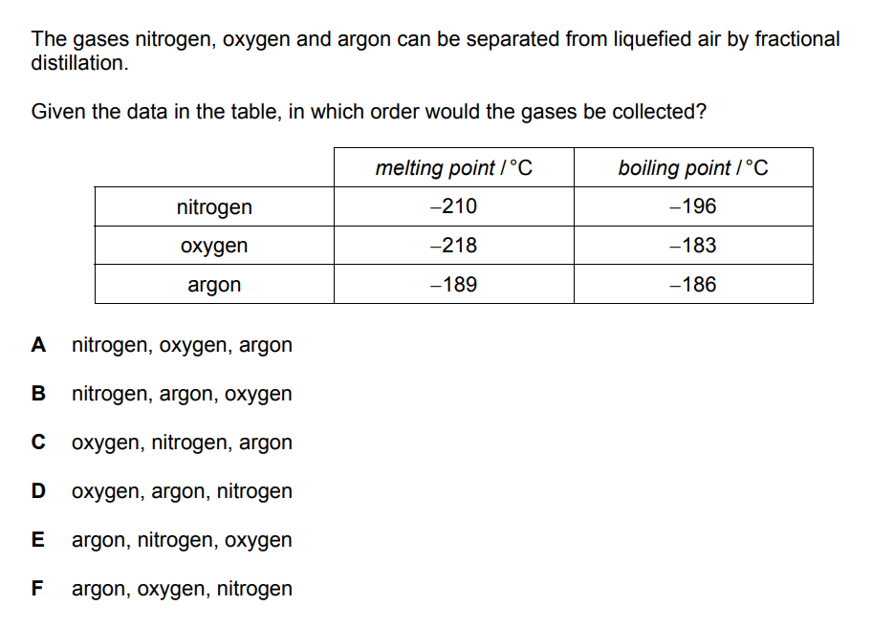

Slide 25
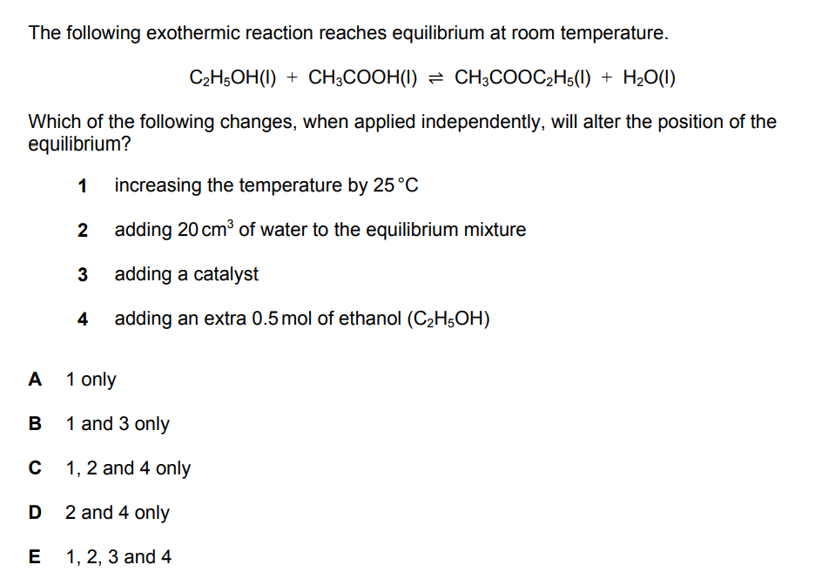

Slide 26
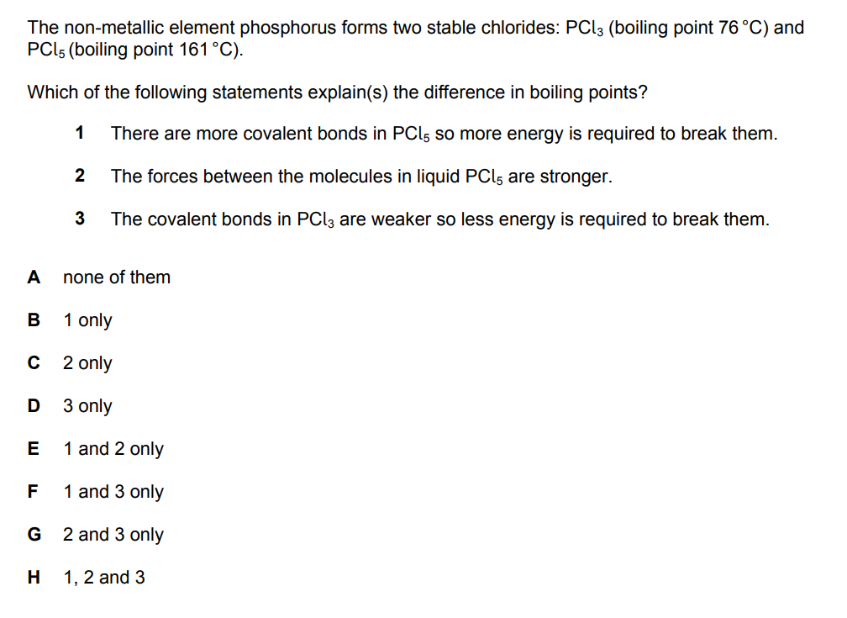

Slide 27
Physics

Slide 28
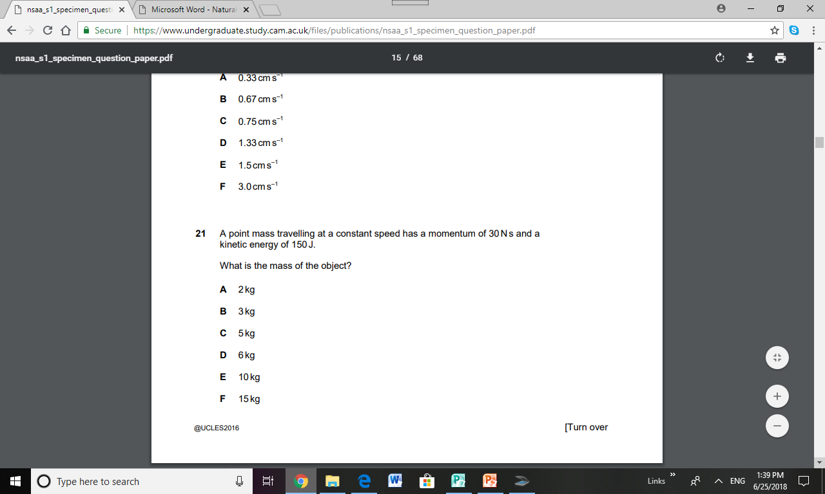
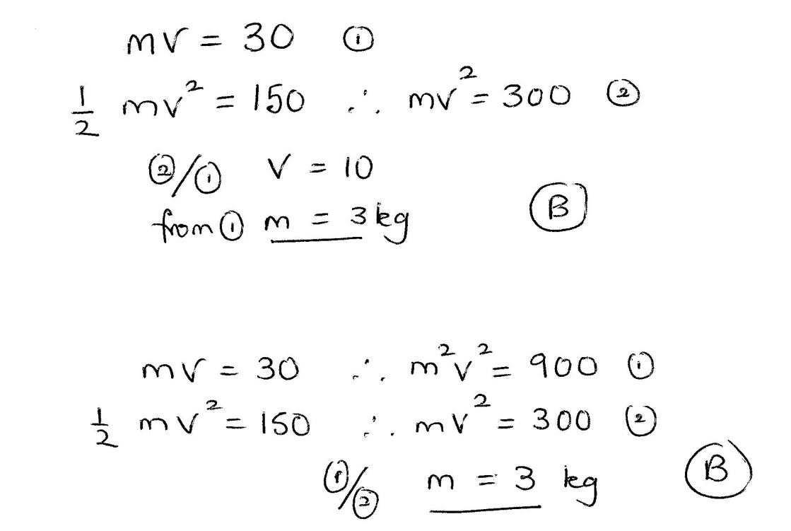

Slide 29
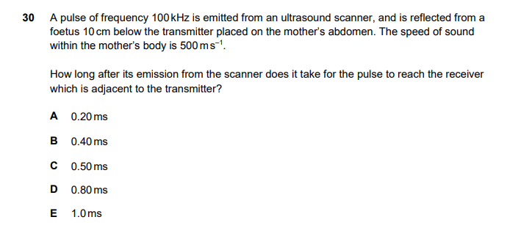

Note that the frequency 100kHz is a redundant piece of information and doesn’t get used in the problem. Don’t waste time thinking about v=fλ.

Slide 30
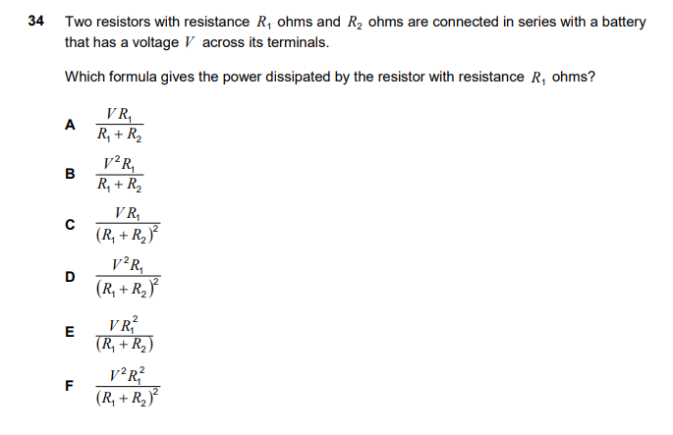

Note: only answer D is of the required form for power “V^2/R”, which is a quicker solution!

Slide 31
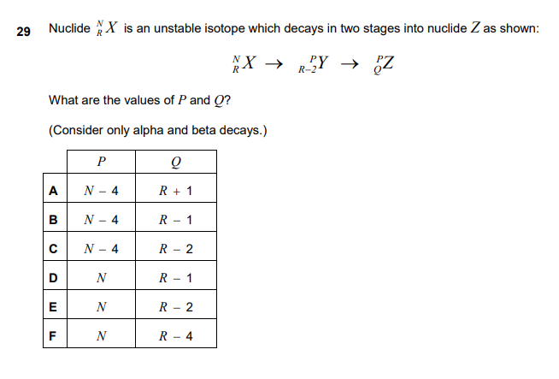

Slide 32
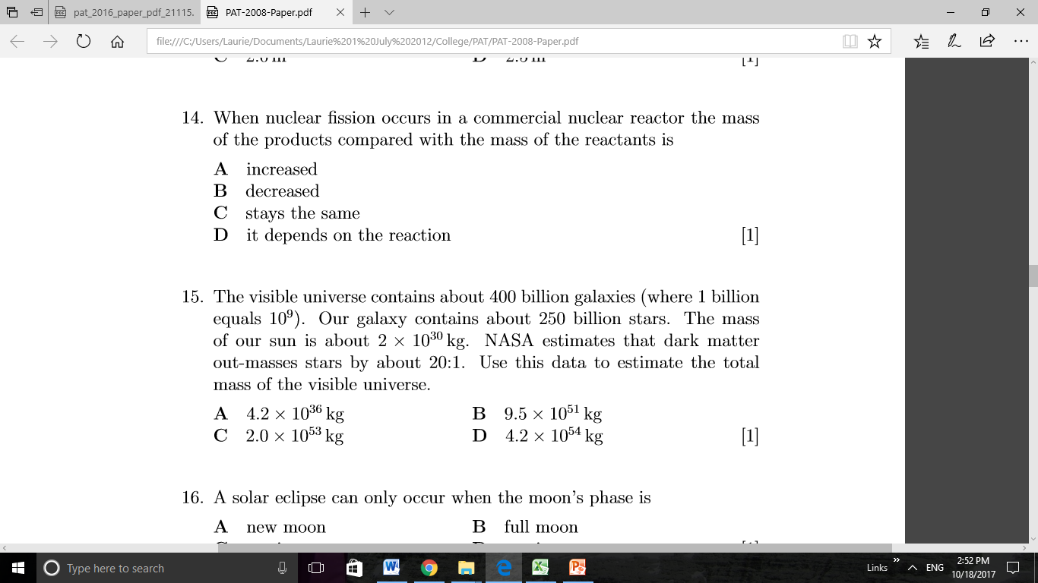

Slide 33
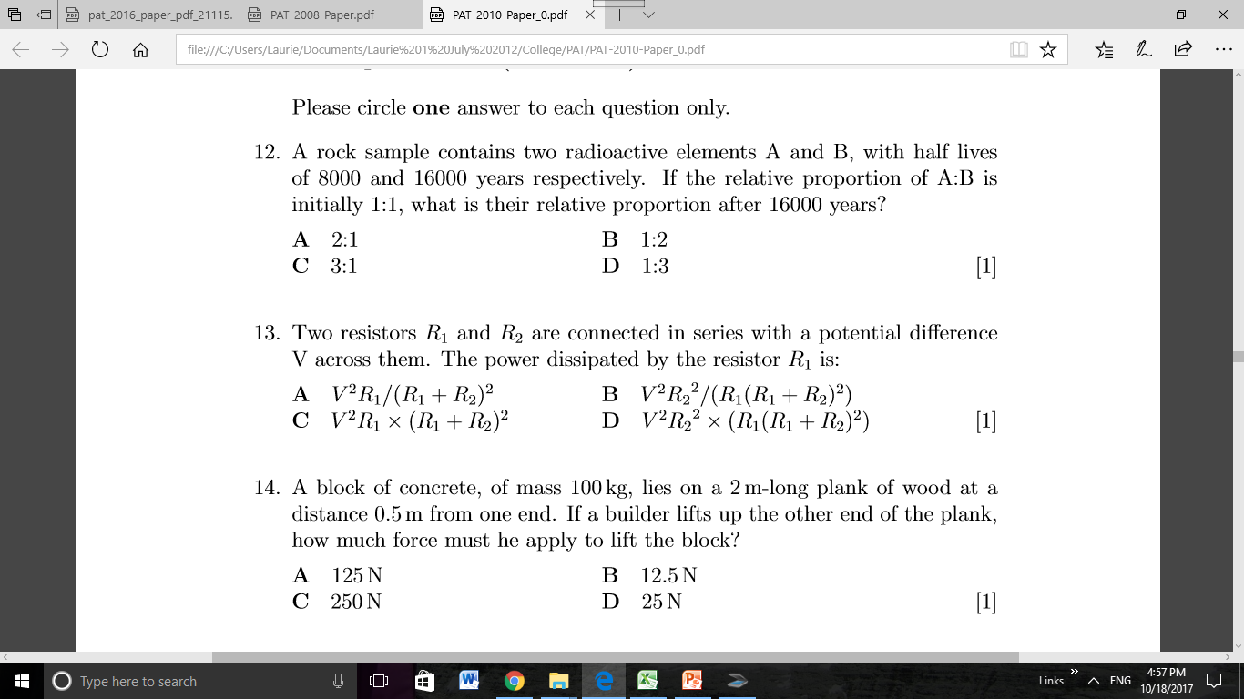
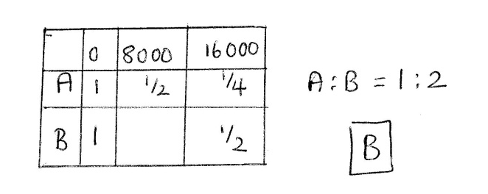

Slide 34
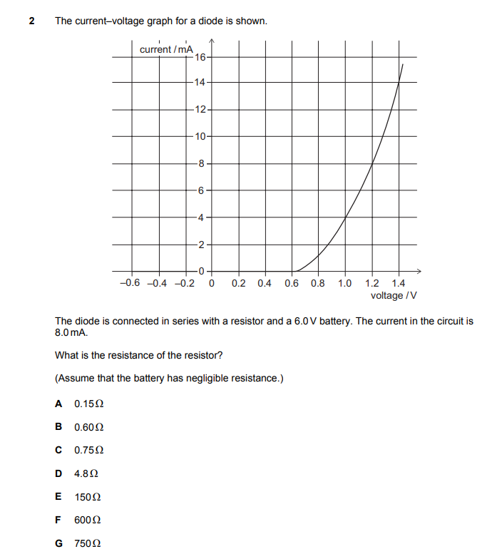
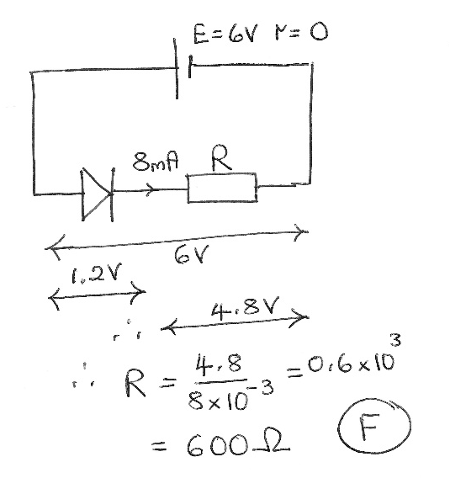

Slide 35
Mathematics 2

Slide 36
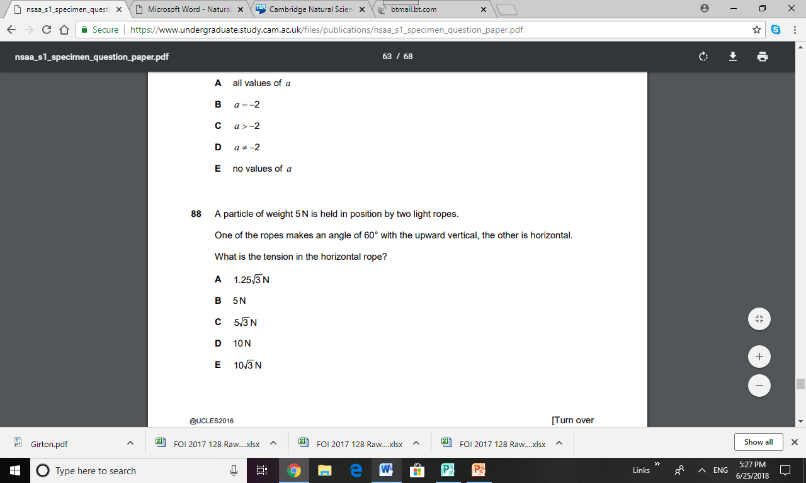
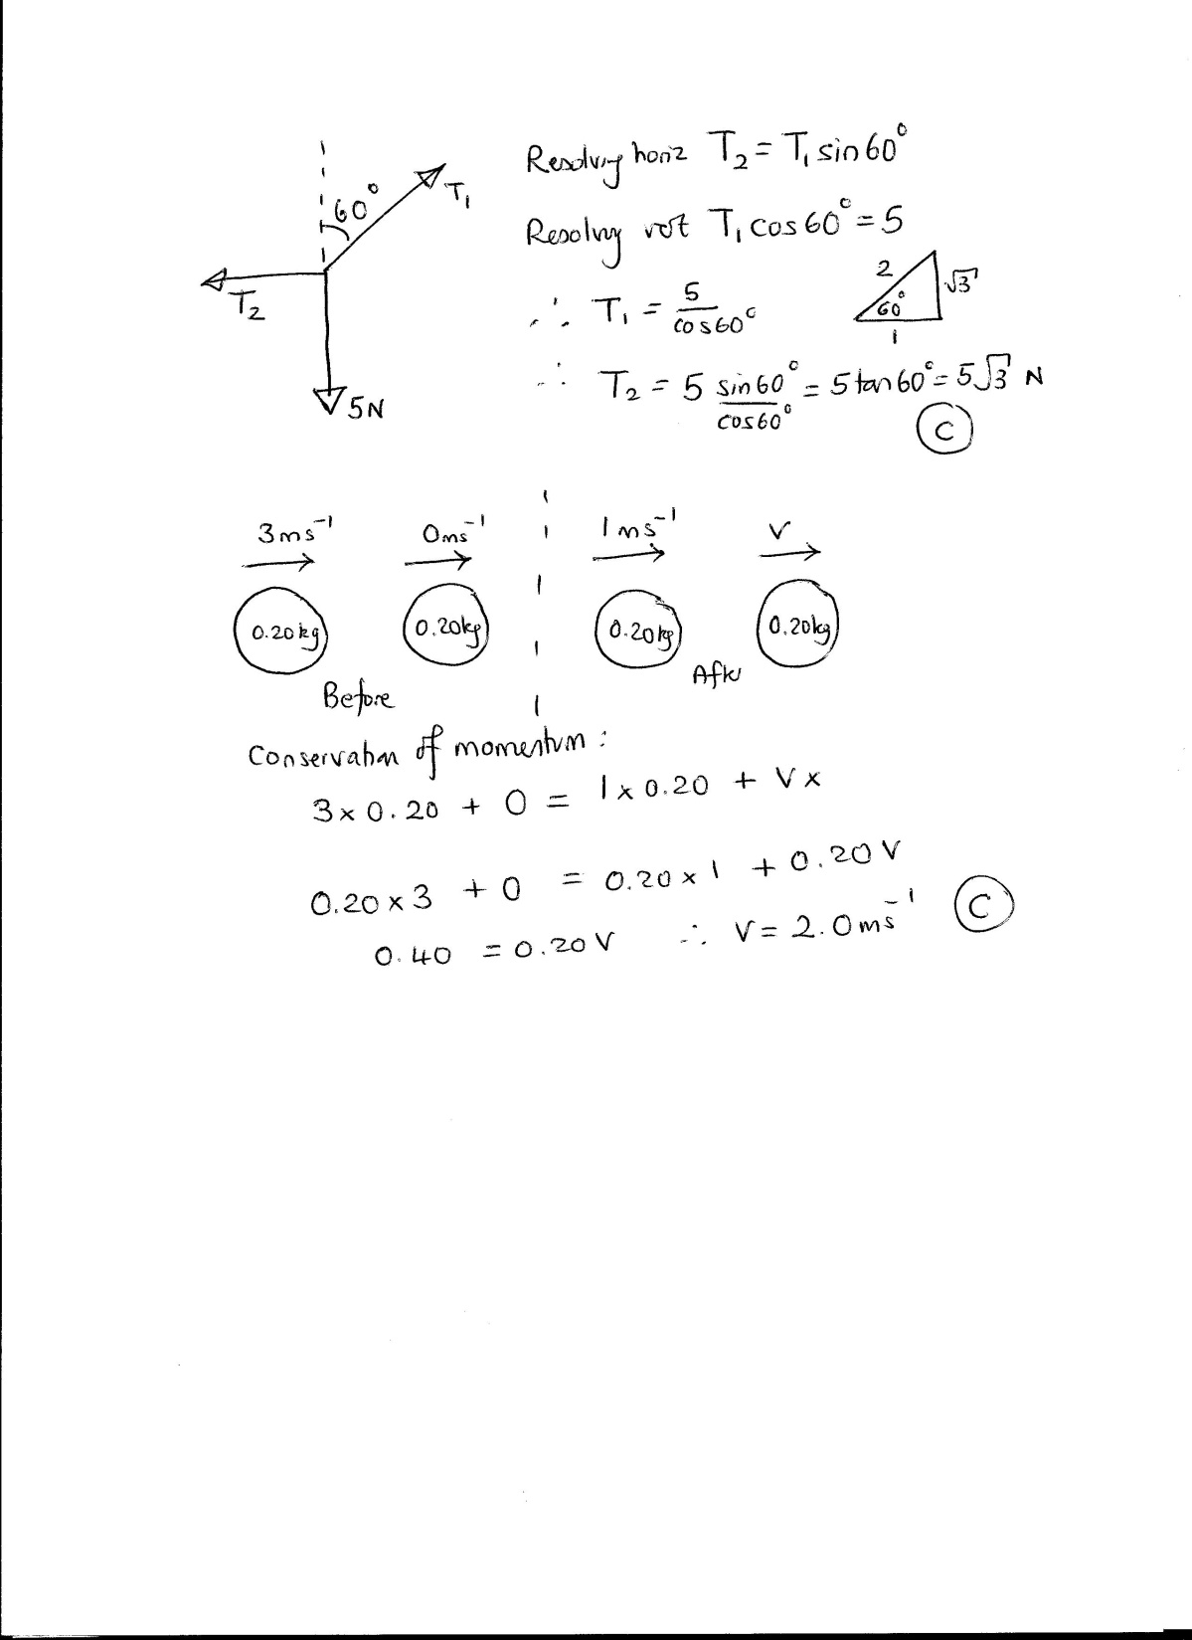

Slide 37
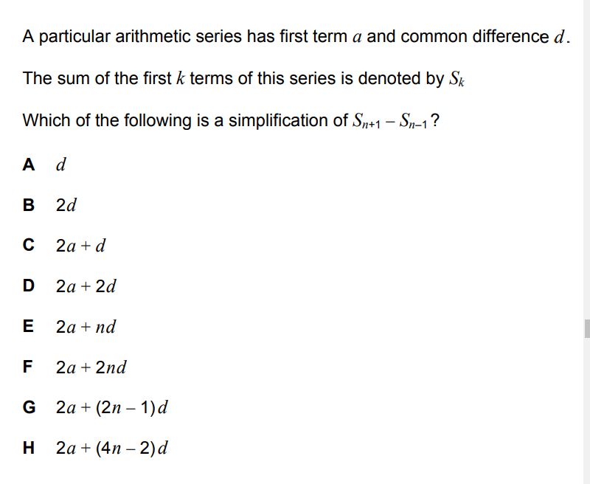
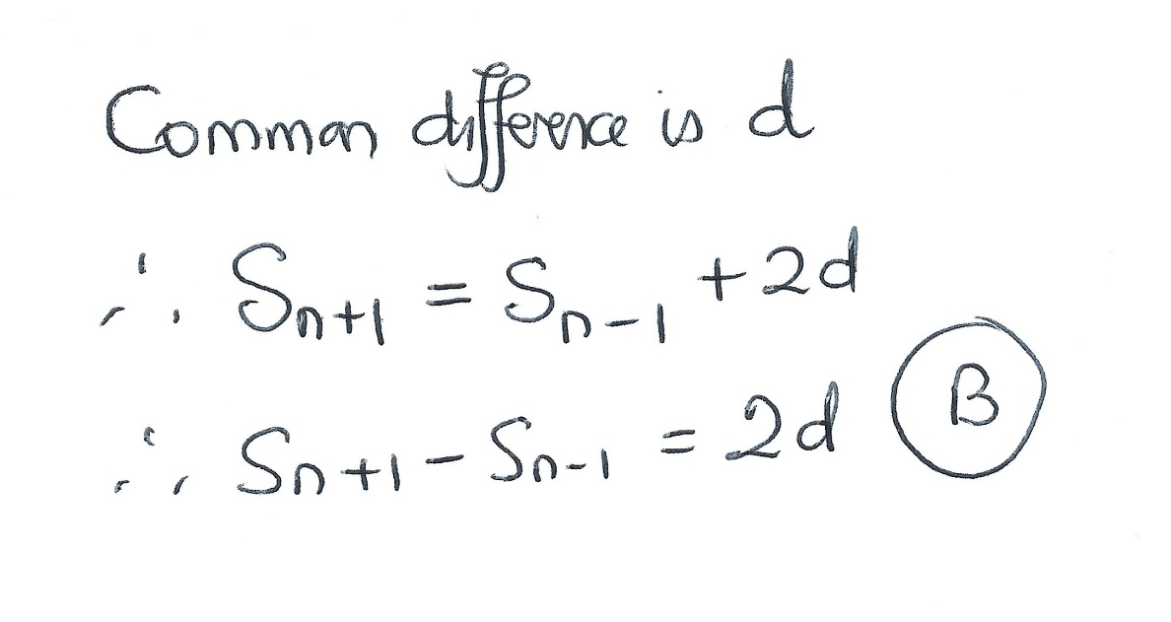

Slide 38
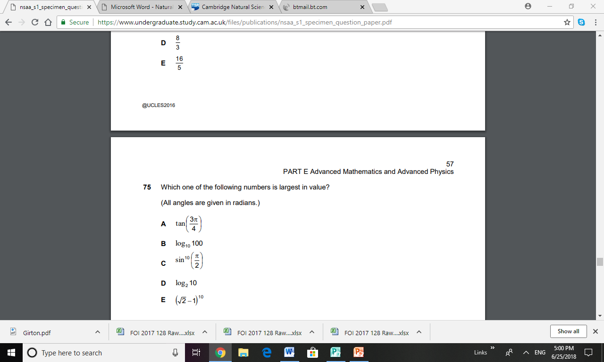
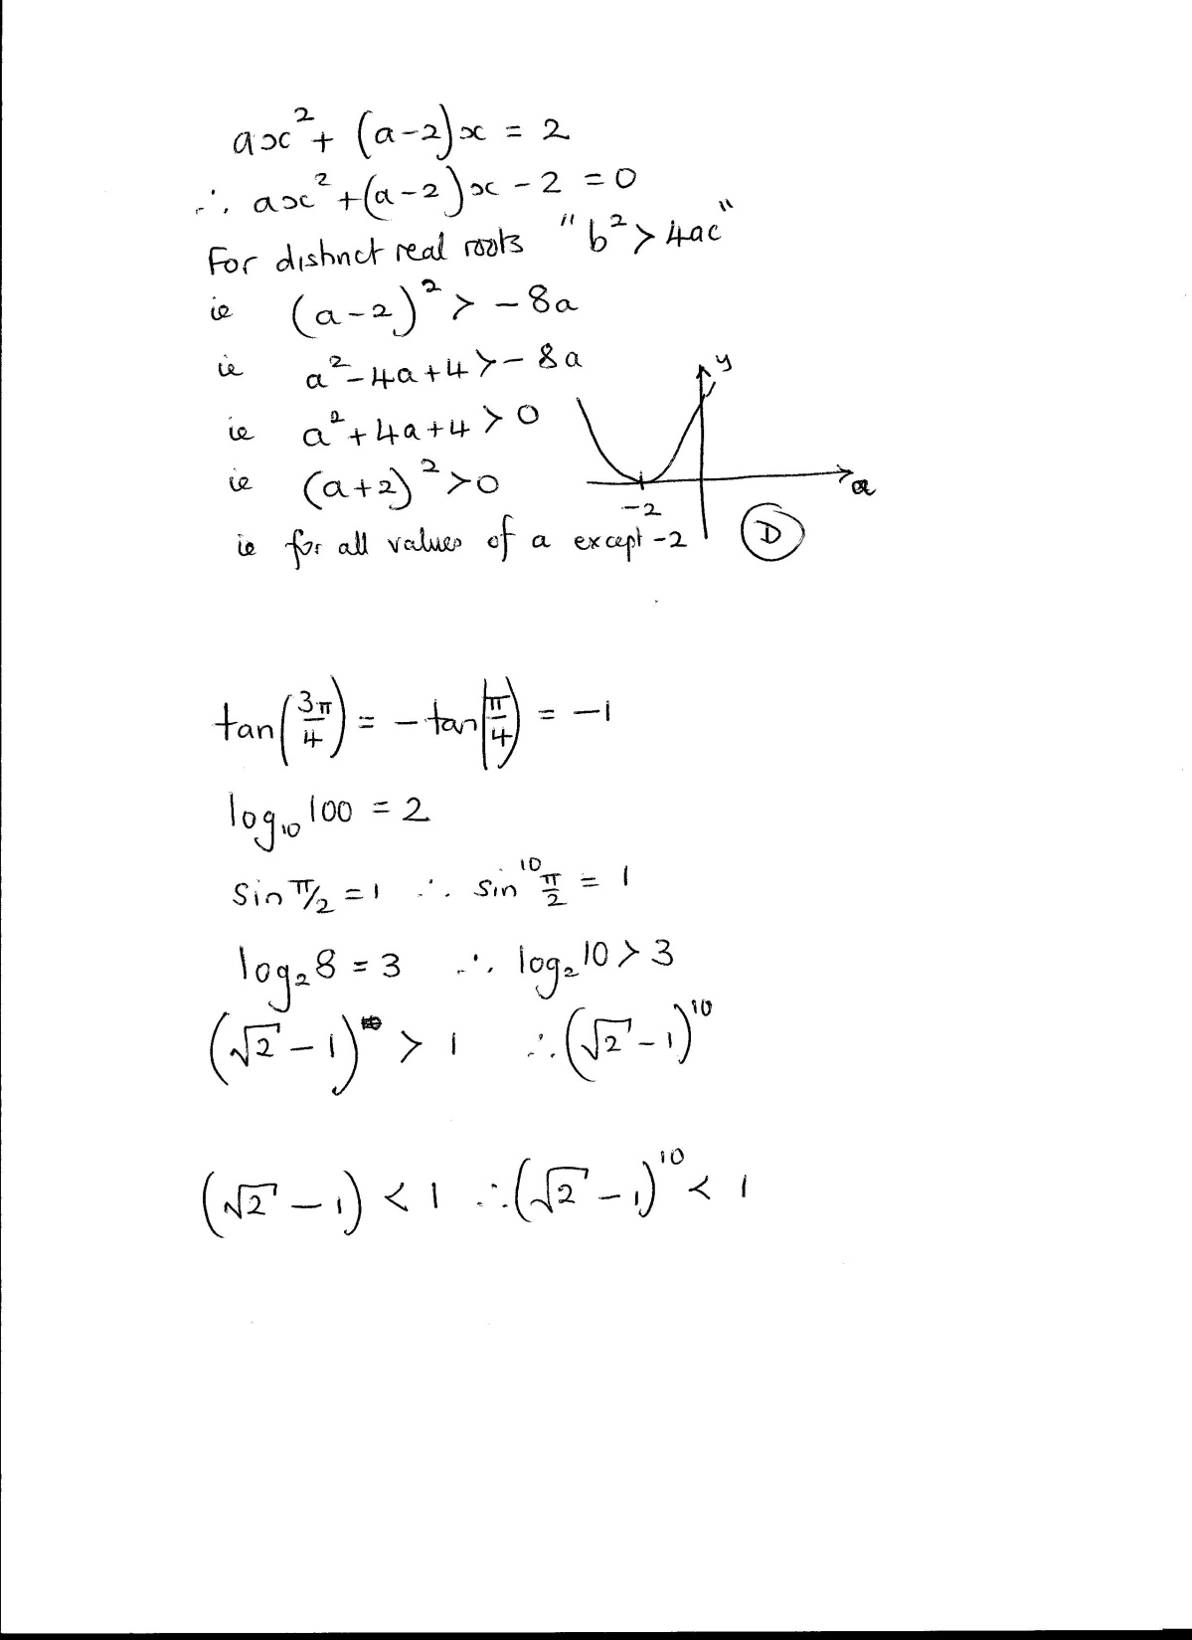

Slide 39
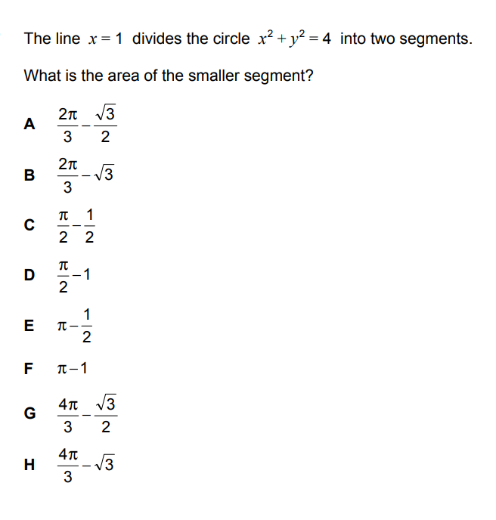
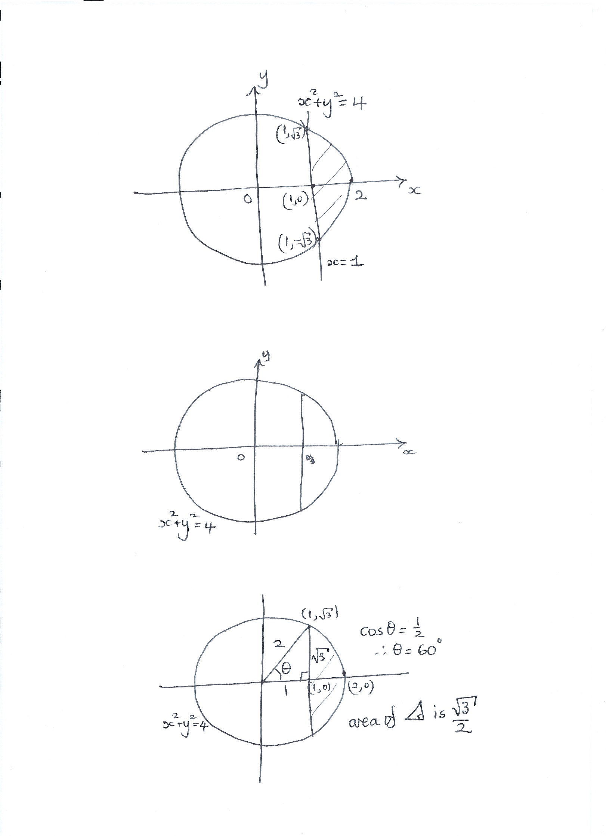
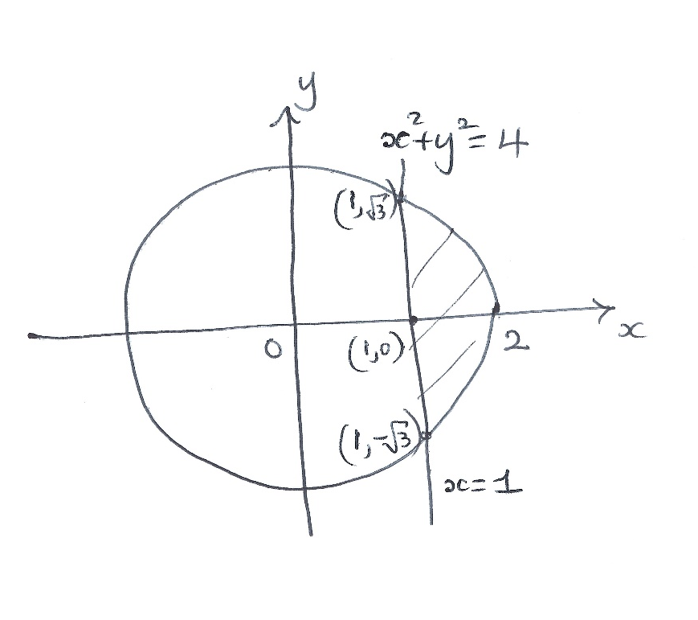
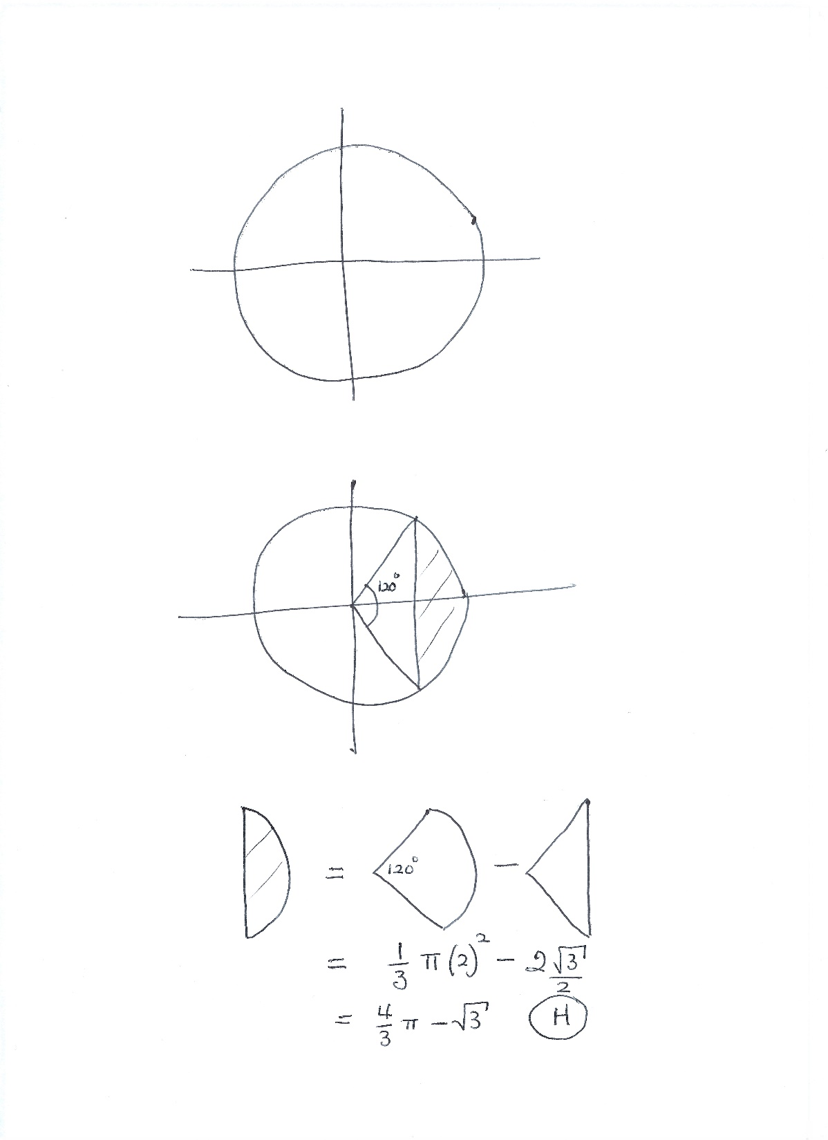
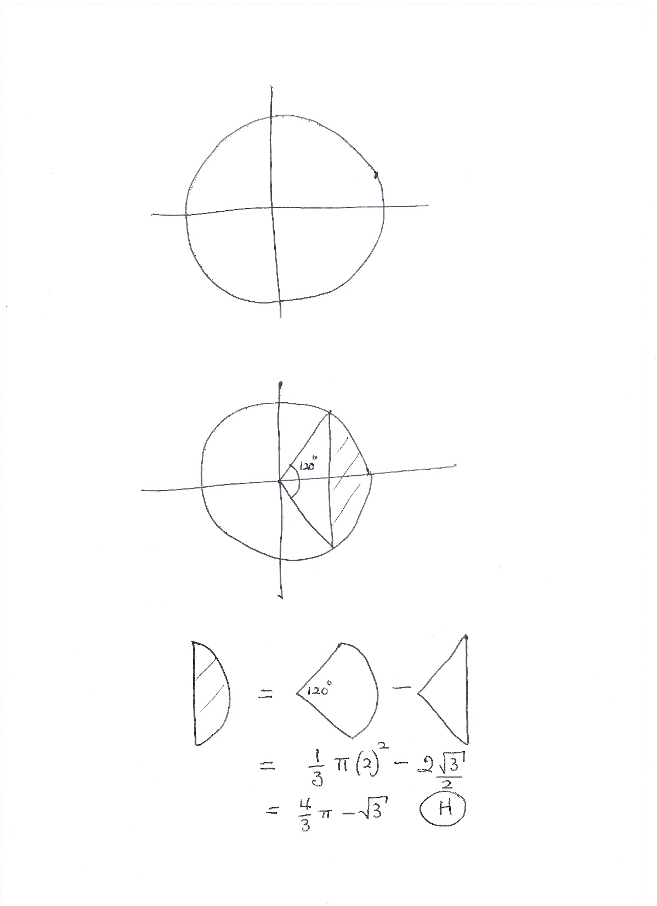
This seems to be quite hard to finish in 1 minute 29 seconds! If a problem is taking too long just guess an answer and mark the question for review.

Slide 40



Slide 41




Slide 42



Slide 43
How to Prepare
Decide your choice of sections
Check the spec for your choices
Refer to the guide for clarification and examples
Practise the specimen test questions
Practise relevant past questions
Complete the practice test at full speed

Slide 44
There are past question papers which are useful for practice from the various tests which have been replaced by ESAT.
The ESAT website has ones from NSAA (sciences) and ENGAA (engineering).
Physics and Maths Tutor has ones from PAT (physics & engineering) and BMAT (Section 2 is useful for biology and chemistry).

Slide 45


The ESAT website has past papers for the former science (NSAA) and Engineering (ENGAA) tests, but some older papers allowed calculators.
https://esat-tmua.ac.uk/esat-preparation-materials/

Slide 46

Oxford’s former PAT test is useful for Physics and Maths question practice. It was used for Physics and Engineering admissions.
https://www.physicsandmathstutor.com/admissions/pat/

Slide 47

The previous medical test BMAT has useful questions, including Biology and Chemistry. It was used for Medicine and also for Biomedical Sciences.
https://www.physicsandmathstutor.com/admissions/bmat/

Slide 48

It has a topic-orientated approach which is useful for targeted practice.
https://www.physicsandmathstutor.com/admissions/bmat/section-2-biology

Slide 49
Peterhouse Admissions
I think a lot of applicants are worrying about prep and are approaching these assessments in the same mindset as A levels. You are advised to read over the supplied material to make sure you're happy with the style of questions and the areas of knowledge expected but after that we don't expect lots of preparation as these are test of ability rather than knowledge (i.e. how can you apply what you know rather than who knows the most). You turn up and do your best!
But, if you spend time familiarising yourself with the style of the questions and practising getting up to full speed, you will be more confident when you take the test and are likely to perform better!

Slide 50
Good Luck!

