Slide 1
ESAT
Engineering and Science Admission Test
2026
You will be sent a copy of this Powerpoint presentation.
It will come in two parts, due to its size.

Slide 2
ESAT Engineering and Science Test
Replaced NSAA and ENGAA from 2024, PAT and BMSAT from 2026
Cambridge: ChemEng, Eng, NatSci, VetMed
Oxford: BioMedSci, BiomedEng, ChemEng, Civil, Electrical, EngSci, InfoEng, MechEng, Physics
Imperial College: BiolSci, BioTech, MicroBiol, Ecology &EnvBiol, Engineering subjects and Physics
UCL: Electronic&Electrical Eng

Slide 3
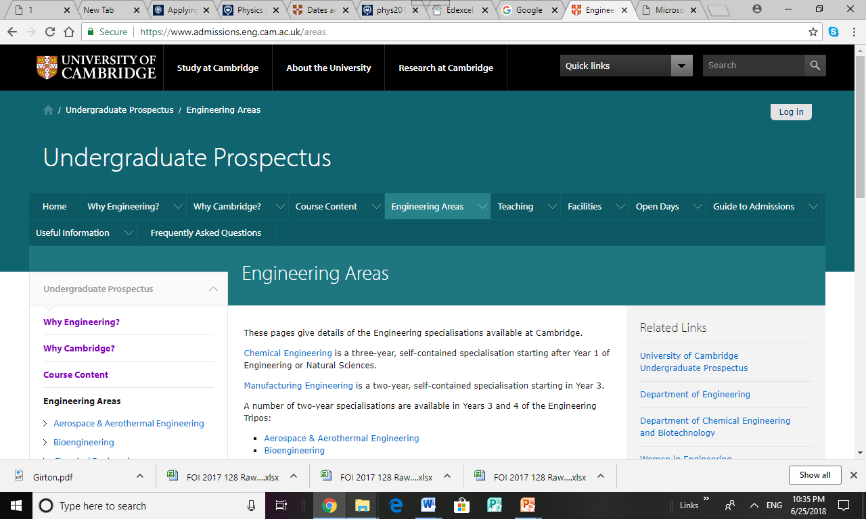
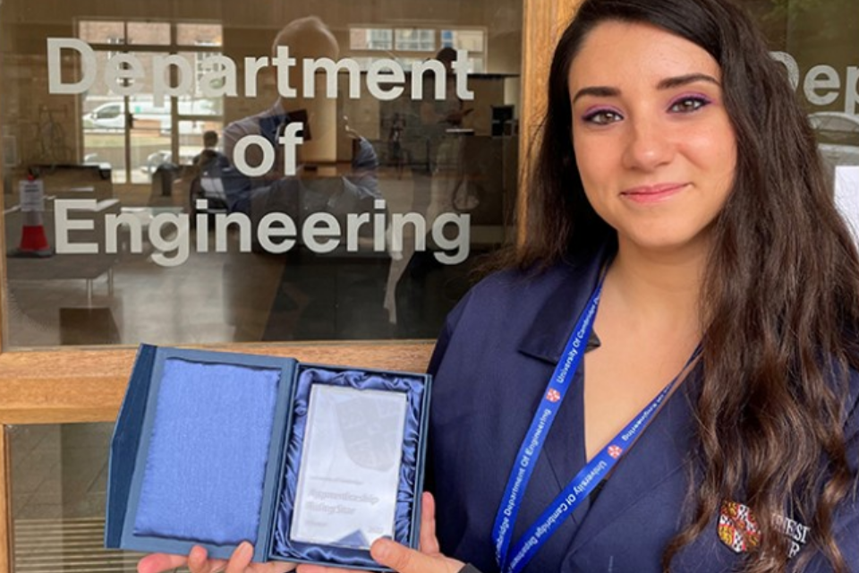
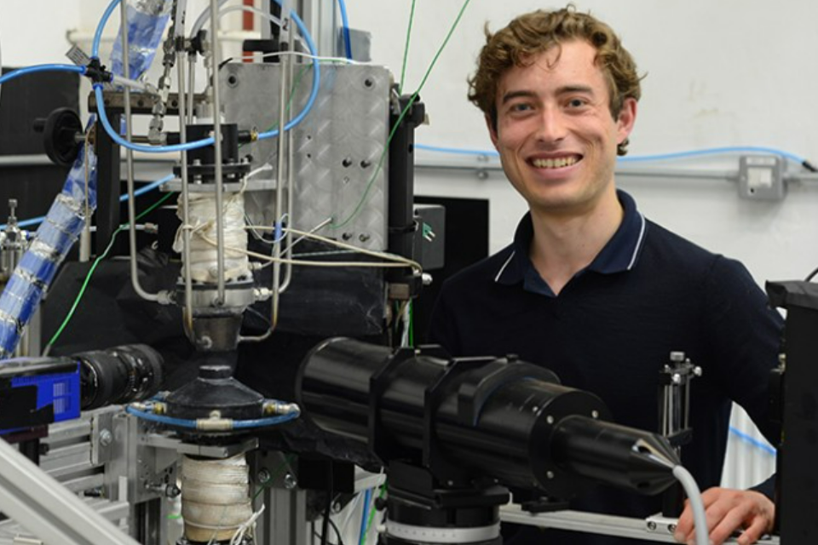

Slide 4
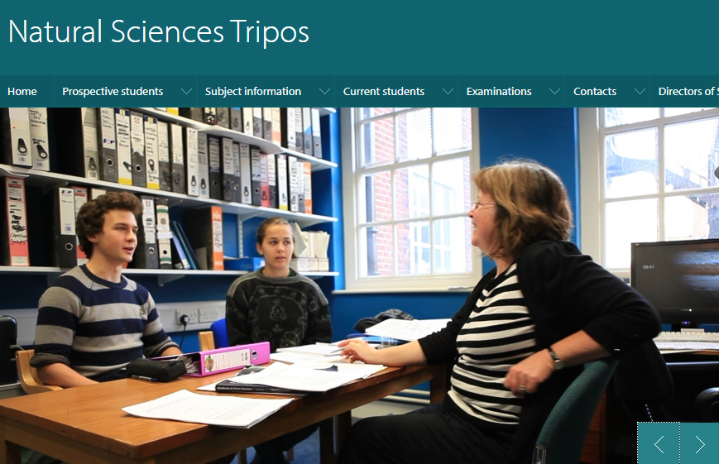

Slide 5
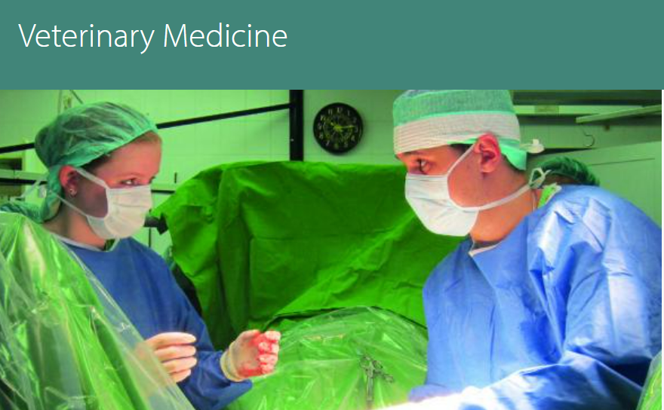

Slide 6
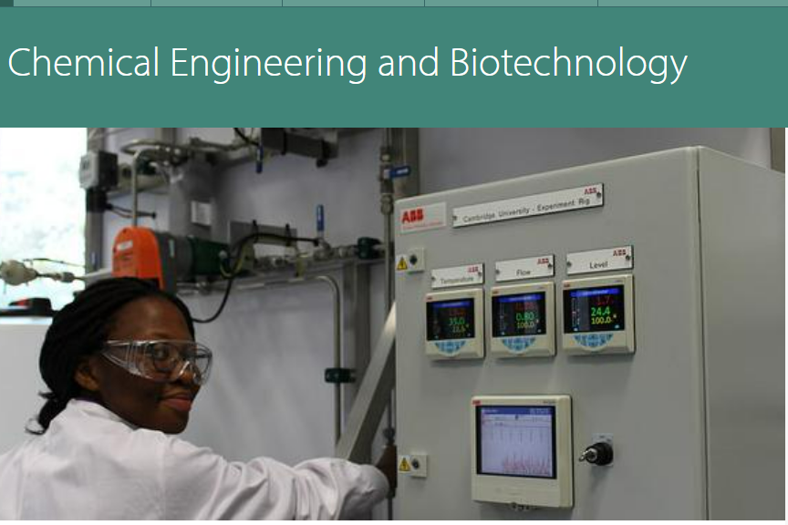

Slide 7
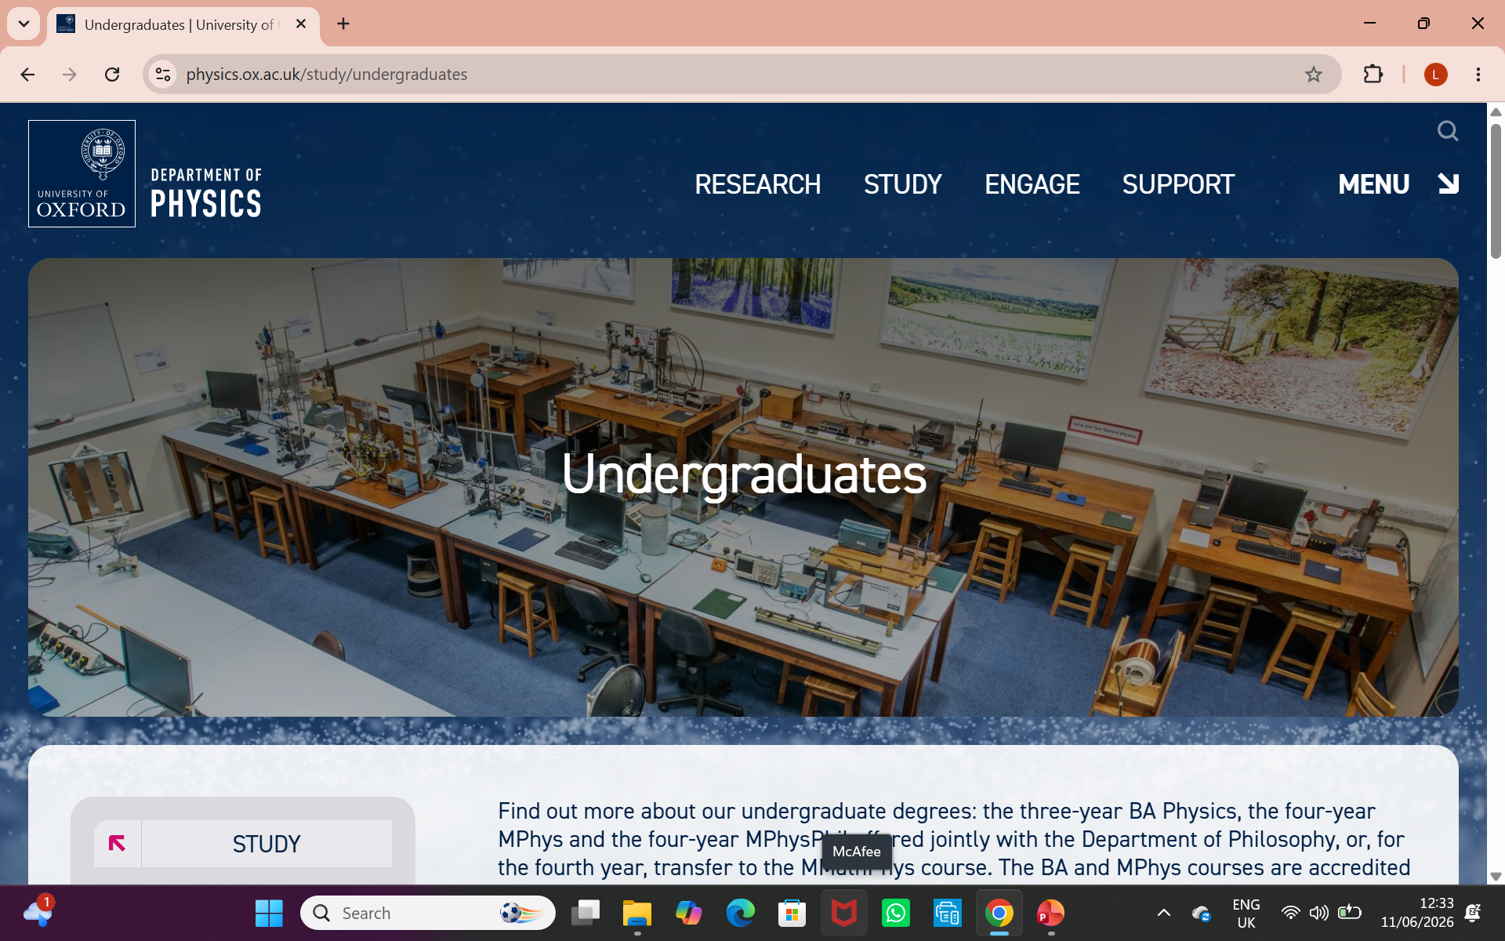

Slide 8
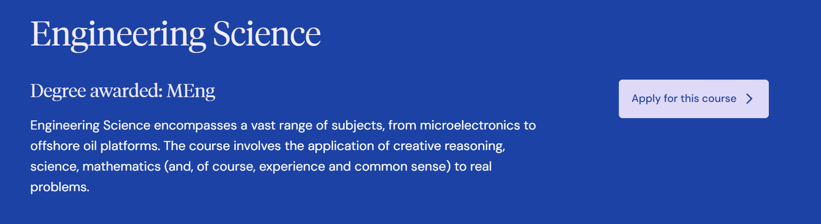



Slide 9
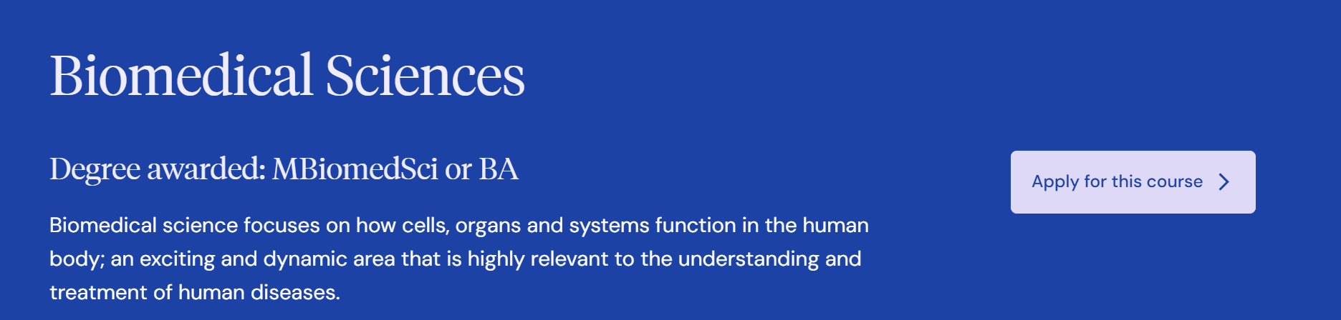

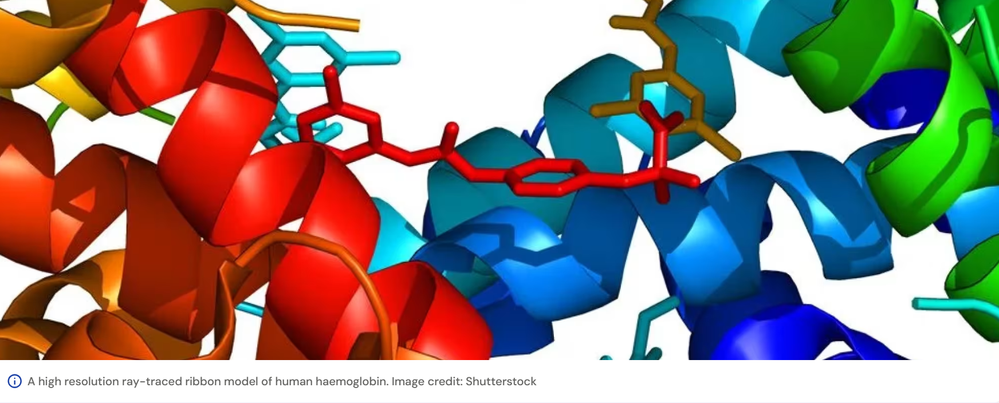

Slide 10
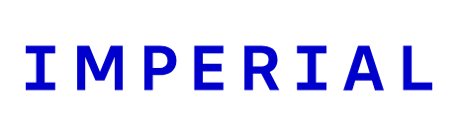
Aeronautical Eng
BioChem
BiolSci
BioTech
Chemical Engineering
Civil and Environmental Engineering
Design Engineering
Ecology and Environmental Biology
Electrical and Electronic Engineering
Mechanical Engineering
Microbiology
Physics

Slide 11
UCL
Electrical and Electronic Engineering

Slide 12
Assessment format (computer based)
The format for the 2026 assessment will be as follows:
Take 3 sections of 27 multiple-choice questions.
Each section 40 mins.
No calculators or formula sheets.
Maths 1 (compulsory)
Maths 2
Biology
Chemistry
Physics
wo
Take two

Slide 13
2026 assessment details
 | ESAT 2 hours | Maths 1 (40 mins) | Two from* Maths 2 Biology Chemistry Physics (each 40 mins)
*Some courses define which two units are compulsory, others let you choose.
The format was different before 2024 so it has implications for the usefulness of the full past papers in NSAA, ENGAA , PAT and BMAT

Slide 14
2026 assessment details
Engineering | ESAT 2 hours | Maths 1 (40 mins) Maths 2 (40 mins) Physics (40 mins)

Slide 15
2026 test details
Each of the five sections of the test will have 27 multichoice questions to be answered in 40 minutes.
This is 1 minute 29 seconds per question (including reading time). This is equivalent to the old NSAA and ENGAA papers which had 1minute 30 seconds per question in Section 1.
It is essential that you put an answer to every question, even if it’s a complete guess, as there are no penalties for wrong answers.

Slide 16
Registration for ESAT 2026
It is your responsibility to register yourself with UAT-UK (already open) and to book a test (booking open between 20 July and 28 September 6pm BST), it is NOT done by your school or college.
https://esat-tmua.ac.uk/register/
You must pay the fee (£78) when you book your test.

Slide 17
Test Centres
Tests are NOT taken at your school or college.
Tests MUST be taken at Pearson Professional Testing Centres (different places from Pearson Diving Theory centres).
Norwich, Lowestoft, King’s Lynn, Bury St Ed’s

Slide 18
The process
1. Set up account with UAT-UK: from 1 June
https://esat-tmua.ac.uk/register/
2. Preparation materials:
https://esat-tmua.ac.uk/prepare/
3. Add a “Test Card” to your UAT-UK account:
Pick your test (ESAT) and your test modules
4. Book your test: from 20 July until 28 September Pay £78
In your UAT-UK account click on your test card for test centre and test day.
5. Sit test: 12 or 13 Oct 2026 (4-8 January option available if you are not applying to Oxford or Cambridge. Tests bookable 26 Oct – 21 Dec)
6. Result: 16 Nov 2026 via your UAT-UK account

Slide 19
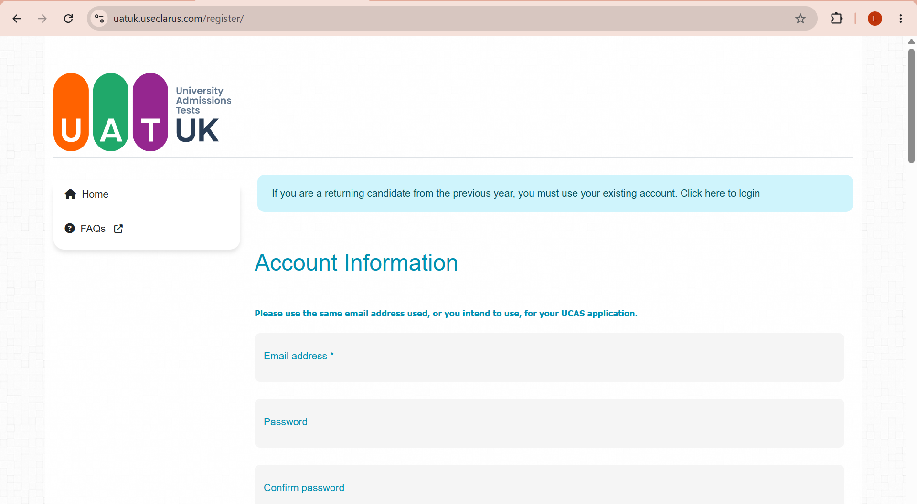
How to Register with UAT-UK
https://uatuk.useclarus.com/register/

Slide 20
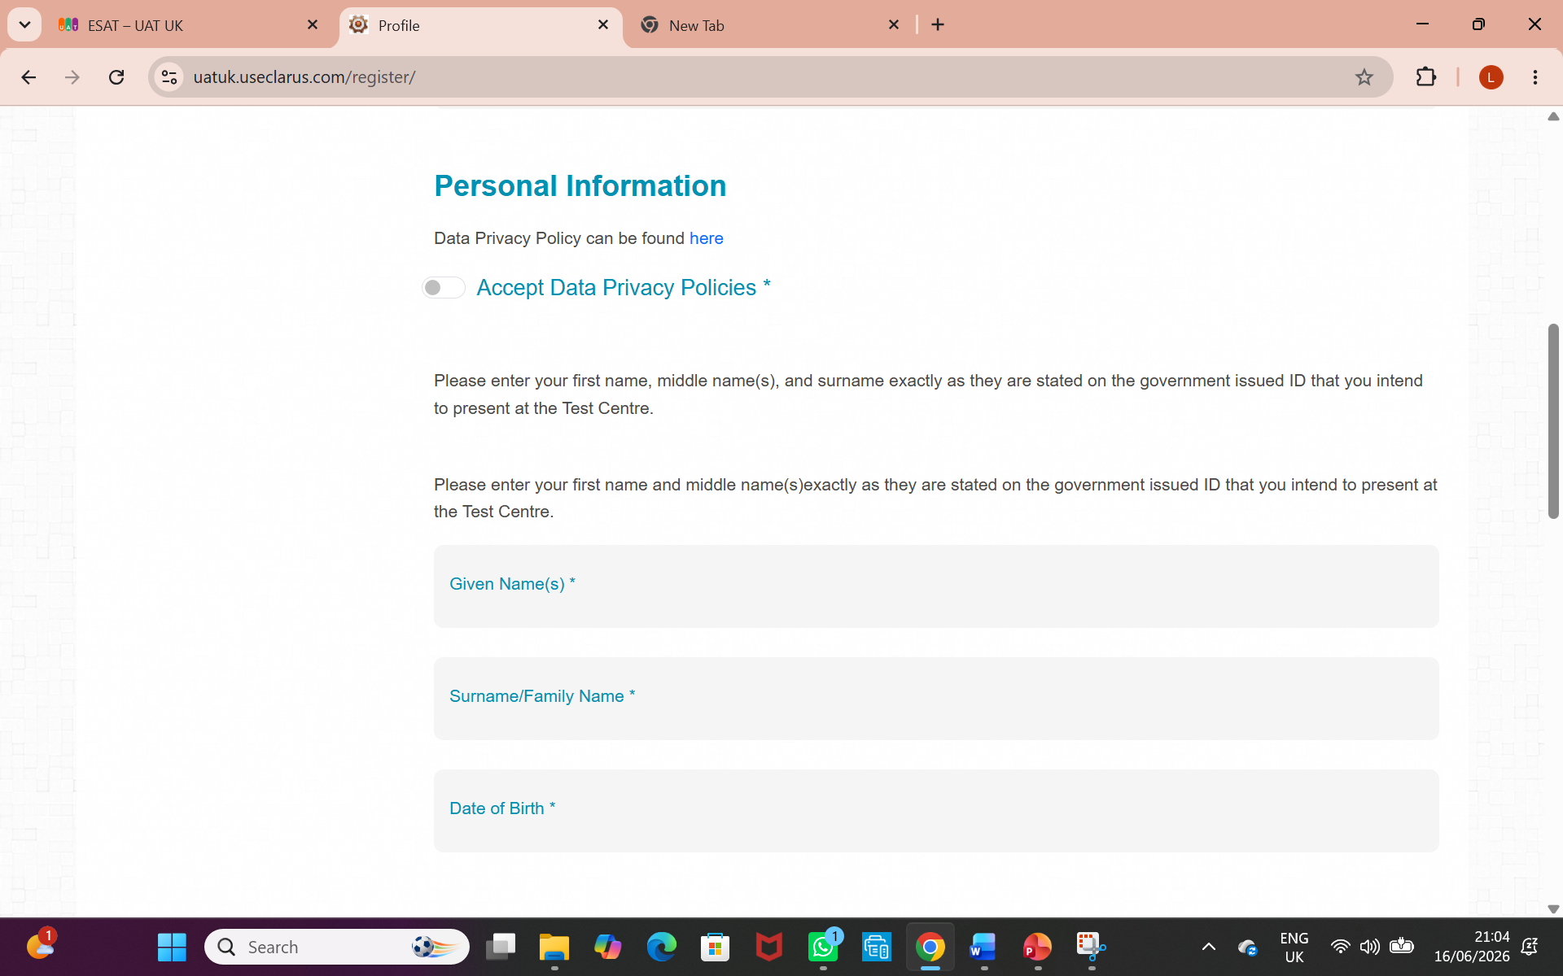
How to Register with UAT-UK

Slide 21
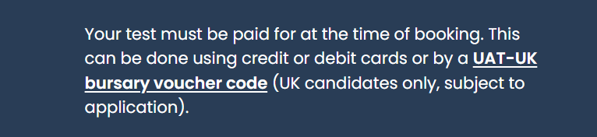
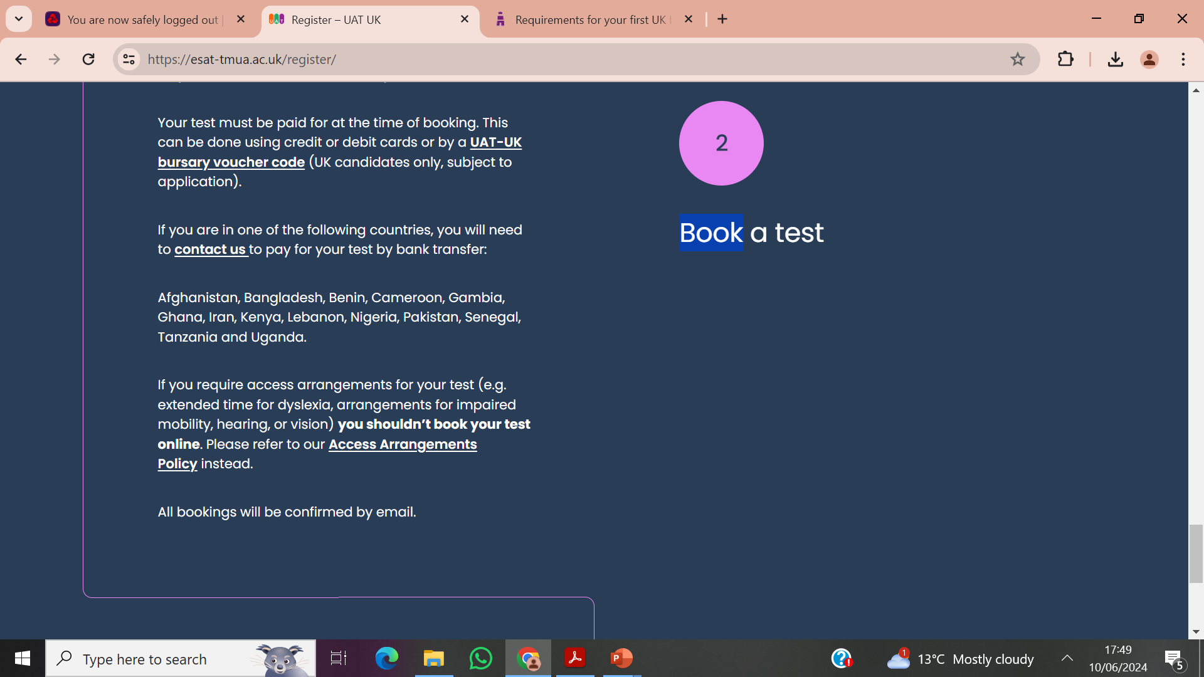
£78
Applications for the UAT-UK bursary are now open.
UK candidates in financial need can apply for a bursary to book the ESAT free of charge.
Important: You must apply for a bursary and wait for confirmation that your application has been approved before booking your ESAT test.
Learn about eligibility criteria and apply for a bursary on the UAT-UK website.
https://esat-tmua.ac.uk/

Slide 22
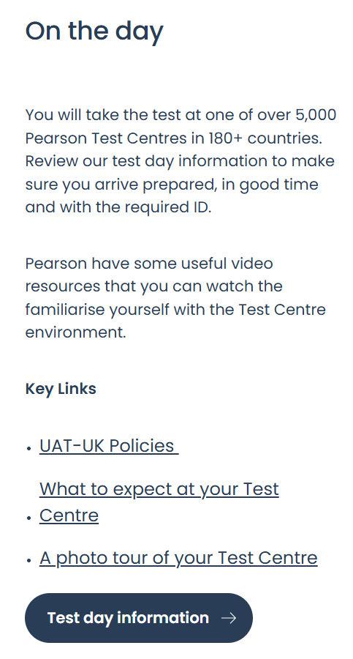
Where do I sit the ESAT?
Pearson Professional Test Centre
Lowestoft
Norwich
King’s Lynn
Bury St Edmund’s
https://esat-tmua.ac.uk/

Slide 23
Test Dates for ESAT 2026
Test dates are Mon 12 and Tues 13 Oct 2026
If you are applying to Oxford or Cambridge, you must sit in October. If you are only applying for Imperial and/or UCL you can choose between October and January test dates. January test booking is open 26 Oct – 21 Dec and test dates are 4-8 January.
You should be able to choose your date when you book the test.
If you need access arrangements you must take the test on 12 October and book by
14 September.

Slide 24
The Year Ahead: Cambridge data for previous years
Places 18
Interviews
75
Offers
22
4
Applications
100
Winter pool
18
Offers 4
Places 2
2
25
35
14
ESAT
Interviews
Exam Results

Slide 25
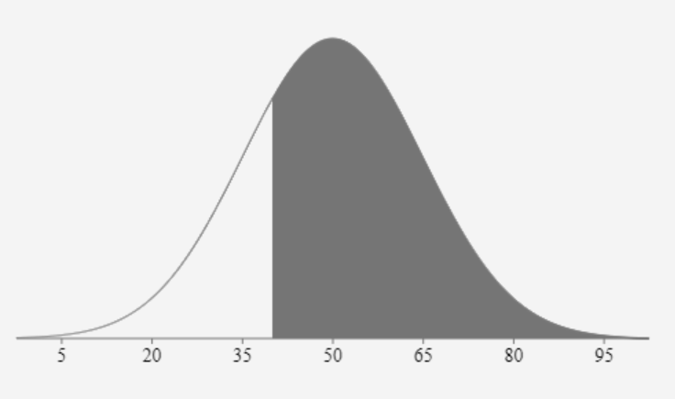
Estimated Score to progress from ESAT?
75%
40
Percentage score

Slide 26
The Year Ahead: Oxford data for previous years
Applications
100
Interviews
30
Offers
12
Places 11
1
70
18
PAT
Interviews
Exam Results

Slide 27
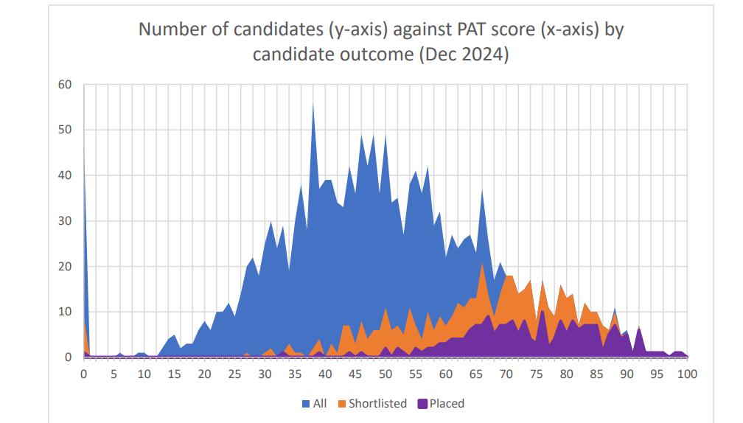
PAT for entry 2025
Oxford applicants are taking ESAT for the first time this year, so maybe the proportion of applicants who are interviewed will change.

Slide 28
ESAT Scores 2026
Scores will be standardized on a 1 (low) to 9 (high) scale (to one decimal point).
They will be sent to the relevant University and accessible by students on 16 Nov 2026, via your UAT-UK account and you should get an email telling you that they are available.
You don’t need to be a superstar in the test; you just need a decent score to get an interview.
Percentage score

Slide 29
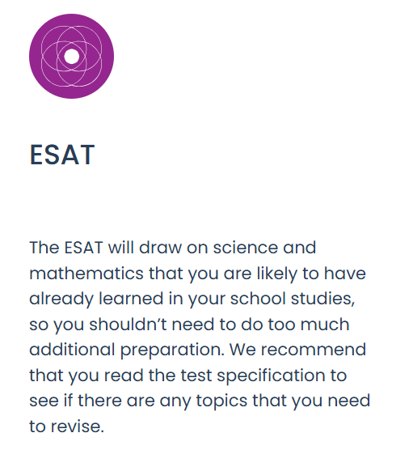
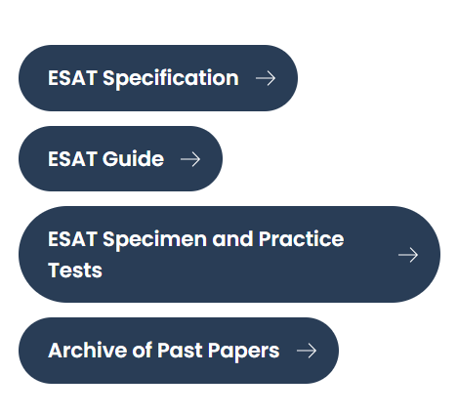
https://esat-tmua.ac.uk/prepare/

Slide 30
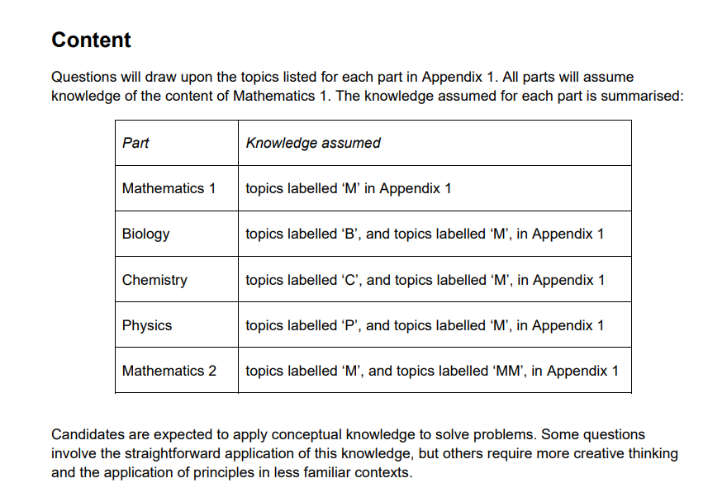

Slide 31
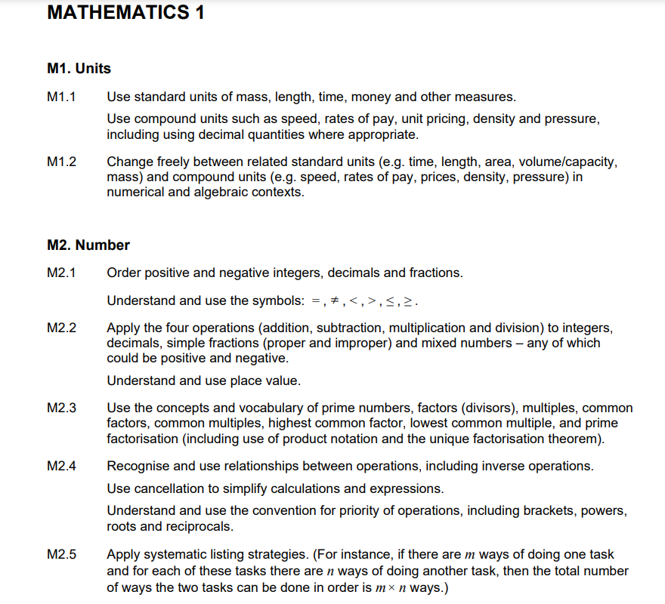
N.B. Only the first page of each subject specification is shown here.

Slide 32
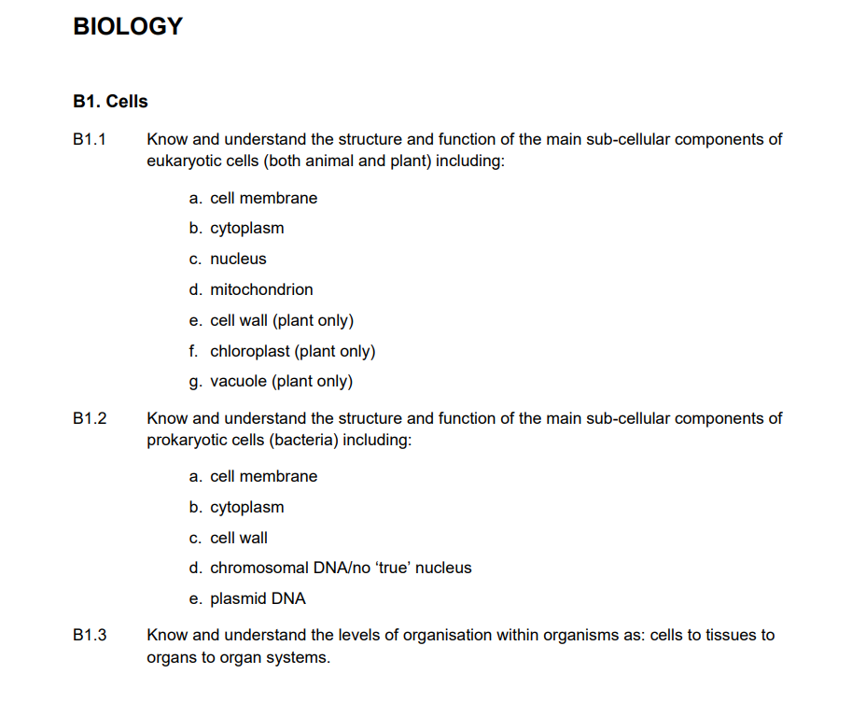

Slide 33
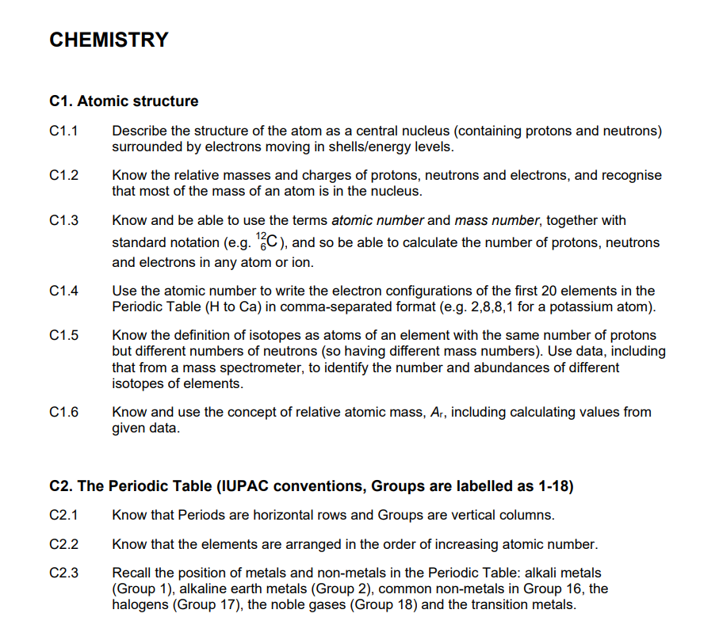

Slide 34
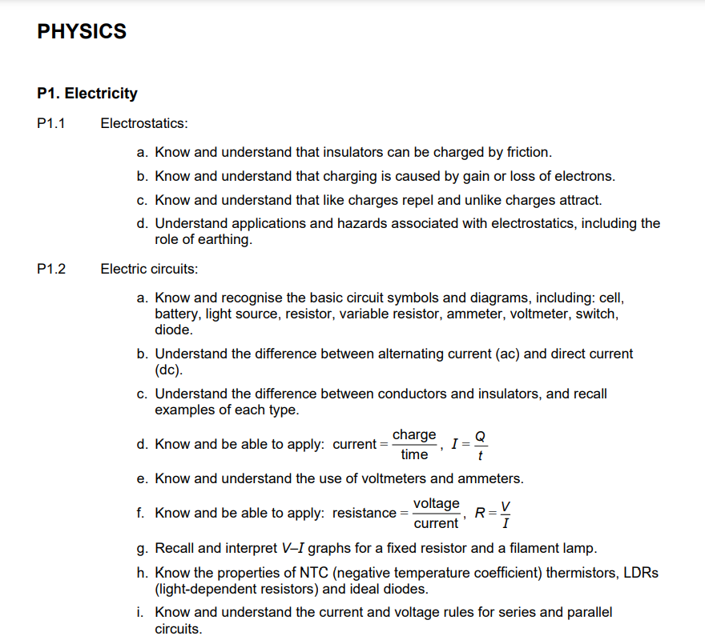

Slide 35
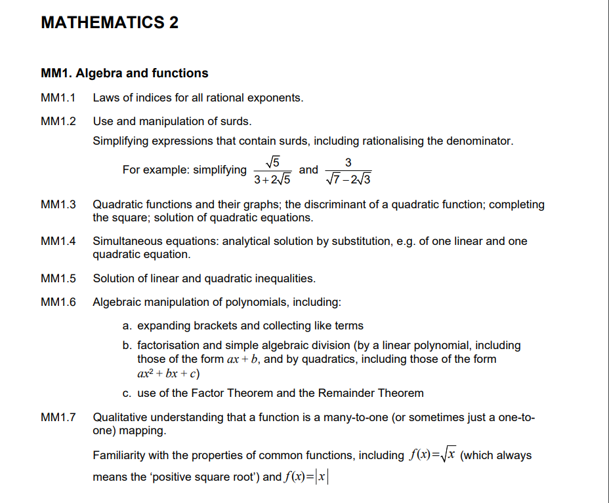

Slide 36
https://esat-tmua.ac.uk/prepare/

Slide 37
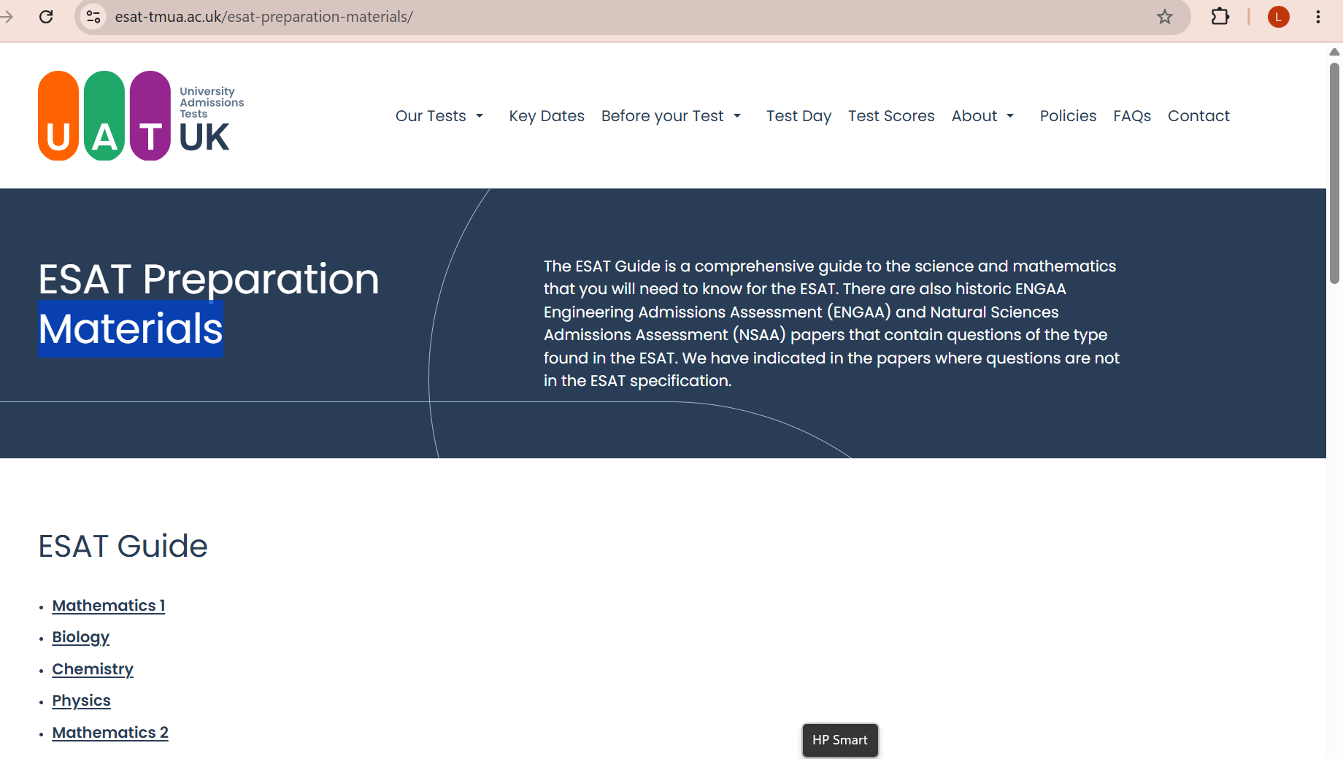
https://esat-tmua.ac.uk/esat-preparation-materials/

Slide 38
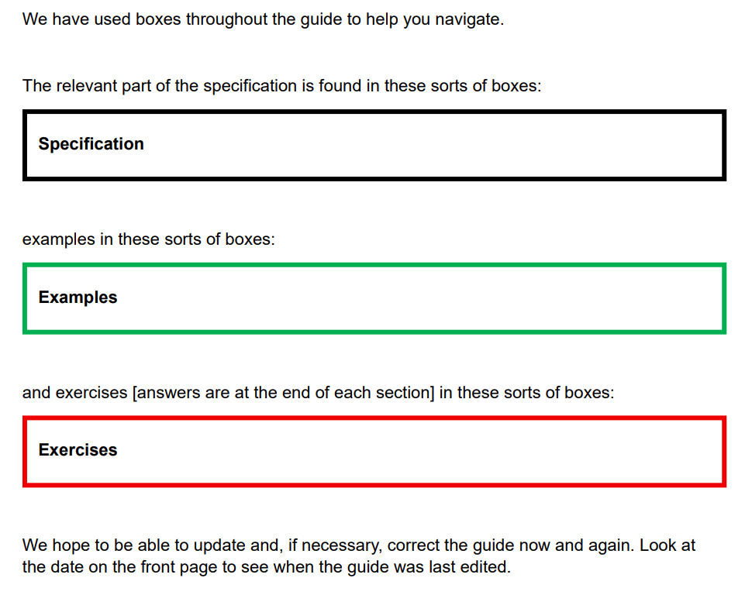
https://esat-tmua.ac.uk/esat-preparation-materials/

Slide 39
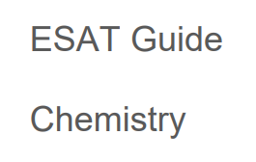
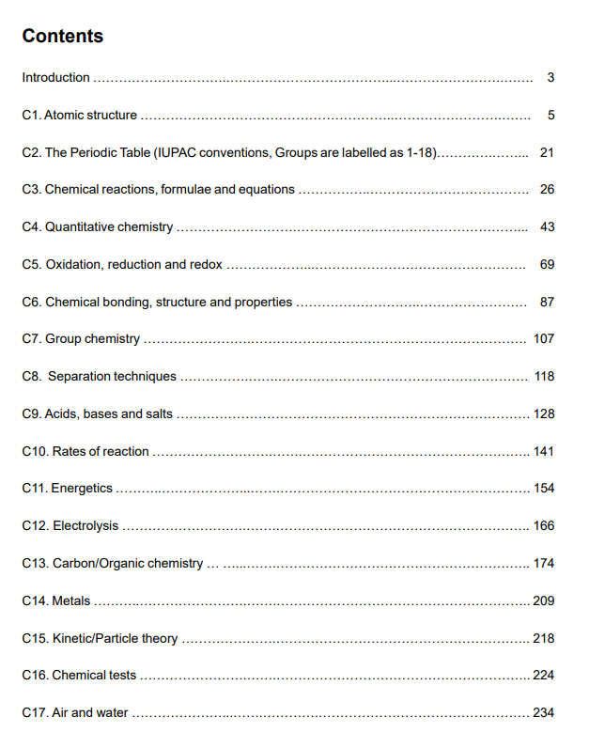
https://esat-tmua.ac.uk/esat-preparation-materials/

Slide 40
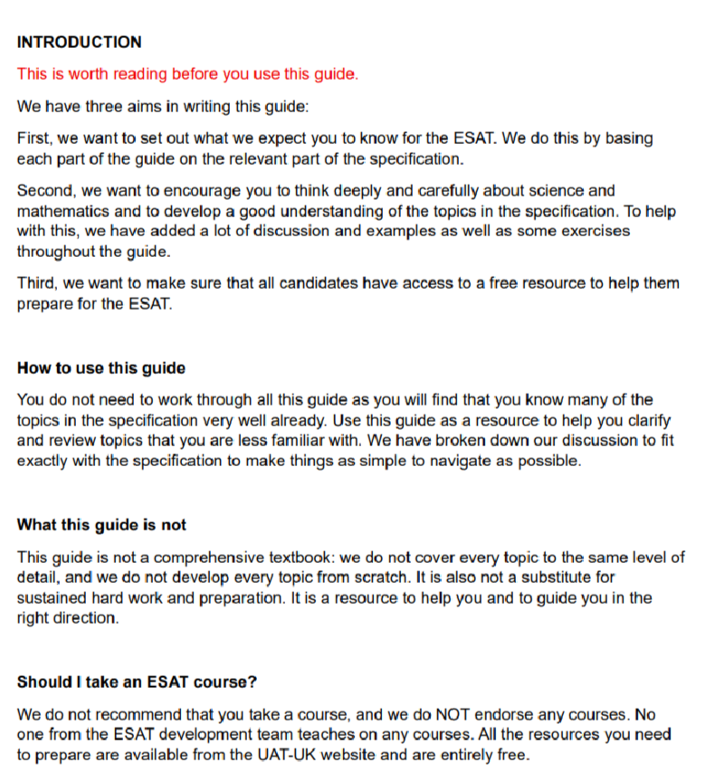
No. of pages!
M1 381
Biol 215
Chem 240
Phys 312
M2 159
https://esat-tmua.ac.uk/esat-preparation-materials/

Slide 41
https://esat-tmua.ac.uk/prepare/

Slide 42
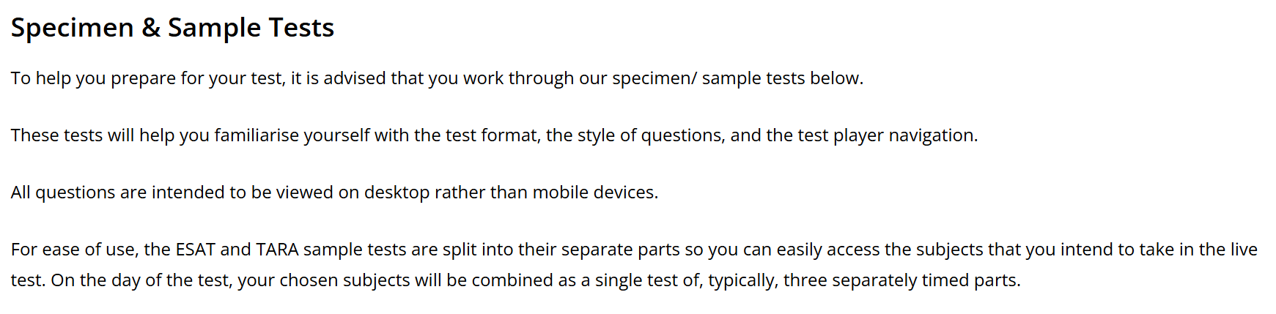
https://esat-tmua.ac.uk/prepare/

Slide 43
https://esat-tmua.ac.uk/prepare/

Slide 44
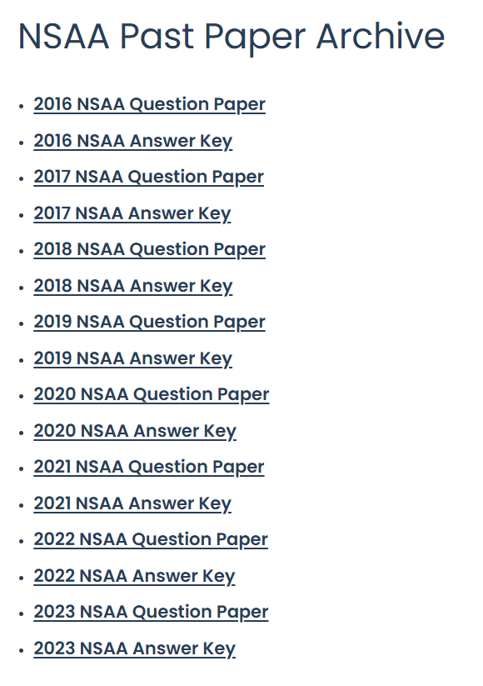
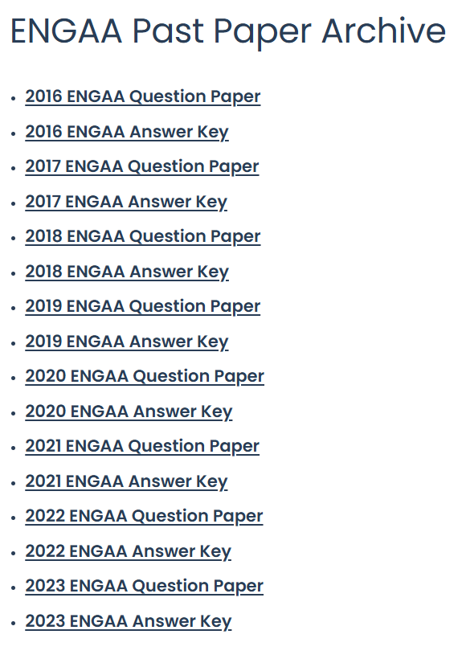
https://esat-tmua.ac.uk/prepare/

Slide 45
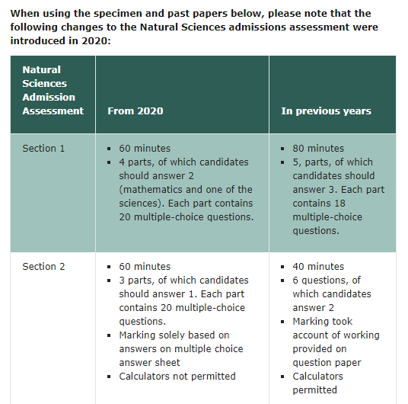
Older papers are less relevant than more recent ones.
https://www.undergraduate.study.cam.ac.uk/courses/natural-sciences

Slide 46
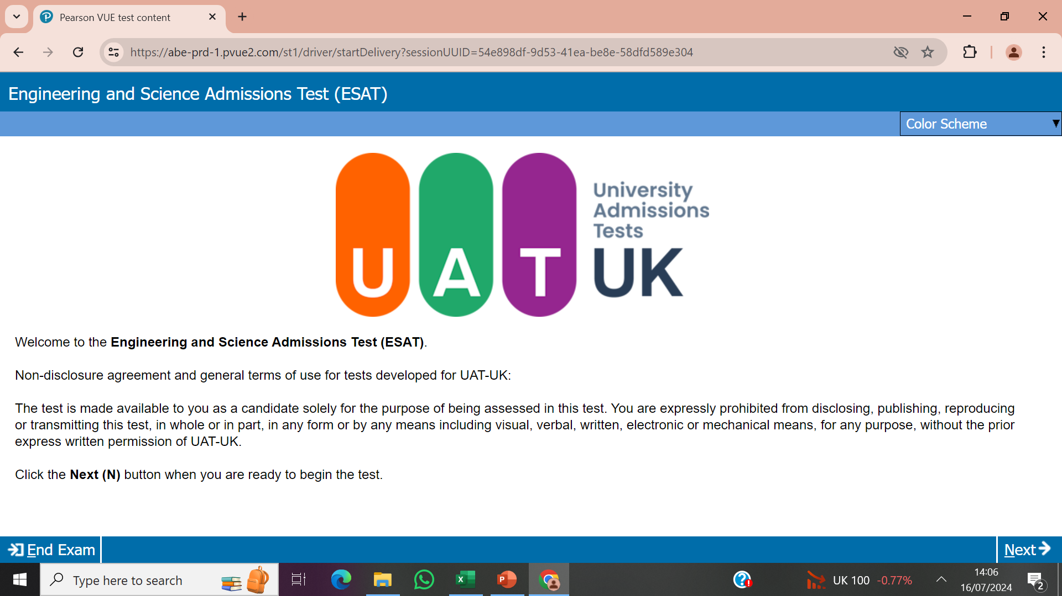

Slide 47
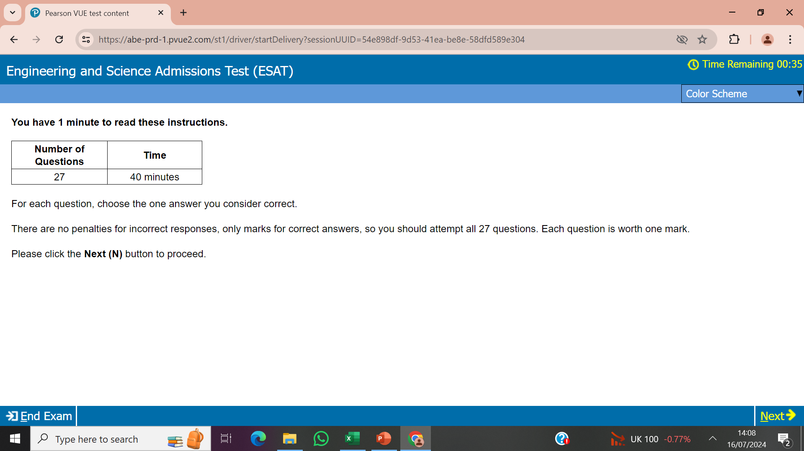

Slide 48
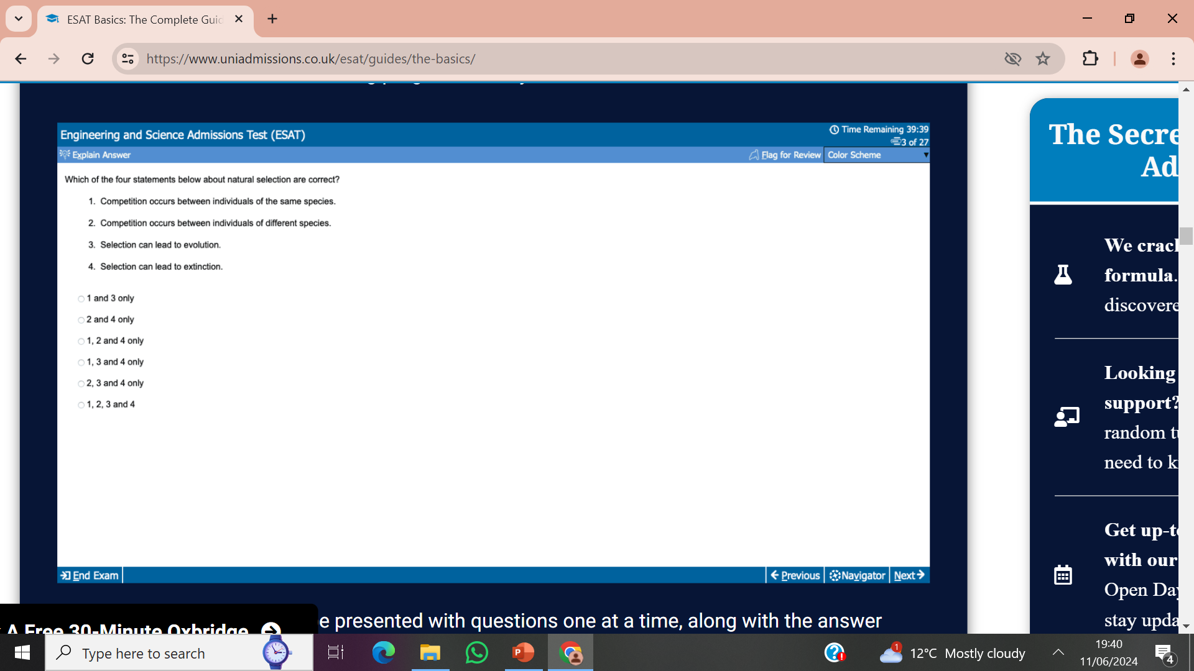
Specimen tests have this explain option
Via https://esat-tmua.ac.uk/prepare/

Slide 49
If unsure of the answer, always guess one and mark the question for “review”. At the end of the test, you can see which questions are for review and think again if you have time. Remember that there are no penalties for wrong answers!

Slide 50
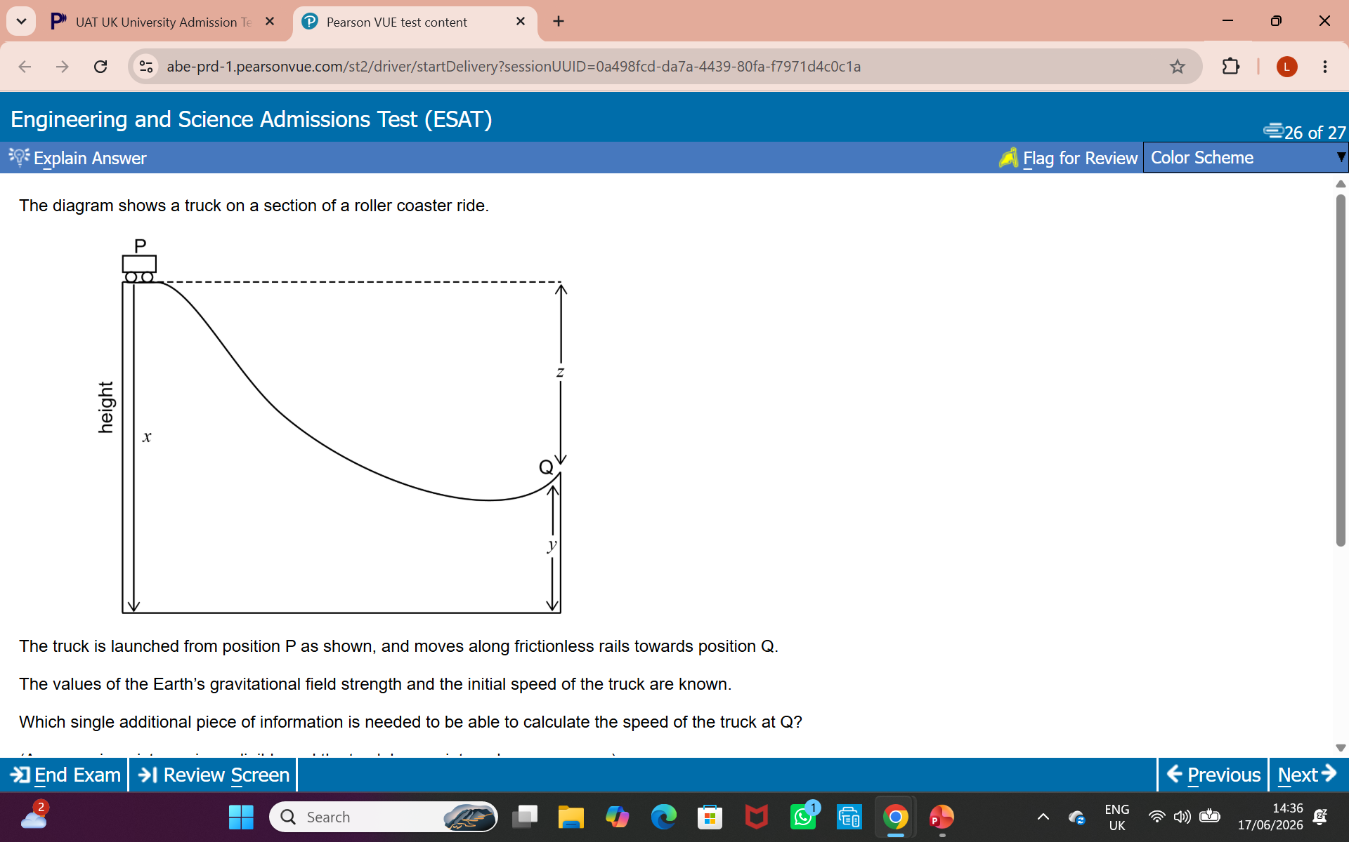

Slide 51
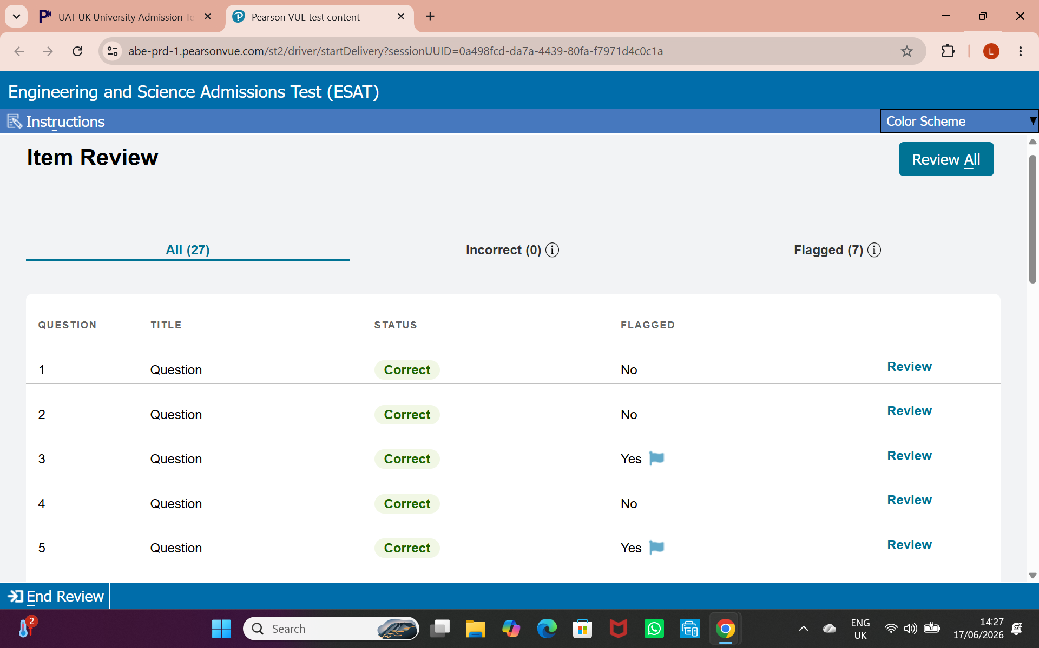

Slide 52
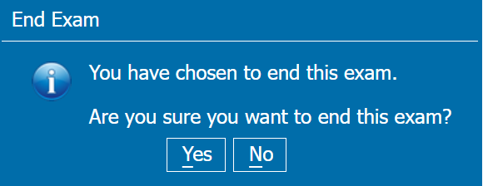

Slide 53
No calculator
No formulae sheet
Erasable whiteboard and pen for doing any working on

