Slide 1



Introduction To Apprenticeships
Understanding Apprenticeships
Version 2: September 2024

Slide 2




Apprenticeships
Today’s session
WHAT THEY ARE
What we’ll be covering
Tips And Tricks
HOW TO APPLY GUIDE
Questions

Slide 3
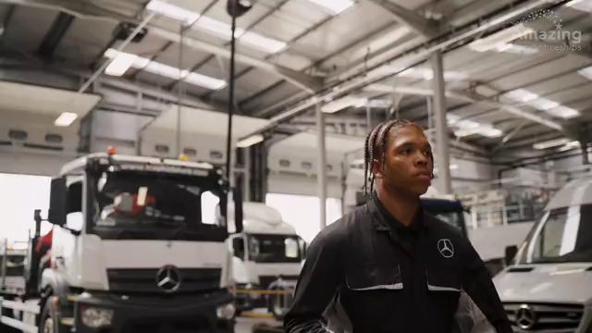
Meet some apprentices

Slide 4









What are apprenticeships?
Intermediate - degree
Typically 1-6 years
Employed
Off the job
Paid a salary
Real responsibilities
Not the easy option
Contract
700+ standards

Slide 5




Levels of apprenticeships
Intermediate
Advanced
Higher
Degree
Equivalent to:
5 GCSE passes at grade 9-4 (A*-C)
Equivalent to:
2 A levels /
International Baccalaureate
Equivalent to:
Foundation degree and above
Equivalent to:
Bachelors or
masters degree
Level 2
Level 3
Levels 4-7
Levels 6 & 7

Slide 6
Levels of apprenticeships
Intermediate (L2)
Advanced
(L3)
Higher
Degree
  Furniture maker
  Security operative
  Barber
  Aviation ground handler
  Dog groomer
  Florist
  Accounts assistant
  Pharmacy assistant
  Marina operative
  Junior estate agent
  Engineering technician
  Pastry chef
  Multi-channel marketer
  Fundraiser
  Scenic artist
  Electrician
  Community wellbeing worker
  Data technician
  Visual effects artist
  Town planning assistant
  Sports coach
  Space engineering technician
  Geoscientist
  Accounting manager
  Midwife
  Social worker
  Civil engineer
110+ standards (L4)
110+ standards (L6)
  Vet technician
  Nursing associate
  Rail engineer
  Marine pilot
  Nuclear technician
  Doctor
  Game programmer
  Play therapist
  Solicitor
  Economist
140+ standards
230+ standards
40+ standards (L5)
60+ standards (L7)

Slide 7









Higher & Degree apprenticeships
University fees paid by employer and/or Government
Work full-time and study part-time
No debt
Integrated degree or degree level
Experience
4-6 years
100+ universities (plus colleges, training providers)
Competitive
Progression
Required
Employer selects University/provider
Notes:
Presenter note: Is this slide appropriate for your audience today? Please hide this slide if you do not intend to cover this content.
Higher and degree apprenticeships are a real alternative to following the traditional route of going to university as a full-time student.
They offer the benefits of higher education without the cost and the opportunity to work and gain experience.
It important to remember that no route is better than the other (H&D apprenticeships or full-time University), it is just about which is best/right for you. Everyone has different learning styles and both routes offer a different way to learn and start your career, as well as other life experiences in different ways.
And so we’re going to quickly cover what higher and degree apprenticeships are and how they work so that you have an understanding of what is involved in order to make the best decision for you.
With higher and degree apprenticeships, they work in the same way as other level apprenticeships.
You will not only be learning, but earning a salary from day one, just studying at a level 4 or upwards.
With a degree apprenticeship, your tuition fees are paid for by your employer and the Government, so you will not be expected to pay the £9000 a year tuition fees – and so you will not get any debt.
There are integrated degree apprenticeships (which designs the apprenticeship assessment as a part of the degree), and non-integrated degree apprenticeships where you work towards an existing degree that meets the knowledge requirements of a job. Both mean you come out with a degree level qualification.
You will study the same course content as if you were at university full time, but are able to put it into practice in the workplace straight away while also learning from colleagues. This also helps you to stay up to date on the latest trends and technology in the sector.
With an apprenticeship, it can also be a benefit that you have gained at least 3 years’ work experience whilst completing your degree, which can give you a competitive advantage when applying for future jobs.
But remember – it’s hard work as a degree apprentice. You’ll be working full time and fitting in the equivalent of a full-time degree alongside. It might take a bit longer than studying full-time – for example, 4 years instead of 3, but you’ll achieve the same degree. Some can take as long as 6 years (for example, solicitor apprenticeship).
More than 100 universities in England offer degree apprenticeships now, but there are also colleges and other training providers who will offer apprenticeships.
The employer will select the University, college or training provider that you would study with, this would not be by selection of the apprentice. This will be based on what works best for the employer and will be selected prior to the apprenticeship starting, so it is important to keep an open mind about this and search for the best employer and role as opposed to which training provider they work with, as it will look different for apprenticeships than full-time courses.
The students on degree apprenticeships are entitled to exactly the same benefits as other students, so you will still have access to the student union, sports facilities, clubs, societies and student discounts, as and when this is appropriate.
So there are lots of benefits that come with higher and degree apprenticeships, but as we have said, what works best for you will depend on your career aspirations, the role, how you like to learn and what may be important for you around your next steps.
No matter what kind of career you want to follow, you need to do your research and find out if there’s a way to get to the role you want through an apprenticeship. That way, you can decide if you would prefer to study full time at college or university, or if you would prefer to go into work as an apprentice and gain qualifications and experience on the job from day one.
Remember, you can apply for apprenticeships alongside applying for university and then you can decide what is right for you later on.
It is important to note that they can also be very competitive. Higher and degree apprenticeships are becoming more and more popular because of all of the benefits, so there is lots of interest from young people and others.
So school/college leavers absolutely can apply for degree apprenticeships and you’ll see many brilliant young people achieving them, but as we discussed earlier, it’s important to keep your options open and consider routes through apprenticeships also e.g. starting at a level 2 or 3 and progressing into a degree apprenticeship.
Data shows that the majority of school leavers going into apprenticeships start at a level 2 or level 3 (where there are more vacancies available) and then may move into higher or degree apprenticeships.
There is no set time for when you need to apply for a degree apprenticeship – you can apply to another level and work your way up.
It’s also important to check what is required for the job role you are interested in. Do they require a degree level apprenticeship or are they offering other routes.

Slide 8










































Range of employers

Slide 9
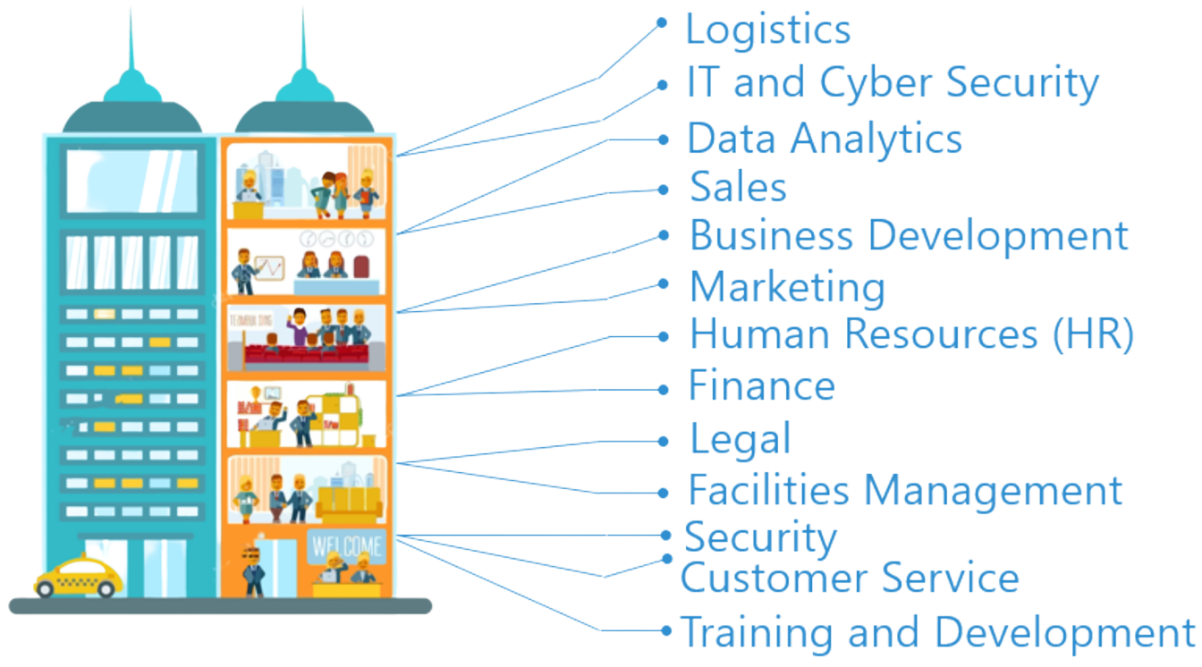
Look inside the company
Logistics
IT and Cyber Security
Data Analytics
Sales
Business Development
Marketing
Human Resources (HR)
Finance
Legal
Facilities Management
Security
Customer Service
Training and Development

Slide 10
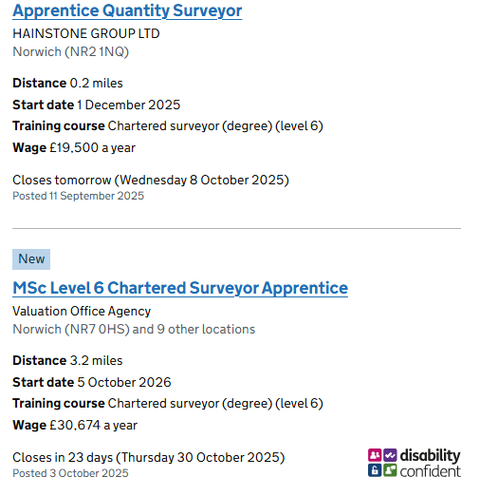

Slide 11






THE APPRENTICESHIP
What interests you about this apprenticeship?
Reflect on the job description
Positioning positively to show skills/strengths
Specific to the employer
Specific to the apprenticeship
Do your research

Slide 12






How can I tell if it’s a good apprenticeship?
Wage
Progression
Job position
Training Provider
Varied role
Ethos and values

Slide 13


What does the employer want to see?
You have the right skills for the job
You would be a good fit for the team
That you have genuine interest in the position
You can demonstrate your knowledge and skills to them
You can communicate effectively throughout
You standout to the employer and make a good impression

Slide 14


Application hints and tips
Research
Sensible contact information
Prepare
Tailor each application
Link your answers back to the employer and job advert
Check your work
Monitor deadlines
Be yourself

Slide 15

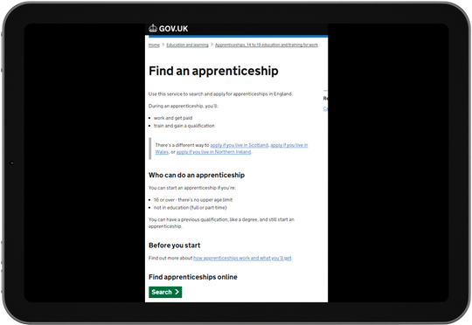



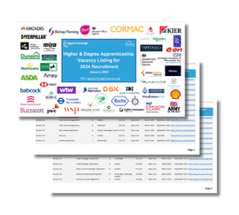

Where else to look
Find an apprenticeship
Local websites
Company websites
Careers websites
Friends and family
Higher and Degree listing
Social media

Slide 16

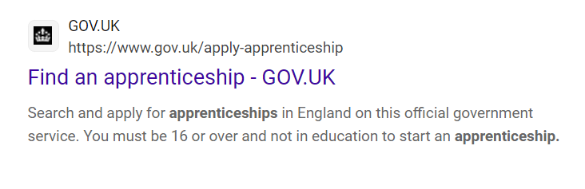


Slide 17
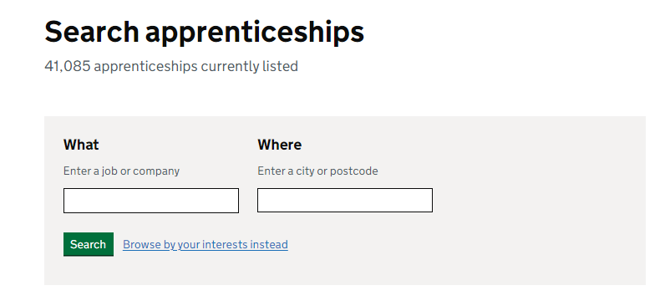
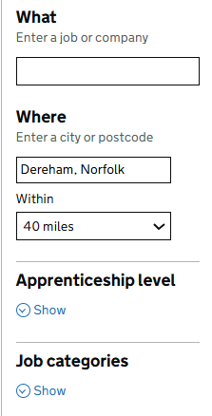
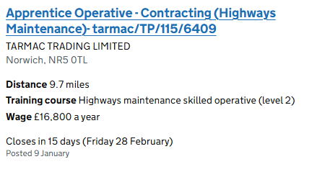

Slide 18


Apprenticeships - Key facts
Levels not linear - dependent on role and experience
Majority of starts in U19s were Intermediate & Advanced
Employer led - apply to employer, they select the provider
Different recruitment methods
Entry requirements vary
Employer decides when they advertise

Slide 19

Any questions?

