Slide 1
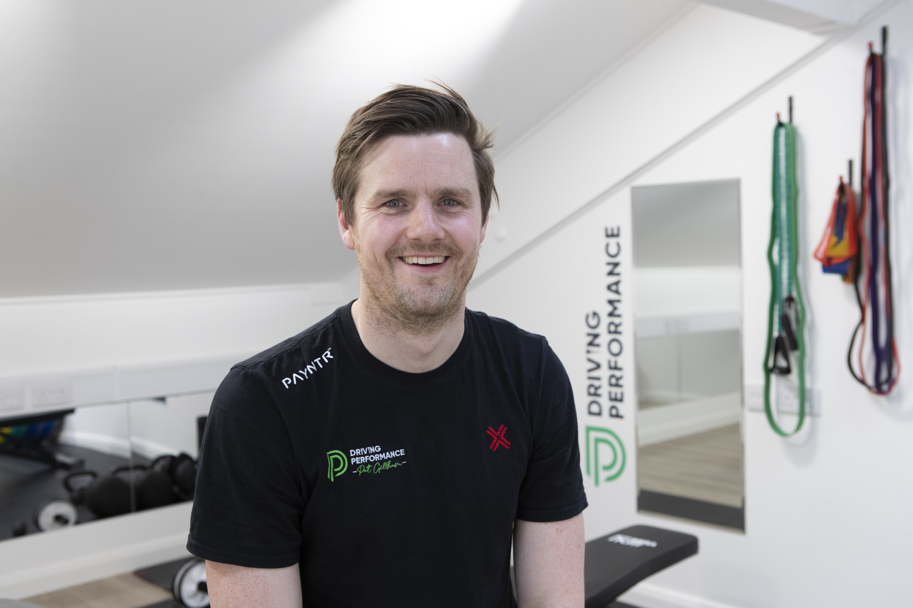
Careers in Sports Physiotherapy
Pat Gillham BA MSc MCSP
Founder & Specialist Golf Physiotherapist
Driving Performance Golf Ltd
New Malden, Surrey

Slide 2
My route
A-levels – PE, English and History
BA Sports Science at Durham University 2003-2007
MSc Physiotherapy at University of Birmingham 2008-2010
NHS/ Private practice – my own clinic eventually
Semi-pro/ Amateur rugby, running consultant physio
Professional golf

Slide 3







Where you can go on this path…

Slide 4
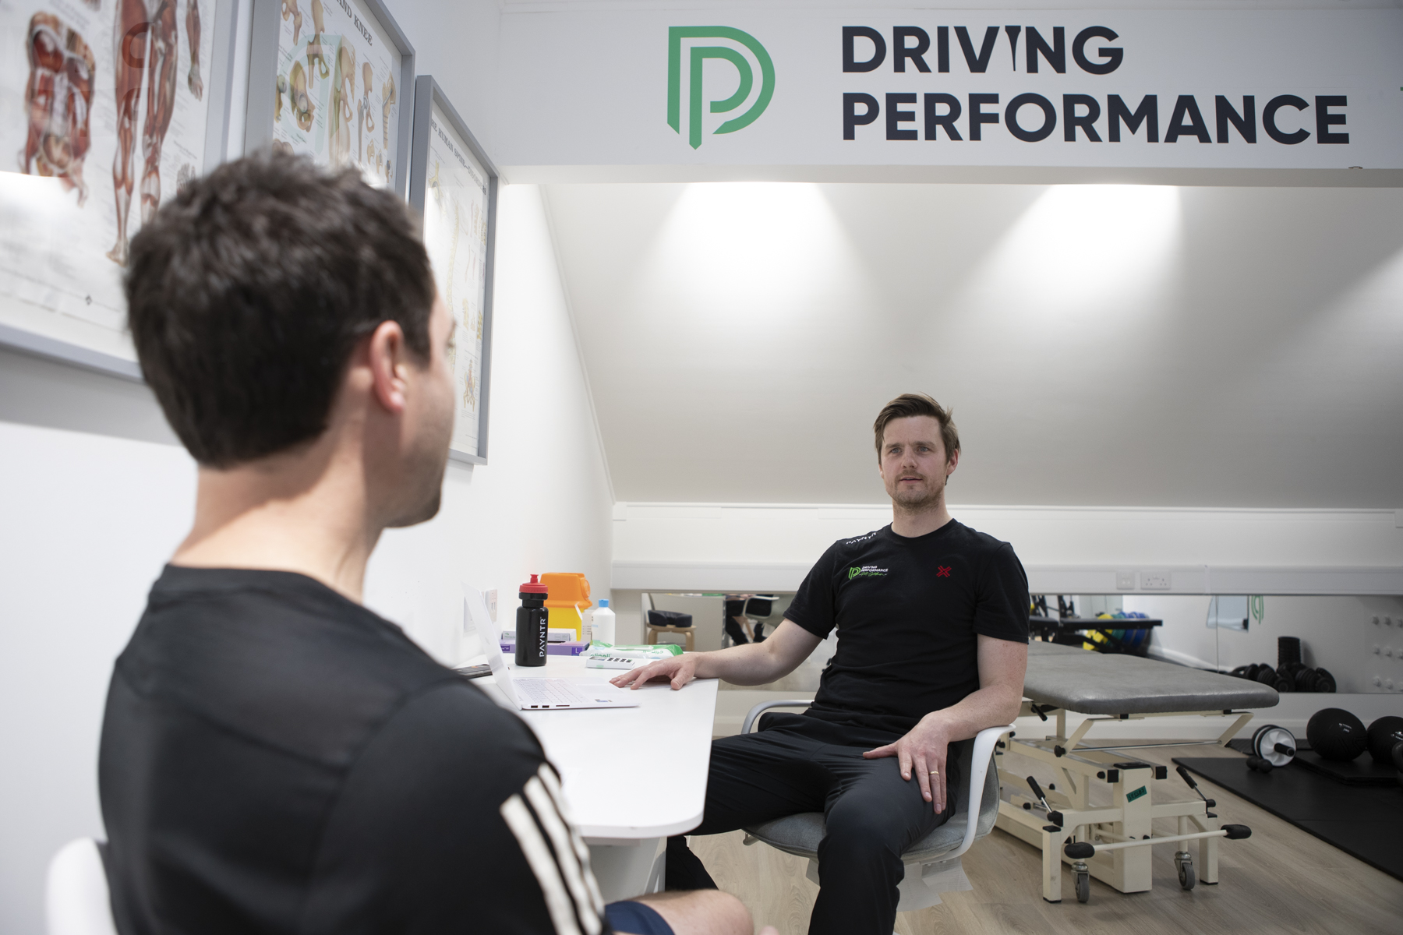
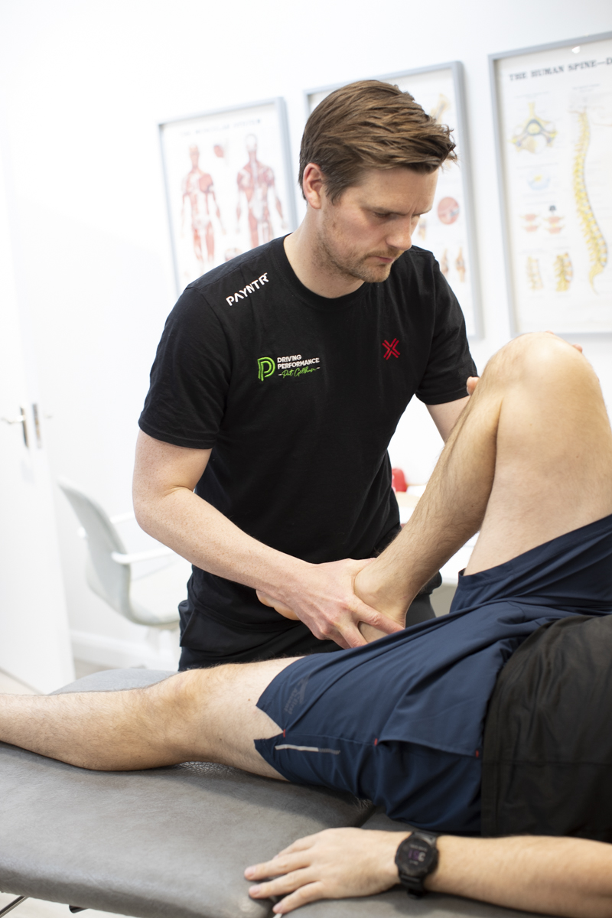
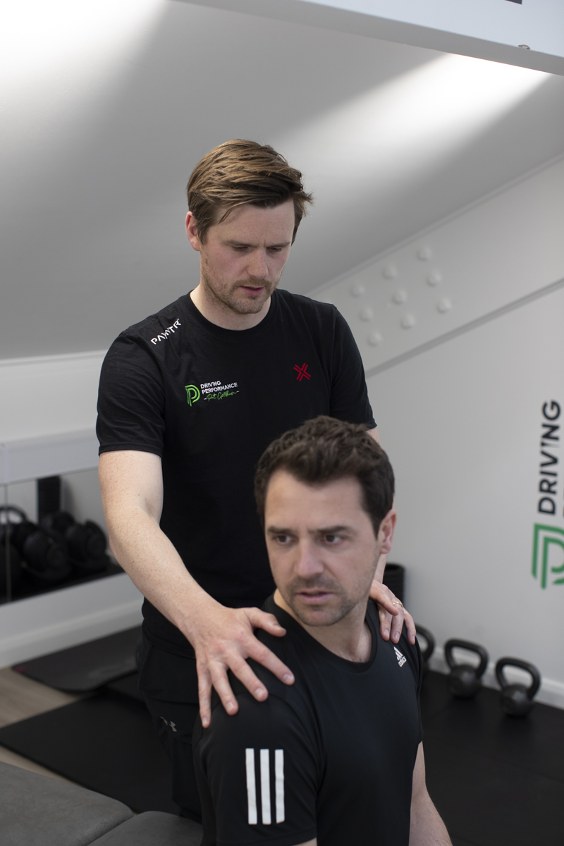
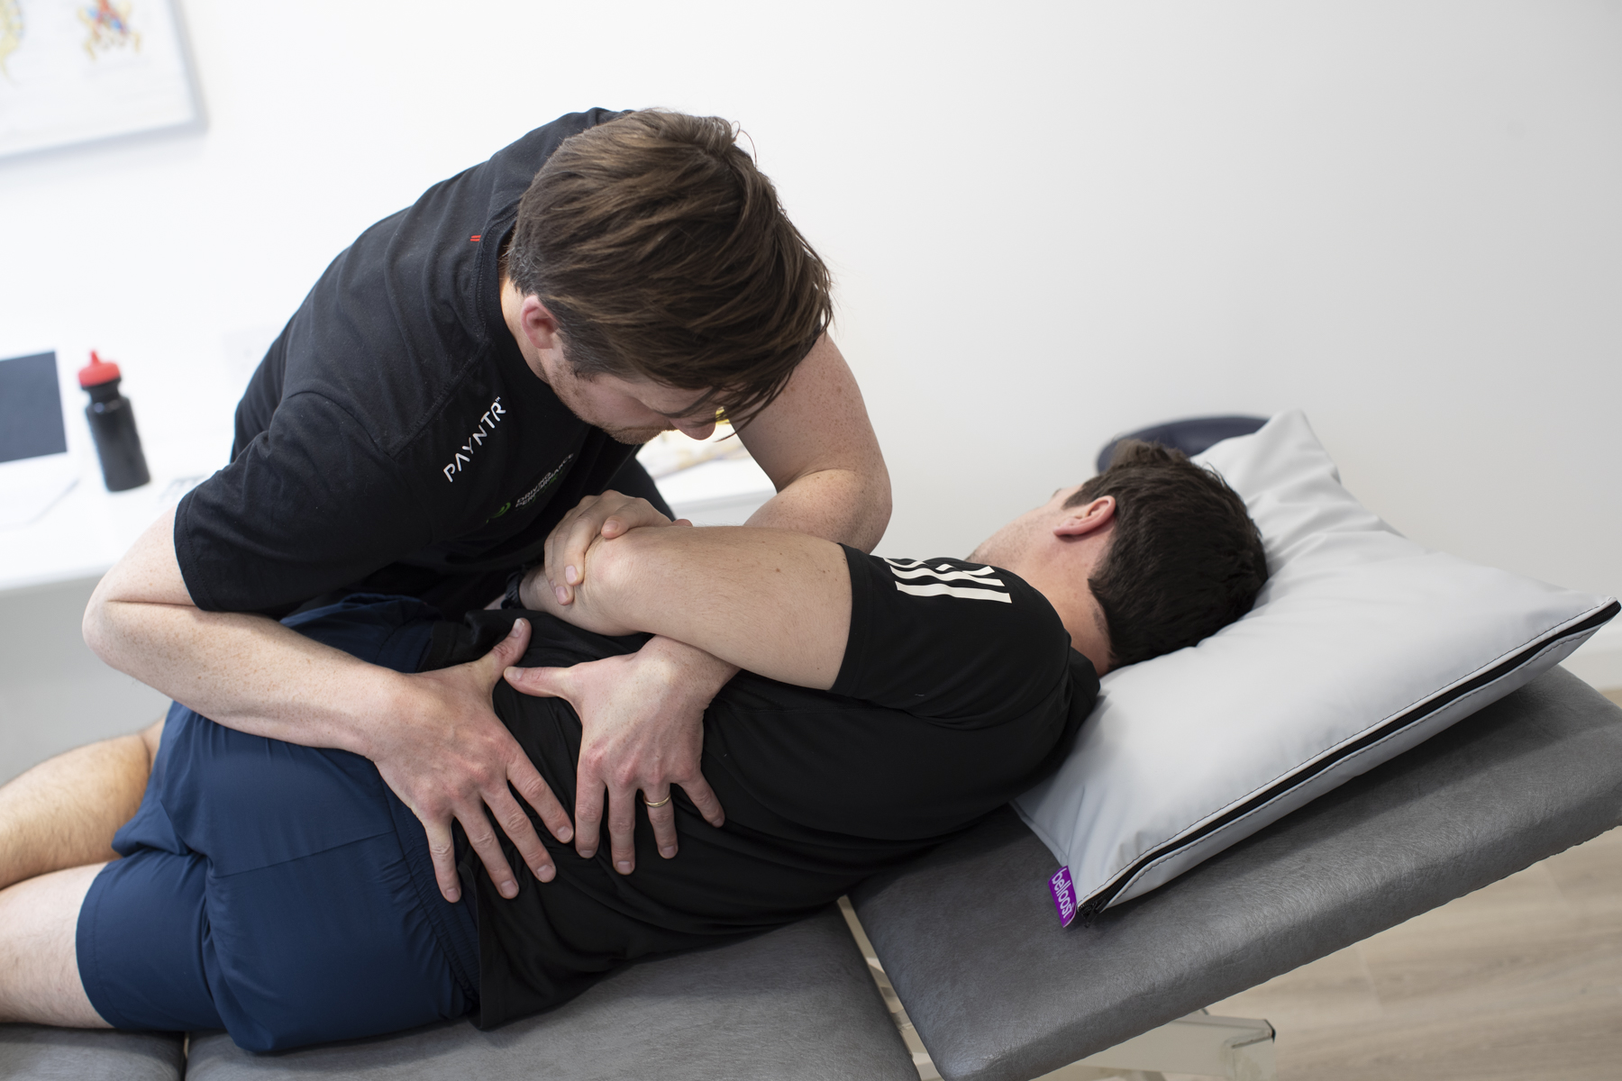
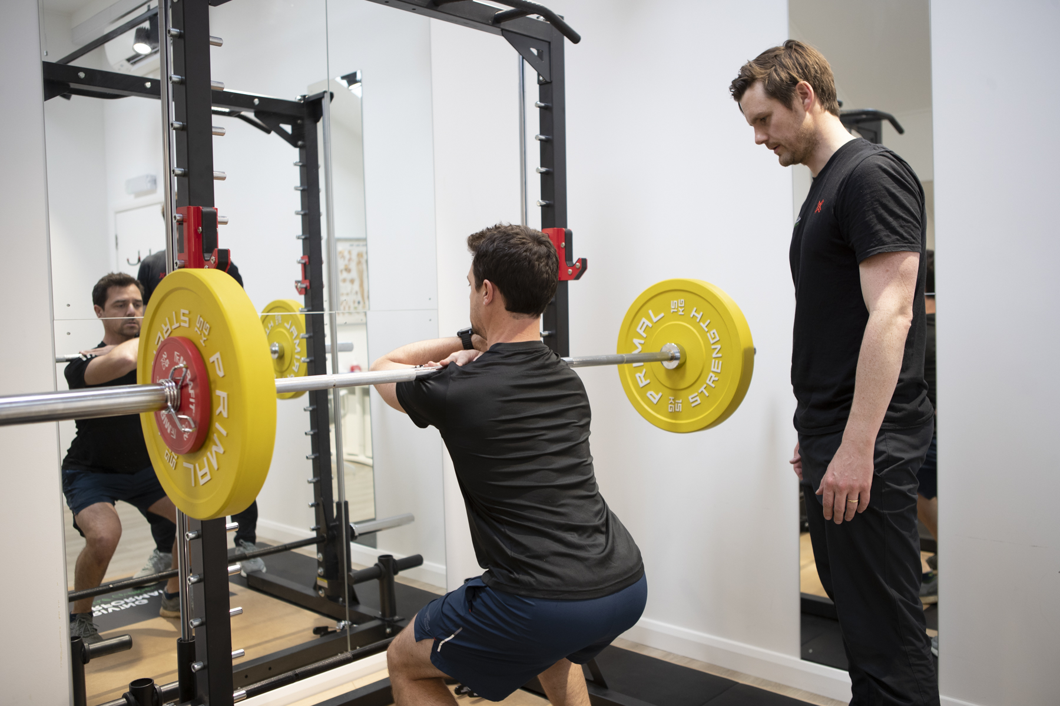
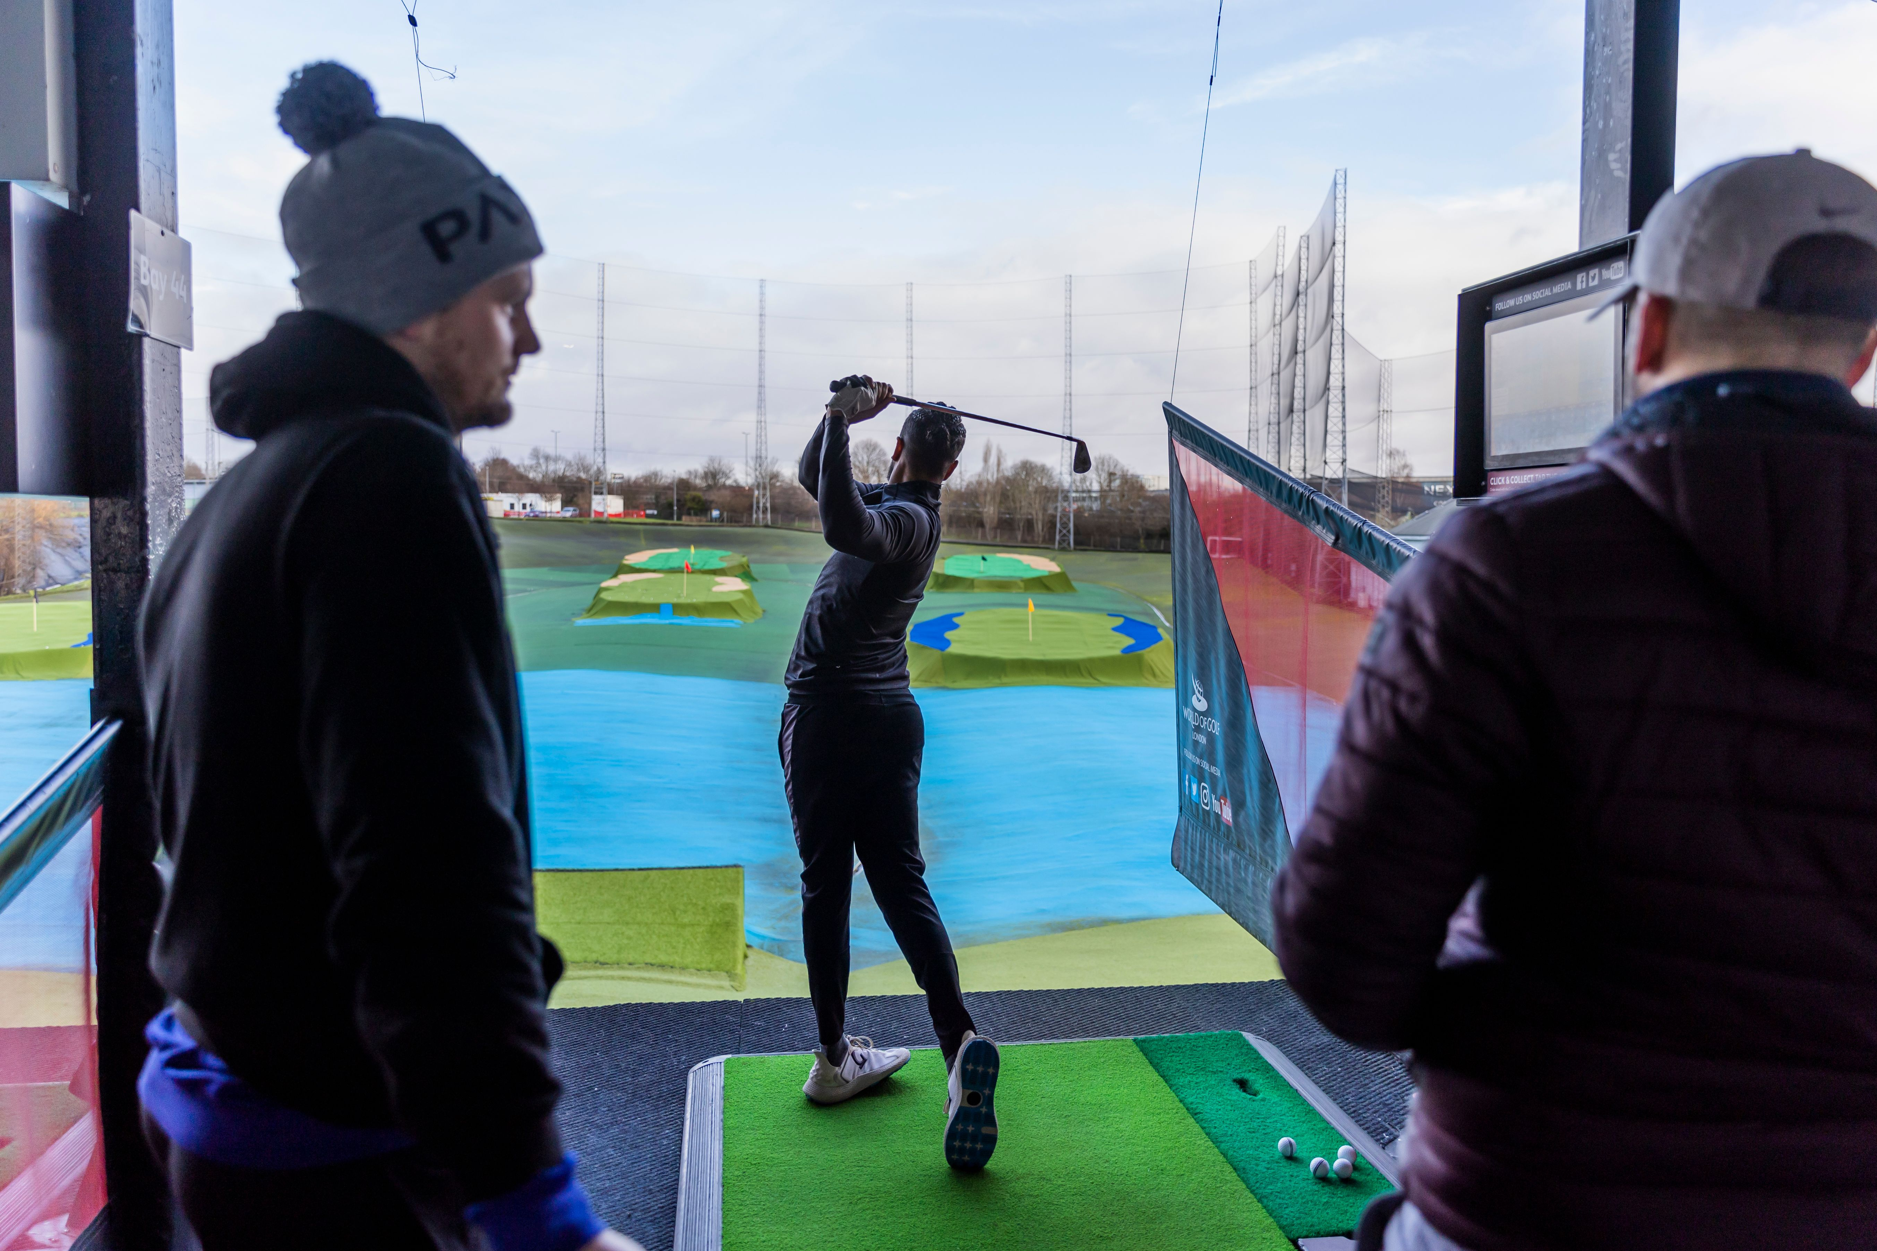
A day in the life of a physio…

Slide 5
Typical injuries…
Spinal pain – neck/back facet joint or intervertebral disc injuries
Shoulder pain – rotator cuff injuries, dislocations, cartilage injuries
Elbow – tendinopathies, impingements, osteoarthritis
Hands/wrists – impingements, ligament injuries, fractures, tendinopathies
Knees – ligament injuries, tendinopathies, meniscal injuries, joint pain
Hip – impingements, tendinopathies, osteoarthritis, cartilage injuries
Foot/ ankle – ligament injuries, fractures, tendinopathies, osteoarthritis

Slide 6
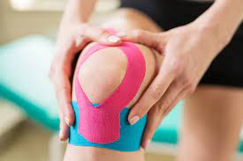
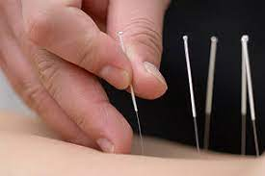
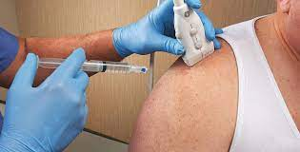
Typical treatments…
Long term benefits:
- Rehabilitation/ exercise
Short term benefits:
- Manual therapy (hands-on treatments)
- Taping
- Acupuncture/ dry needling
- (Injections/ prescribing medication)

Slide 7
What you can do…
Best ways to advance:
Work Experience
Talk to Physios
Work out a pathway…

Slide 8
Any Questions?
Pat.Gillham@drivingperfgolf.co.uk

