Slide 1
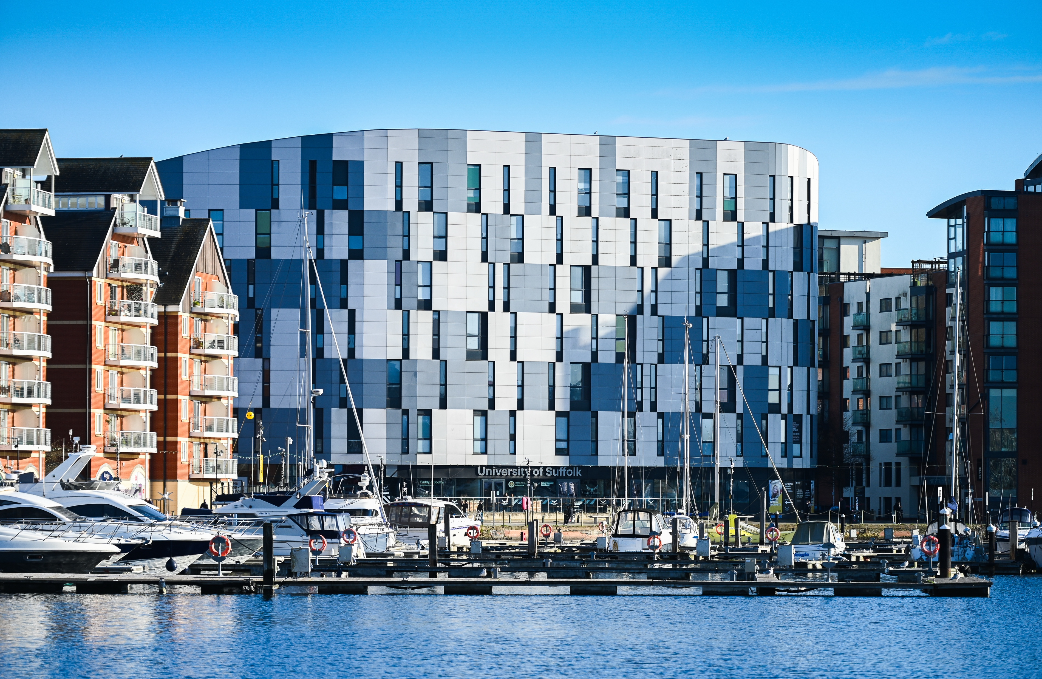
hello

Slide 2
Creative Industries
& Humanities
Dr. Vassiliki Tzomaka, Head of Creative Industries & Humanities
Senior Lecturer in Graphic Design & Illustration
Children’s Picturebook Author/Illustrator and Graphic Designer

Slide 3
perfect location

Slide 4
Creative industries & Humanities
BA (Hons) Architecture
BA (Hons) Digital Film Production
BA (Hons) Fine Art
BA (Hons) Graphic Design
BA (Hons) Graphic Design (Graphic Illustration)
BA (Hons) Photography
BA (Hons) Screenwriting
BSc (Hons) Games Development
BA (Hons) Esports
BA (Hons) English
BA (Hons) History
MA Creative and Critical Writing
MA History

Slide 5


Notes:
SLT
Our mission at The University of Suffolk is to deliver positive transformation through education, training, research and business and community engagement.​
This year, this work has been recognised at the What Uni Student Choice Awards where we won University of the Year. This award is particularly meaningful to us as the award is voted for by our students.
We also scooped awards for Learning and Teaching and Student Support.

Slide 6
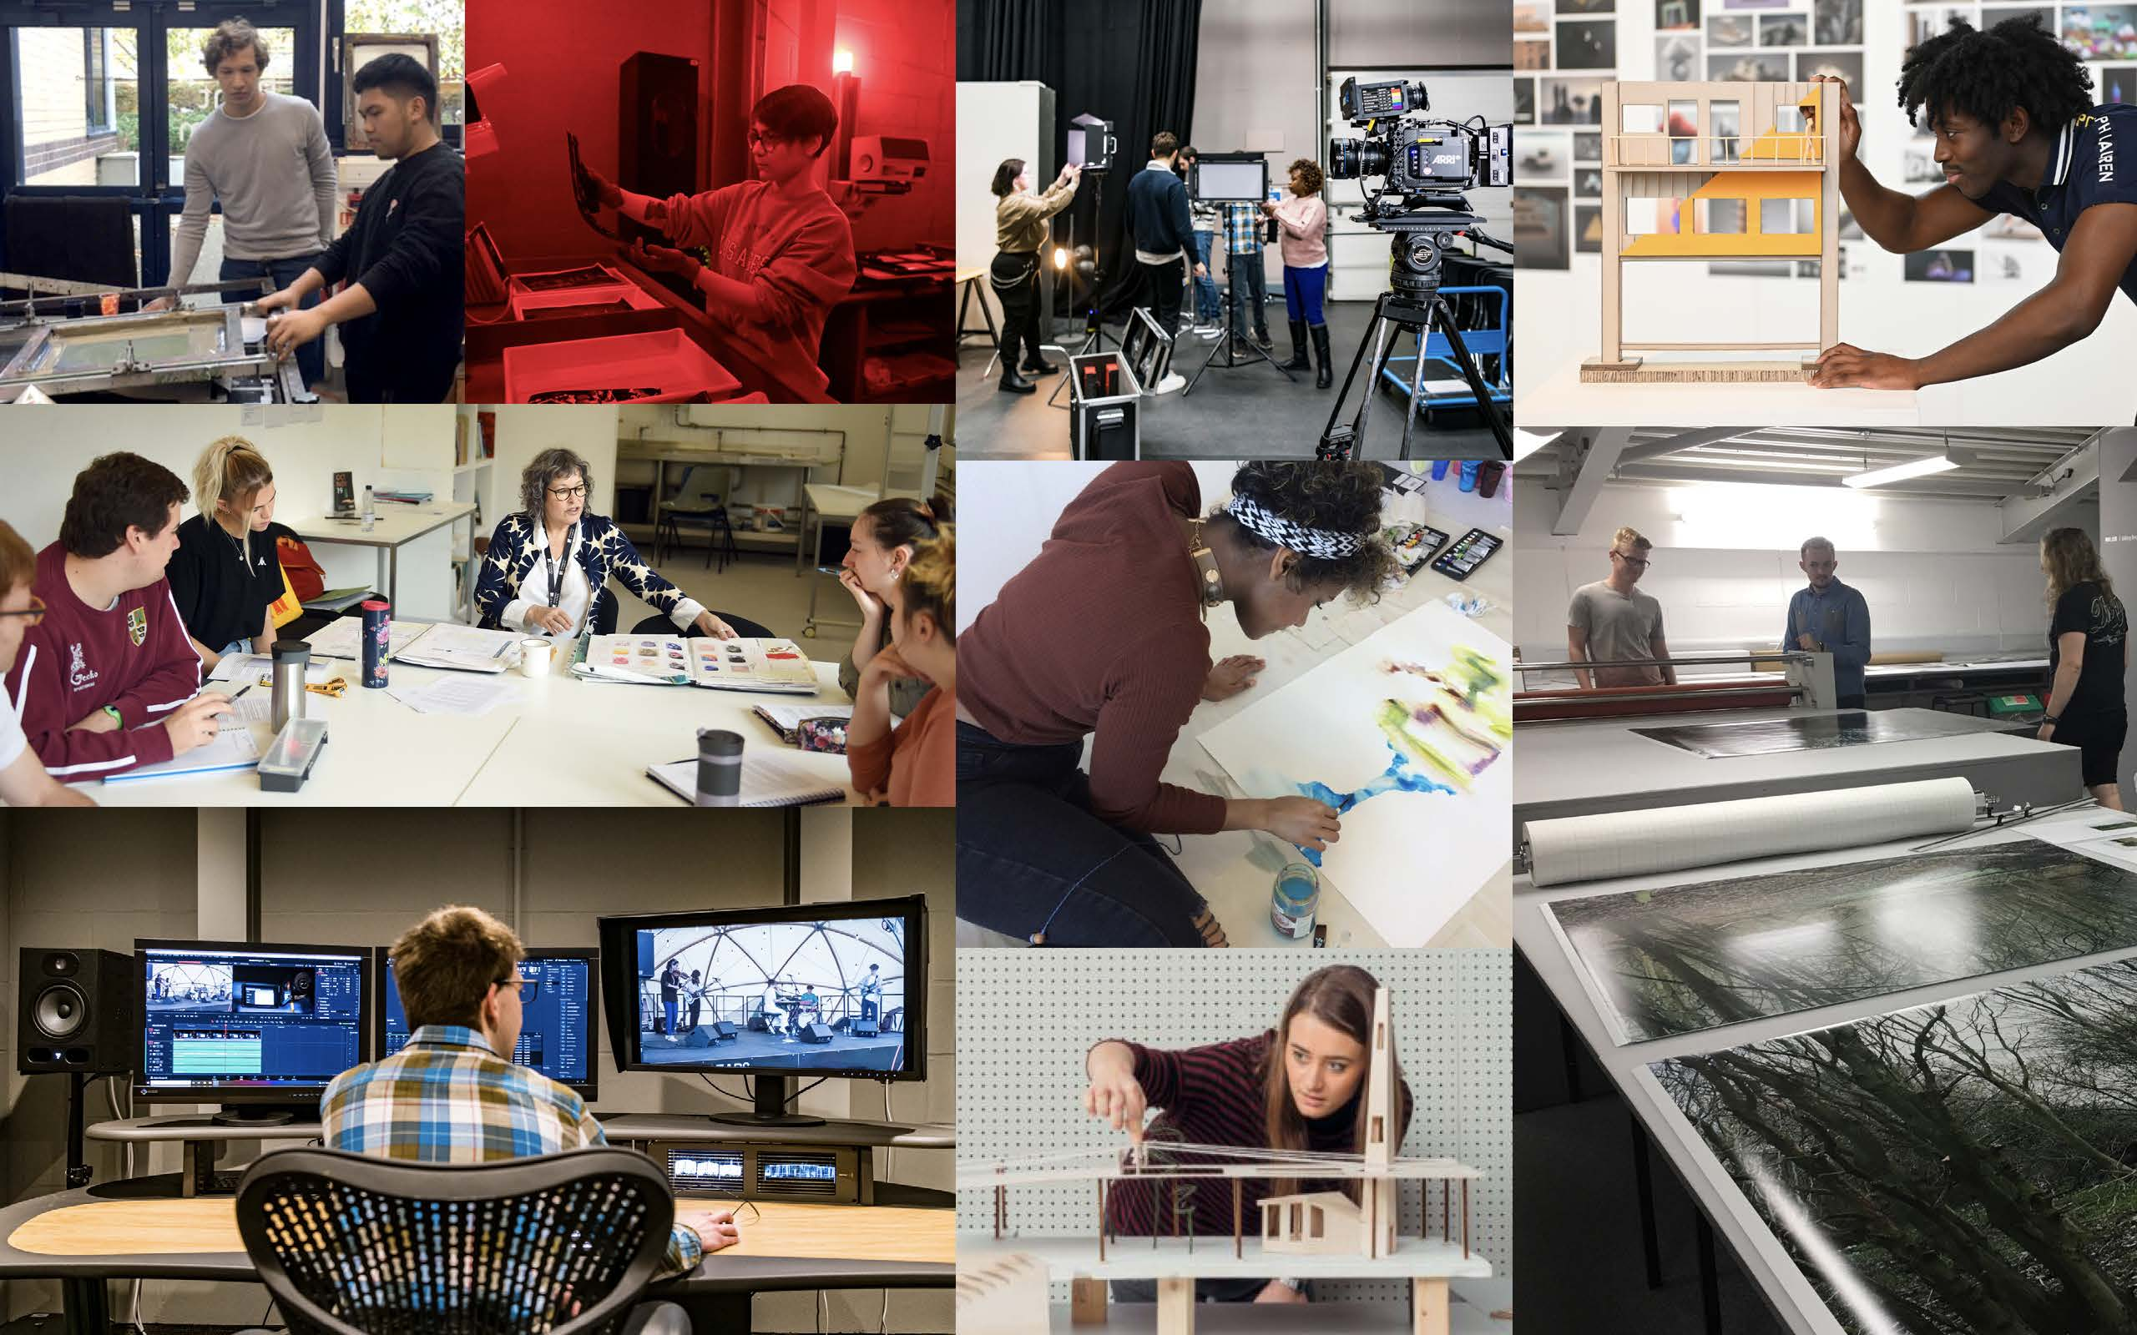

Slide 7
OUR ETHOS
﻿Students allowed to steer the direction of their studies
﻿Small studio/class sizes typical of industry work environments
Mirroring professional practice
Collaborative with courses across university
﻿Focus on transferable skills maximizing employment options
﻿Taught by professional and research active staff

Slide 8
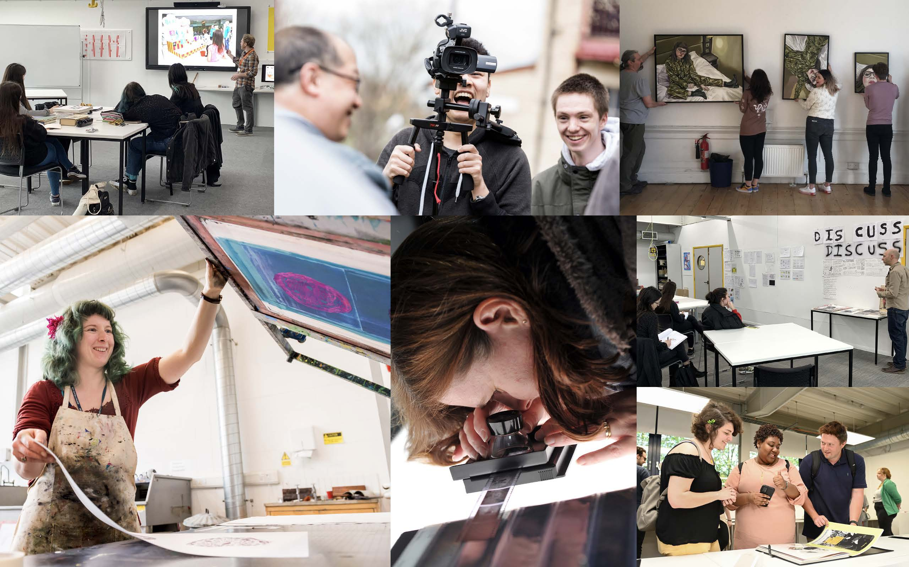

Slide 9
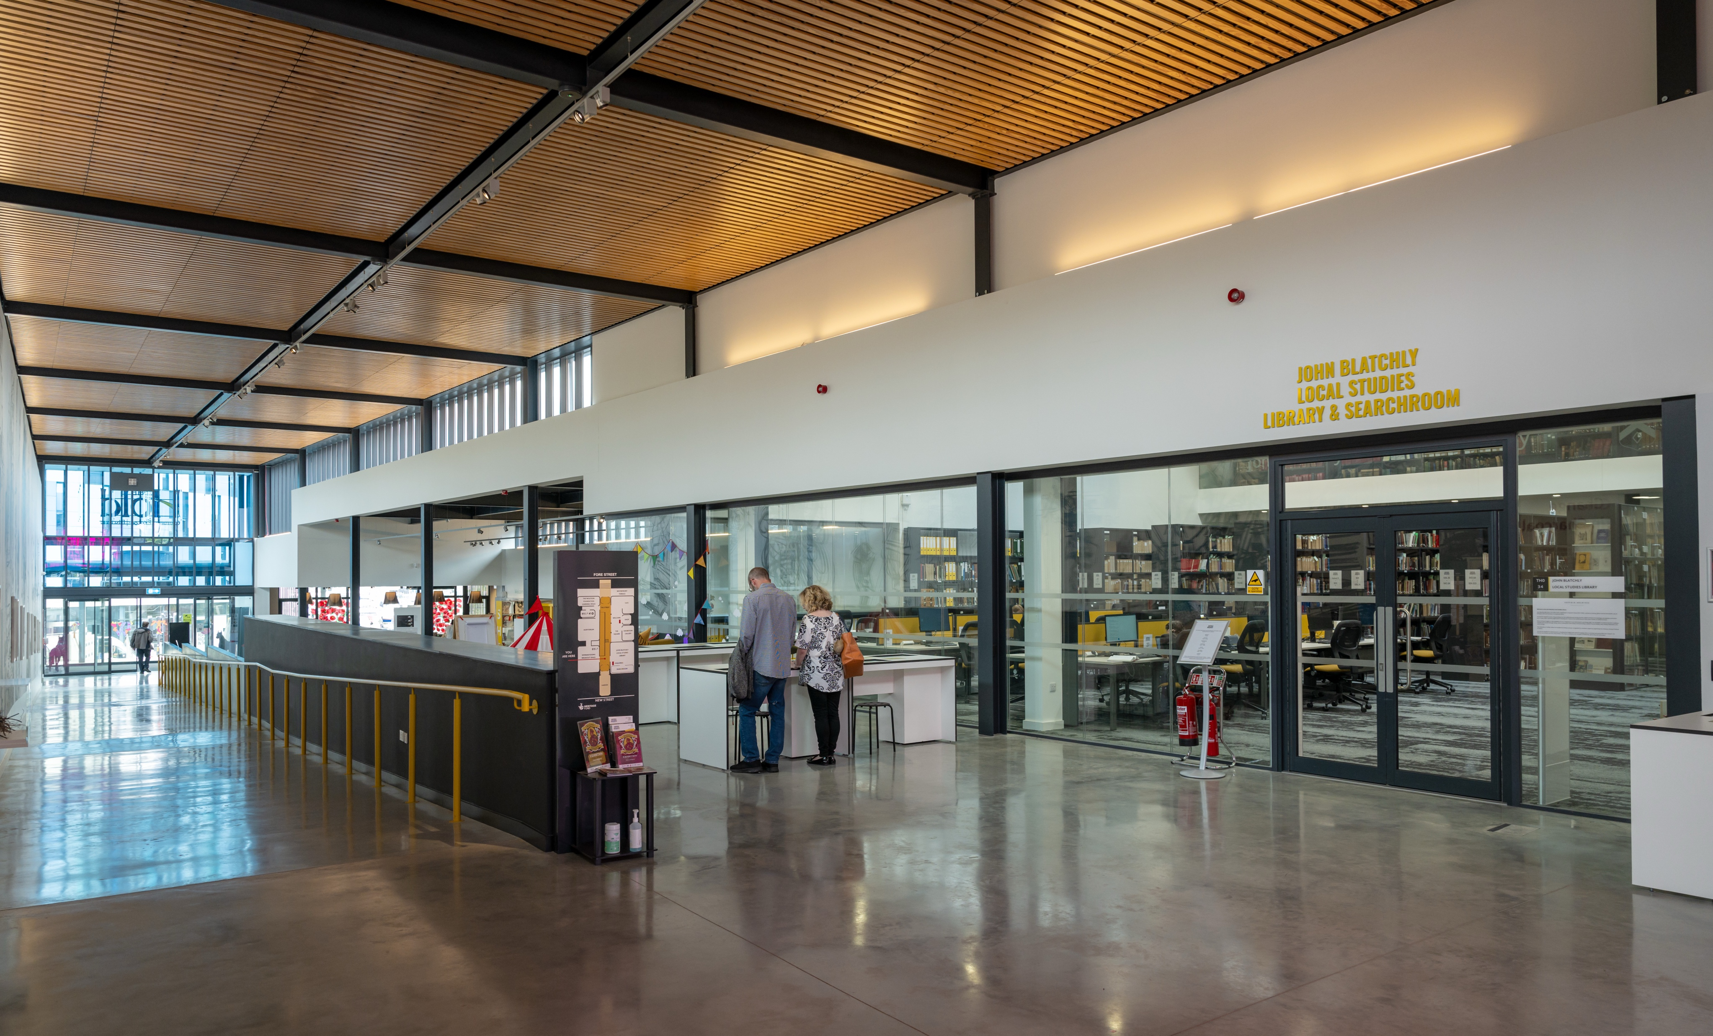
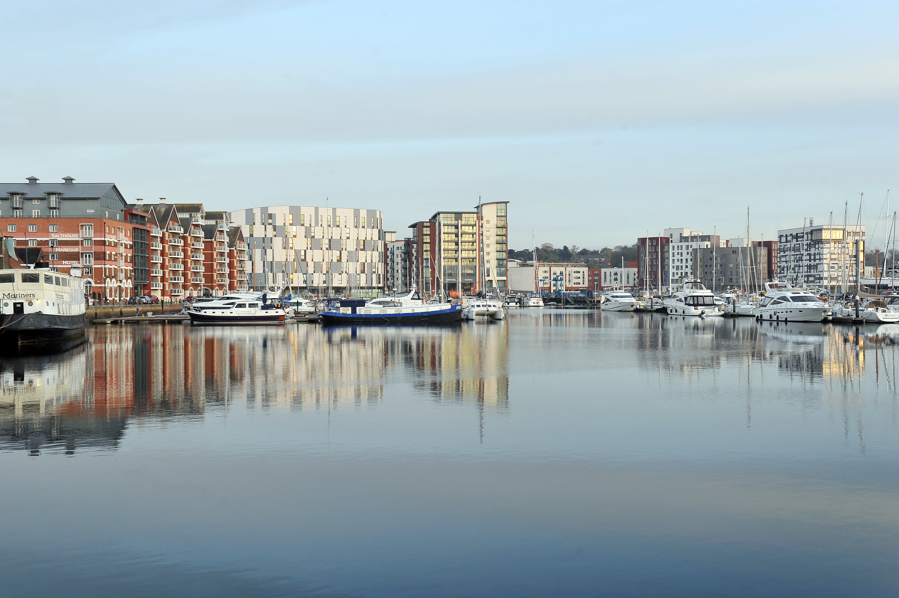
The hold
Suffolk Archives

Slide 10

Questions

Slide 11
Plan a Visit

Slide 12
uos.ac.uk
uniofsuffolk

