Slide 1

City College Norwich Higher Education
Helen Temple
HE Student Support Officer
(Employability and Progression)
helen.temple@ccn.ac.uk

Slide 2
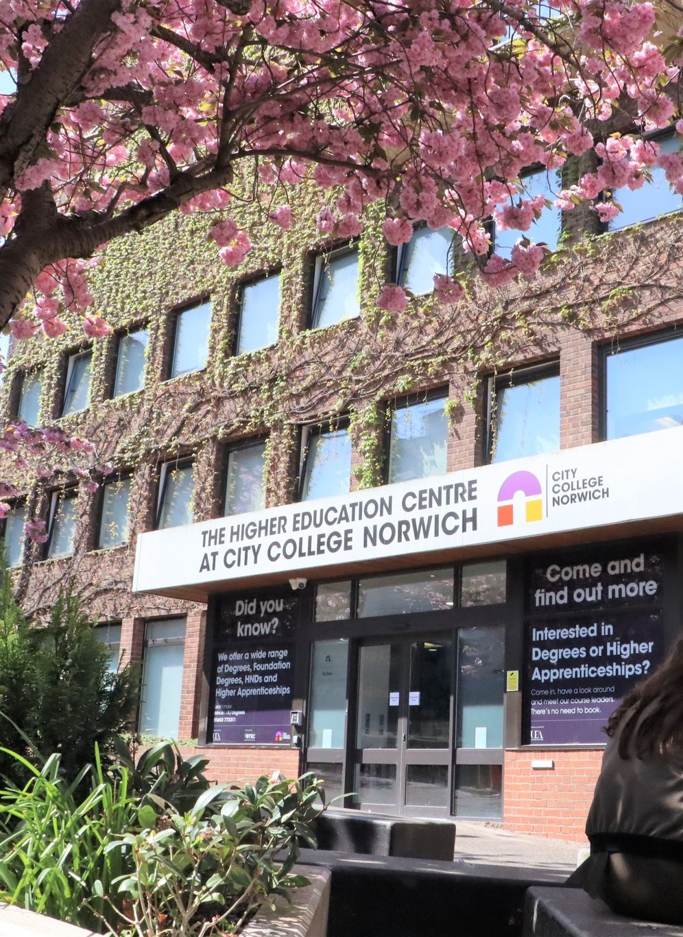
Why study with us?
Degrees awarded by UEA - partner college
UEA campus card - access to UEA library, Sportspark and more
City centre location
Classroom-based learning at Norfolk House
Small group sizes
Condensed timetable of 1-1.5 days a week
Experienced lecturers
Easy access to a wide range of student support

Slide 3
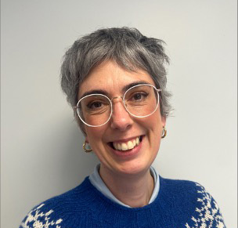
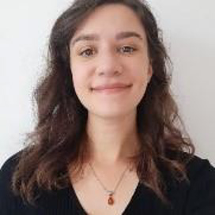
Student Support Officers
Helen Temple
Careers guidance
Support with teacher training applications and interviews
Hannah Brown
Accessing financial advice or wellbeing services
Support with reasonable adjustments
Support with academic skills and personal organisation
We also have a dedicated HE Library Team and access to the City College Wellbeing Team.

Slide 4

What our students say about CCN HE
'The classes are small, so it feels like you're getting seminars every session rather than lectures. It felt like I could always ask questions and get the support I needed.'
Jasmine, 2023 graduate
'I really liked that City College is so much smaller than other providers. I felt really comfortable there. I was also able to work alongside my degree and get that experience with children that I needed to go into teaching.'
Jessie, 2023 graduate

Slide 5

Which CCN degrees typically lead to teaching?
BA (Hons) Childhood and Youth Studies
BA (Hons) Additional Needs and Disabilites (Children and Young People)
BA (Hons) Youth Work

Slide 6

BA (Hons) Childhood and Youth Studies
Suitable for people looking for a career with children and young people
Modules include Childhood Development, Children's Health and Wellbeing and Digital Worlds
Runs over 1.5 days a week
Entry requirement: 80 UCAS points
Course leads Jasmine Presley: jasmine.presley@ccn.ac.uk

Slide 7
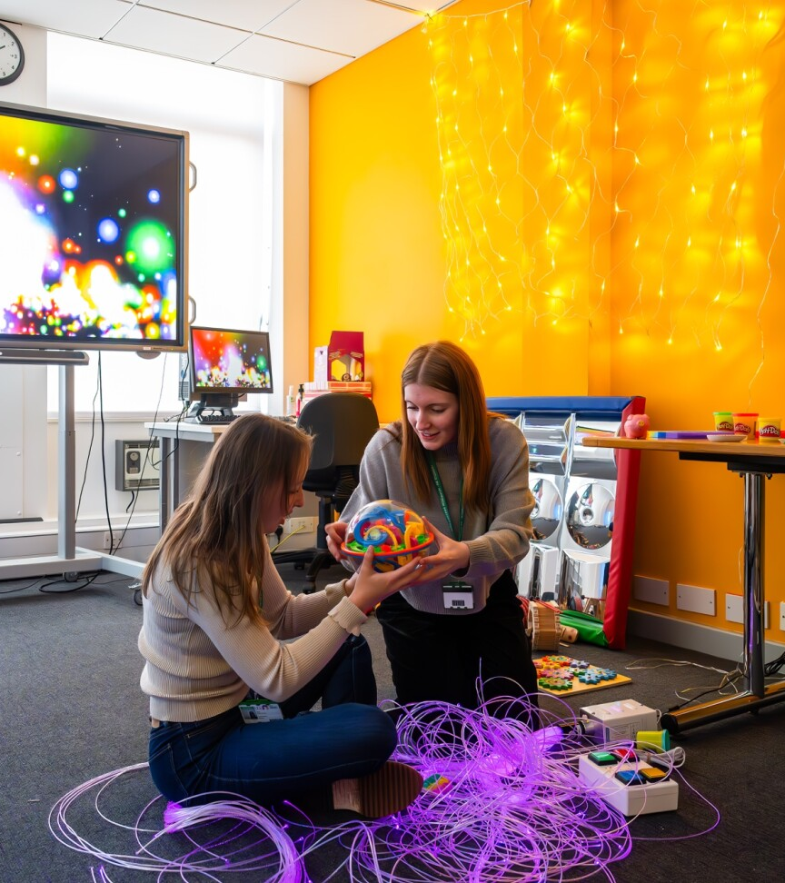
BA (Hons) Additional Needs and Disabilities (Children and Young People)
Suitable for people interested in developing skills and understanding in supporting children and young people with additional needs and disabilities, and their families
Modules include Diagnosis and Development, Attitudes and Values, and Assistive Technology
Runs over 1.5 days a week
Entry requirement: 80 UCAS points
Course lead Claire Carkin: claire.carkin@ccn.ac.uk

Slide 8
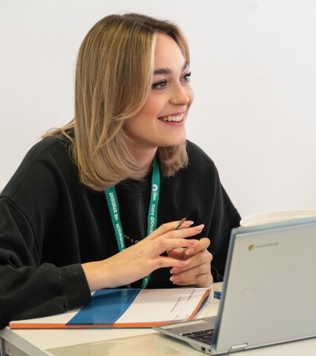
BA (Hons) Youth Work
Suitable for people who want a comprehensive and professionally recognised youth work qualification
Modules include Developing Relationships with Young People and Communities, Adolescent Development and Developing and Leading Projects
Runs over 1 day a week
Entry requirement: 80 UCAS points
Course lead Alexia Zinonos-Lee: alexia.zinonos-lee@ccn.ac.uk

Slide 9
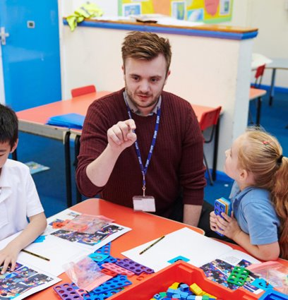
Norfolk Teacher Training Centre @ CCN
Relevant programmes offered:
  School Direct Primary Teacher Training
  School Direct Secondary Teacher Training
Both programmes confer QTS
Close links between CCN Higher Education and NTTC, with many of our students going on to complete teacher training there

Slide 10

CCN student on transitioning to NTTC
'I had an idea in high school that I wanted to teach, and my degree proved that it was the right decision for me. It also gave me a real insight into children and childhood theories, and modules like Safeguarding and Curriculum Practice helped me move into teacher training at NTTC feeling well prepared.'
Alicia, 2023 graduate in Childhood and Youth Studies

Slide 11
Contacts
Helen Temple
HE Student Support Officer
(Employability and Progression)
helen.temple@ccn.ac.uk
Megan Broadey
Student Recruitment Officer
megan.broadey@ccn.ac.uk
The Advice Shop @ CCN
Expert impartial advice
https://www.ccn.ac.uk/support-and-advice/the-advice-shop/
01602 773 773

