Slide 1
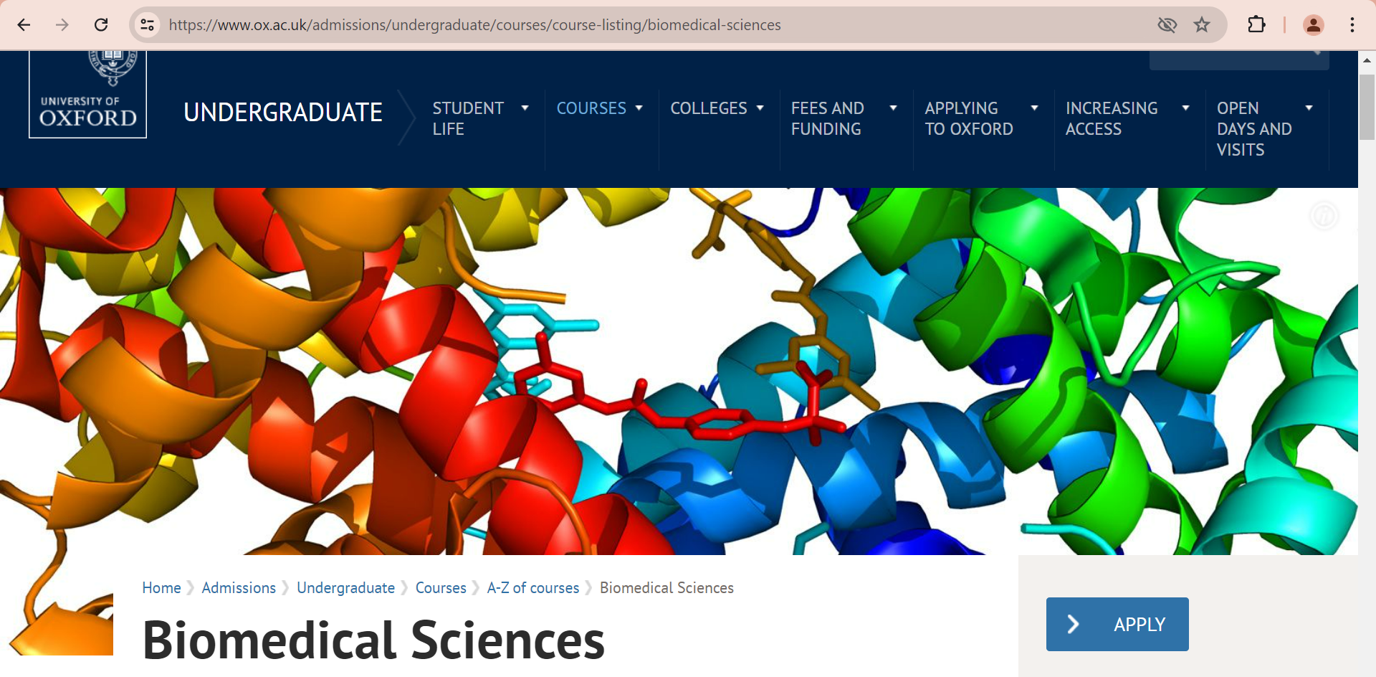
You will be sent a copy of this presentation.
Updated as at 24-06-2025 but keep checking for more information on the BMSAT website
https://www.ox.ac.uk/admissions/undergraduate/applying-to-oxford/guide/admissions-tests/biomedical-sciences-admissions-test

Slide 2
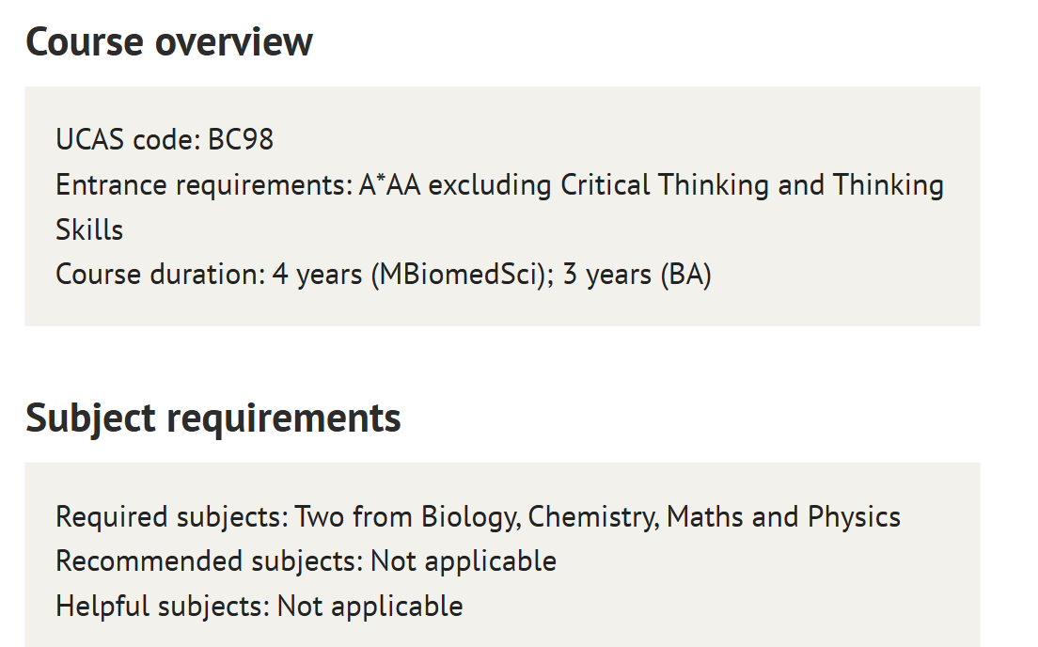
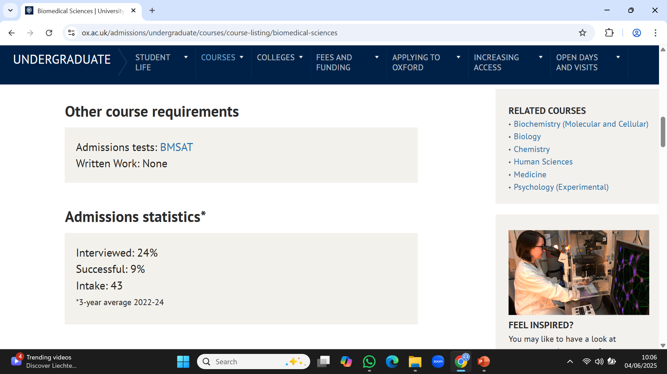

Slide 4
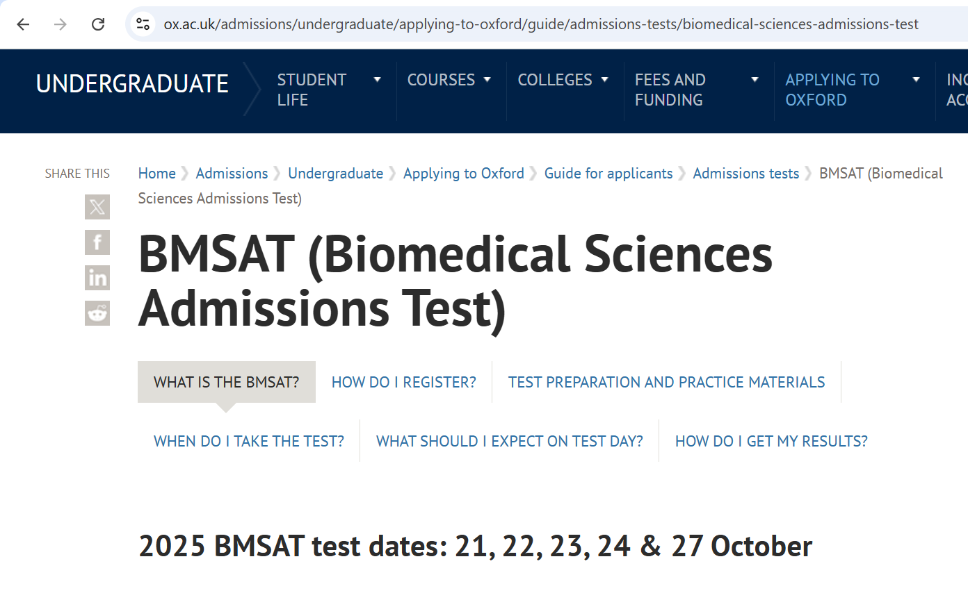
https://www.ox.ac.uk/admissions/undergraduate/applying-to-oxford/guide/admissions-tests/biomedical-sciences-admissions-test

Slide 5
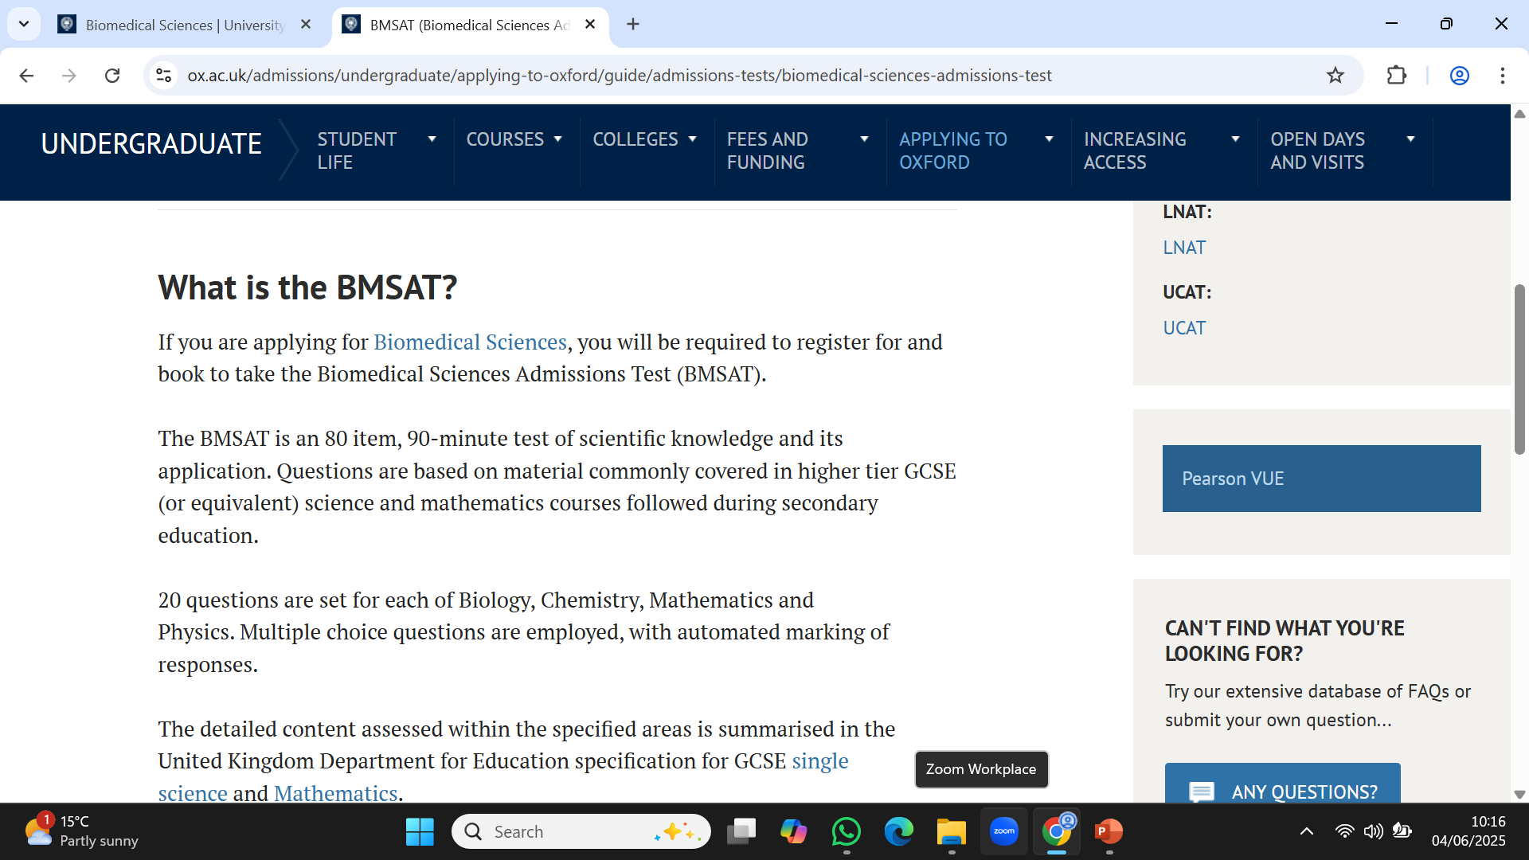
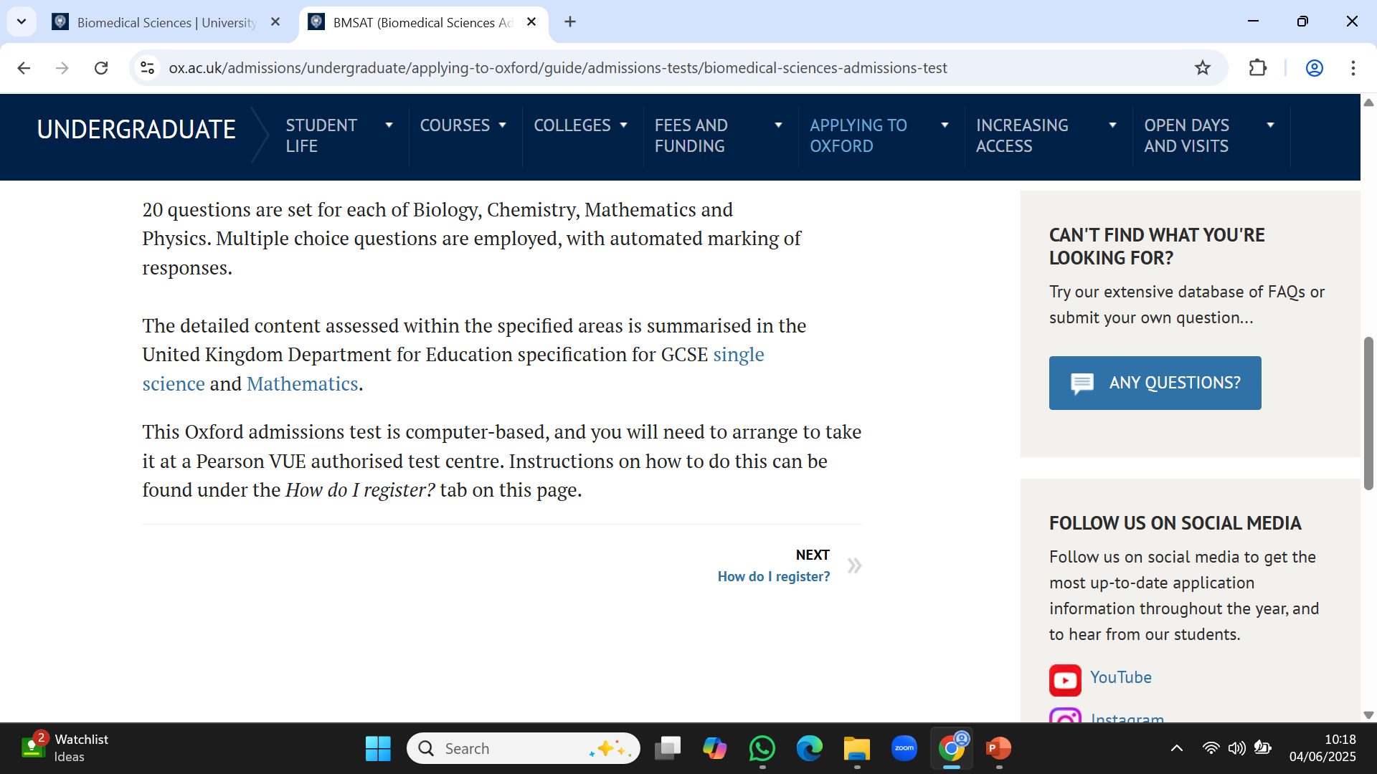
https://www.ox.ac.uk/admissions/undergraduate/applying-to-oxford/guide/admissions-tests/biomedical-sciences-admissions-test

Slide 6
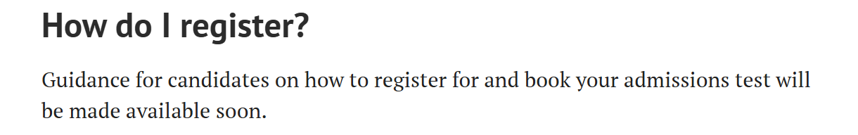
https://www.ox.ac.uk/admissions/undergraduate/applying-to-oxford/guide/admissions-tests/biomedical-sciences-admissions-test
Step 1: Have started your UCAS Application so that you already have your UCAS ID
Step2: Register for your test between 18 June and 19 September (6pm BST) at Oxford Admissions Test Registration portal for course code BC98
Step 3: Book your Pearson VUE test between 18 August and 20 September (6pm BST) via Oxford Admissions Test Registration portal Ensure that you scroll down to the confirmation button.

Slide 7
When you register, ensure that you use your full name as shown on the photo ID that you will use when you attend the test centre to take the test.
Passport
Photo driving licence
Government photo ID card

Slide 8
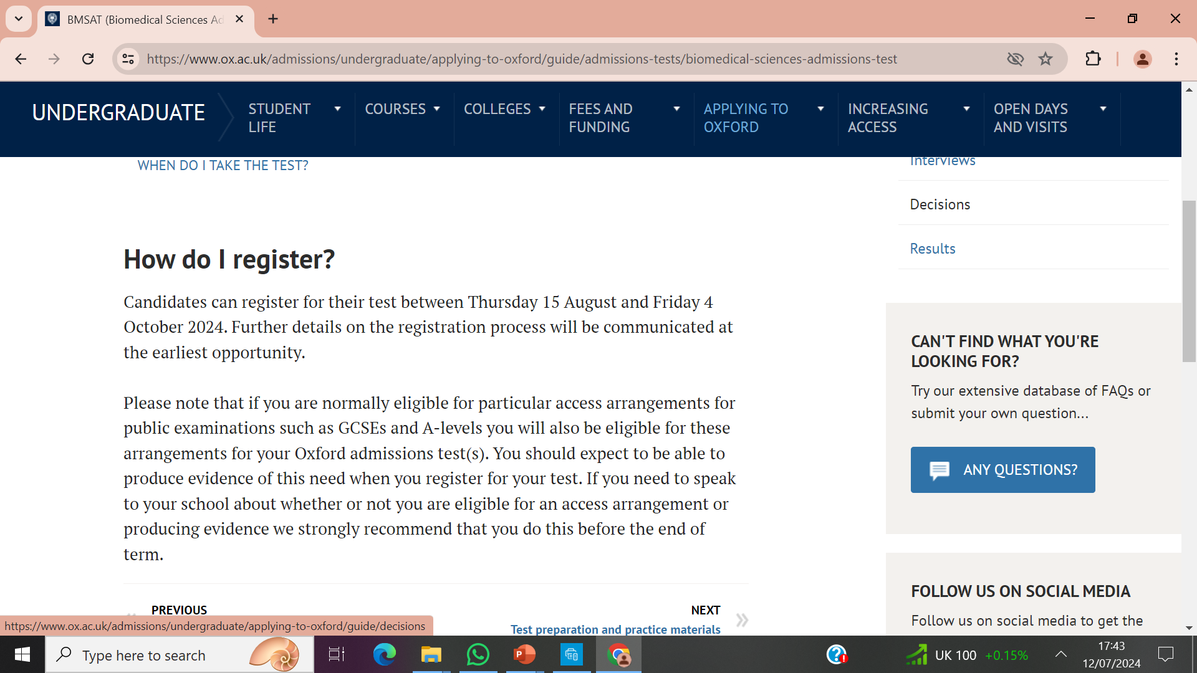
Access arrangements

Slide 9
BMSAT Oct 2025
Key Dates
18 June: Registration opens
18 August: Test booking opens
19 Sept: Registration closes
20 Sept: Test booking closes
21-24 & 27 October: Test dates

Slide 10
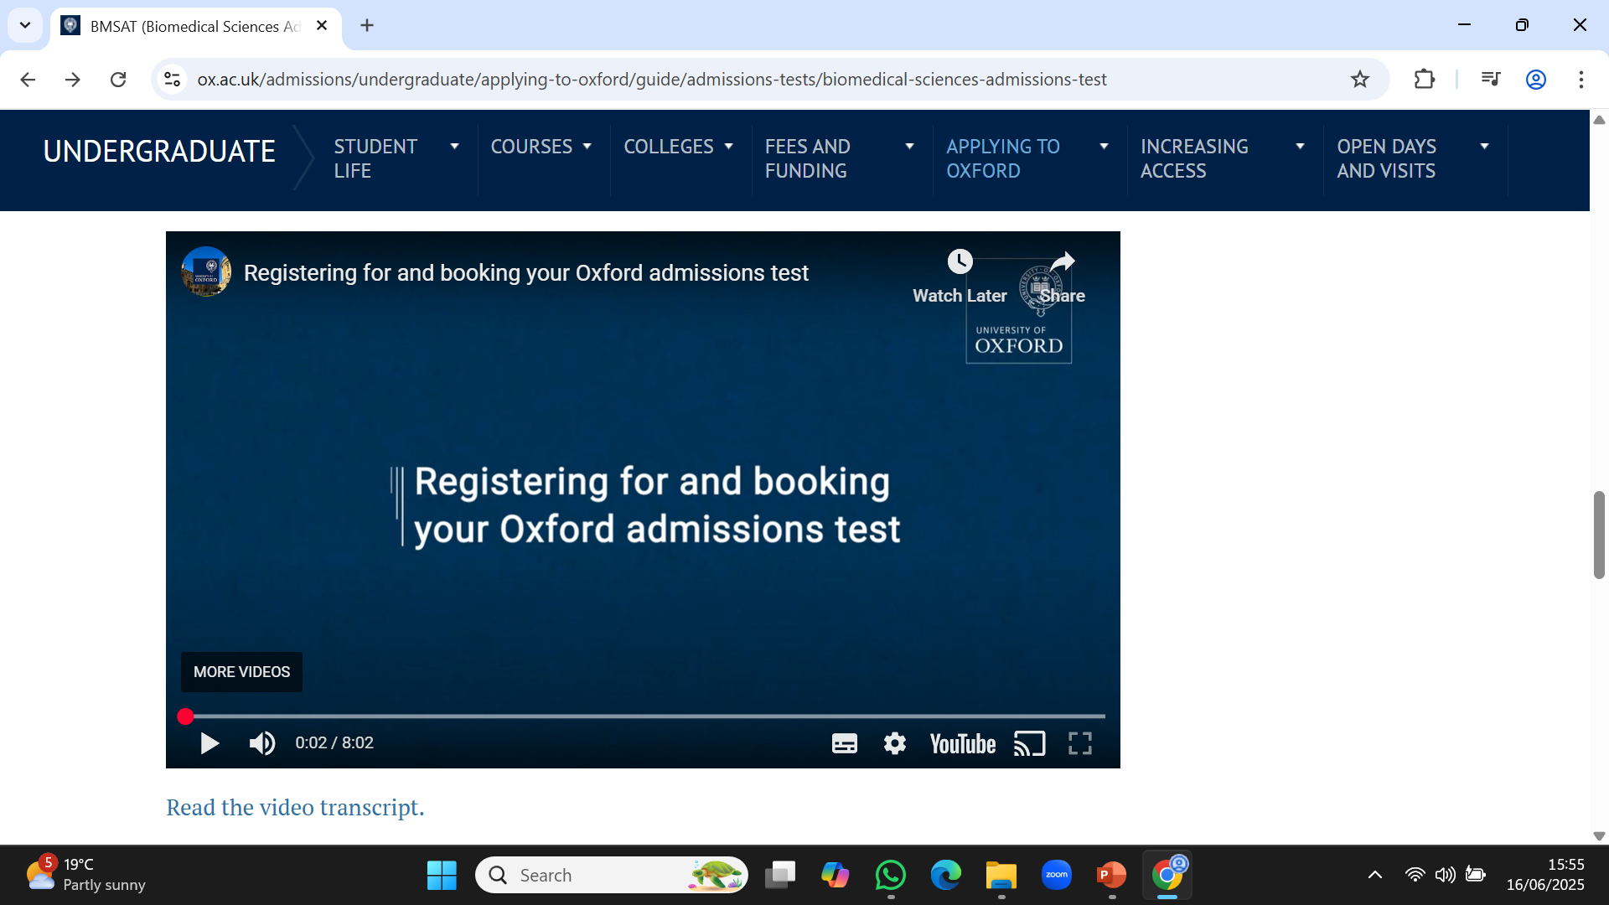
https://www.ox.ac.uk/admissions/undergraduate/applying-to-oxford/guide/admissions-tests/biomedical-sciences-admissions-test

Slide 11
BSMAT Format
On-line at Pearson Professional Test Centre (Norwich, Lowestoft, King’s Lynn, Bury St Edmund’s)
80 Multichoice questions in 90 minutes
20 in each of Biology, Chemistry, Physics and Maths
Based on GCSE (Higher Tier) Science and Maths specification
No penalty for wrong answers
No calculator, tables, formula sheet
Pen & erasable white board available for working

Slide 12
BMSAT for entry 2024
The Year Ahead (percentages)
Applications
100
Interviews
24
Offers
8
Places 8
76
16
BMSAT
Interviews
Exam Results

Slide 13
BMSAT for entry 2024
The Year Ahead (numbers)
Applications
538
Interviews
129
Offers
43
Places 43
409
86
BMSAT
Interviews
Exam Results

Slide 14
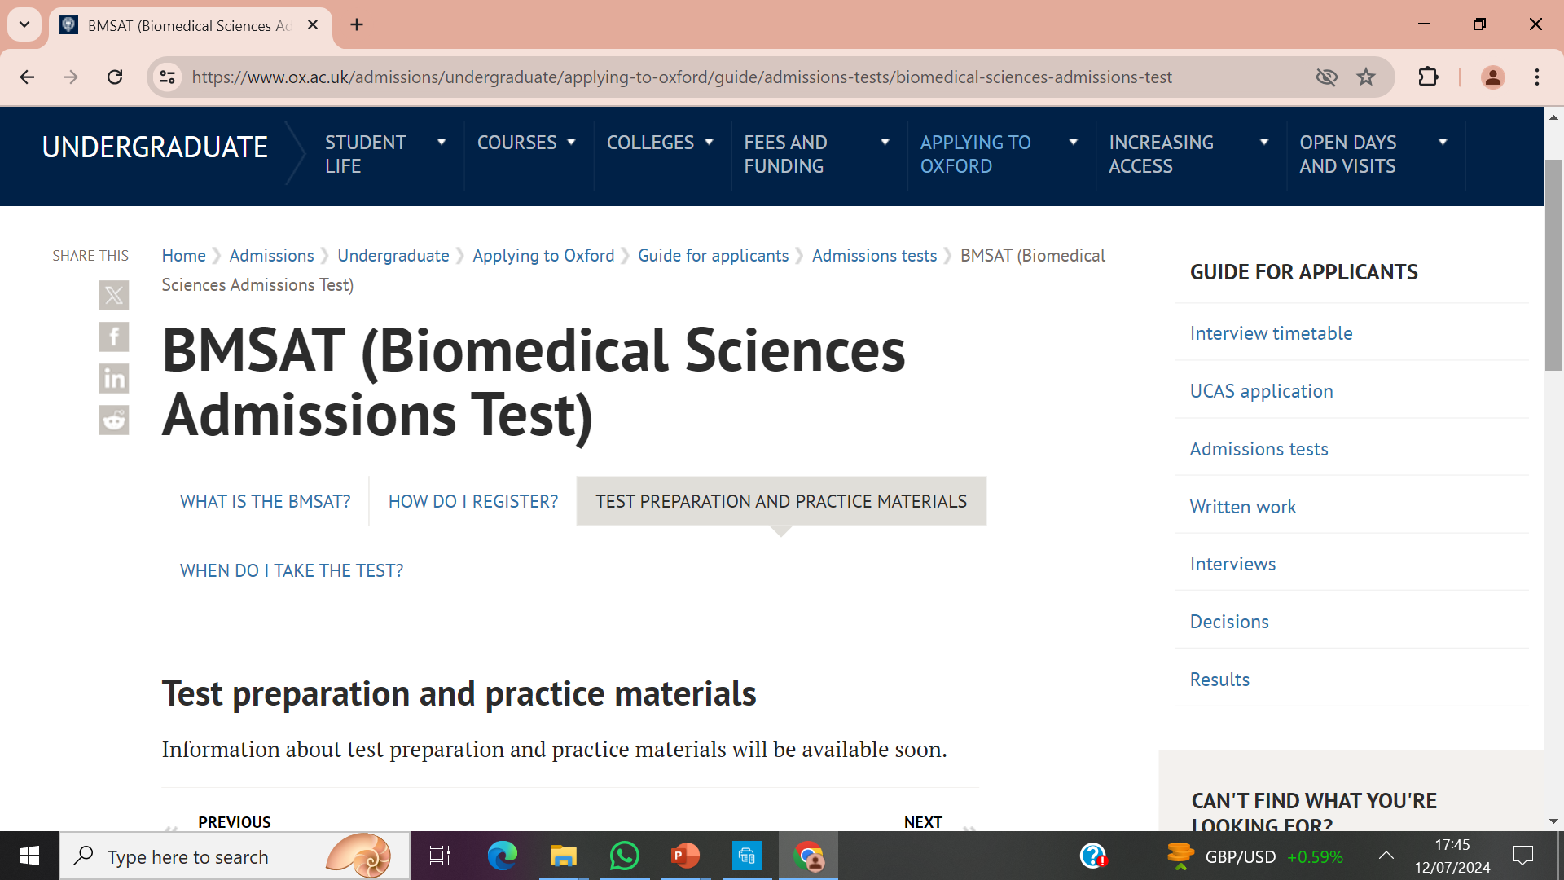
As at 24-6-2025

Slide 15
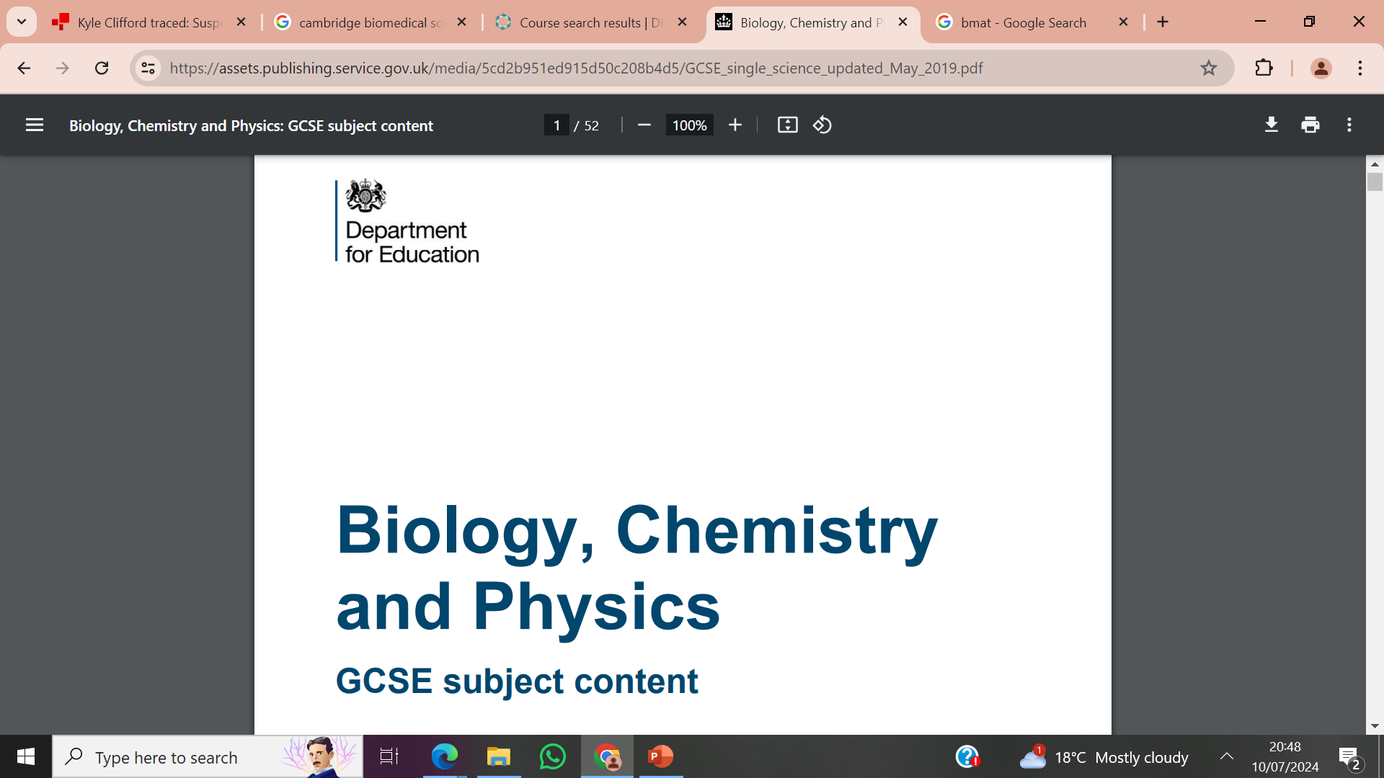
Science knowledge and applications

Slide 16
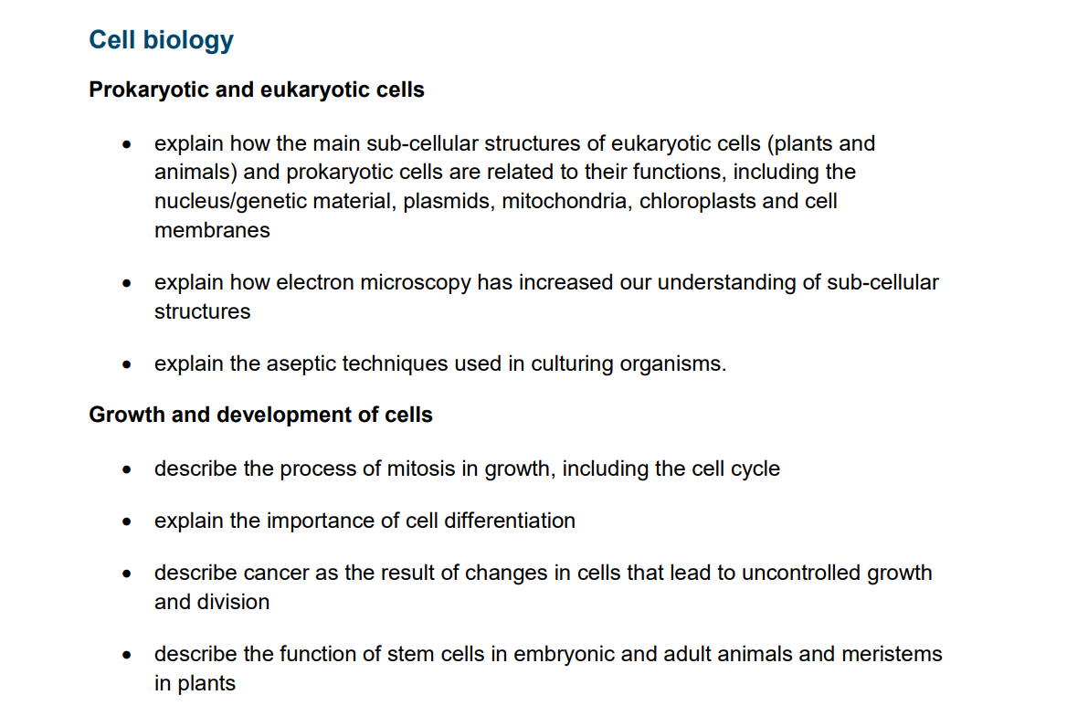
Biology knowledge and applications
This is just the first part, see DfE website for full spec.

Slide 17
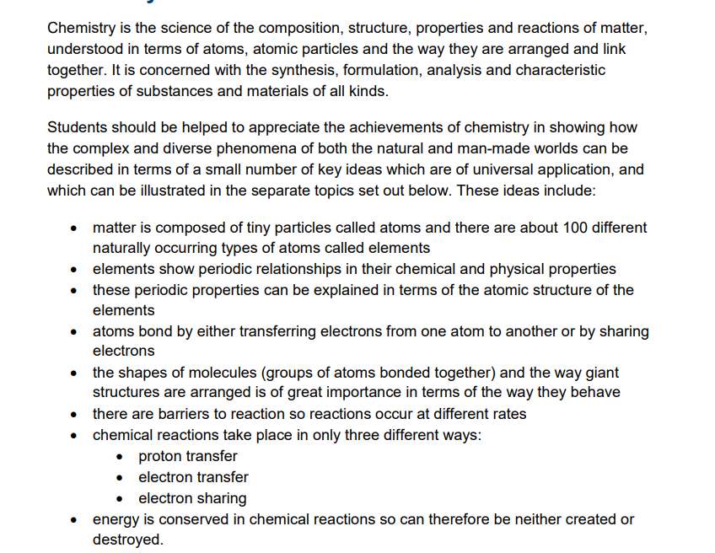
Chemistry knowledge and applications
This is just the first part, see DfE website for full spec.

Slide 18
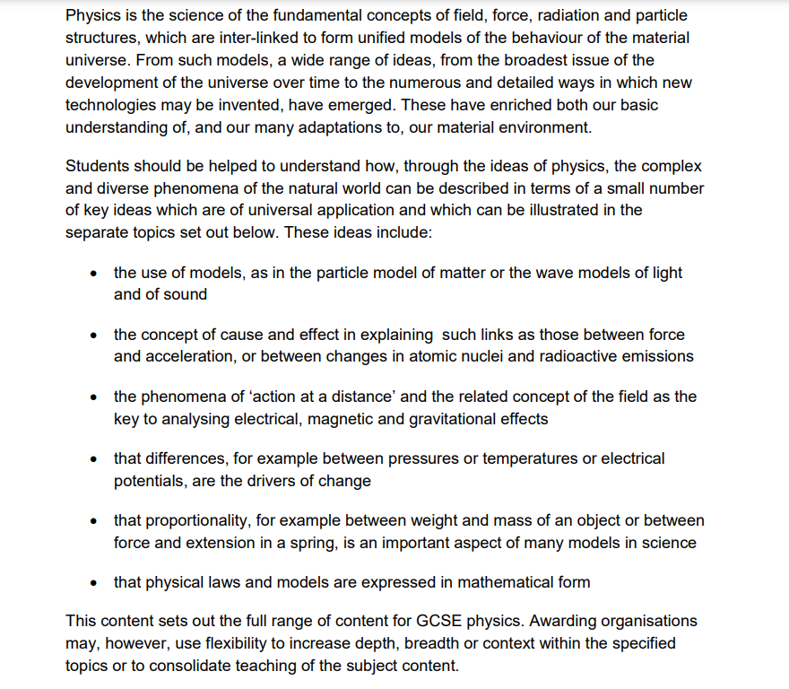
Physics knowledge and applications
This is just the first part, see DfE website for full spec.

Slide 19
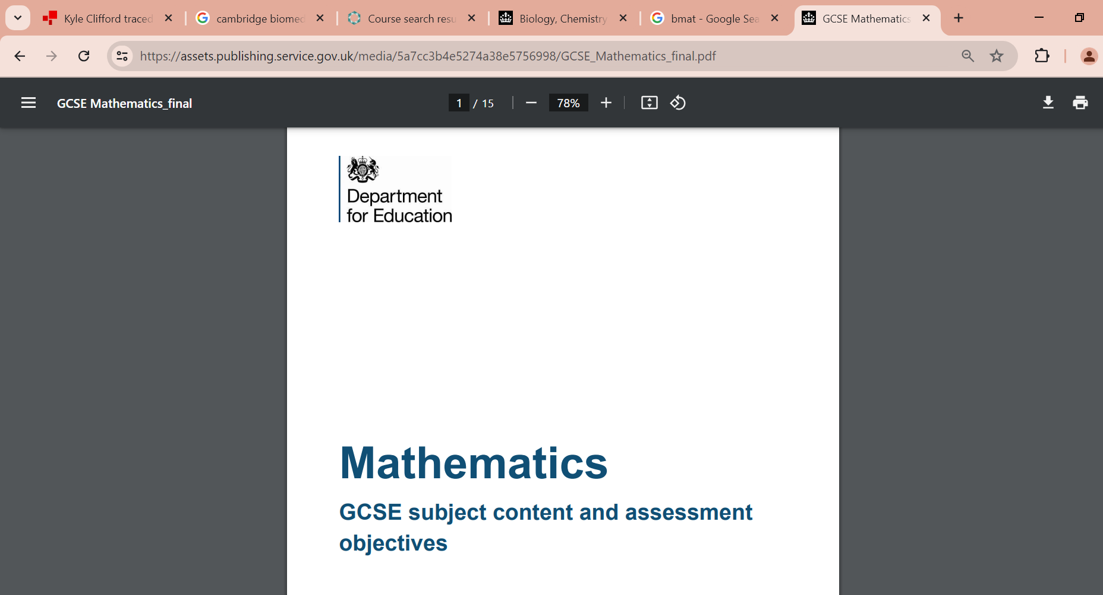
Maths knowledge and applications

Slide 20
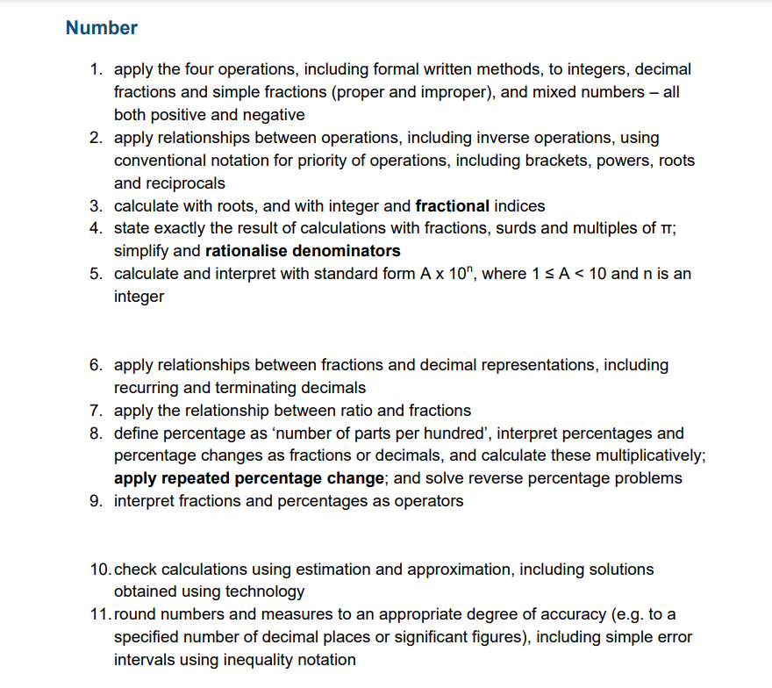
Maths knowledge and applications
This is just the first part, see DfE website for full spec.

Slide 21
Origins of the BSMAT
Until 2024 Biomedical students sat the BMAT (Biomedical Admissions Test) alongside Medics and Dentists but this test was discontinued in 2024.
The new BMSAT is now purely based on science and maths questions as in Section 2 of the old BMAT which was non-calculator.
Instead of 27 questions in 30 minutes there are now 80 questions in 90 minutes.
Old BMAT Section 2 style questions are the most useful practice via www.physicsandmathstutor.com
Other past papers such as ESAT, ENGAA, NSAA and PAT have useful multichoice questions but generally allocate more time per question.

Slide 22
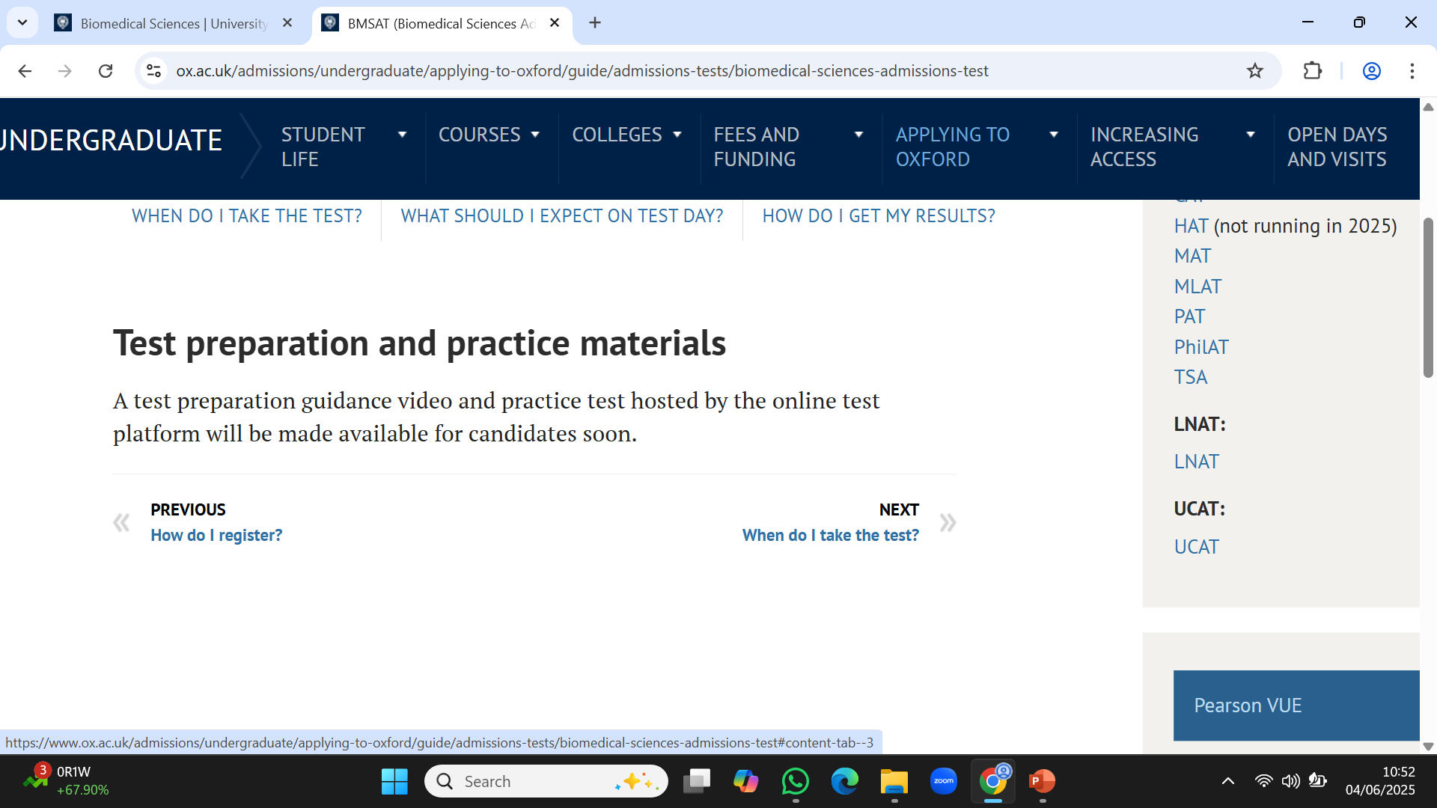

Slide 23
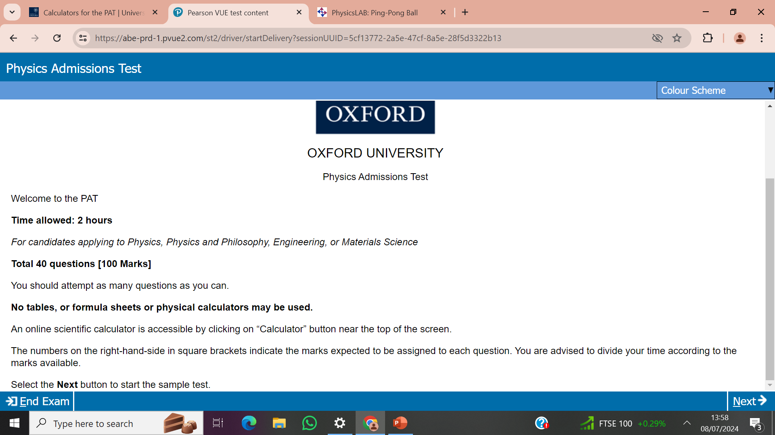
Biomedical Sciences Admission Test
Biomedical Sciences Admission Test
Welcome to BMSAT
Time allowed 90 minutes
80 multichoice questions

Slide 24
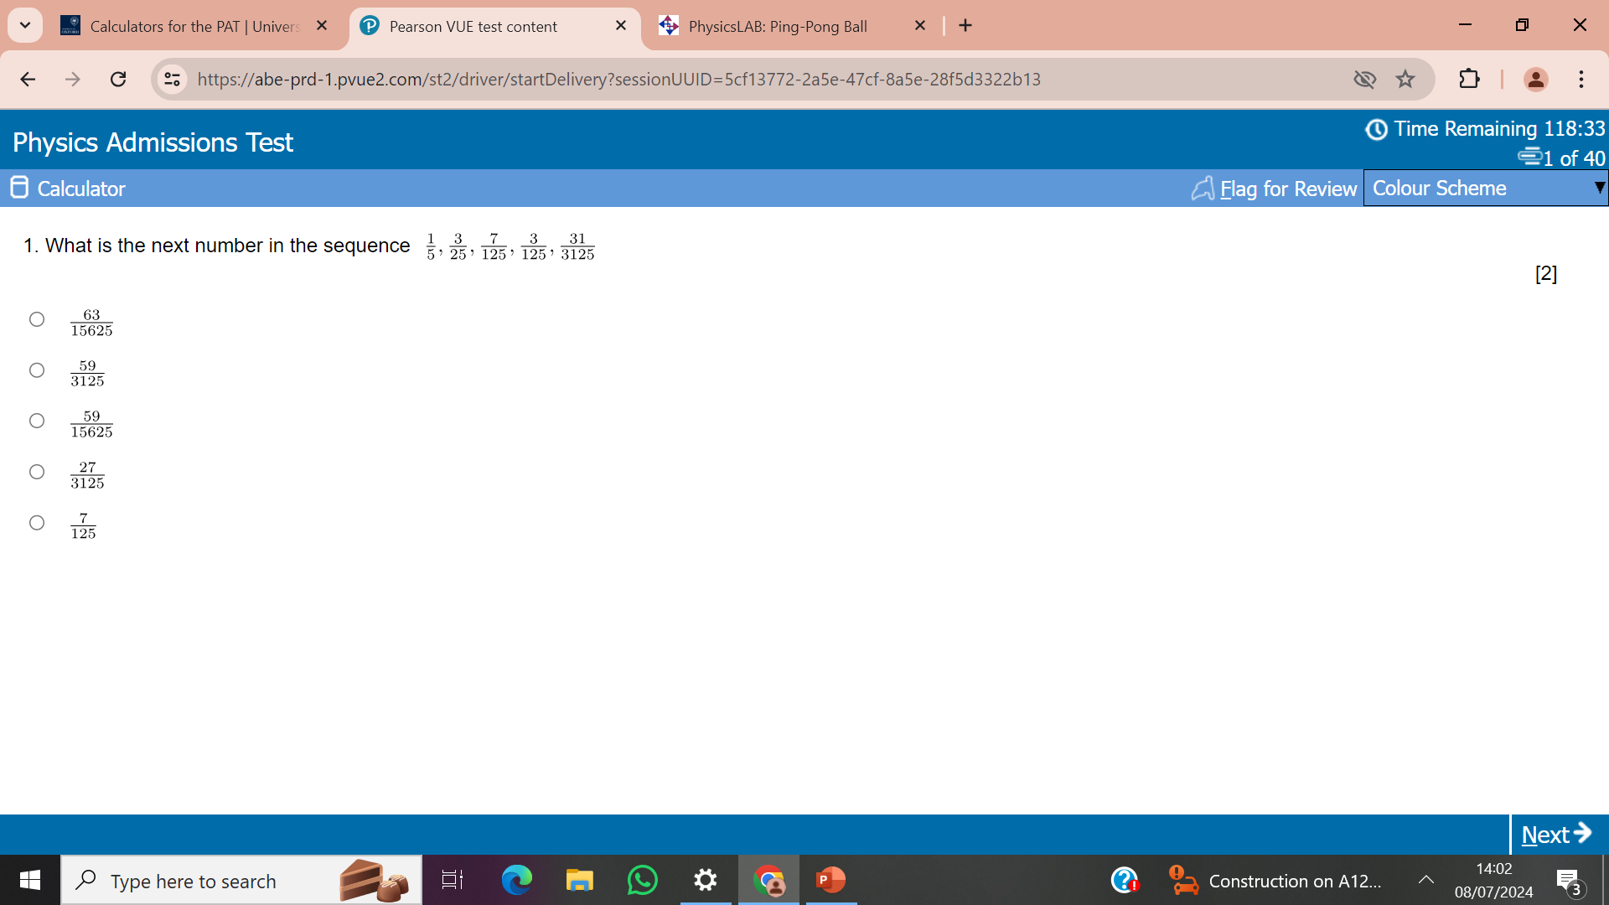
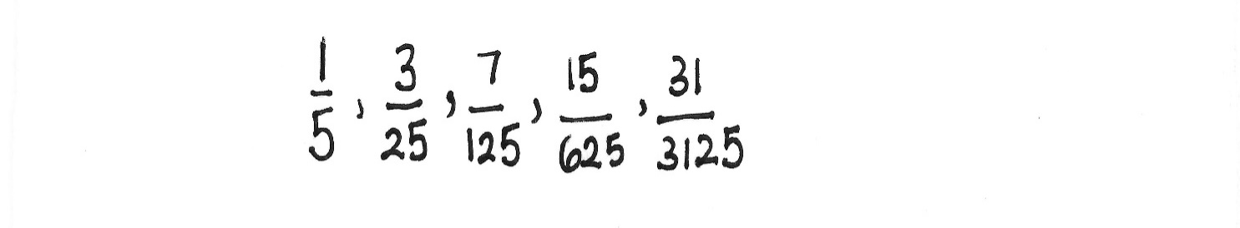

Biomedical Sciences Admission Test

Slide 25
Biomedical Sciences Admission Test

Slide 26
Biomedical Sciences Admission Test
If unsure of the answer, always guess one and mark the question for “review”. At the end of the test you can see which questions are for review and think again if you have time. Remember that there are no penalties for wrong answers!

Slide 27
Some Examples
Average time available 1 min 7 sec per question.

Slide 28
Biology
Average time available 1 min 7 sec per question.

Slide 29
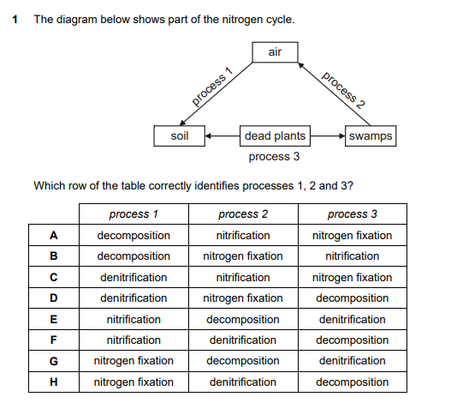

Slide 30
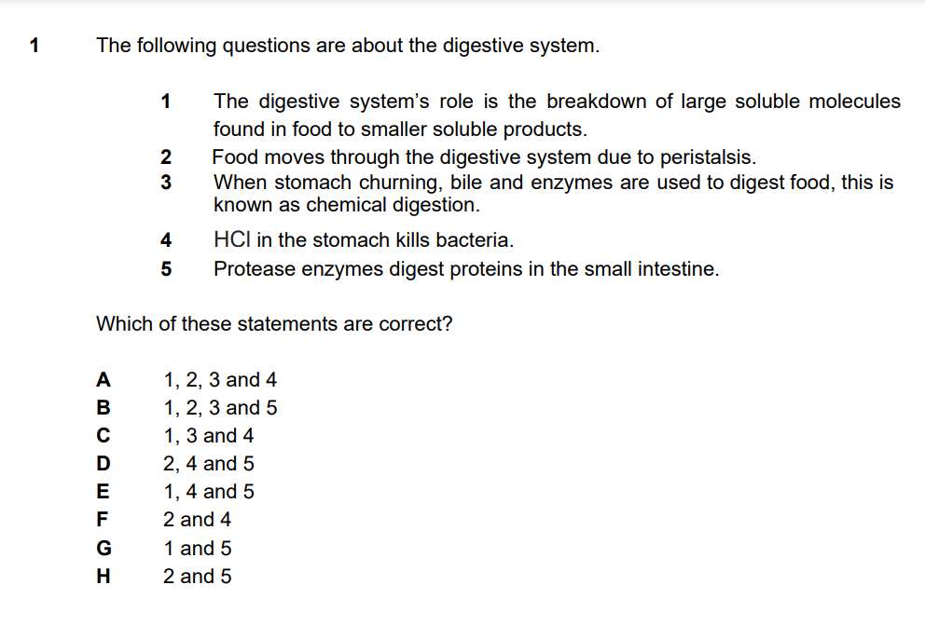

Slide 31
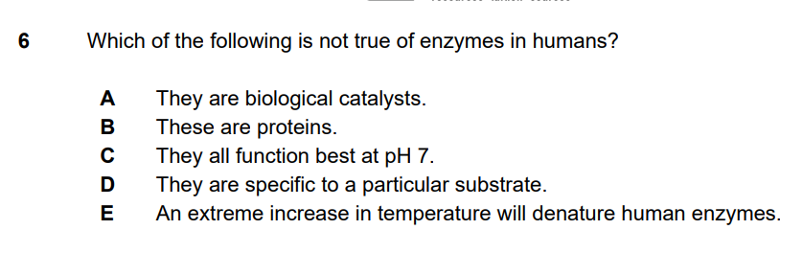

Slide 32
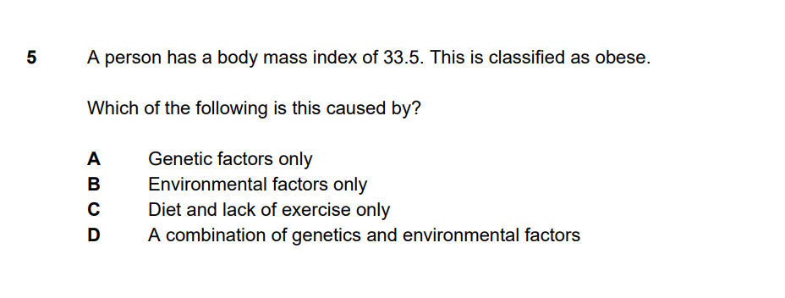

Slide 33
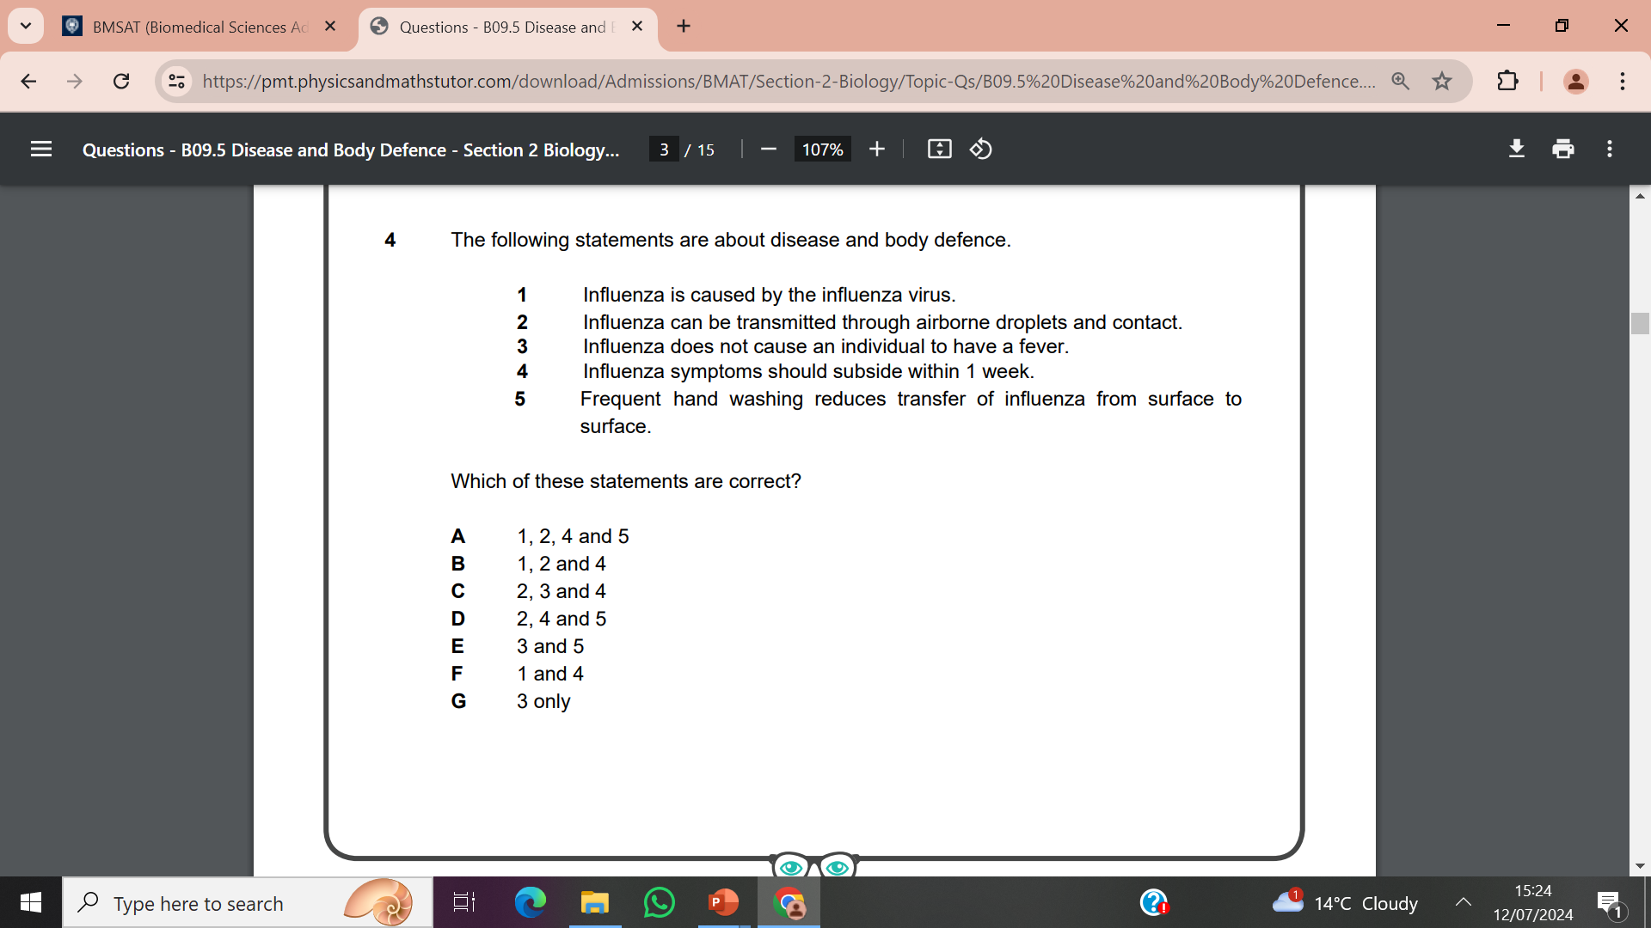

Slide 34
Chemistry
Average time available 1 min 7 sec per question.

Slide 35
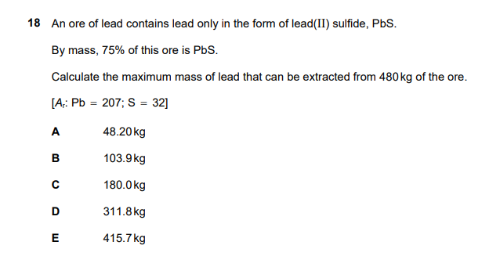
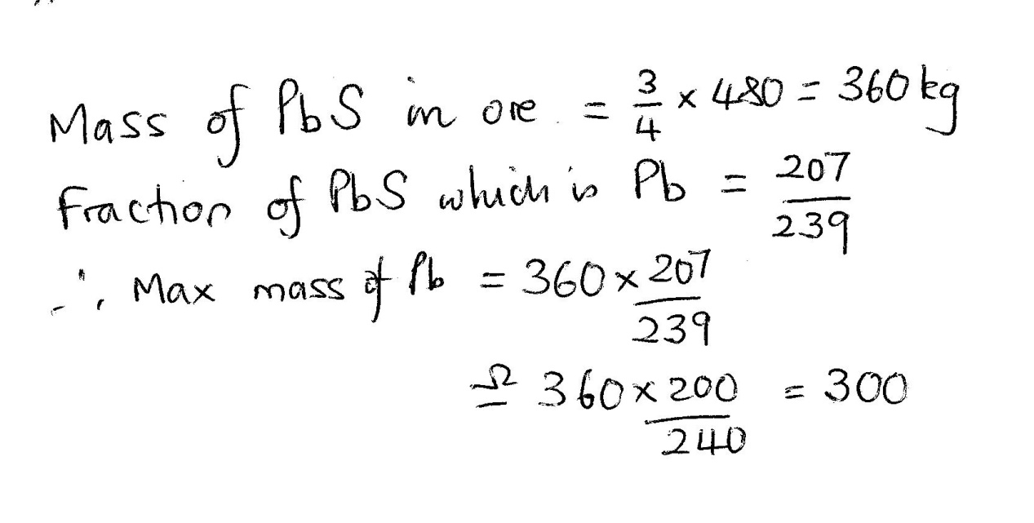

Slide 36
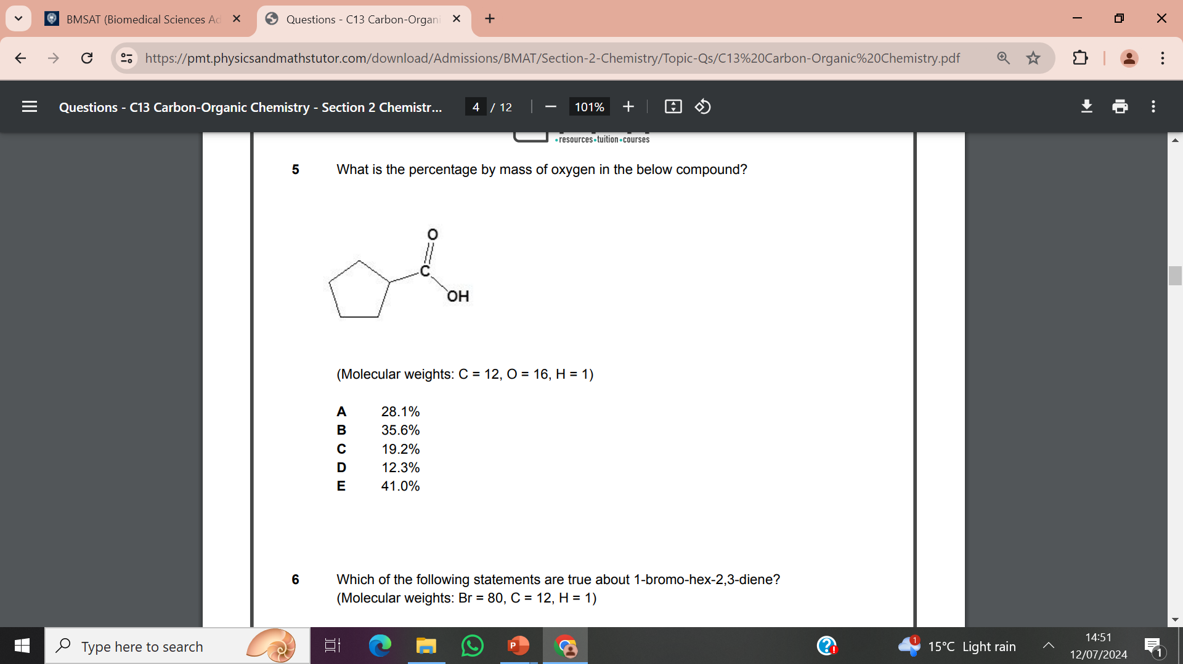
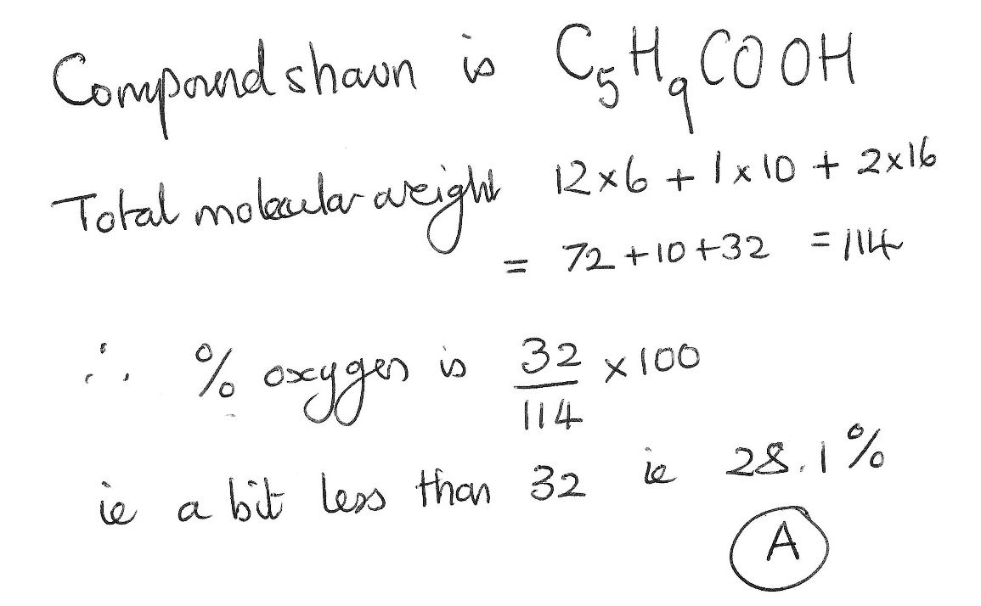

Slide 37
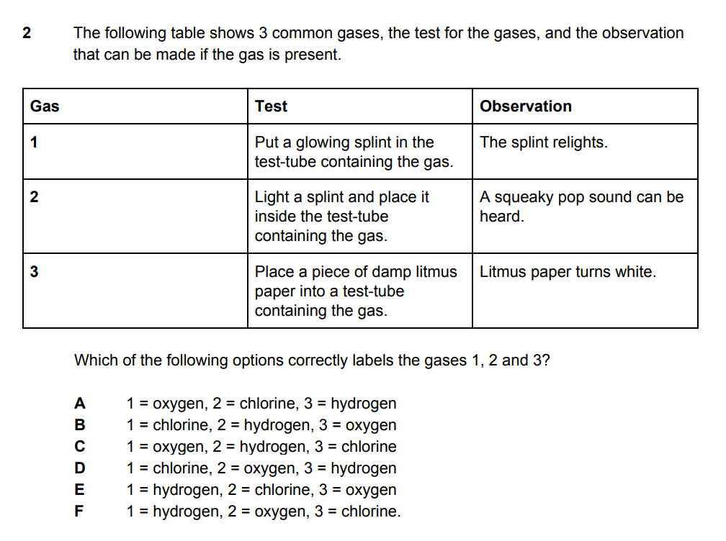

Slide 38
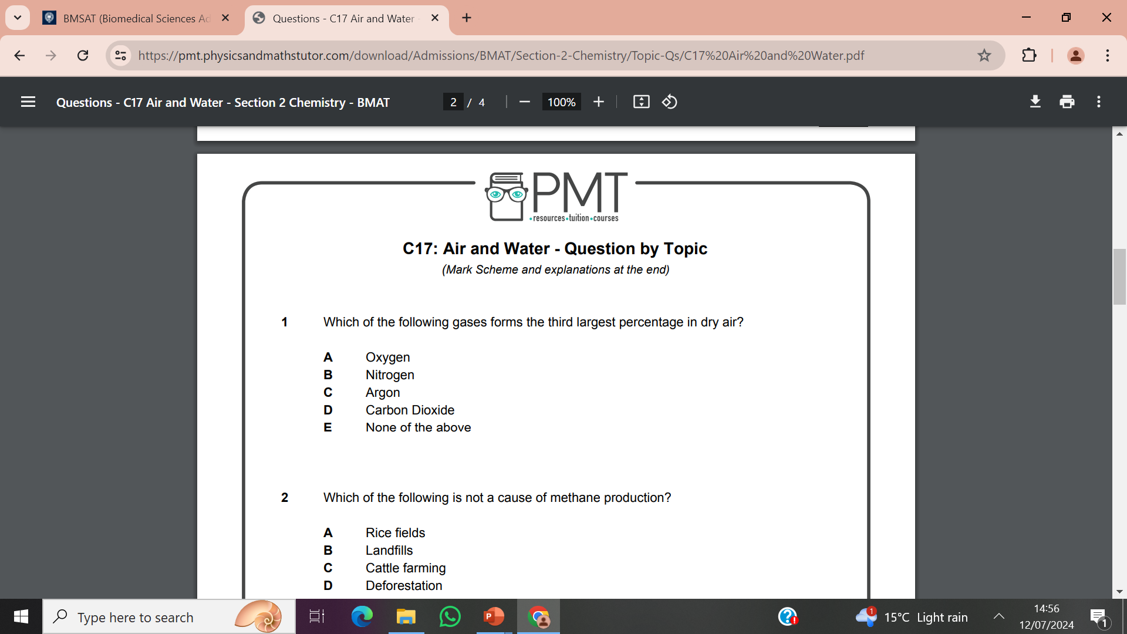

Slide 39
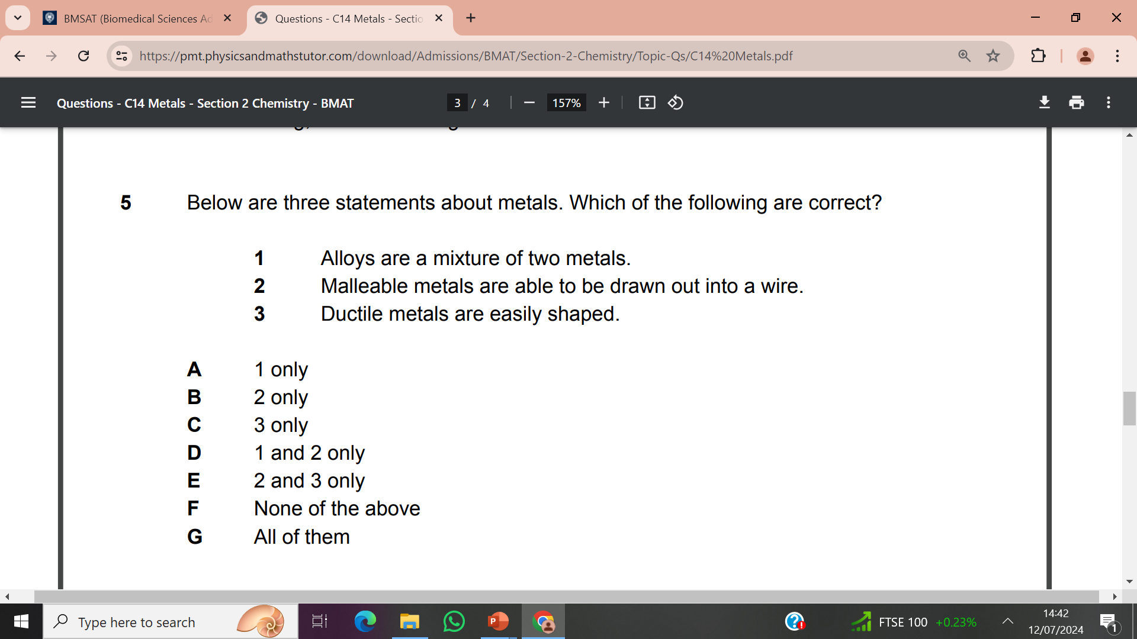

Slide 40
Physics
Average time available 1 min 7 sec per question.

Slide 41
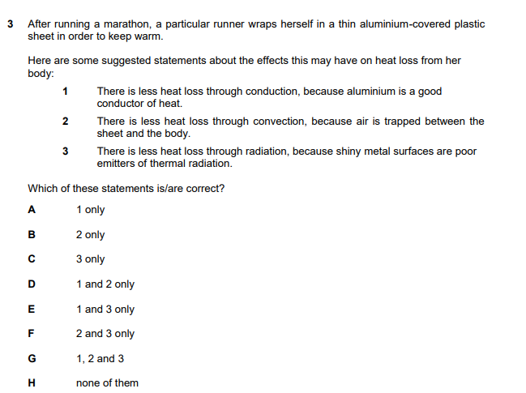
No
Yes
Yes

Slide 42
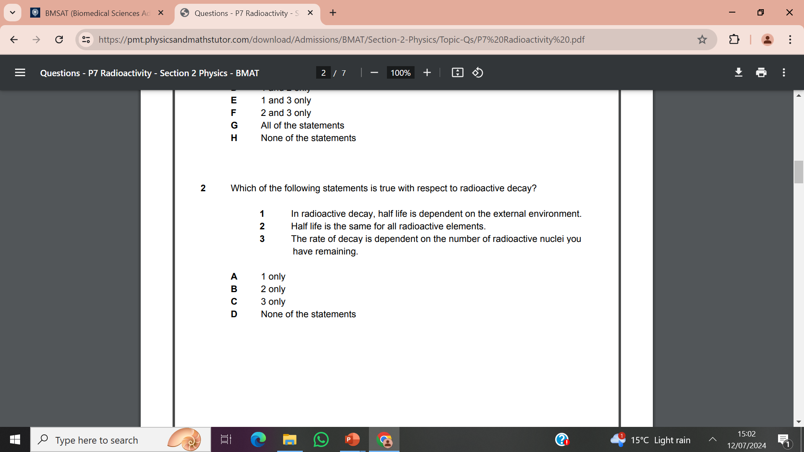

Slide 43


Slide 44
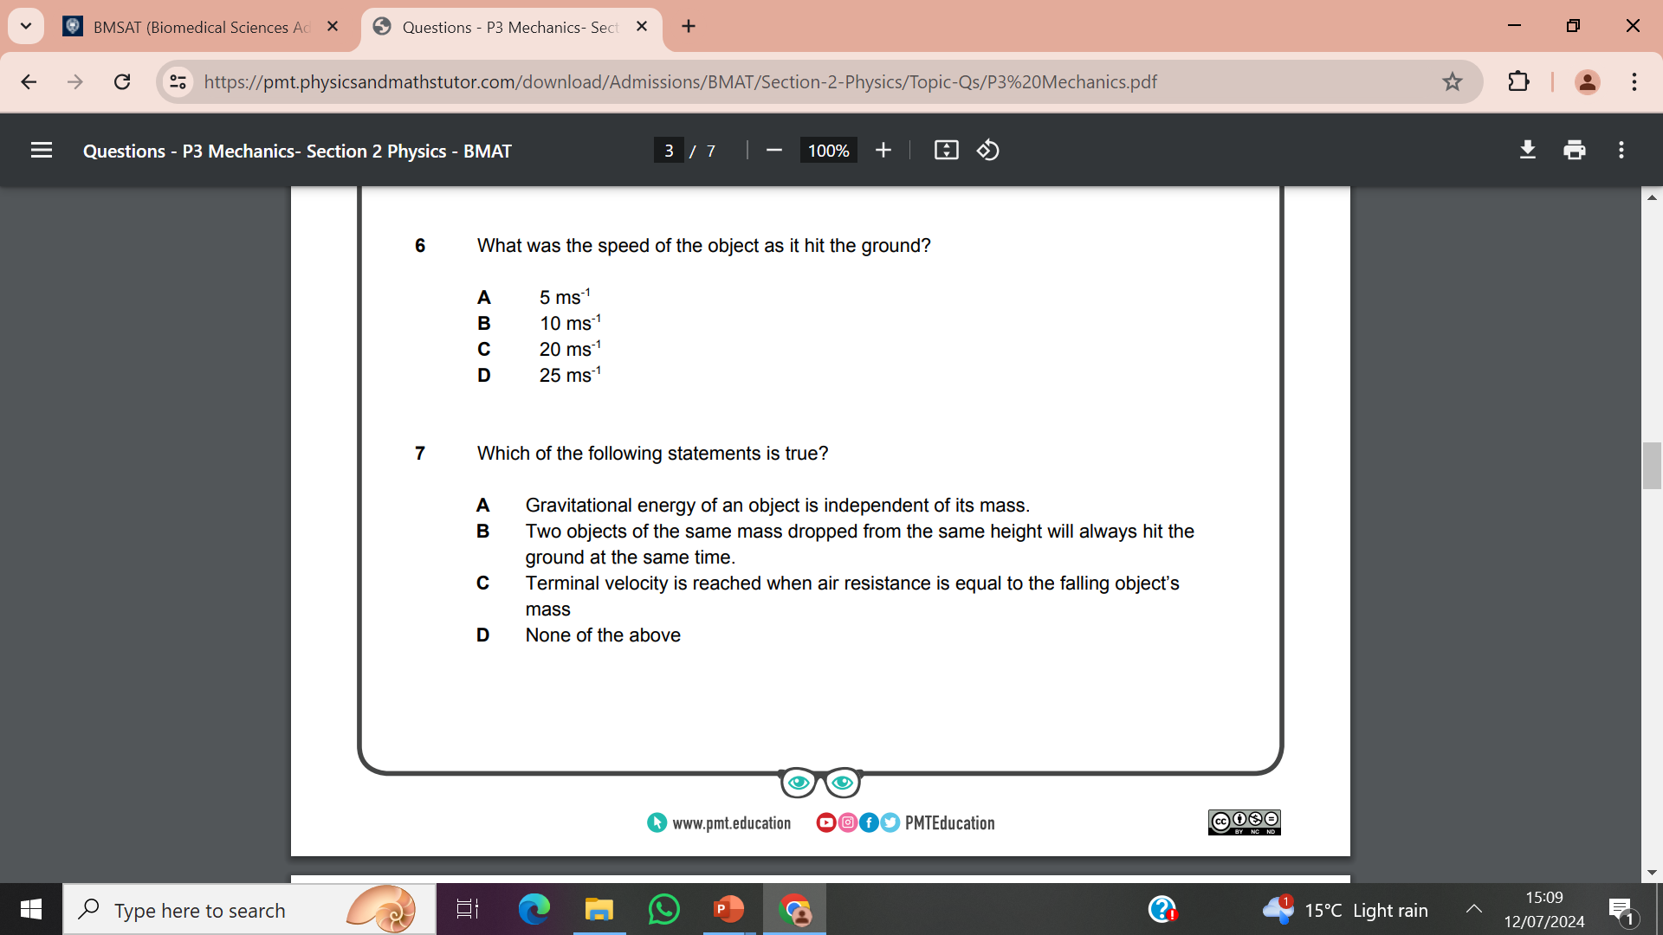

Slide 45
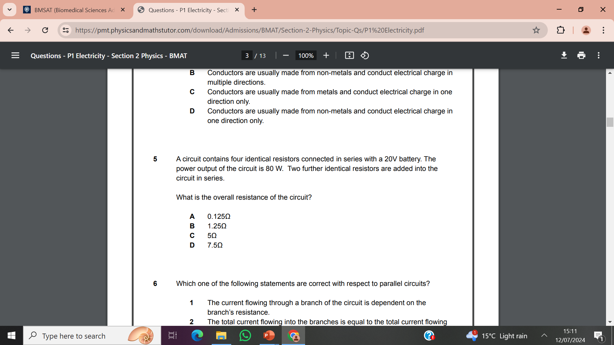
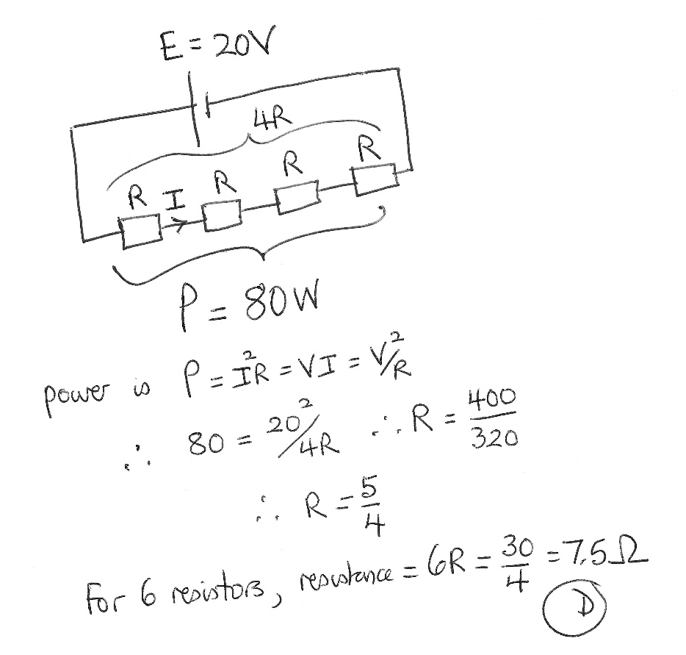

Slide 46
Maths
Average time available 1 min 7 sec per question.

Slide 47
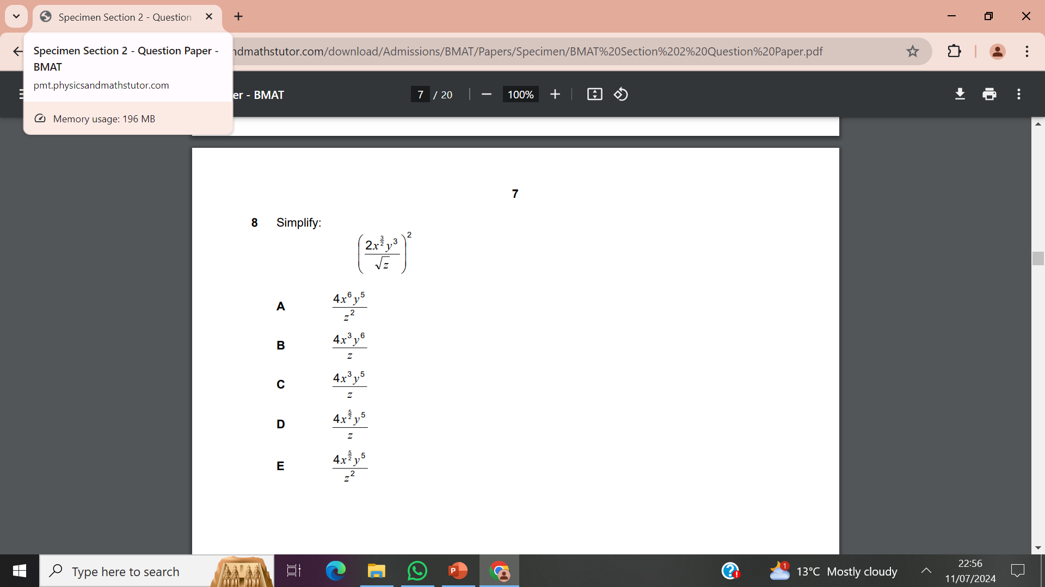
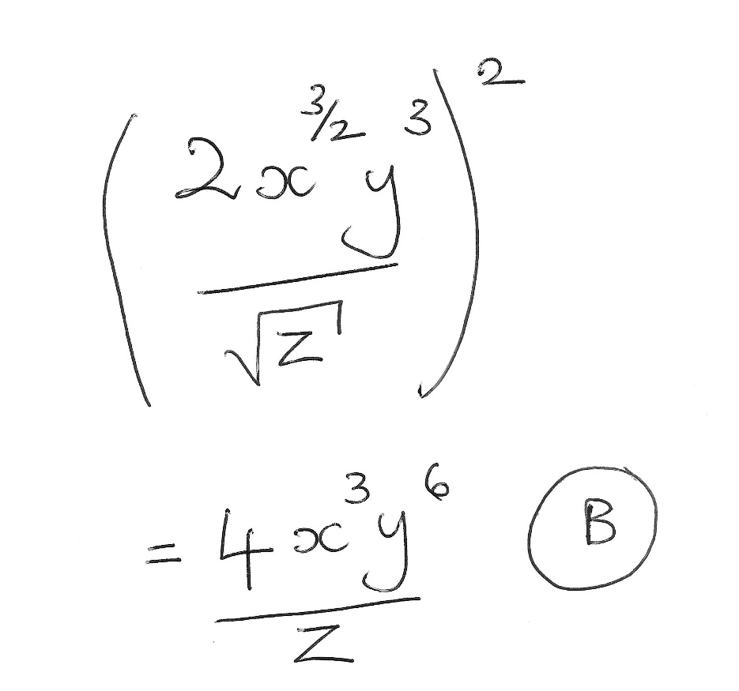

Slide 48
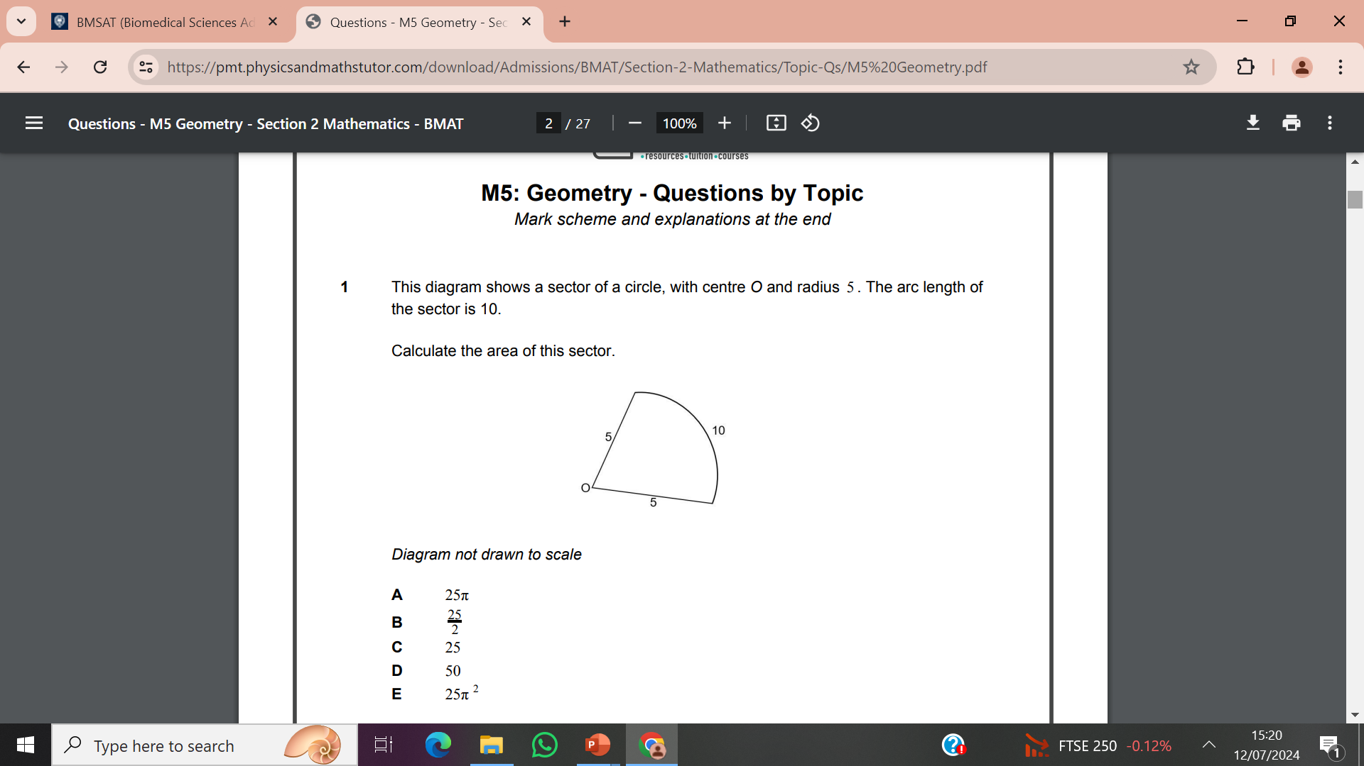


Slide 49
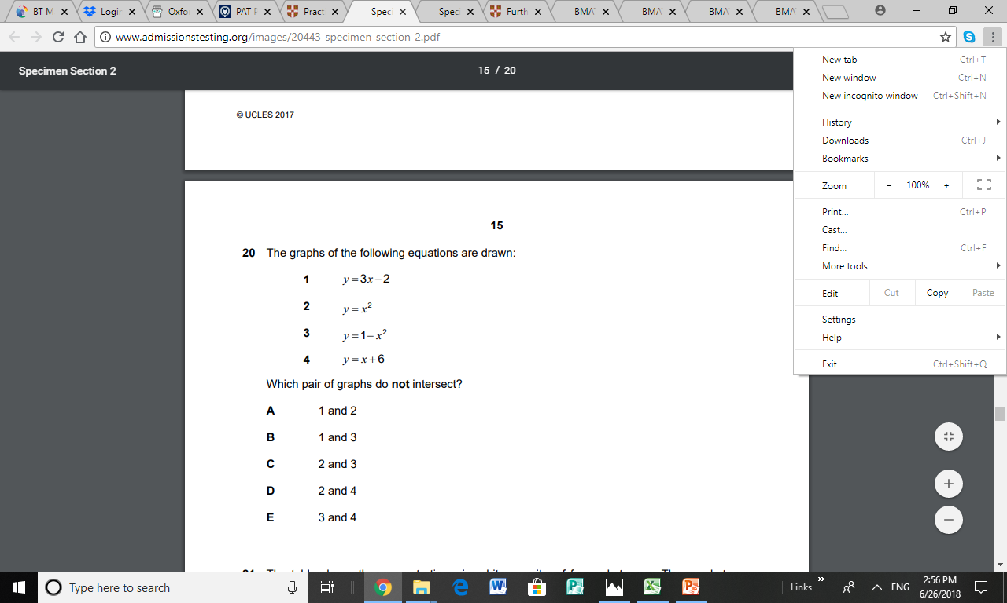


Slide 50
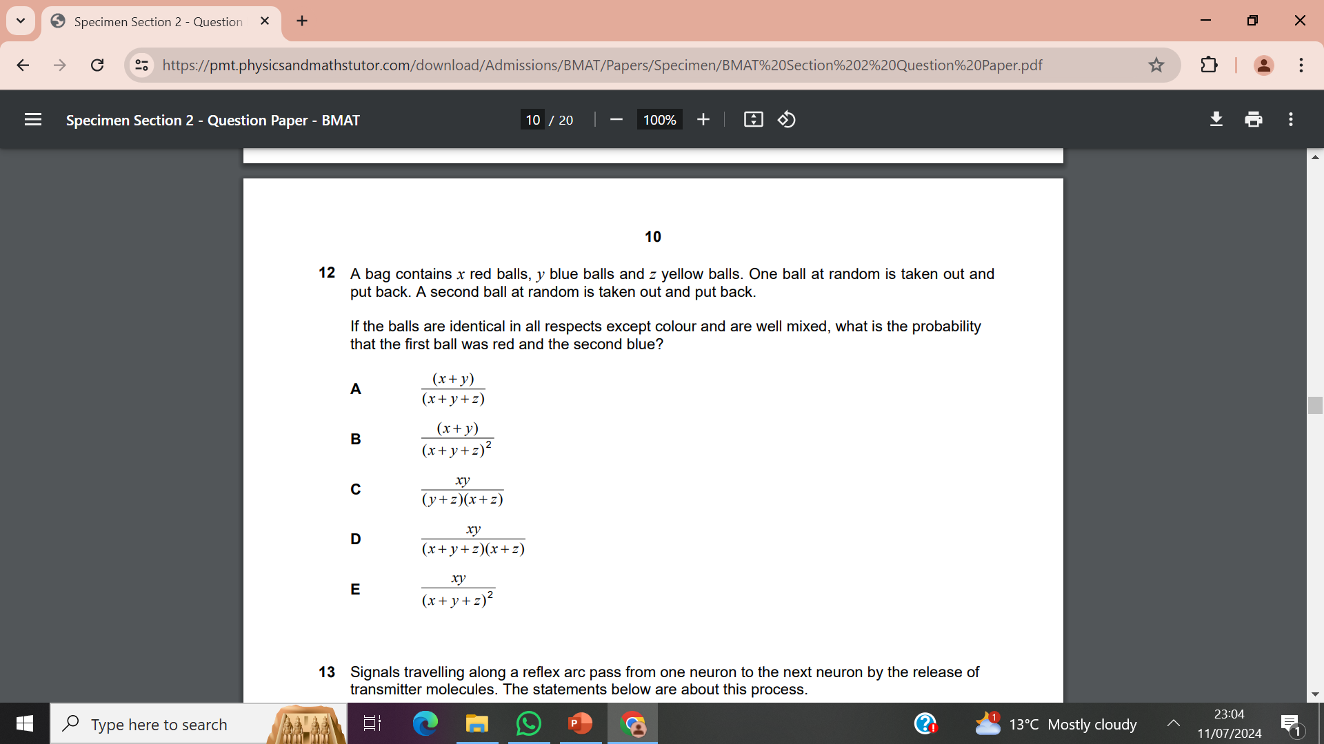


Slide 51
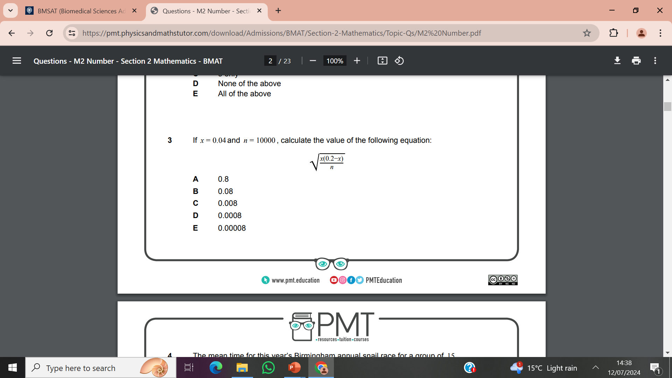


Slide 52
How do I prepare for BMSAT?

Slide 53
Preparing for BMSAT
Check the Spec
BMSAT sample questions “are expected to be available shortly”!
Practise past BMAT section 2 questions at www.PhysicsandMathsTutor.com
Additional relevant examples can be found in ESAT (Cambridge Engineering and Science Admissions Test) and old NSAA (Natural Sciences)
PAT (Physics Aptitude Test Oxford) and some bits of UCAT (for Medics)
Last year there was NO BMSAT practice test!

Slide 54
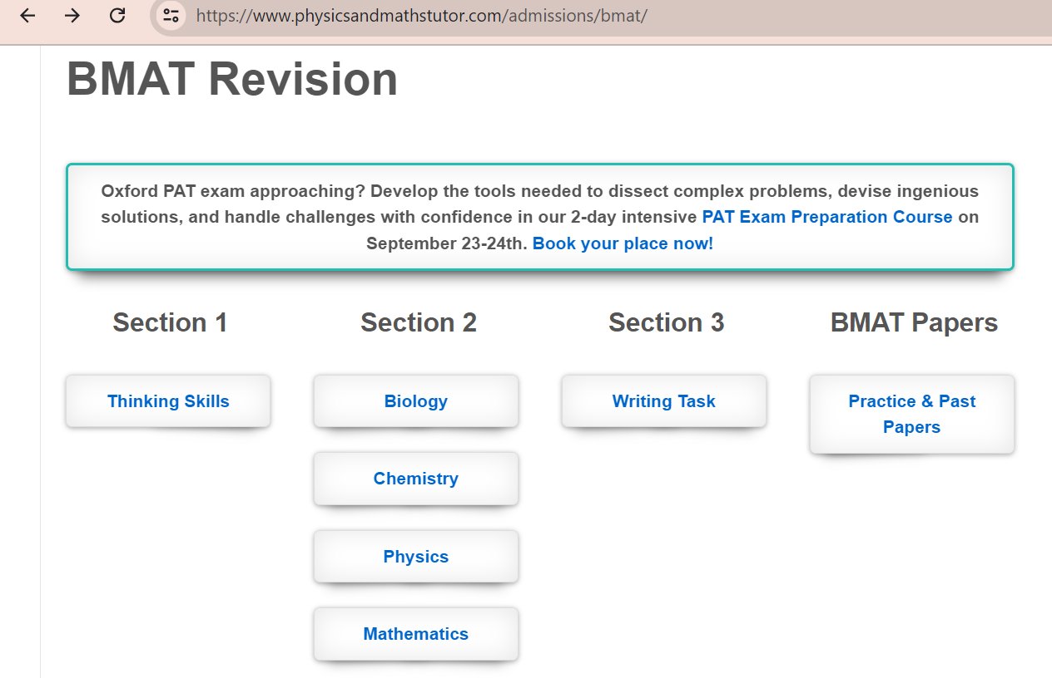
www.physicsandmathstutor.com

Slide 55
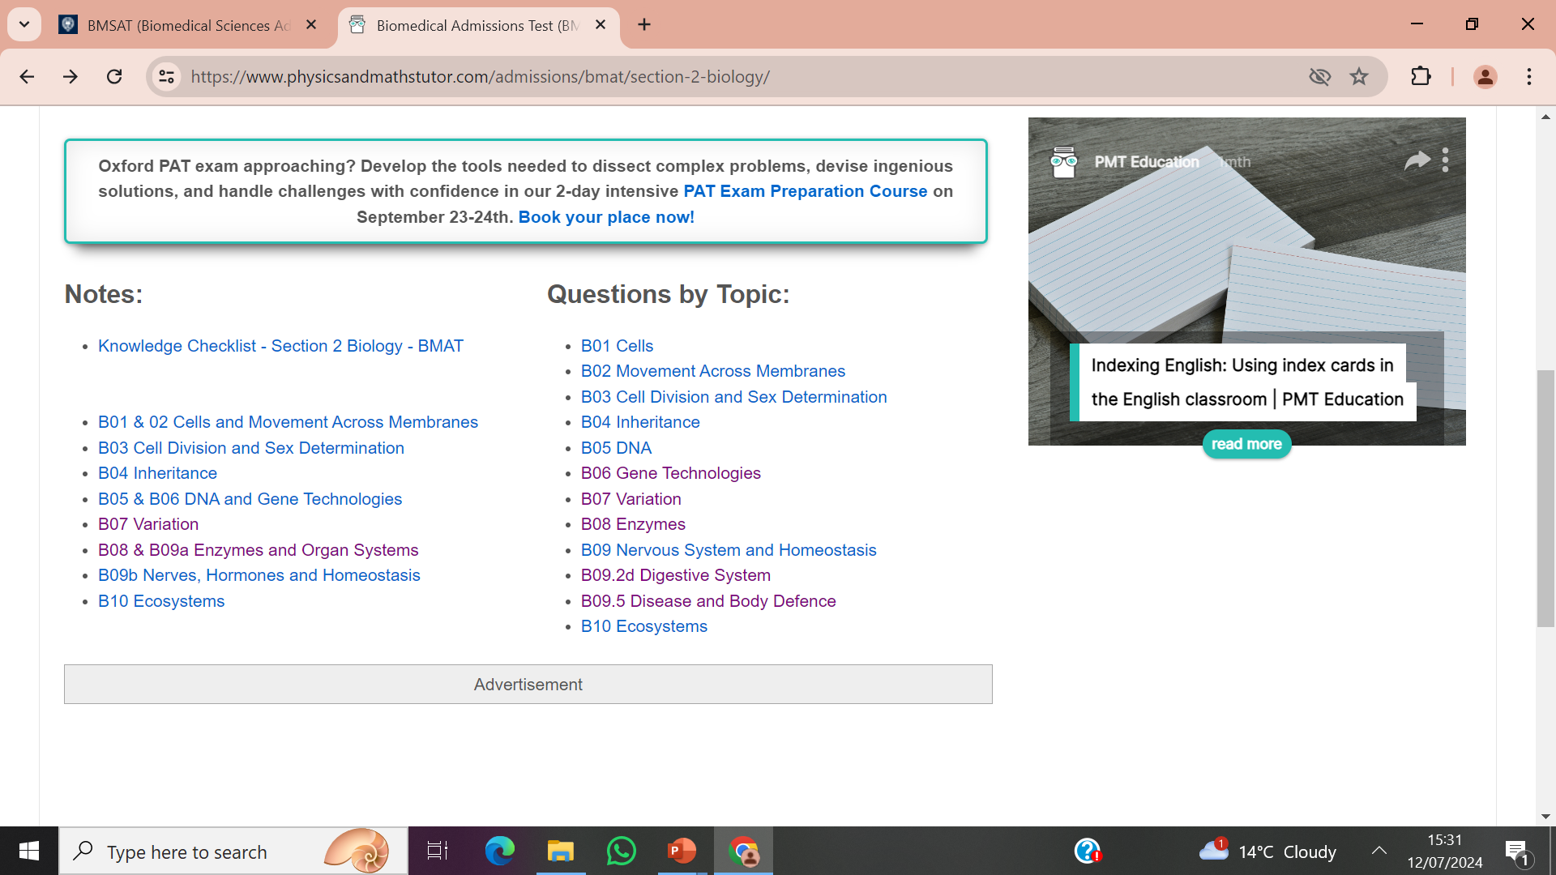
Biology

Slide 56
Looking at a practice test 1
In the absence of an actual BMSAT practice test, you could look at the practice test for Oxford’s PAT (Physics Admission Test), just to see how the Pearson computer will work.
Bear in mind that this is a calculator paper, whereas BMSAT is not. The specification is more extended and it’s all Physics and Maths. However, it does show you how the test works.

Slide 57
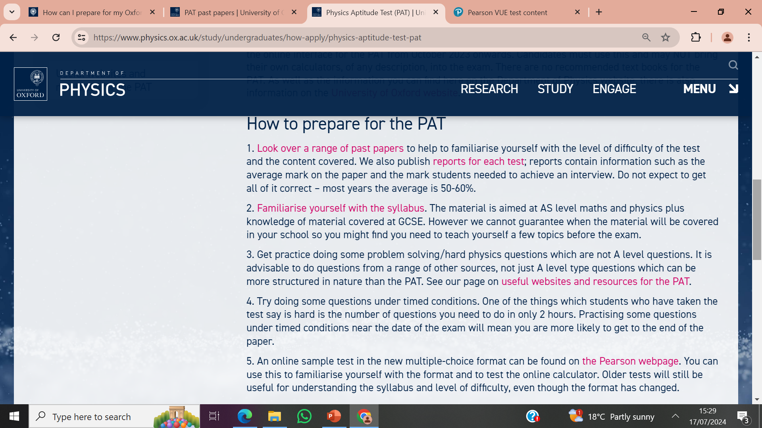

Slide 58
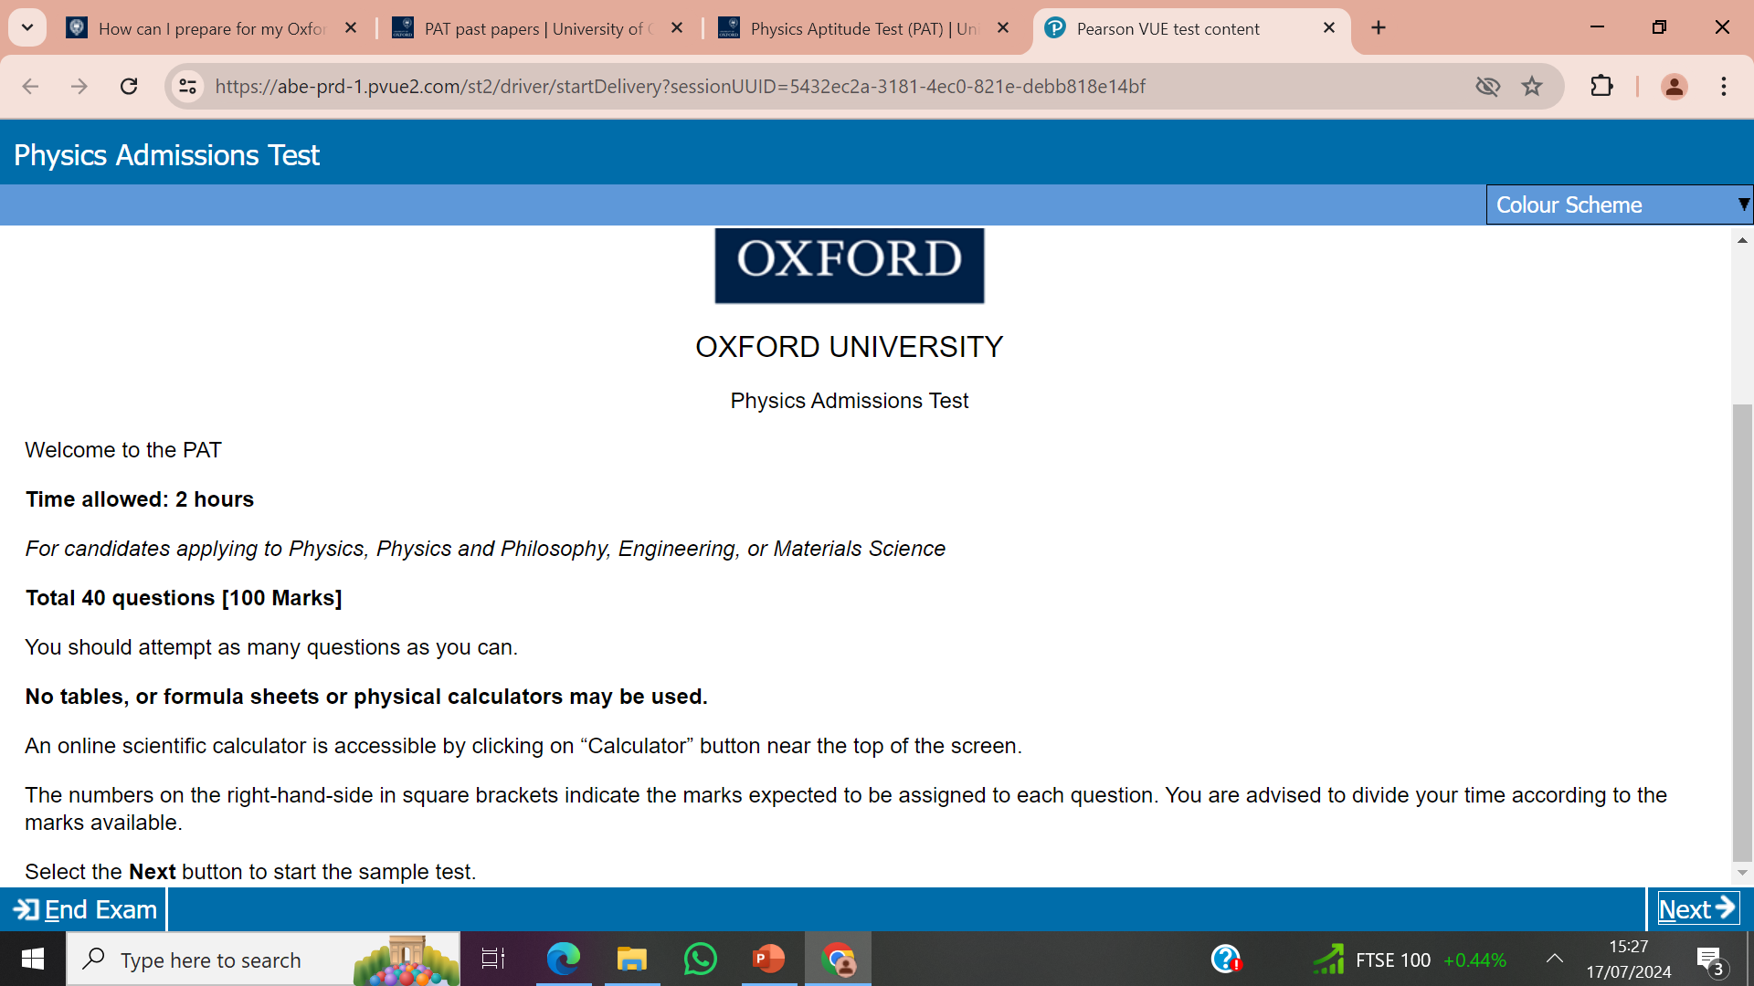

Slide 59
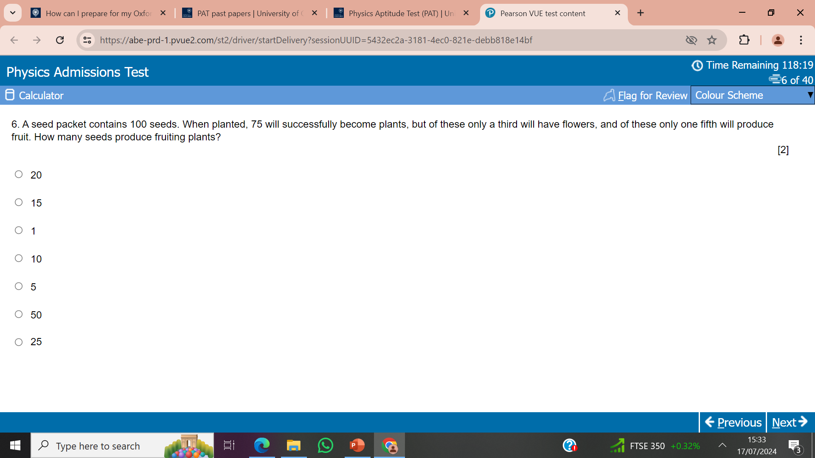

Slide 60
Looking at a practice test 2
Alternatively, you could look at the sample tests and practice tests for Cambridge’s ESAT (Engineering and Science Admissions Test Admission Test), just to see how the Pearson computer will work.
This is a non calculator paper like BMSAT. The specification is also based mainly on Higher GCSE with some A level topics. It also has questions across Maths and all three Sciences and the questions are geared to 1 minute 30s per mark. However, it does show you how the test works.

Slide 61
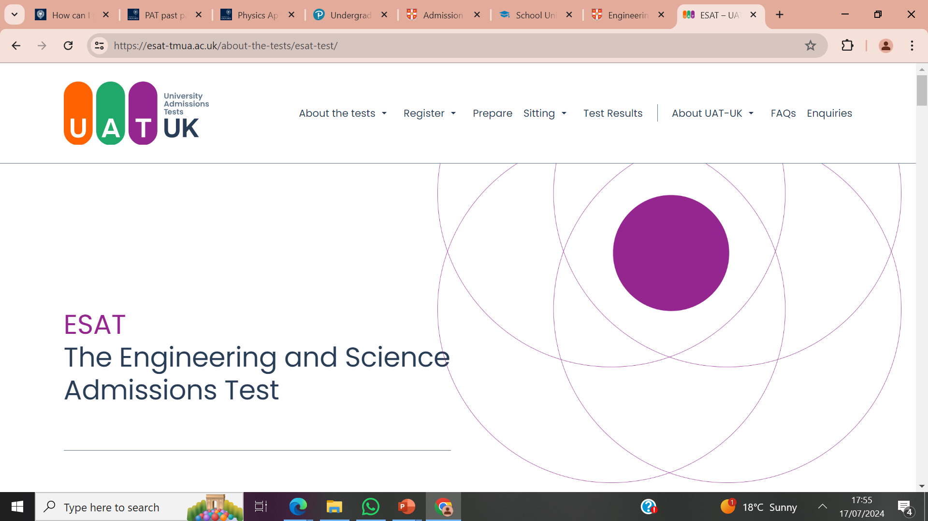

Slide 62
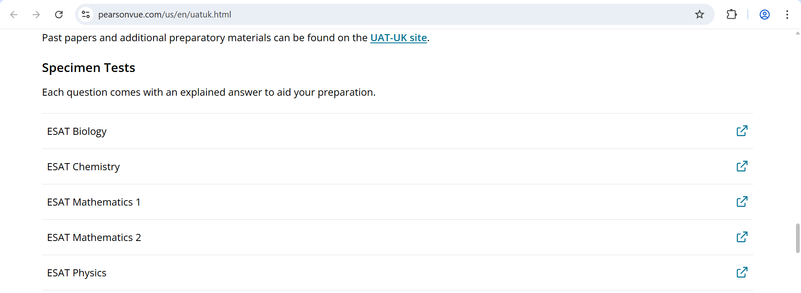


Slide 63


Slide 64

https://www.pearsonvue.com/us/en/uatuk.html

Slide 65

The sample tests have this useful option of “Explain Answer”, obviously this isn’t there in the practice tests.

Slide 66


Slide 67
Good luck!

