Slide 1
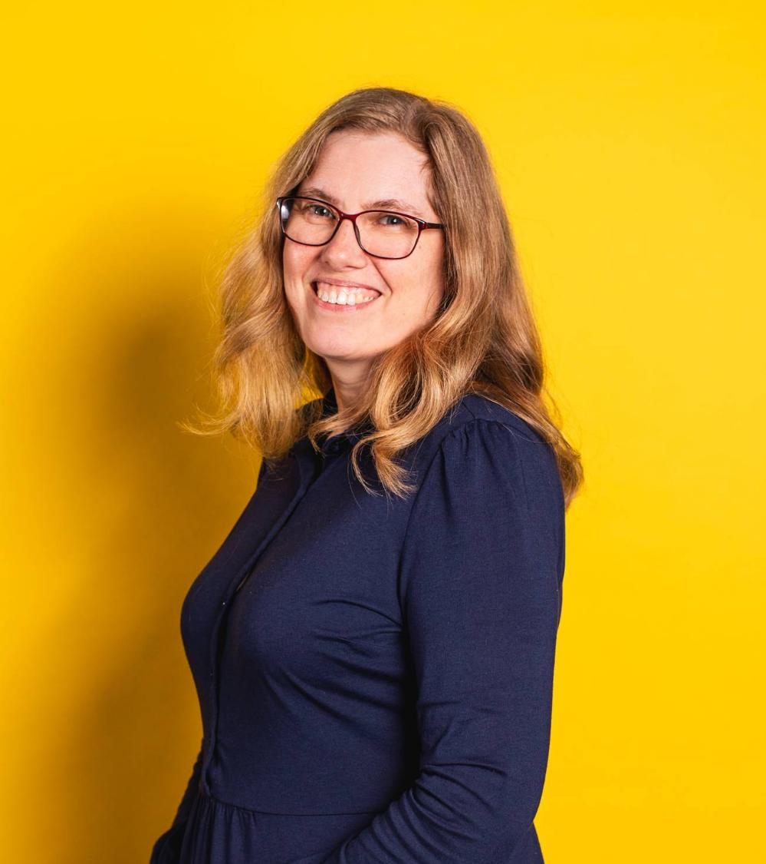
Dr Andrea Smith
University of Suffolk
Former journalist (newspapers, radio, TV and online)
Producer of radio programmes (news and entertainment)
Contributor to programmes on BBC Radio, podcasts etc.

Slide 2

Getting into the media
Local Newspapers
Weekly free paper
Local evening daily paper
BBC
Broadcast assistant → journalist → producer
Now
Programme contributor and script writer

Slide 3

Top Tips
Get involved in stuff now
Make sure you’re across any possible job vacancies/internships
Network & make contacts
Follow people on social media who do what you want to do
Opportunities can be unexpected

Slide 4


Dr Andrea Smith
Lecturer in English & Creative Writing
University of Suffolk
andrea.smith@uos.ac.uk

