Slide 1
Lee Rampling
Pork/Lamb Business Unit Director
Chartered Management Accountant

Slide 2
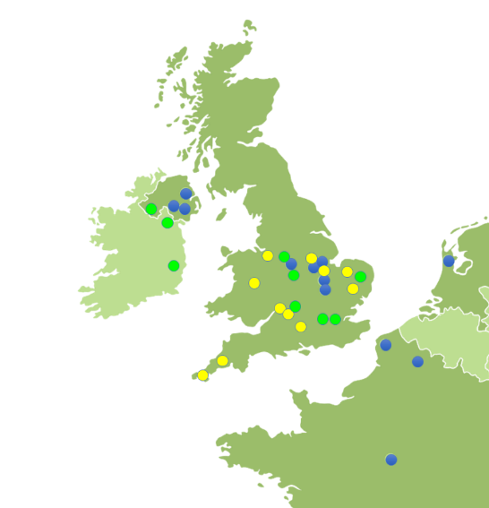
TOP EUROPEAN FOOD COMPANY
£4.2 billion UK turnover (FY23)
20,000 UK & Europe team members
40+ sites across the UK & Europe
Production facilities; hatcheries; feed mills
Set to be the #1 UK Grocery manufacturer
Unrivalled expertise in fresh UK pork, lamb and chicken
Producing authentic chilled and frozen ready meals
Snacking ranges, added value and food service products
Portfolio of iconic brands

Slide 3






CHAMPIONING BRITISH FOOD FROM FARM TO FORK
Over 80 years’ UK agricultural heritage
4,500+ British farming partners across all regions
#1 UK organic & free-range chicken producer
Leading farm assured lamb supplier
#1 UK higher welfare pig farmer
#3 UK retail meat-free category (Richmond)
Over 99% of UK households shop our categories
#1 UK prepared foods producer

Slide 4






OUR ICONIC BRANDS
Fridge Raiders is the UK’s No.1 Chicken snack brand
Richmond is the nation’s favourite sausage brand
(Circana & Kantar marketplace MAT To 01/09/24.)

Slide 5


Pork/Lamb Overview
11
Production
sites in UK
5
Fresh
processing facilities
c. 350,000 pigs on
the ground at any given time
c.320 farms
Geographically
spread
Processing up to
c. 2.4 million pigs per year
6
Added-value processing facilities
Unique vertically integrated supply chain
Processing up to
c. 1 million lambs per year

Slide 6



































Pilgrim’s UK Business (Pork/Lamb)
Moy Park Business (Chicken)
Pilgrim’s Food Masters Business (Prepared/Brands)

Slide 7
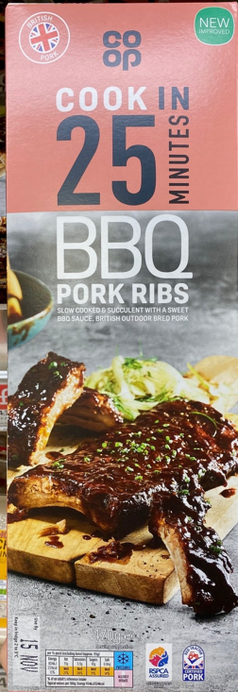
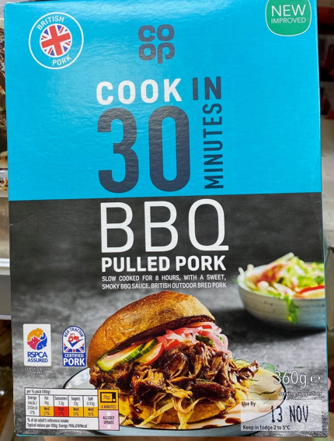
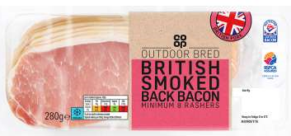
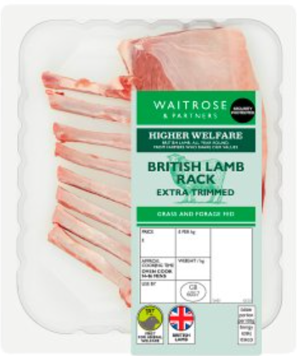



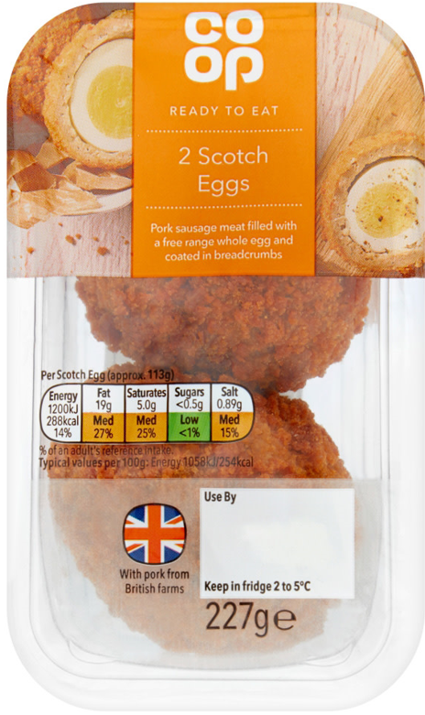

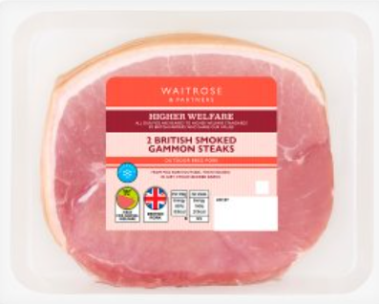
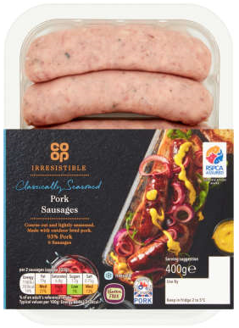
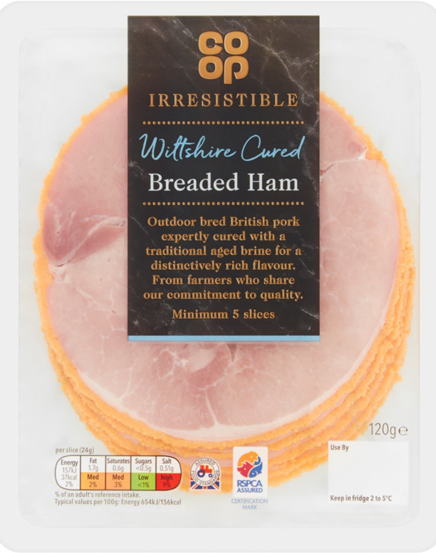

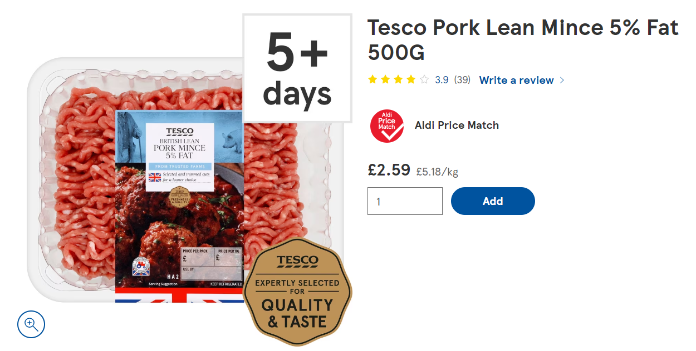
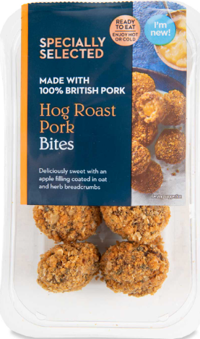
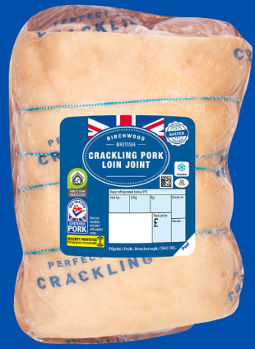




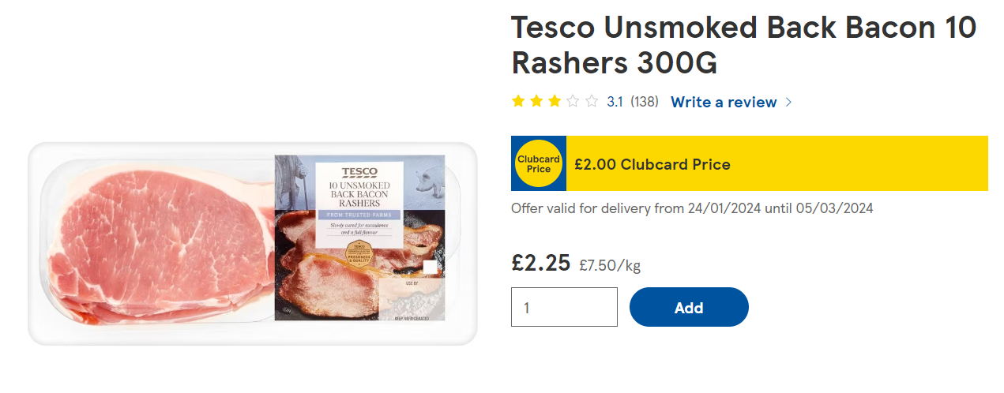
Some of our products…

Slide 8

My Responsibilities as Pork/Lamb Business Unit Director
Responsible for keeping colleagues safe
Establish the Business Strategy and direction – communicate this to the team
Overall Responsibility for Business Finance Performance
Responsible for planning and logistics/Health and Safety/Sustainability and Human Resources
Sit on the European Executive Board

Slide 9

My Career Path
Didn’t go to
University
Trainee Accountant
Commercial
Finance Manager
Finance Director
Joint Managing Director
Managing
Director -
Fresh
Pork/Lamb
Business Unit
Director
Management
Accountant
Financial
Controller
Obtained BTEC ONC in Business Studies and Economics (Accountant A Levels)
Plastics Manufacturing company (studied toward AAT Qualification in the evenings)
Windows & Plastics Manufacturer (Studied CIMA Qualification in the evenings = 3 years)
Car Dealerships/
Seafood Processor/Poultry Processor (£8m - £100m Revenue Business)
Pork Processor (Pricing in Supermarkets)
Dalehead Foods/Bernard Matthews
Dalehead
Foods
Pilgrim’s UK
Pilgrim’s
Europe
Over 30 years of experience in Manufacturing and Food Processing Finance Roles

Slide 10



What does an Accountant in industry do?
Preparation of Weekly/Monthly Management Accounts to monitor/record Business Performance
Annual Budgeting/Shorter-term forecasting (Benchmarking Business Performance)
Compliance – Statutory Accounts/Taxation
Cost Products/Price for Customers (work with Commercial Teams)
Investment Appraisals (Machinery/IT/Premises/Facilities)
Project Management – Cost Cutting/Expansion
Cashflow Management
Working Capital Control – Stocks/Debtors/Creditors

Slide 11
What skills do I need?
Aspiring Accountants Need:
Numeric/Logical mind…It’s all about numbers
Energy/Drive – get involved in the business and understand it to put the information you produce into context
Inquisitive mind – Why do we do what we do, the way in which we do it?
People Skills – Influencing, supporting, being a team member
Commitment – to complete the qualifications
Resilience – It’s challenging and doesn’t always go to plan

Slide 12
Accountancy Qualifications
Qualification | Website
Association of Accounting Technicians (Accountancy Support Roles - GCSE Entry Point) | https://www.aat.org.uk/
Chartered Institute Of Management Accountants (Business Management - A level Entry Point) | https://www.cimaglobal.com/
Institute of Chartered Accountants of England and Wales (Professional Route Top 4 Accountancy Practices/Banks/City - Degree Entry Point) | https://www.icaew.com/
Association of Chartered Certified Accountants (Smaller Accountancy Practices & Business Advice - A Level Entry Point) | http://www.accaglobal.com/
Chartered Institute of Public Finance Accountants (Local Government - A Level Entry Point) | https://www.cipfa.org/

Slide 13

Roles in industry
Senior Member of Business Team
Site Director
Accountant
HR Manager
Technical Manager
Commercial Lead
Operations Manager

Slide 14
Further Information
Pilgrim’s Europe - Europe - Pilgrim's Global
Careers - Search Jobs

