Slide 1


School of Education
#ARUEdu
Chelmsford | Cambridge | Peterborough | Distance Learning
Paula Daines
Deputy Head of School

Slide 2


Why ARU?
University of the Year Times Higher Education 2023 awards.
Awarded Gold in the Teaching Excellence Framework 2023
Top 10% in the country for graduate employment Graduate Outcomes Survey 2024
One of the top 350 universities in the world for the seventh successive year Times Higher Education University World Teaching Rankings 2023
13th in the country for course quality.
Top 5 in the UK for health and wellbeing. Times Higher Education (THE) Impact Rankings 2024.
2

Slide 3


Why study with the School of Education?
Ranked 13th in the UK for Education courses in the Guardian University Guide 2025
Scored 95% for Learning resources and Communication of mental well-being support on our BA Early Childhood Studies and BA Montessori Early Childhood Studies degrees in the National Student Survey 2024
Scored 100% for Communication of mental well-being support and 90% for Assessment and feedback and Student Union representation on our FdA Early Years and Education in the National Student Survey 2024
The only UK University provider of specialist Montessori degrees at Undergraduate and Postgraduate level.

Slide 4
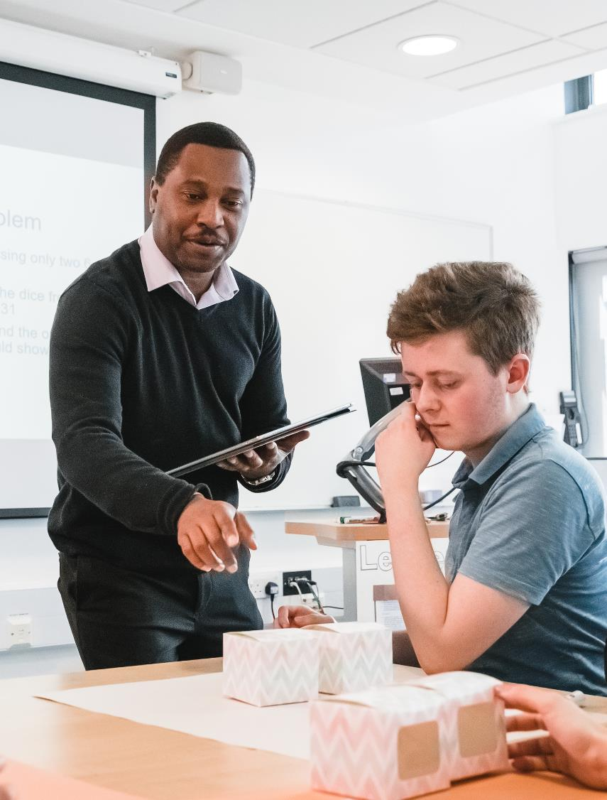
Our academic staff
Skilled teaching & learning experts
Many are Senior and Principal Fellows of the Higher Education Academy (HEA)
Bring their research findings into their teaching (many of the books you will be using are written by our academics!)
Have a vast amount of experience of Education in the real world
Committed to engaging you in the wider academic community through participation in research seminars and new projects.
Notes:
The Education team bring a variety of expertise and experience to all of our courses. From early years, through primary and secondary school and across the further and of course higher education sectors.
Some of our lecturers also work part time in practice, for example managing a chain of Montessori pre-schools and in senior leadership roles in primary schools.
One of our principle lecturers is president of OMEP a world organisation for early childhood. And all of the team are fellows, senior fellows and principle fellows of the Higher Education Academy.
We are all skilled in high quality teaching and learning. However the most important element is that we work with you to guide you and to engage you in your learning process.
Many of us are also alumni of Anglia Ruskin, we have sat where you are now and so importantly we welcome you with understanding and enthusiasm to the education sector.

Slide 5
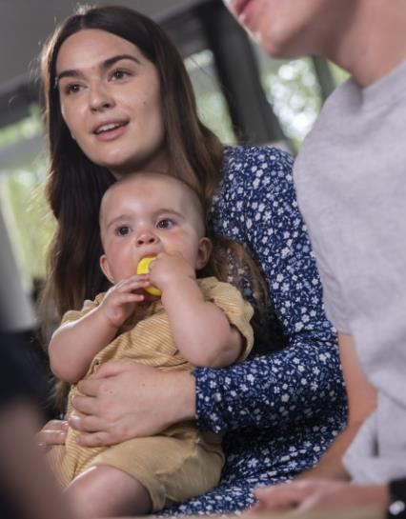
Our Education Courses
BA (Hons) Education with Sustainability or Inclusive Practice (3yrs) 96 UCAS points
BA (Hons) Primary Education Studies (2yrs Accelerated) 96 UCAS points
BEd (Hons) Primary Education with QTS (3yrs) 120 UCAS points
Notes:
So Across our campuses and online we offer a range of undergraduate and postgraduate courses.
And Although you might just be considering your first degree course at the moment
we will work with you right from the beginning to support your long term career goals.

Slide 6
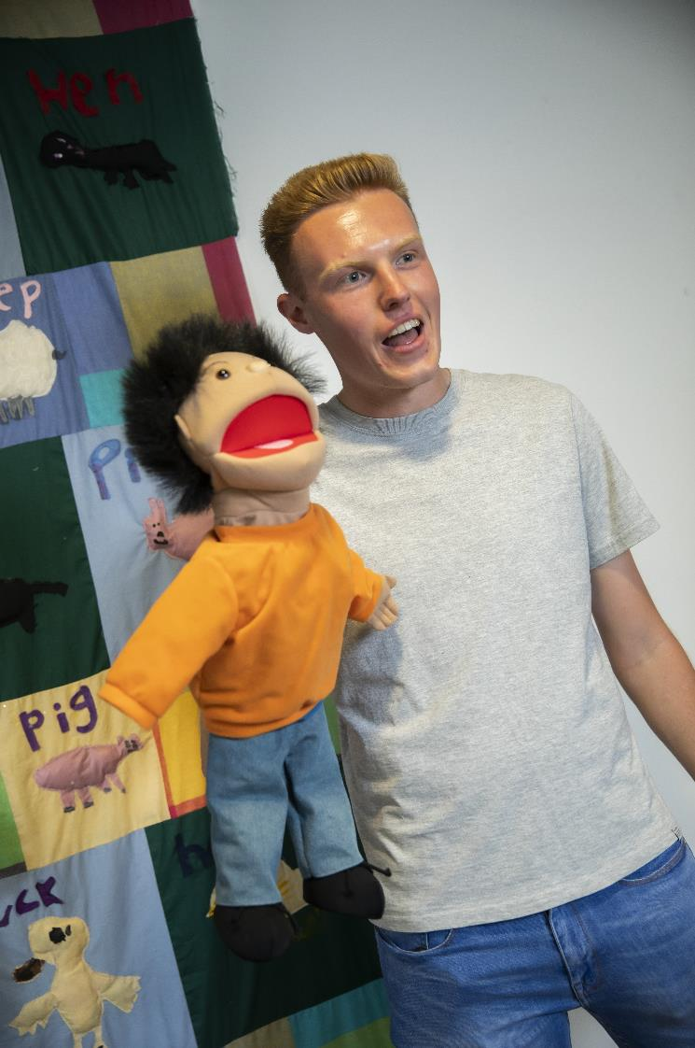
Primary Education Studies
BA (Hons)
2 year accelerated degree
Prepares you to be a Primary School Teacher
Taught over 3 Trimesters in 2 years, finishing in July each year.
Support to gain a place with a teacher training provider (QTS) for your ‘3rd year’.
Support to continue to our PGCE (alongside your QTS provider)

Slide 7
University Trimesters (2024/25 example)
Year 1 Level 4 Level 4 Level 5
Year 2 Level 5 Level 6 Level 6
Trimester 1
23 September – 13 December
Christmas break
Trimester 2
20 January – 11 April
Easter break
Trimester 3
12 May – 1 August
Summer break

Slide 8
Course Structure
Core modules – Level 4
Safeguarding
Understanding Human Development
Building Relationships
Research in Education
The Arts in Primary Education

Slide 9
Course Structure
Core modules – Level 5
Identity and Social Justice
Learning Theories
Research in Education
STEM and Core Subjects in Primary Teaching

Slide 10
Course Structure
Core modules – Level 6
Leadership and Enterprise
Neuroscience and Neurodiversity
Future Learning: Practice, International Policy and AI
Undergraduate Major Project
Humanities and Creativity: Museum Learning & Outdoor Environments

Slide 11

BEd (Hons) Primary Education with QTS
DfE Accredited to provide Initial Teacher Training with QTS (Qualified Teacher Status).
Train to teach Primary (5-11 years) key stages 1 and 2.
Taught over 3 trimesters in 3 years, with intensive placements.
Notes:
120 tariff - interviews
Highly competitive course
Significant primary school experience 15 / 20 days in school
Intensive way to train to be a primary school teacher
3 trimesters
No transfer from PES
Highly intensive 9-5
Broad portfolio of skills

Slide 12

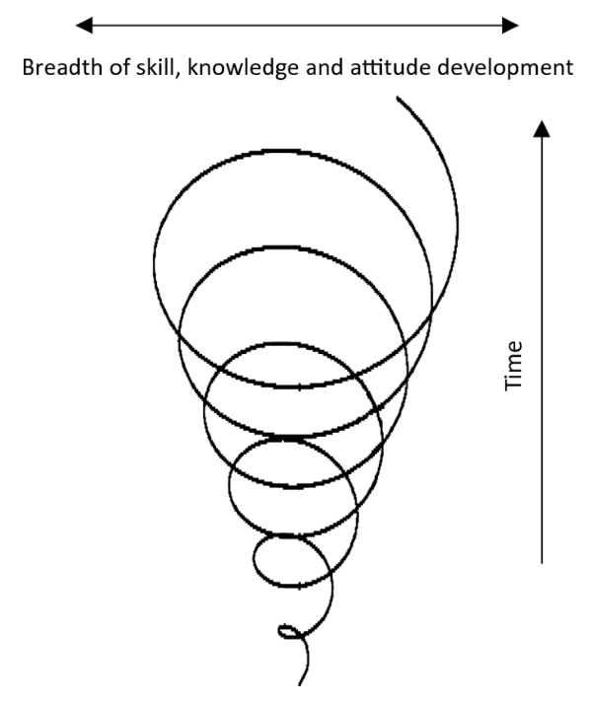






About the course
The Core Curriculum
The Wider Curriculum
Key Professional Skills
School Placement
Ruskin Module
Qualified Teacher Status Award
Notes:
Core curriculum – Eng / Ma / Sci inc phonics
Wider –Foundation subjects: Geog / Hist / Art / DT / PSHE / IT / RE
Key skills – assessment, planning, marking, adaptive teaching, SEND, working with adults, behaviour management, safeguarding. Including additional school experience as part of Intensive Training and Practice.
School placement – assessed tasks practicing the skill of teaching – managing the classroom and creating the conditions for learning
Ruskin module – focusing on multidisciplinary team working –practical, (year 2 only)
QTS award – how you demonstrate all your learning over the 3 years to meet the Teacher’s Standards – we recommend you to the government and then you will be able to start as an ect

Slide 13

Placements
Assessed placements in every year
Minimum 8 weeks per year
Experience across two key stages
Observing, 1:1, group work progressing to whole class responsibility
Lesson planning, marking and feedback, working with other adults, parents, extra-curricular opportunities
Placement bursary to support additional costs.
Notes:
Personalised approach to placements
Can’t guarantee you won’t have to travel etc – don’t make any promises
Working with regional partners across Cambridge, Chelmsford and Peterborough

Slide 14

Admissions for September 2025
50 places: Chelmsford
40 places: Cambridge
30 places: Peterborough
120 UCAS Points
GCSEs (Maths, English and Science)
Selection event on campus
Enhanced DBS check
Conditional Offer
Notes:
GCSEs – grade 4 or above. Must have them prior to entry.
We will accept A level equivalents as long as meet the entry requirements above. No specific A level or equivalent subjects needed.

Slide 15

Selection Events
We're looking to select the most dedicated and ambitious future teachers
We interview for all places on our BEd Primary Education with QTS, giving you the chance to get to know us and explore all that we have to offer too
Face to face on your chosen campus​
Short pre-prepared task followed by interview​
Representation from our school partners​
Looking for potential at this stage​
Notes:
Interview likely to be a short task e.g. 10 minutes sharing a children’s book followed by group discussion and 1:1 interviews.
Prep on website for interviewing

Slide 16
Which Education course is right for you?
 | BA (Hons) Education with… | BA (Hons) Primary Education Studies – 2 year accelerated | BEd (Hons) Primary Education with QTS
How long does it take? | 3 years taught over 2 trimesters | 2 years taught over 3 trimesters | 3 years taught intensively over 3 trimesters
When do I qualify? | You need to do postgraduate teacher training to gain Qualified Teacher Status (usually taking one year)* | You need to do postgraduate teacher training to gain Qualified Teacher Status (usually taking one year)* | When you complete your 3 year degree
When can I start teaching? | When you qualify, usually after 4 years | When you qualify, usually after 3 years | When you qualify, after 3 years
Is there a placement? | Classroom observation | Classroom observation | Three high quality assessed placements
What is the overall cost? | Usually £9,250 x 3 (plus costs) | Usually £11,100 x 2 (plus costs) | Usually £9,250 x 3 (plus costs)
Why do this course? | Broad degree preparing you for careers in many fields of education | Broad degree preparing you for careers in many fields of education | Intensive, competitive route into primary teaching
Why would this suit me? | If you prefer a more gradual learning approach and would like to explore other areas of education as well as teaching | If you are comfortable with an accelerated learning approach and would like to explore other areas of education as well as teaching | If you are ambitious and committed to being a primary school teacher
*For full postgraduate training options visit https://getintoteaching.education.gov.uk/train-to-be-a-teacher

Slide 17

Assessment
Portfolios
Articles
Group presentations
Essays
Lesson plans
Posters
Creative text
Notes:
We assess your learning in each of your modules in a variety of ways.
There are no exams on any of our Education courses, instead we assess you in ways that fit the sector that you’re studying.
For example, lesson plans, writing a professional article, and portfolios of practice.
Creative and traditional assessments are also integrated with the support you need to develop your academic writing and referencing skills. We’ll encourage you to read widely around your topic, developing your understanding, and your engagement with current and contemporary research.

Slide 18
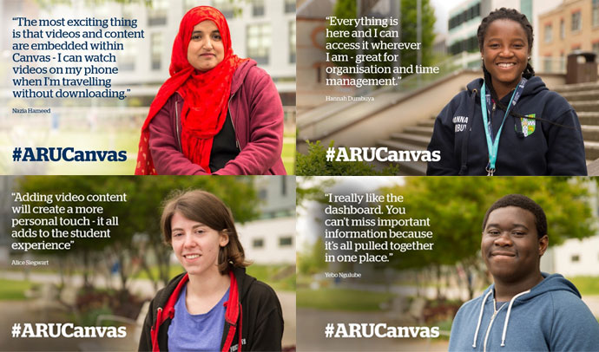

Digital learning
Notes:
At Anglia Ruskin you will also have access to an online teaching and learning community.
Our canvas system ensures all of your module materials and resources are available for you to access at any time.
Online discussion boards enable you to ask questions and discuss key topics with your peers.
And you’ll also have opportunities for formative feedback and even to submit your assignments online.
You can also access all of your university services through your student website, as well as the digital library collection.

Slide 19
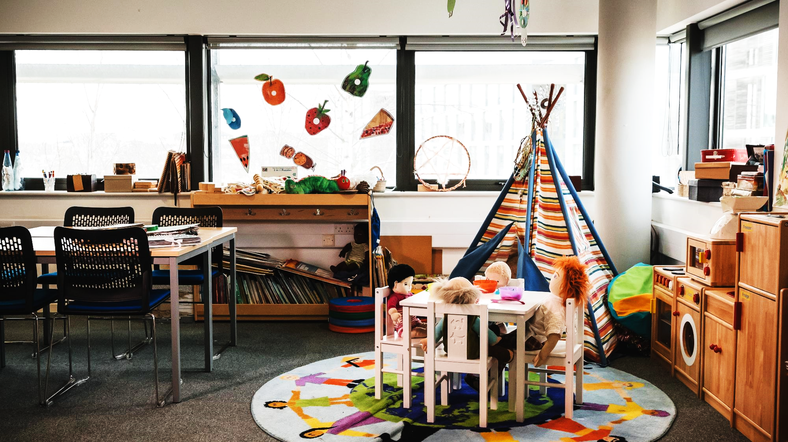
Trips and activities
Enrichment trips (Museum of Childhood and Outdoor learning spaces, Science Museum, Forest School)
Taiwan and India teaching exchanges
Careers fairs
Conferences
CPD opportunities
Paediatric First Aid
School Away Days
Guest Speakers
Notes:
However, the course that you choose is just one part of your wider university experience.
There are so many events, activities and societies available to you that if you are not in the classroom, in a setting or in the library there will be plenty to fill your time.
Specifically, across the Education courses, you will have many opportunities to engage in enrichment trips, attend conferences, gain your Paediatric First Aid certificate, and of course build your networks through our careers fairs with your potential employers.

Slide 20


Careers and student destination
A pathway to Teacher Training
Children’s Services
Family Support and Outreach Work
Charities (Action 4 Children, Barnardos)
Education Policy & Legislation
Postgraduate study – Education specialism, social work, therapies, leadership, SEND
Notes:
Education is a unique and varied sector in which to work, and likewise there are a multitude of career pathways that are available to you.
This slide provides some common examples, however new job roles within the sector are being defined all the time.
You might already know what career you are working towards, or you may have no idea.
Some of our students change their minds during their course and some are inspired by the guest speakers an employers they meet during their course.
Wherever you sit on your career path, we will help you grow and develop the knowledge, skills and experience you need to take that next step.

Slide 21
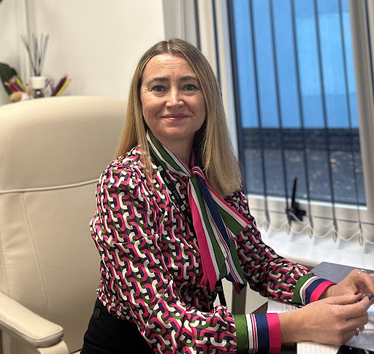
What Our Students Say
Emma Speller
BEd (Hons) Primary Education (grad. 1998)
Worked in education ever since. Currently Head Teacher at Heybridge Primary School in the Kemnal Academy Trust (TKAT).
“We did two or three work experiences a year on the course, in blocks of two or three weeks, and I would be working with the teachers.
That’s where you learn the job – from experienced teachers doing it themselves, and being in the classroom with the children.
You could apply all that pedagogy you learned in the lectures, and I think the marriage of the two gives you what you need to be a teacher.”

Slide 22
What are the main challenges?
You’ll be required to develop both your academic and practical skills. Writing at the right academic level, respecting deadlines and managing your time can be difficult. We have many Student Support Services:
Course​
Personal Development Tutor ​
Study Skills Plus ​
Group and individual support from your lecturers and peers​
Life​
ARU Temps
Sport and Active Anglia​
Counselling and Wellbeing Service​
Student Union ​
Notes:
And while university is an amazing experience, it also has challenges.
Our job is to challenge you, to help you think outside the box, to question ideas, and eventually to change and lead practice.
For many of you it might be your first time away from home, the first time you have lived independently, and for everyone it will involve new ways of working.
You’ll also need to manage your time, attend your classes and meet your submission deadlines. You’ll need to do your own reading and studying, as well as managing any responsibilities you already have at home or at work.
So to support you, we have some central support services such as study skills and wellbeing services.

Slide 23
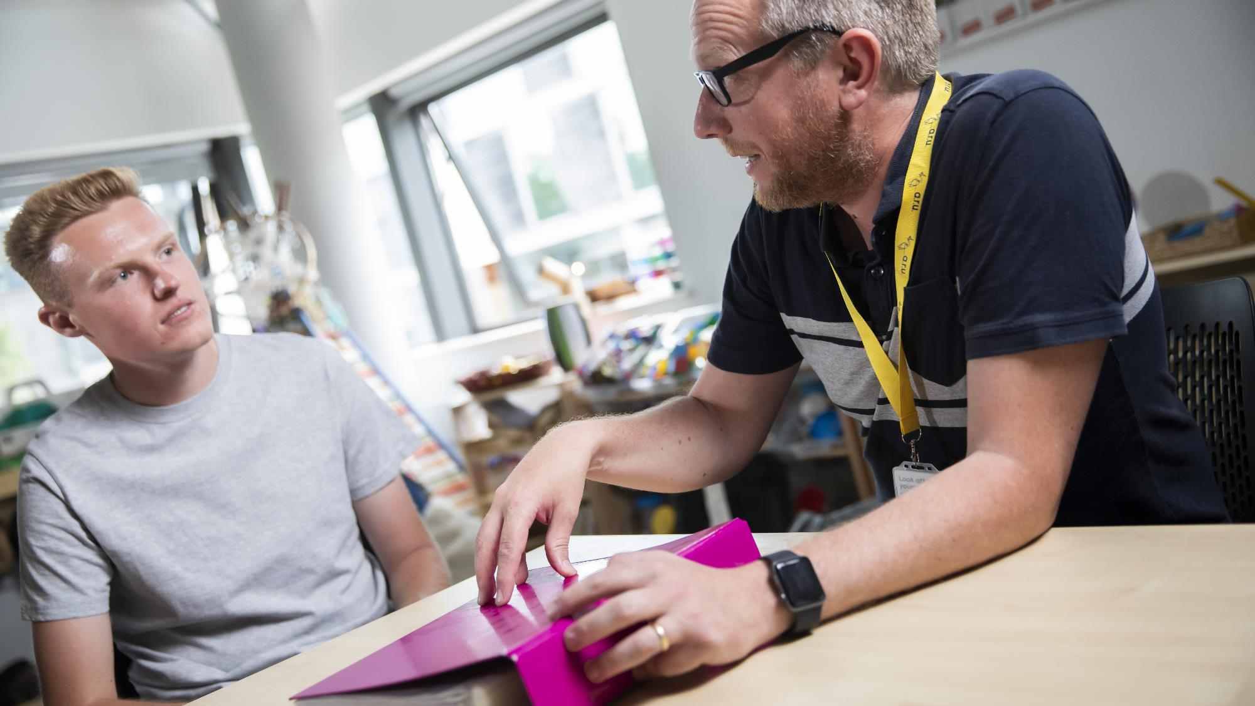
Also here to help
Course Leader
Module Tutor
Personal Tutor
Student Advice
Study Skills Tutors
Employability
Finance
Head of School
Deputy Head of School
Notes:
But importantly you will also be surrounded by many people ready and willing to help you.
Your course leader, you’ll have a personal tutor, your head and deputy head, and also wider university departments such as employability support and financial advice.

Slide 24
What our students say:
“I have been supported in my work but I have also received personal support and support with my future. I have loved this course from beginning to end and do not want it to end. The education team are like one big family.”
“…the best teachers I have had throughout my education. They are very supportive, know what they are talking about and understand when we have problems”
“Couldn't have got through the course without the support of the lecturers so thank you from the bottom of my heart! I have enjoyed and will cherish my time at ARU.”
“…lecturers have been particularly supportive during personal tough periods of time. My learning has never suffered because of external circumstances.”
“I feel they have pushed me to achieve results that I did not think I was capable of achieving.”
Notes:
However statistics aside, the most important element of our courses, are the relationships we build with our students and the level of support that we and the wider university offer to help our students achieve their career dreams.
As summarised by one of our students; the education team are like one big family – and we looking forward to welcoming you to Anglia Ruskin University.

Slide 25

Any questions?
Keep in touch:
X (Twitter): @ARUEducation / @ AngliaRuskin
Instagram: arueducationahess / angliaruskin
TikTok: @ARUEducation
Notes:
Do also feel free to connect with us on social media, and keep up to date with everything that is happening across our Chelmsford, Cambridge and Peterborough campuses.

